Slide 2
Outline
Why R is better than Python (don’t @ me)
Why R is better than SAS
Why R is better than Excel or Prism
Install and try out

Slide 3
Resources
https://rafalab.github.io/dsbook/
http://r4ds.had.co.nz/
https://www.edx.org/course/data-science-r-basics
https://www.datacamp.com/
R-bloggers
Stackoverflow

Slide 4
Why is R better than Python
It’s not
But it is easier to learn
More readily available statistical tools
Data exploration and making nice graphs is easier
tidyverse helps with the last two points

Slide 5
Why is R better than SAS
R is free
R is open source
New methods come out in R first
Large helpful online community
With tidyverse R syntax not as hard to learn
RStudio
R markdown
Shiny apps
gganimate
Interoperable: Rcpp, reticulate, htmlwidgets

Slide 6
Why is R better than excel and Prism
Reproducible research
Much easier to automatize repetitive tasks
Many more powerful tools
More flexibility

Slide 7
Install
Google: CRAN
Google: RStudio

Slide 8
In this session, we will learn…
https://www.rstudio.com/wp-content/uploads/2016/01/rstudio-IDE-cheatsheet.pdf
Install packages: example tidyverse
Create RStudio projects
Importing data
Perform t-test
Repetitive tasks
Dot Plot

Slide 9
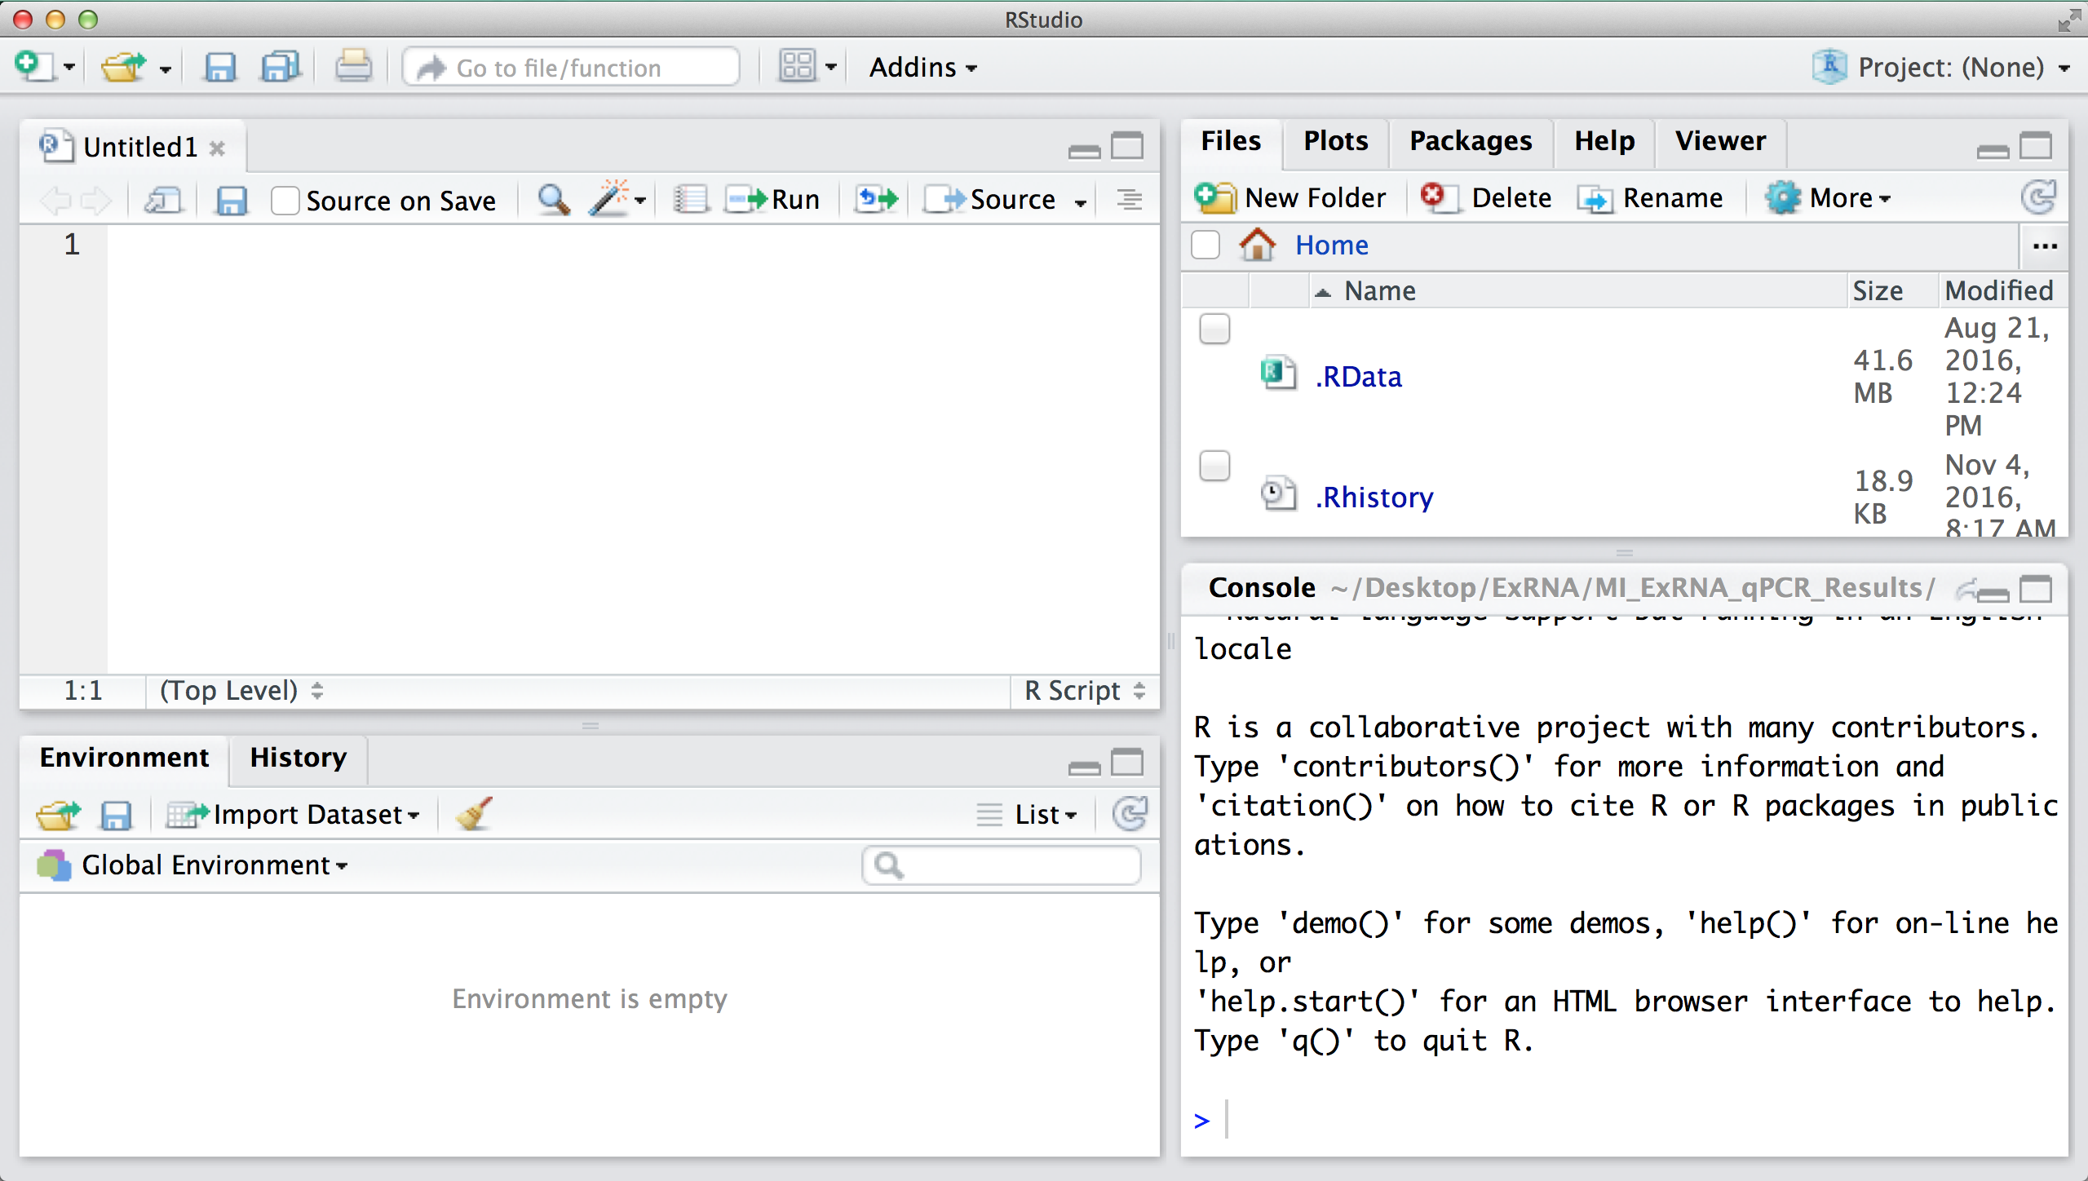
Getting familiar with your R installation and Rstudio

Slide 10
Coding- the importance of being exact
> f <-2
> F + 1
Error: object 'F' not found
Case matters!
Try not to use spaces
Sometimes you simply cannot: variable names cannot contain spaces
Even if it is valid (such as in file names) it just makes things more difficult
> FA <-2
> F A + 1
Error: unexpected symbol in "F A"

Slide 11
Download Demo Code from Github
https://github.com/yaoyu-e-wang/R-course/tree/master/NTUST-Dec26-2018

Slide 14
Basic Data Analysis Using R

Slide 16
Hierarchical Clustering
Ch. 17
Build a tree-based hierarchical taxonomy (dendrogram) from a set of documents.
One approach: recursive application of a partitional clustering algorithm.
animal
vertebrate
invertebrate
fish reptile amphib. mammal worm insect crustacean

Slide 17
Hierarchical Clustering: Dendrogram
Clustering obtained by cutting the dendrogram at a desired level: each connected component forms a cluster.

Slide 18
Hierarchical Agglomerative Clustering (HAC)
Sec. 17.1
Starts with each doc in a separate cluster
then repeatedly joins the closest pair of clusters, until there is only one cluster.

