Slide 1
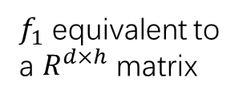

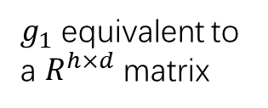
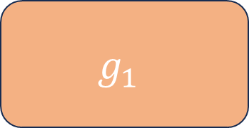
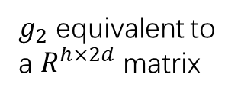


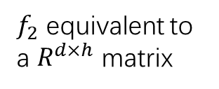
Zero order
dim=d
Zero order
dim=d
First order
dim=d
Concat
dim=2d
$$g_{1}$$
$$g_{2}$$
$g_{1}$ equivalent to a $R^{h×d}$ matrix
$g_{2}$ equivalent to a $R^{h×2d}$ matrix
hidden vector
dim=h
hidden vector
dim=h
$$f_{1}$$
$$f_{2}$$
$f_{1}$ equivalent to a $R^{d×h}$ matrix
$f_{2}$ equivalent to a $R^{d×h}$ matrix
First order
dim=d
Second order
dim=d

