Slide 1
Cyclistic Case Study
Analysis Insight Action
“How annual members and casual riders used Cyclistic bikes differently in 2025”
Google Data Analytics Professional Certificate
Prepared by James Seby Bacus
Google Data Analytics Professional Certificate | Case Study 1
01
Notes:
Open by framing Cyclistic as a marketing analytics case: the goal is not to describe all riders, but to find behavioural differences that can inform membership conversion.

Slide 2
CYCLISTIC BIKE-SHARE CASE STUDY
Business task and analytical frame
BUSINESS PROBLEM
BUSINESS OBJECTIVE
CORE QUESTION
The company wants to increase the number of annual members as they are more valuable. However, the company does not fully understand the differences between the rider types that use the company’s bike-sharing services
Convert casual riders
Usage differences
Develop evidence-based marketing strategies that encourage selected casual riders to become annual members.
“How do annual members and casual riders use Cyclistic bikes differently?”
Six guiding questions:
Why and How?
Which rider type rides more?
Which rider type rides longer on average?
How does usage change across the year?
Which day of the week is most popular?
Which hour sees the highest rider volume?
Are there bike type preferences by rider type?
This analysis is critical to reveal the differences of Cyclistc rider uses through volume, duration, scale, and intensity analyses,.
Google Data Analytics Professional Certificate | Case Study 1
02
Notes:
Explain that the case study starts from a marketing conversion problem. The report therefore focuses on differences that could become campaign logic: volume, duration, timing, seasonality, and bike type.

Slide 3
CYCLISTIC BIKE-SHARE CASE STUDY
Data and processing approach
Data source
Cyclistic/Divvy trip data for January-December 2025, using the most recent complete year in the case study.
Rstudio workflow*
* Memory limit-safe
Tools
RStudio with tidyverse and lubridate for processing and visualisation; Excel for validation, filtering, and exploratory checks.
Read monthly CSV
Summarise
Append summaries
Visualise
Basically, instead of forcing all raw rows into one massive table, each file was processed individually and collapsed into small summary tables for ease due to Rstudio’s memory limitation.
My Cleaning decisions
Created ride length, month, day of week, and hour fields.
Removed rides with zero/negative duration and rides over 24 hours.
Focused on rider type, timing, duration, and bike type; route analysis was excluded due to missing station fields.
Portfolio note
The workflow is transparent, reproducible, and suited to limited cloud resources.
Google Data Analytics Professional Certificate | Case Study 1
03
Notes:
Briefly explain the crash issue and how summary-first processing was a practical and defensible solution. Emphasise that the analysis preserved the variables required for the business questions.

Slide 4
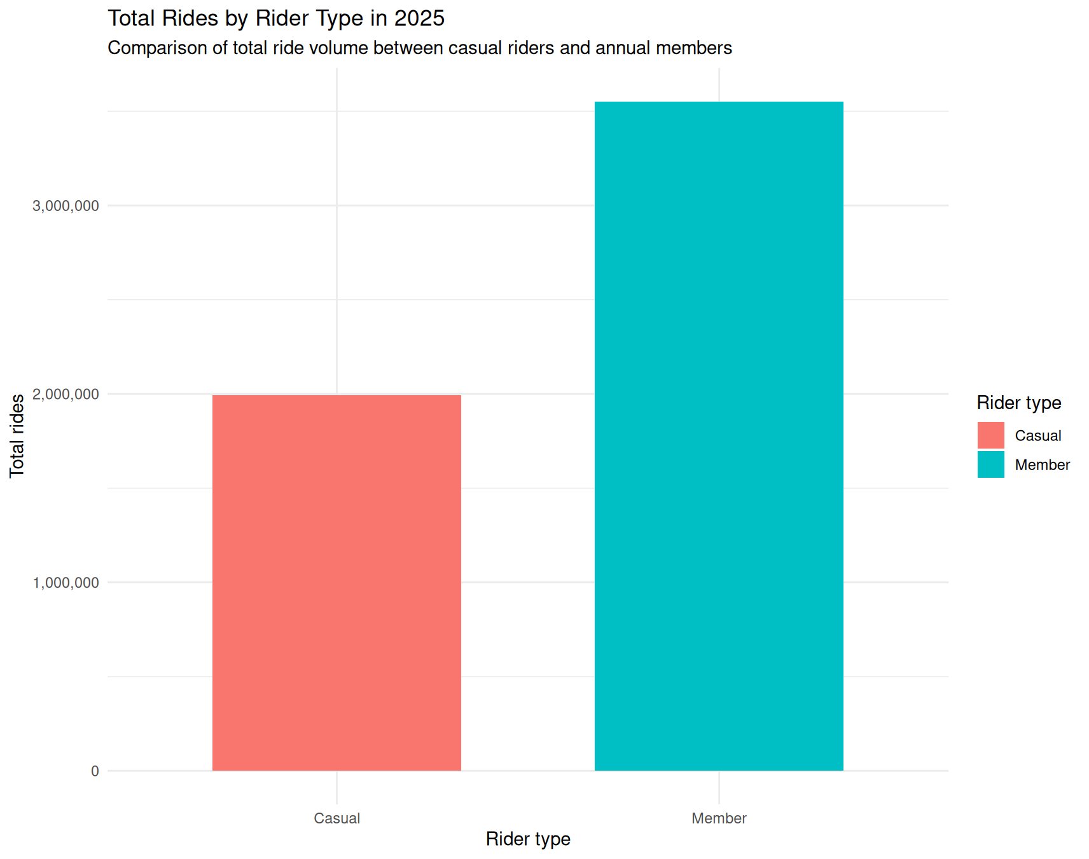
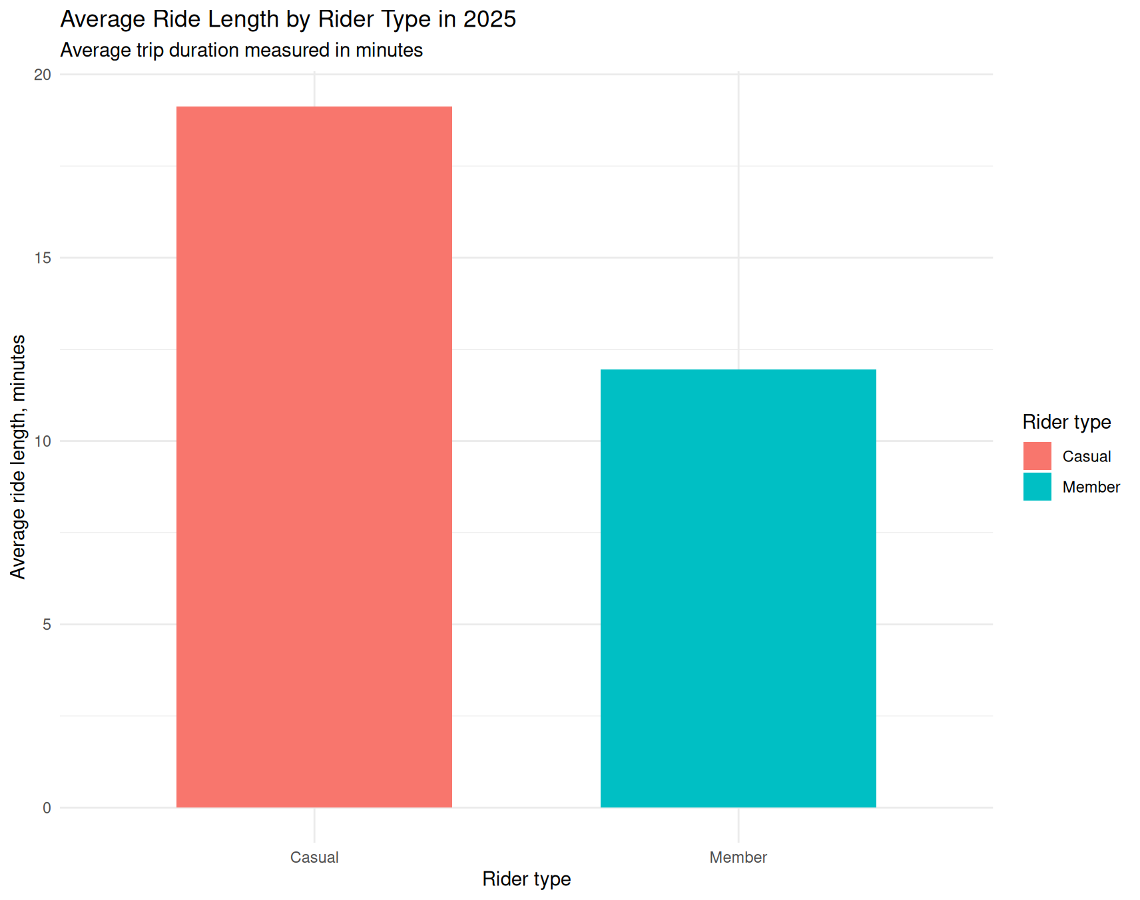
CYCLISTIC BIKE-SHARE CASE STUDY
Members ride more often; casual riders ride longer
Key interpretation
Members generated 3,552,553 rides in 2025, compared with 1,994,774 casual rides. However, casual riders averaged 19.3 minutes per ride versus 11.95 minutes for members, suggesting lower frequency but more discretionary or leisure-oriented use.
Google Data Analytics Professional Certificate | Case Study 1
04
Notes:
This slide sets up the main contrast: members are higher-volume, but casual riders take longer trips. This is the first clue that they should not be marketed to in exactly the same way.

Slide 5
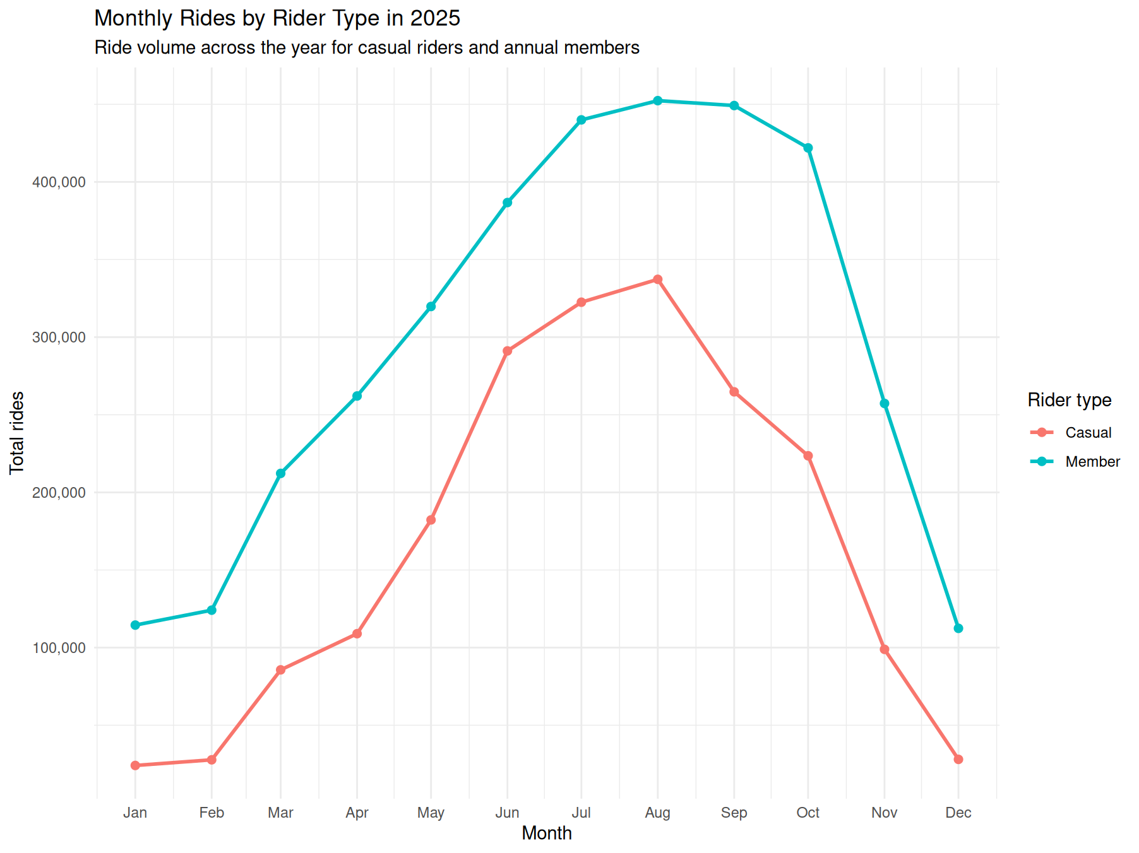
CYCLISTIC BIKE-SHARE CASE STUDY
Usage rises sharply in warmer months
What the chart says
Both rider types peaked in August and dropped sharply in colder months. The seasonal pattern was expected for casual riders, but it also appears strongly among members, implying that even habitual riders remain sensitive to weather and seasonal conditions.
Marketing implication
Membership messaging should intensify before and during late spring, summer, and early autumn, when riders are already most engaged.
Google Data Analytics Professional Certificate | Case Study 1
05
Notes:
Avoid saying this proves temperature causes ridership unless weather data is modelled. Present it as seasonal alignment and likely weather sensitivity.

Slide 6
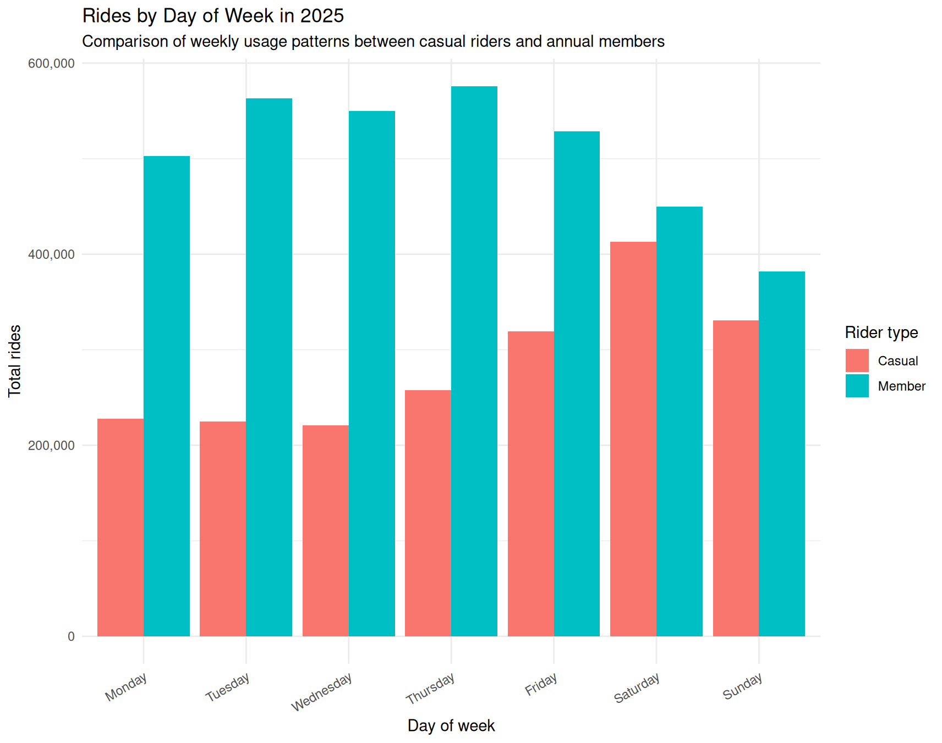
CYCLISTIC BIKE-SHARE CASE STUDY
Weekday members vs weekend casual riders
Member pattern
Member usage is strongest during the working week, with Thursday recording the highest total member ride volume.
Casual pattern
Casual usage peaks on Saturday, and casual riders have longer weekend ride durations than members.
Interpretation
The day-of-week pattern supports a split between routine-oriented member usage and leisure-oriented casual usage.
Google Data Analytics Professional Certificate | Case Study 1
06
Notes:
Connect the result directly to marketing: if Saturday is the most important casual day, weekend campaigns and leisure framing are more relevant than only commute messaging.

Slide 7
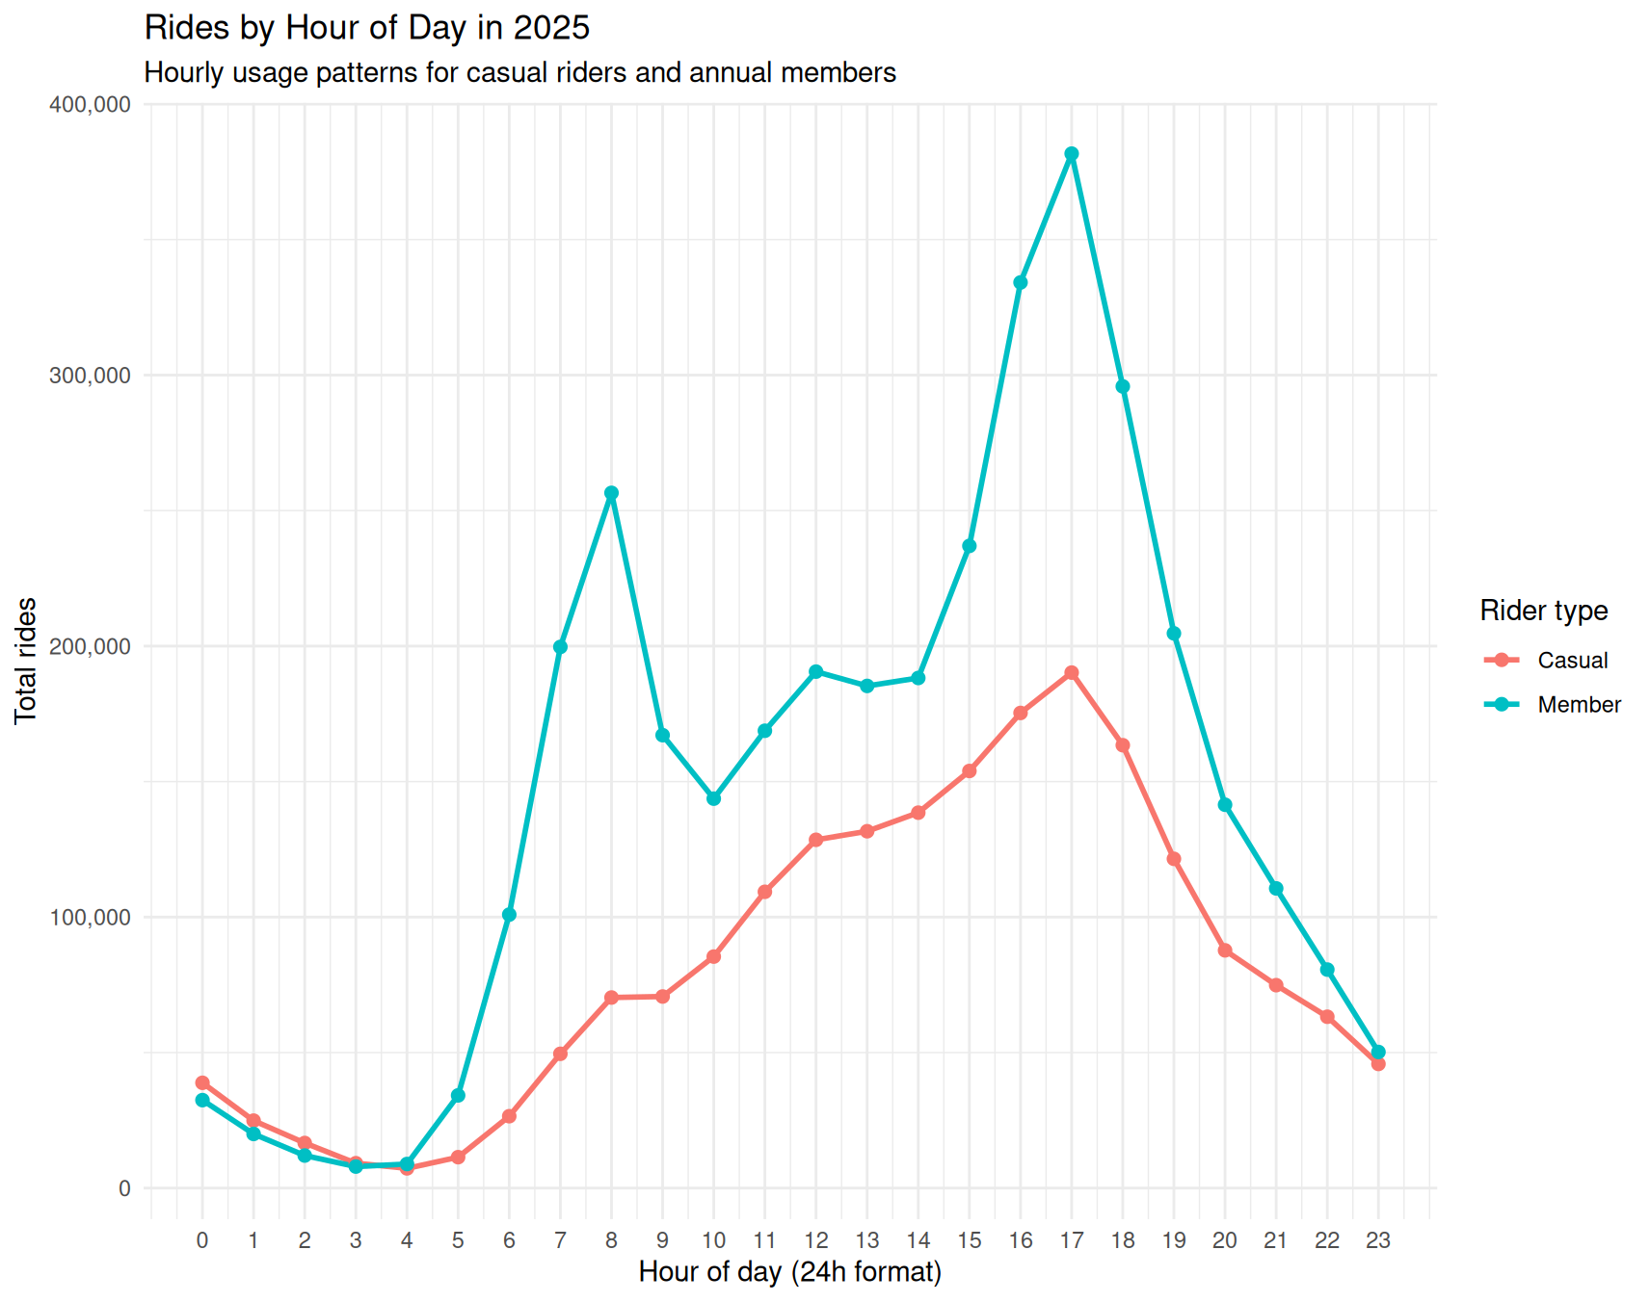
CYCLISTIC BIKE-SHARE CASE STUDY
Member demand clusters around commute-adjacent hours
Peak Hour
For both rider types, the highest ride volume occurred during 17:00–17:59.
Evidence Strength
The highest-volume member hours are tightly clustered around morning and late-afternoon travel windows, reinforcing the interpretation of practical or commute-adjacent use.
Contrast
Casual ridership rises more gradually and is less tightly clustered around commute windows.
Google Data Analytics Professional Certificate | Case Study 1
07
Notes:
Mention that both groups peak at 5pm, but the surrounding hourly pattern is more revealing than a single maximum.

Slide 8
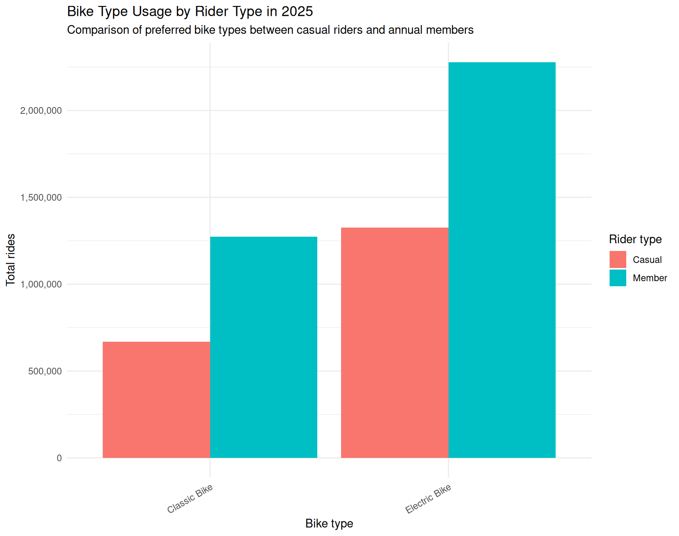
CYCLISTIC BIKE-SHARE CASE STUDY
E-bikes dominate across both rider types
Casual Rides
Casual Rides
66%
66%
Approximate share of member rides taken using e-bikes.
Approximate share of casual rides taken using e-bikes.
Casual Rides
Casual Rides
66%
66%
Approximate share of casual rides taken using e-bikes.
Approximate share of casual rides taken using e-bikes.
Implication
E-bike preference is not unique to one segment. It is a broad product strength that can support both commuter convenience and leisure positioning.
Google Data Analytics Professional Certificate | Case Study 1
08
Notes:
This is a useful finding because e-bike messaging can work for both groups, but the framing should differ: convenience for members, ease and enjoyment for casual riders.

Slide 9
CYCLISTIC BIKE-SHARE CASE STUDY
Synthesis: the two groups have different usage logics
Annual members
Casual riders
Higher total ride volume
Shorter average ride lengths
Stronger weekday pattern
Morning and late-afternoon commute-adjacent peaks
E-bike usage supports practical urban mobility
Lower total ride volume
Longer average ride lengths
Stronger weekend pattern
More leisure/discretionary usage signal
E-bike usage supports longer, easier recreational trips
CORE TAKEAWAY:
Casual riders should not be treated as merely “lower-frequency members”.
Google Data Analytics Professional Certificate | Case Study 1
09
Notes:
This slide is the bridge between the analysis and the recommendations. It reframes the findings into two practical user logics: routine mobility versus leisure/discretionary use.

Slide 10
CYCLISTIC BIKE-SHARE CASE STUDY
My recommendations for Cyclistic
1.
2.
3.
Launch seasonal conversion campaigns
Target high-potential casual riders
Reframe membership around leisure
Run warmer-month membership campaigns before and during peak ridership. Frame membership as cost-effective for repeated recreational and weekend use, not only commuting.
Prioritise casual riders who ride repeatedly, use e-bikes frequently, or take longer weekend trips. Use personalised cost comparisons to show when membership becomes financially sensible.
Build weekend and leisure-based messaging around exploration, flexibility, popular routes, e-bike convenience, and spontaneous city travel.
STRATEGIC PRINCIPLE:
Target behavior that already resembles high engagement instead of attempting to convert every casual rider equally.
Google Data Analytics Professional Certificate | Case Study 1
10
Notes:
Emphasise that these recommendations are not generic. They map directly to the identified behavioural patterns: seasonality, weekend use, ride duration, and e-bike preference.

Slide 11
CYCLISTIC BIKE-SHARE CASE STUDY
Limitations and next steps
Current limitations
Next analyses
The dataset does not include rider demographics, pricing history, weather, customer motivations, marketing exposure, or confirmed conversion outcomes. It also has missing station fields, so route analysis was excluded.
Add weather data, pricing data, campaign data, and repeat-casual identifiers. Segment casual riders into tourists/visitors, local leisure users, and high-frequency near-members.
FINAL MESSAGE:
Cyclistic’s strongest opportunity is not to market annual membership to all casual riders equally, but to identify high-potential casual users and speak to the motivations already visible in their behaviour: leisure, flexibility, e-bike convenience, seasonality, and repeated long-duration use.
Google Data Analytics Professional Certificate | Case Study 1
12
Notes:
Close with a confident, simple insight: different usage patterns imply different marketing logic.

Slide 12
Thank you

