Slide 1
Cloud Computing
James T. Jones
email

Slide 2

Cloud computing
What is it? cloud computing is providing services such as platform, software or infrastructure to companies through virtual means. It can be a storage area or your entire companies network
Click ME!!

Slide 3
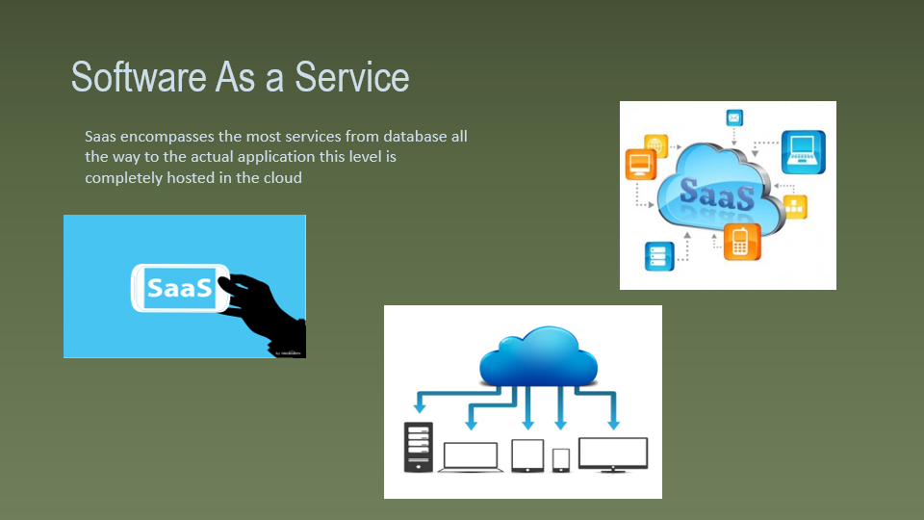
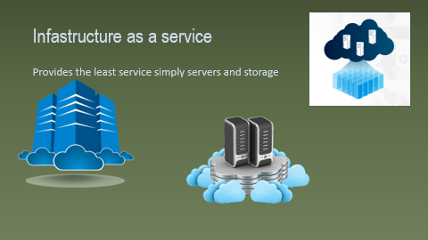
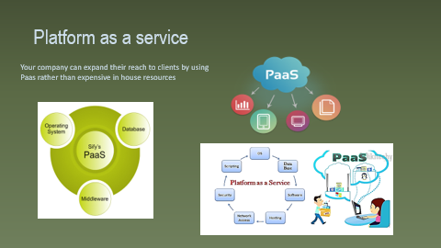
Cloud services
Paas
saas
iaas
Cloud provider
Cloud server
user
user
user

Slide 4
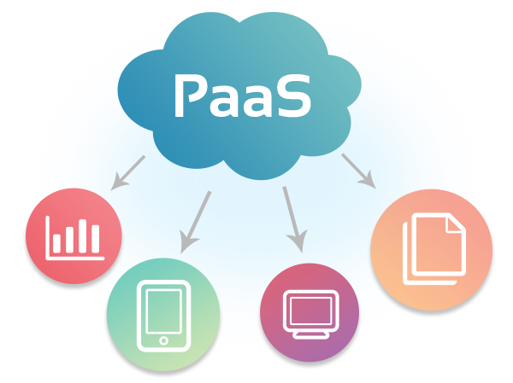
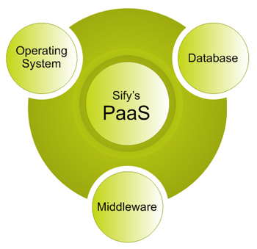
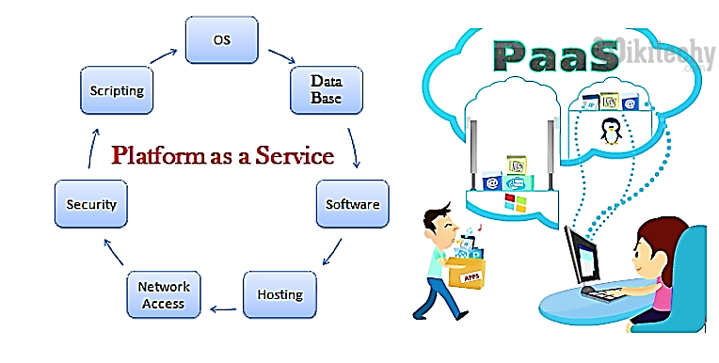
Platform as a service
Your company can expand their reach to clients by using
Paas rather than expensive in house resources

Slide 5
Cloud services
Paas
saas
iaas
Cloud provider
Cloud server
user
user
user

Slide 6


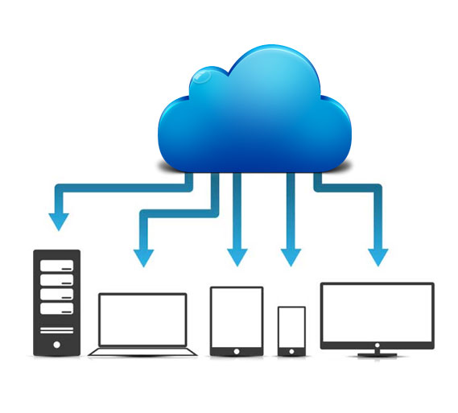
Software As a Service
Saas encompasses the most services from database all the way to the actual application this level is completely hosted in the cloud

Slide 7
Cloud services
Paas
saas
iaas
Cloud provider
Cloud server
user
user
user

Slide 8
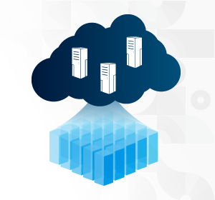

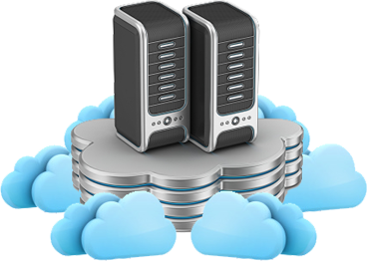
Infastructure as a service
Provides the least service simply servers and storage

Slide 9


Interested in learning which service is right for you? Select the link below to find out
Find data more interesting?
CLICK HOMER
Choose Lisa

Slide 10
Bibiliography
Digital image. Clipart Library, n.d. Web.
Digital image. Cloud Infinit. N.p., n.d. Web.
Digital image. A Cloud. N.p., n.d. Web.
Digital image. Cloud Review. N.p., n.d. Web.
Digital image. Microchannell. N.p., n.d. Web.
Digital image. Mobidev. N.p., n.d. Web.
Digital image. Opex Tech. N.p., n.d. Web.
Digital image. Plm. N.p., n.d. Web.
Digital image. Wiki Techy. N.p., n.d. Web.

