Slide 1


Drosophila flight performance data analysis
EMBO Course – Drosophila Genetics and Genomics
By James Tan Sheng Yi, Dr. Luisa Pallares and Saudat Alishayeva
Friedrich Miescher Laboratory of the Max Planck Society, Tubingen

Slide 2

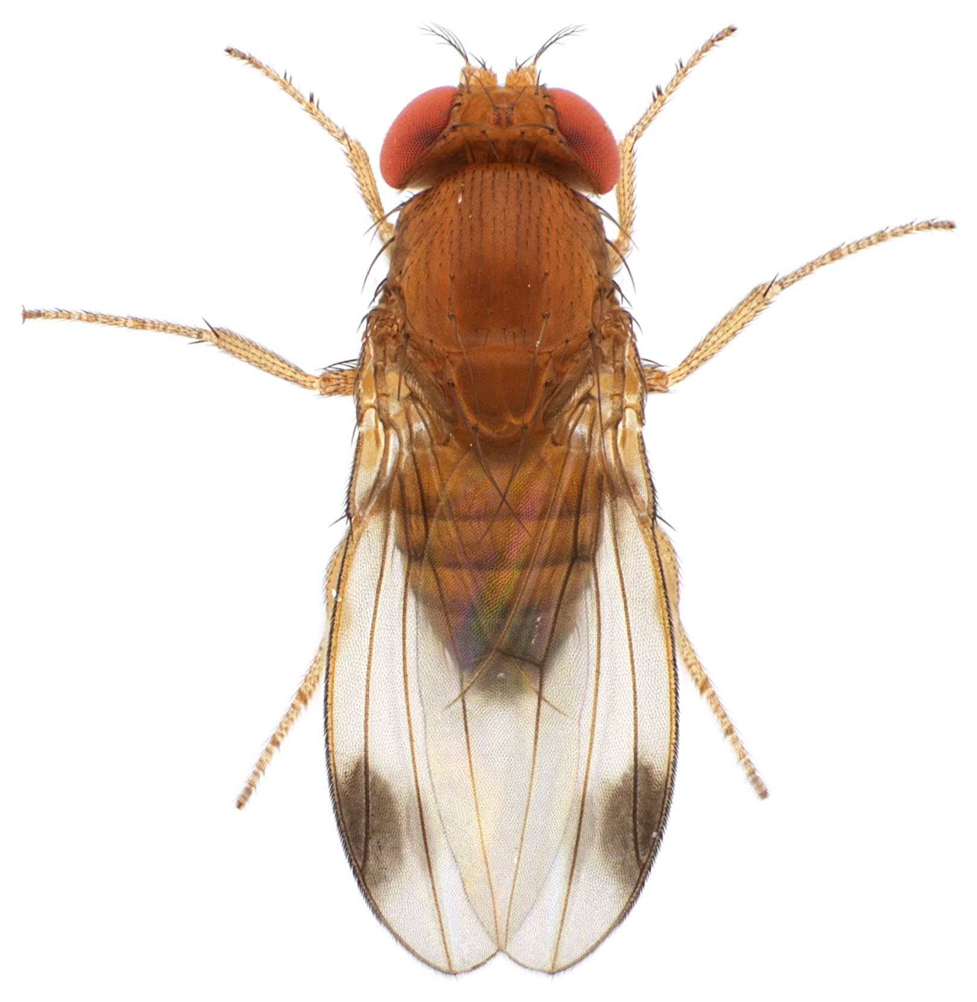
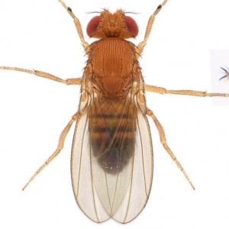
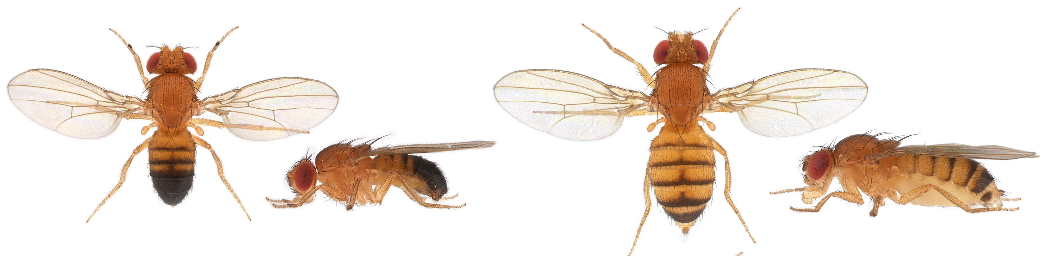
What factors affect flight performance of flies?
Questions
Different species?
Different populations of the same species?
Different sexes of the same species?
D. melanogaster Male
D. melanogaster Female

Slide 3
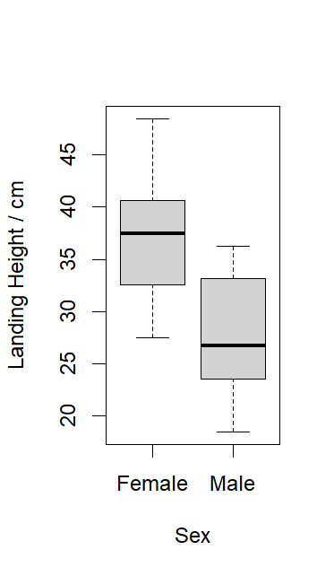
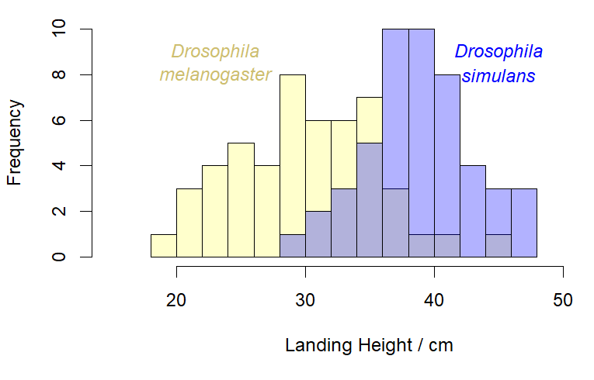
Plot the data to view the distributions
To-do
Histograms or Density Plots
Boxplots
e.g., histograms for species
e.g., for sex

Slide 4
Conduct statistical analyses – Which tests to go with?
To-do
F test → Equal variances?
T test → Equal means?
If the distributions are non-Normal/Gaussian or have unequal variances:
Wilcoxon test → Equal medians?
Kolmogoroff-Smirnoff test → Same distributions?

Slide 5
Try it out with your collected data!
Script to run all analyses is available if you are unfamiliar with R (EMBO_Drosophila_Course_Flight_Performance_Data_Analysis.R)
Dummy dataset used to generate plots in this presentation is also available

