Slide 1


Drosophila flight performance data analysis
EMBO Course – Drosophila Genetics and Genomics
By James Tan Sheng Yi, Dr. Luisa Pallares and Saudat Alishayeva
Friedrich Miescher Laboratory of the Max Planck Society, Tubingen

Slide 2

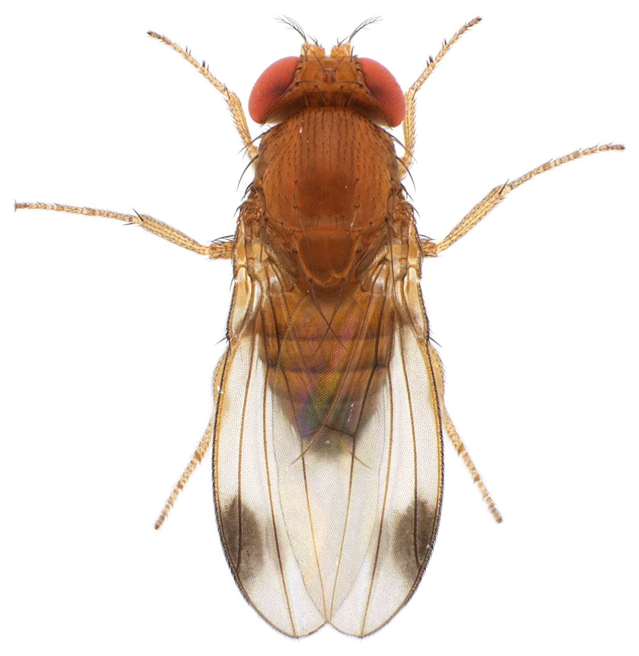
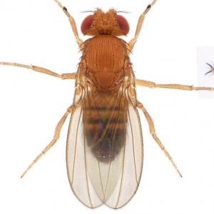
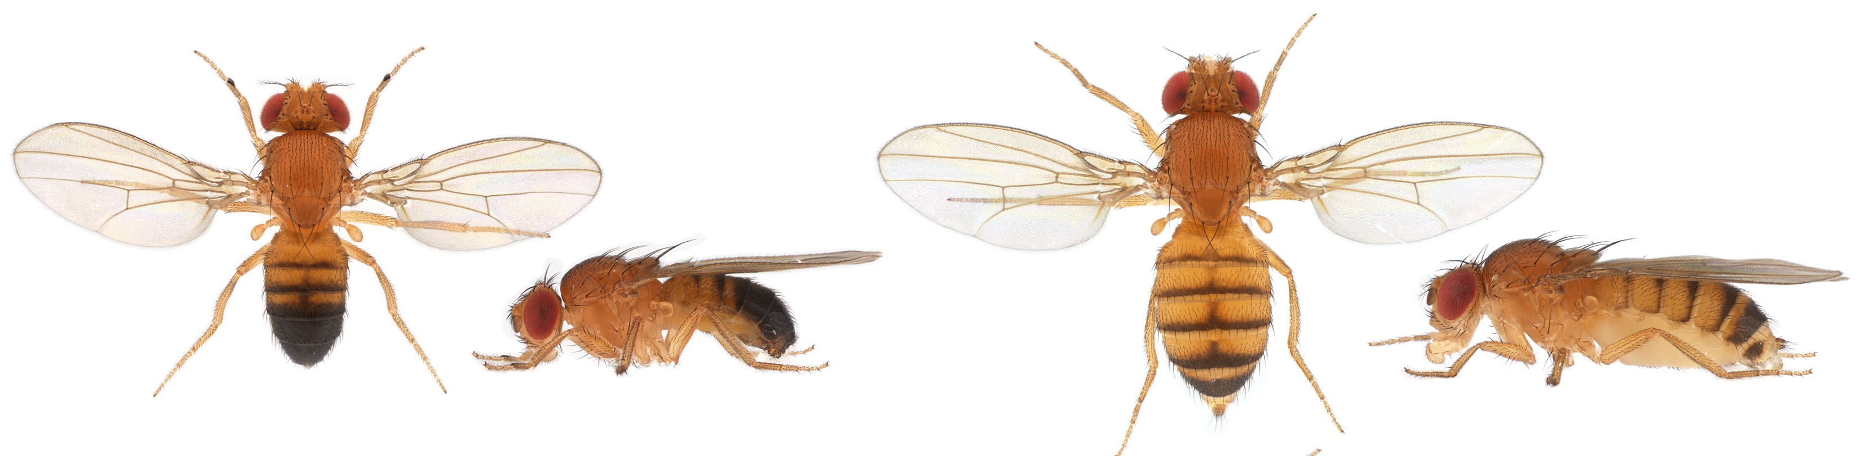
What factors affect flight performance of flies?
Questions
Different species?
Different populations of the same species?
Different sexes of the same species?
D. melanogaster Male
D. melanogaster Female
Images from (http://gompel.org/images-2/drosophilidae)

Slide 3
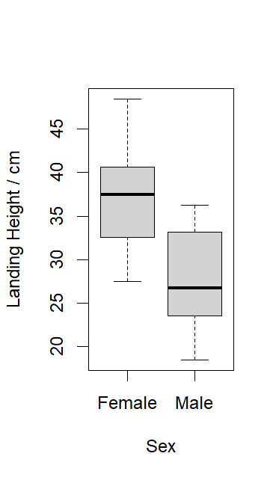
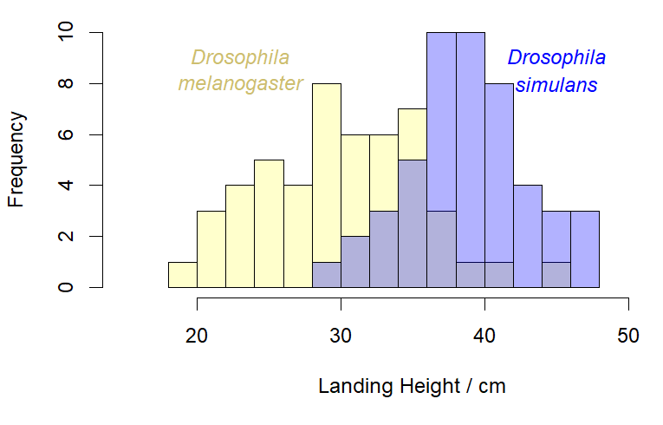
Plot the data to view the distributions
To-do
Histograms or Density Plots
Boxplots
e.g., histograms for species
e.g., for sex

Slide 4
Conduct statistical analyses – Which tests to go with?
To-do
F test → Equal variances?
T test → Equal means?
If the distributions are non-Normal/Gaussian or have unequal variances:
Wilcoxon test → Equal medians?
Kolmogoroff-Smirnoff test → Same distributions?

Slide 5
Try it out with your collected data!
Script to run all analyses is available if you are unfamiliar with R (EMBO_Drosophila_Course_Flight_Performance_Data_Analysis.R)
Dummy dataset used to generate plots in this presentation is also available

