Slide 1
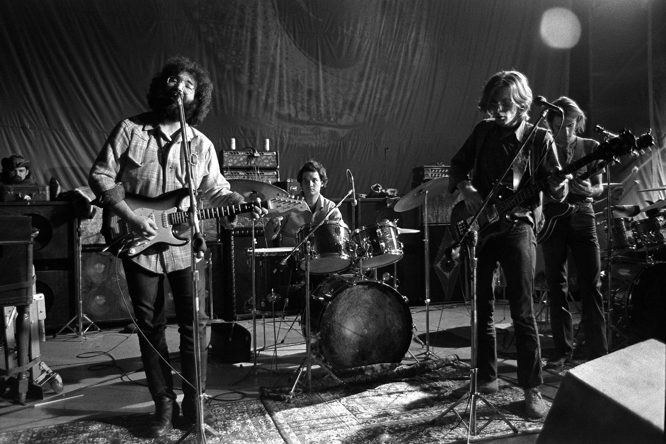

GETDOWN
The music connection Application
Designed By
William Stearns * James Townsend * Derek Reed

Slide 2
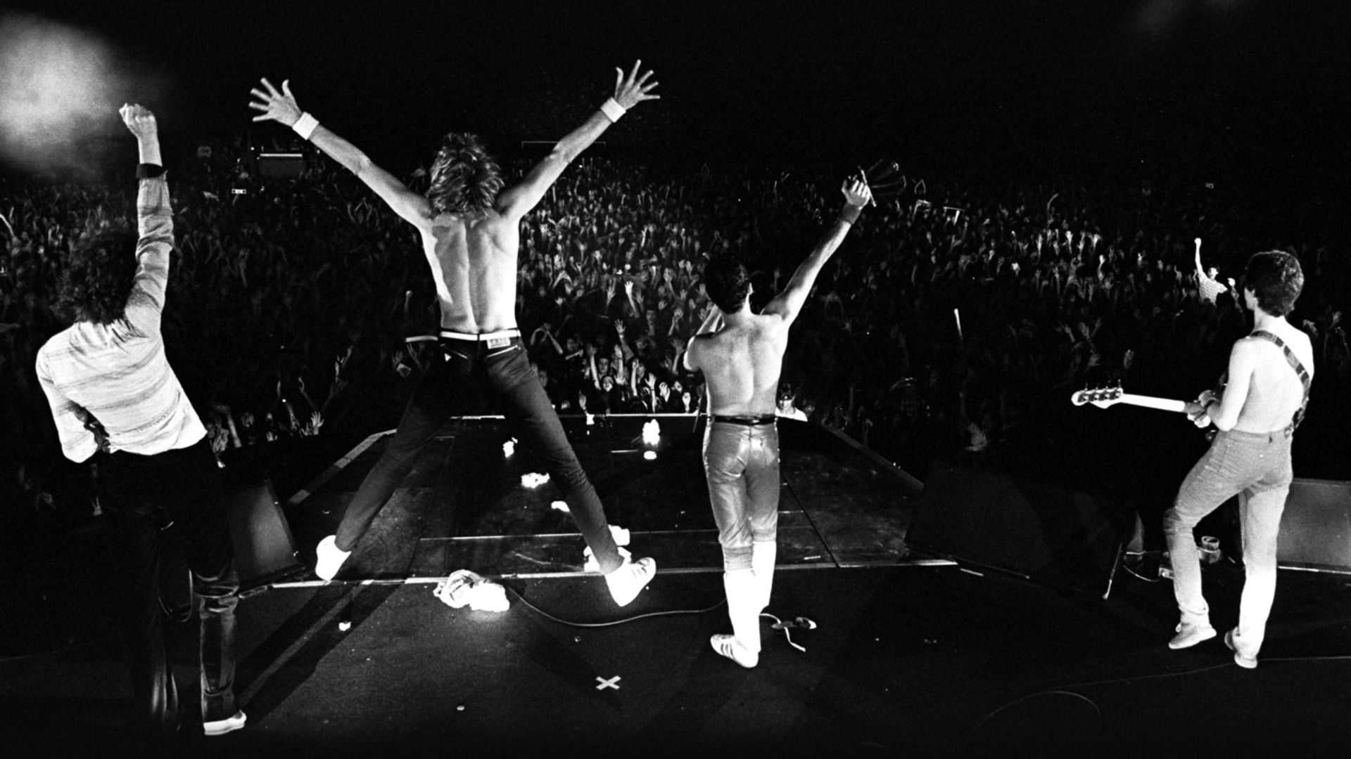
PURPOSE
TO TURN THE REGULAR WEEKEND INTO AN EXPERIENCE THAT WILL LAST A LIFE TIME

Slide 3
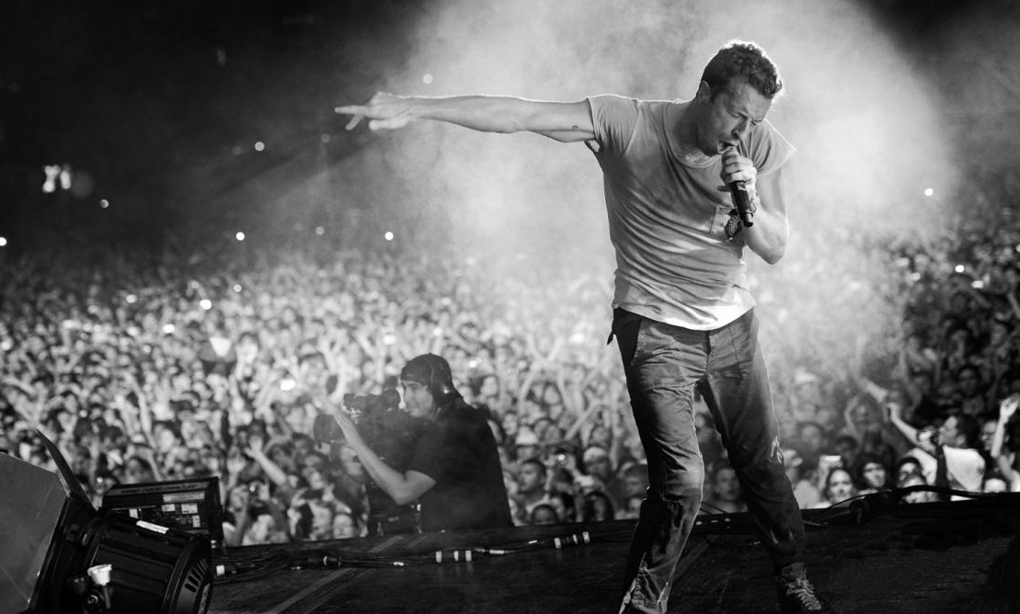
TECHNOLOGY
The APPLICATION UTILIZES THE JAMBASE API and MICROSOFT’S MAPPING API TO put the best concert experience within Reach

Slide 4
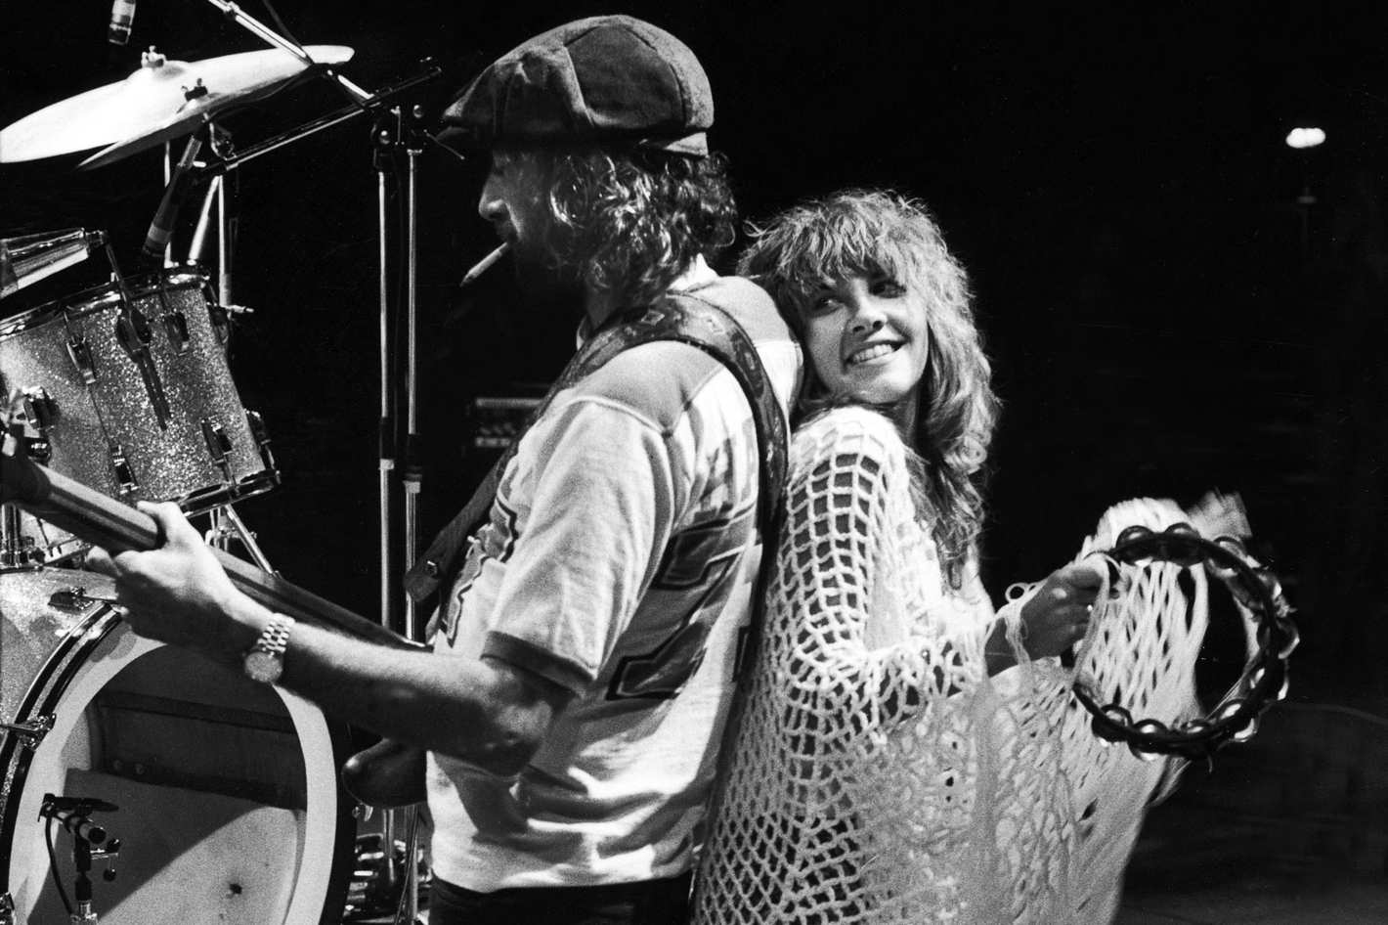
Specializations
Derek Reed Front End Development
James Townsend Map API
William Stearns JamBase API

Slide 5
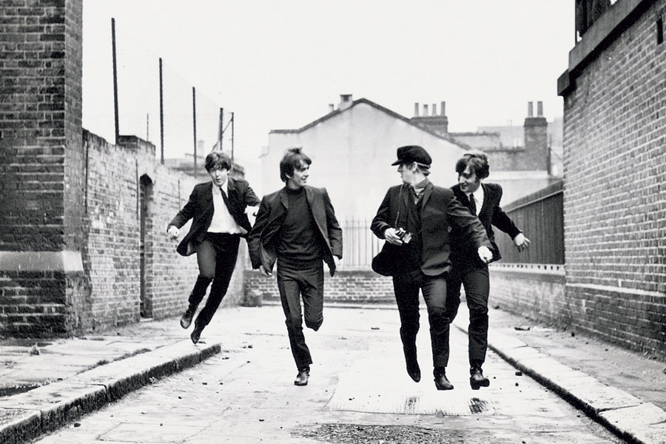
Problems Solved & What we learned in the process

Slide 6
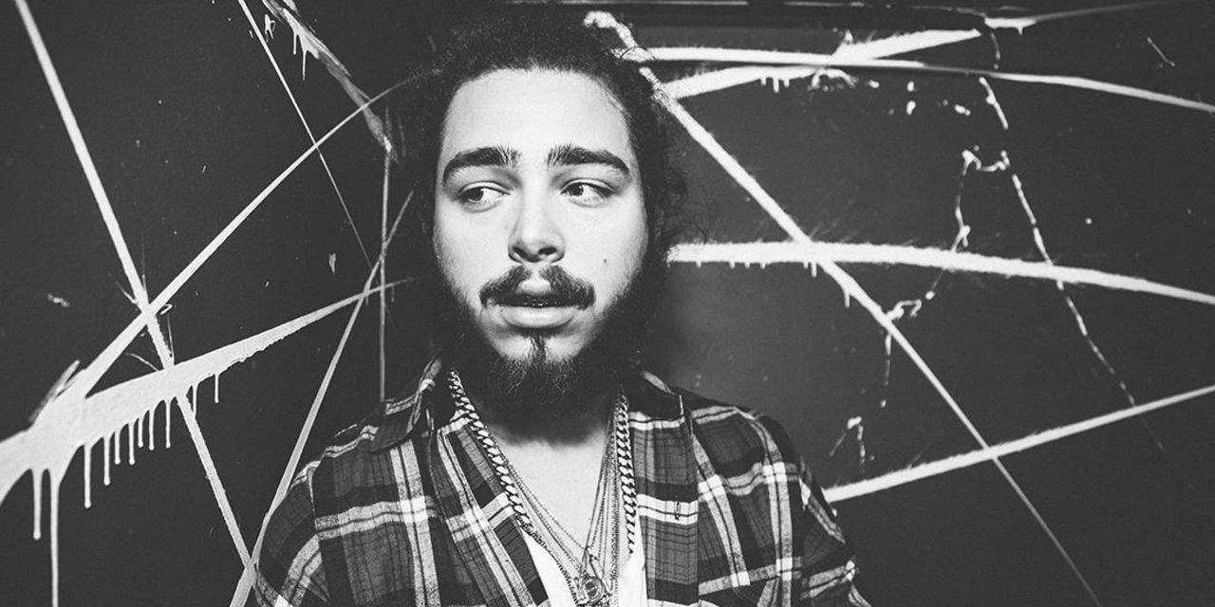
Whats Next for GetDown

