Slide 1
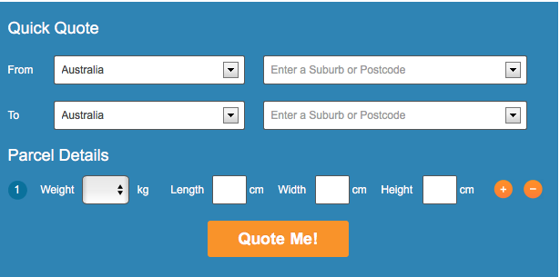




On the Spot
Search
Go
Home
FAQ
Customer Portal
Employee Portal
Help & Advice
Contact US
News!
asdsdsadasdasdasdsadasddddddddddddddd
asdasd
asdsadasdasd
Quick Quote

Slide 2
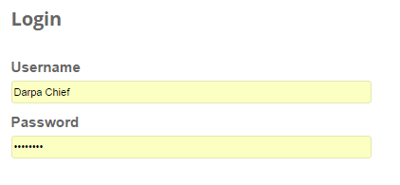
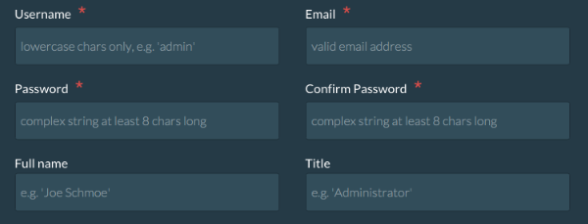
On the Spot
Search
Go
Home
FAQ
Customer Portal
Employee Portal
Help & Advice
Contact US
Create Account
Login
Clear Form
Create Account

Slide 3


On the Spot
Search
Go
Home
FAQ
Customer Portal
Employee Portal
Help & Advice
Contact US
Customer information
Priority of package:
Additional Delivery Instructions
Signature Required:
Submit

Slide 4

On the Spot
Search
Go
Home
FAQ
Customer Portal
Employee Portal
Help & Advice
Contact US
Employee News and information
Business Portal
Login
Driver Portal
Login

Slide 5
On the Spot
Search
Go
Home
FAQ
Customer Portal
Employee Portal
Help & Advice
Contact US
Business Portal
Upcoming Orders
Order ID: xxx
Order ID: xxx
Order ID: xxx
Order ID: xxx
Order ID: xxx
Order ID: xxx
Order ID: xxx
Order ID: xxx
Order ID: xxx
Order ID: xxx
Enter delivery Number
Go
Driver Responsible
Order Size
Delivery Time
Time
Signature Records
Records
Pickup Times
Pick up times

Slide 6

On the Spot
Search
Go
Home
FAQ
Customer Portal
Employee Portal
Help & Advice
Contact US
Driver Portal
Enter delivery Number
Go
Order Size
Order Size
Deliver Location
Location
Delivery Prioritization
Prioritization

Slide 7
On the Spot
Search
Go
Home
FAQ
Customer Portal
Employee Portal
Help & Advice
Contact US
FAQ filler

Slide 8
On the Spot
Search
Go
Home
FAQ
Customer Portal
Employee Portal
Help & Advice
Contact US
Help and Advice
filler

Slide 9
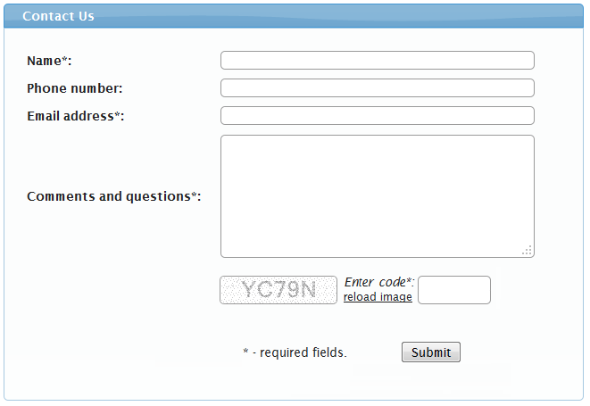
On the Spot
Search
Go
Home
FAQ
Customer Portal
Employee Portal
Help & Advice
Contact US
Contact Us
Need help contact us and will get right back to you

Slide 10
On the Spot
Search
Go
Home
FAQ
Customer Portal
Employee Portal
Help & Advice
Contact US
Search Results
Filler text

