Slide 1
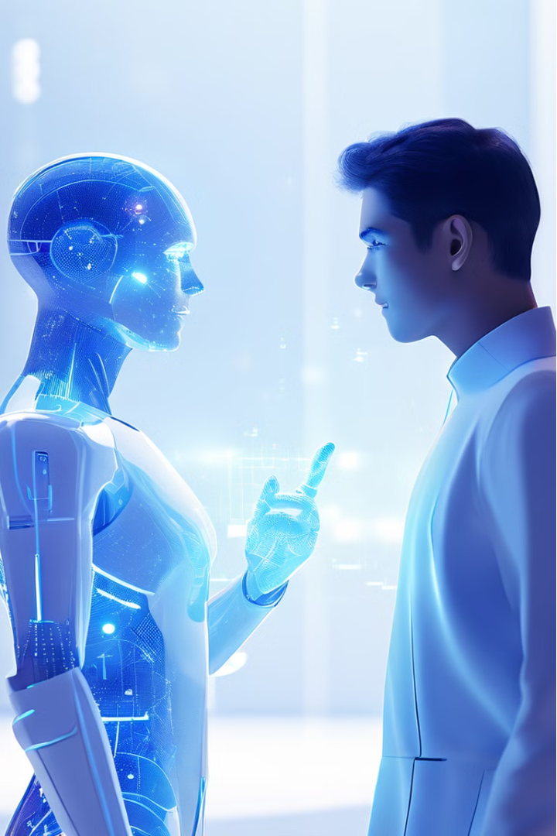



Understanding ChatGPT: The Conversational AI Revolution
In the rapidly evolving landscape of artificial intelligence, ChatGPT stands out as a groundbreaking conversational AI model that has captured the attention of the world. This intelligent software agent, developed by OpenAI, has the remarkable ability to engage in natural, contextual dialogue, offering a glimpse into the future of human-machine interaction. From its historical development to its diverse applications and the challenges it faces, this comprehensive guide will explore the transformative power of ChatGPT and its role in shaping the future of AI technology.
by James Tzeng

Slide 2
The Fascinating History of Chatbots
ELIZA (1964)
GPT Models (2018-2023)
The pioneering chatbot, ELIZA, was developed by Joseph Weizenbaum, laying the foundation for natural language processing and conversational AI. ELIZA simulated a Rogerian psychotherapist, engaging users in text-based dialogues.
The breakthrough in language models came with the development of the Generative Pre-trained Transformer (GPT) models, culminating in the highly advanced ChatGPT, which showcases remarkable language understanding and generation capabilities.
1
2
3
ALICE (1995)
ALICE, created by Richard Wallace, was an early chatbot that used pattern matching and natural language processing to engage in more sophisticated conversations, further advancing the field of conversational AI.

Slide 3
Exploring the Capabilities of ChatGPT
Natural Language Processing
Personalized Assistance
Continuous Learning
ChatGPT's underlying architecture enables it to continuously learn and expand its knowledge, ensuring that it remains up-to-date and able to adapt to evolving information and language patterns.
ChatGPT excels at understanding and generating human-like text, allowing for seamless conversations and the ability to tackle a wide range of tasks, from answering questions to providing detailed explanations and even creative writing.
The model's ability to grasp context and tailor its responses to individual users makes it a versatile assistant, capable of providing customized support in various domains, such as education, customer service, and task planning.

Slide 4
Unleashing the Potential of ChatGPT
1
Educational Applications
2
Creative Collaboration
ChatGPT can revolutionize the educational landscape by providing personalized tutoring, generating learning materials, and facilitating engaging discussions on a wide range of subjects.
The model's ability to assist with ideation, writing, and problem-solving makes it a valuable partner in creative endeavors, from brainstorming new concepts to refining written works.
3
Automated Assistance
4
Language Learning
ChatGPT can streamline various administrative and customer service tasks, freeing up human resources to focus on more strategic and high-impact work.
The model's language understanding and generation capabilities can be leveraged to create interactive language learning experiences, providing users with personalized feedback and practice opportunities.

Slide 5
Embracing the Challenges of ChatGPT
Bias and Fairness
Privacy and Security
Ensuring that ChatGPT's outputs are free from harmful biases and that the model treats all users equitably is a crucial challenge, requiring robust data curation and ethical AI principles.
Safeguarding user privacy and preventing the misuse of ChatGPT's capabilities, such as the generation of misinformation or malicious content, are ongoing concerns that require comprehensive security measures.
Transparency and Interpretability
Continuous Adaptation
Enhancing the transparency and interpretability of ChatGPT's inner workings can help users better understand the model's decision-making processes and build trust in the technology.
Adapting ChatGPT to keep pace with the ever-evolving language, knowledge, and user needs is a constant challenge, requiring ongoing research and development efforts.

Slide 6




The Future of Conversational AI
Global Accessibility
Healthcare Applications
Transformative Education
Intelligent Automation
As ChatGPT and similar AI models become more widely available, they have the potential to bridge language barriers and provide accessible information and services to people around the world.
Conversational AI can revolutionize healthcare by providing personalized medical advice, assisting with patient monitoring, and supporting mental health interventions.
The integration of ChatGPT and other AI-powered tools into the educational system can enhance learning experiences, foster creativity, and personalize the learning journey for students.
Conversational AI can streamline various organizational and administrative tasks, freeing up human resources to focus on more strategic and high-impact work.

Slide 7
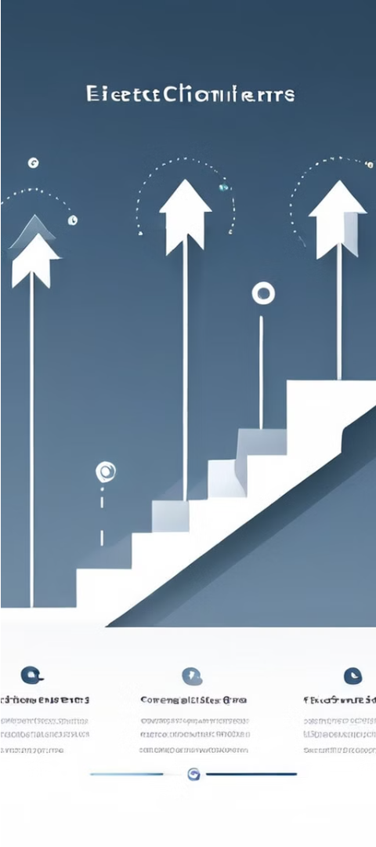



Responsible Development of ChatGPT
Ethical Considerations
Ensuring the responsible development and deployment of ChatGPT requires ongoing discussions and the establishment of clear ethical guidelines to mitigate potential harms and protect user privacy.
Collaboration with Experts
Partnering with experts in fields such as linguistics, psychology, and social sciences can help enhance the capabilities of ChatGPT while addressing the complex challenges it faces.
Continuous Improvement
Regularly updating and refining ChatGPT's underlying models, training data, and safety measures is crucial to maintain its effectiveness and trustworthiness as the technology rapidly evolves.

Slide 8
Embracing the Future with ChatGPT
Empowerment
ChatGPT has the potential to empower individuals by providing personalized assistance, expanding access to information and services, and fostering creativity and innovation.
Efficiency
Integrating ChatGPT into various industries and workflows can streamline processes, reduce manual effort, and optimize resource allocation, leading to increased productivity and cost savings.
Societal Impact
As ChatGPT and other conversational AI models become more widespread, they can have far-reaching societal implications, from transforming education and healthcare to enabling more inclusive and accessible communication.

