Slide 1
Mini Project – “Prometheus’’

Slide 2

Team Members
Aakash Dhande
Megha Kaushik
Mounika T
Rajkumar Gupta
Suchitra Koganti
Supreetha Bade
Utkarsh Upadhyay

Slide 3
Project Details
It is a Course Management platform with the help of which both student and teacher can easily access and manage their homework. It is one of the solutions that can be utilized to tackle the problem of our conventional educational system.
The goal of this application is to help the teachers to allot the homework to the respective students anytime and help students to plan their homework effectively.

Slide 4
Project Details
With the help of Prometheus , we can store , process, retrieve and analyze the homework and students as well as teachers to the database and administrative inventory.
This makes it lot easier for the teacher as well as the student to manage their homework and assignment , since everything is available online any time.

Slide 5
Roles Of Teacher
Can schedule homework assignments for the courses they teach .
2. Can view all the homework assignments for their students.
3. Teacher cant view the planning of the students.

Slide 6
Roles of ADMIN
Manage the application.
2. Can add Teachers, Students and courses to the system.
3. Can search Teachers, Students and courses to the system.

Slide 7
Roles Of Student
Can enroll for Courses.
2. Can view their Homework.
3. Devise a planning for their Homework.

Slide 8
Scope
Students always struggle in planning of their homework, they cannot prioritize the homework as all of the work is not properly managed at a single place. Prometheus does the exact same work for you, it stores and organizes all your homework so that you can plan accordingly. As for teachers, teachers don’t have enough time to interact with their students and check or review their homework. Thus a teacher can easily login through Prometheus and check what the progress of their students is. This makes it lot easier for a institute to appoint and review the homework allotted to students.

Slide 9
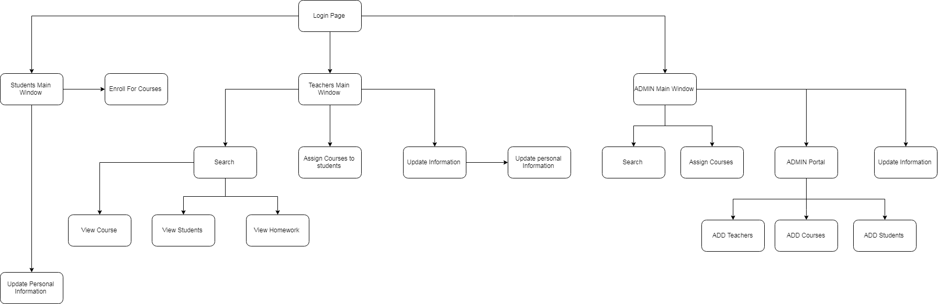
Diagram Depicting Entire Project

Slide 10
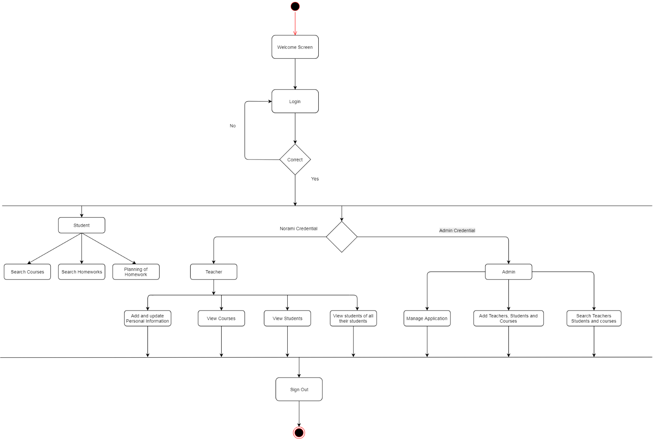
Sequence/Activity Diagram

Slide 11
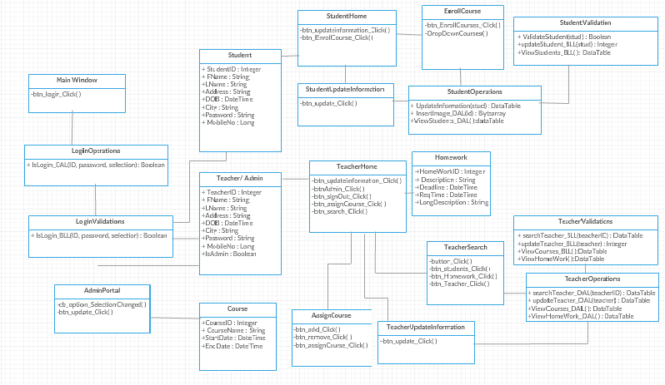
Class Diagram

Slide 12
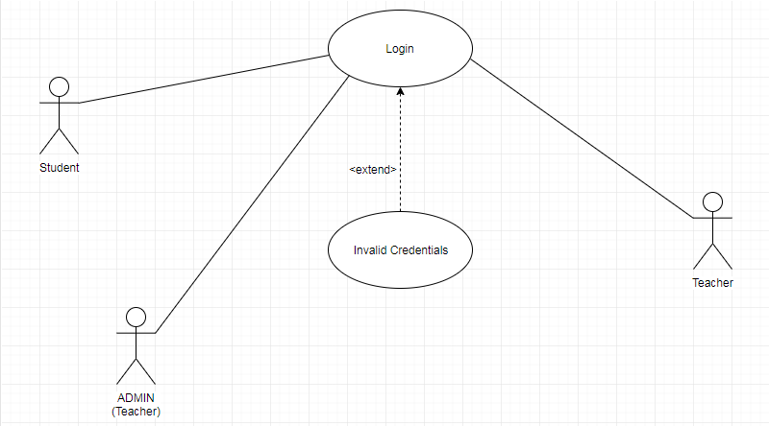
Use Case Diagram for Login

Slide 13
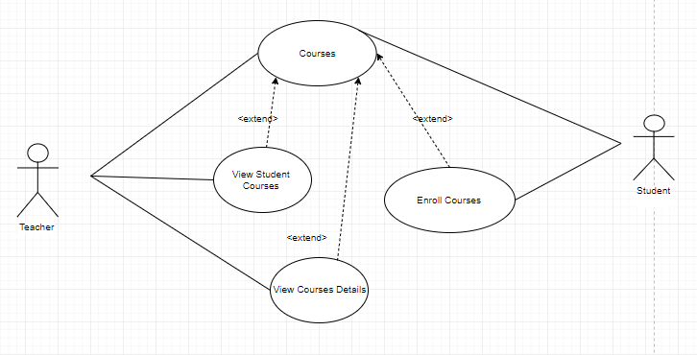
Use Case Diagram for Courses

Slide 14
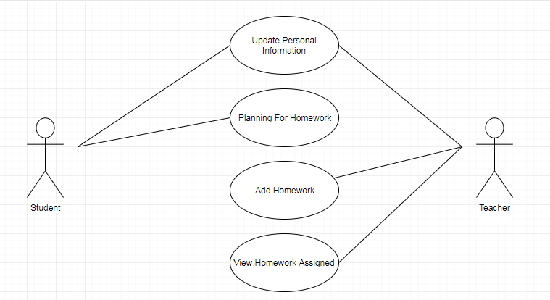
Use Case Diagram for Homework

Slide 15
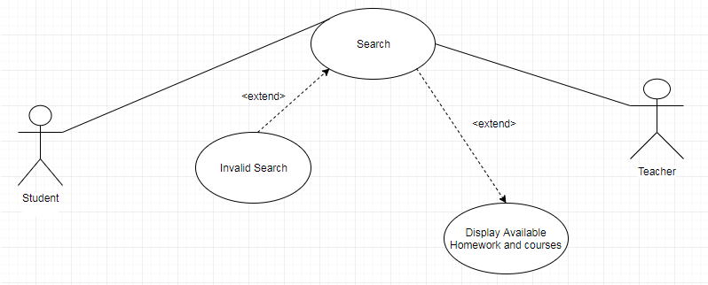
Use Case Diagram for Search Homework

Slide 16
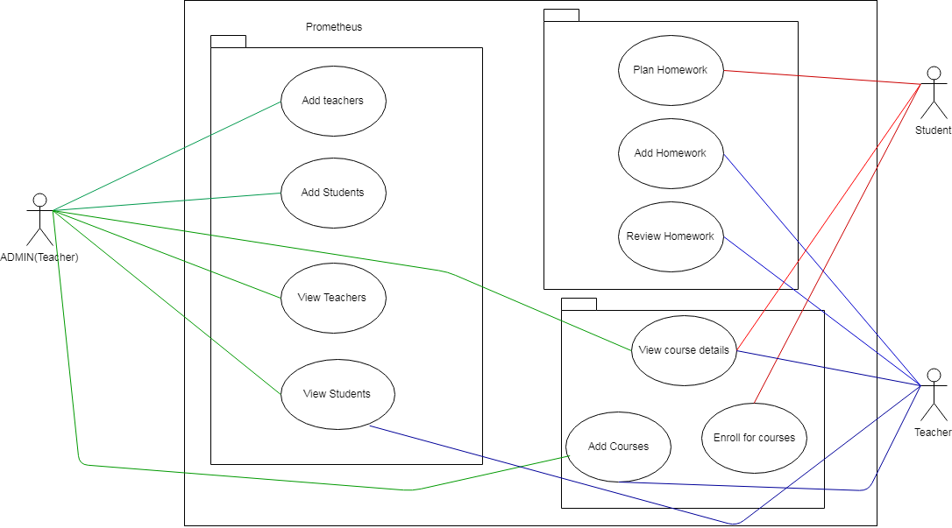
Use Case for Structure

Slide 17
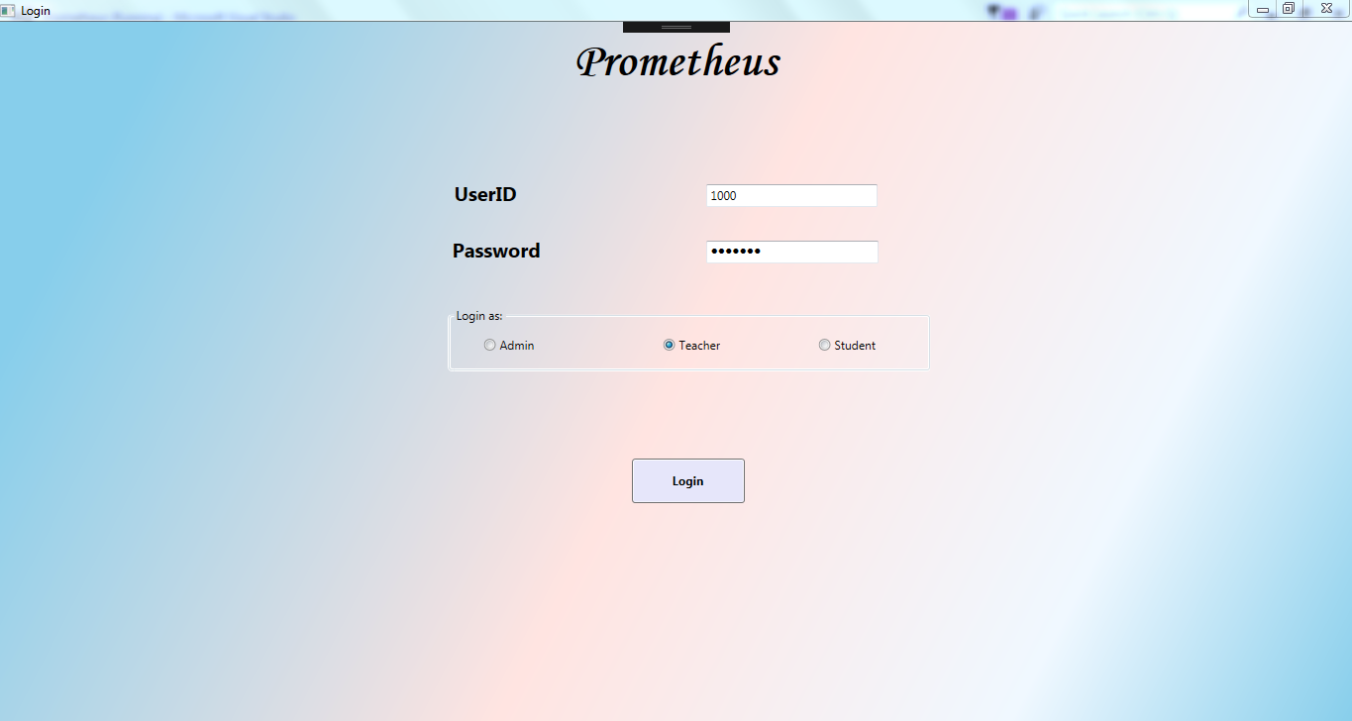
Screen shots ( Login )

Slide 18
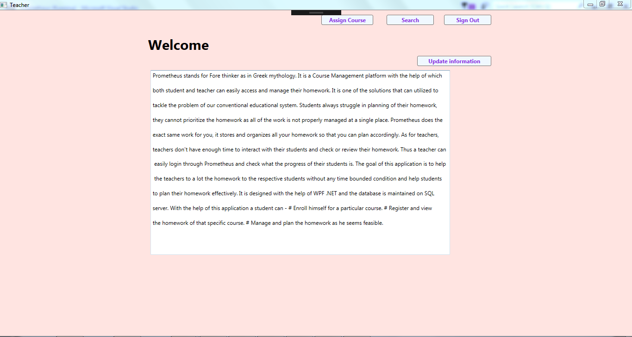
Screen shots ( Teacher )

Slide 19
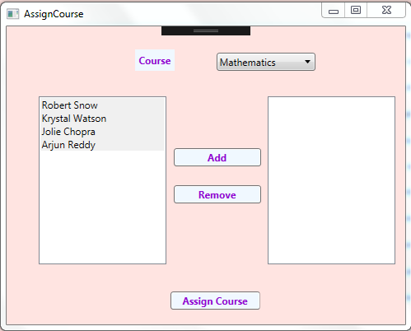
Screen shots ( Teacher )

Slide 20
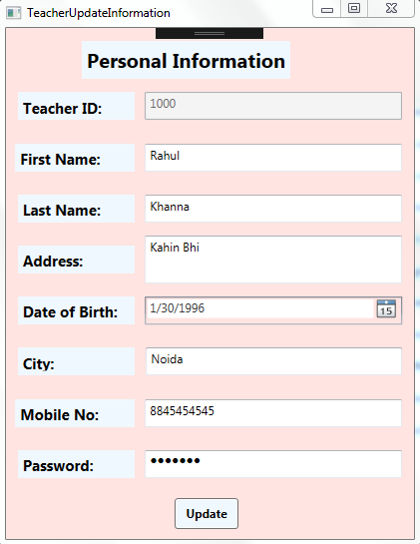
Screen shots ( Teacher )

Slide 21
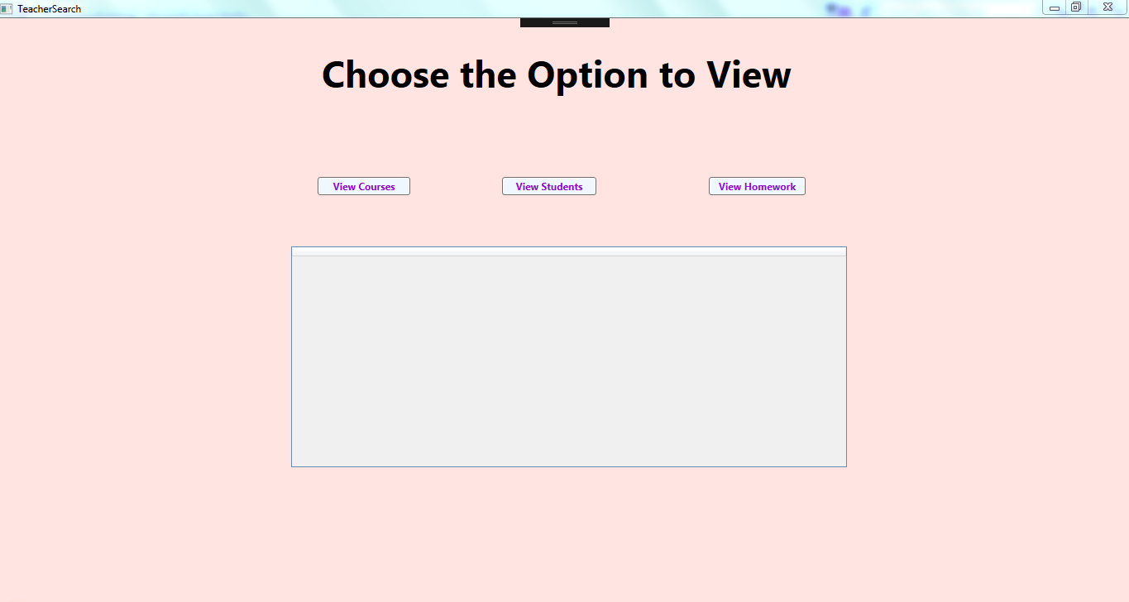
Screen shots ( Teacher )

Slide 22
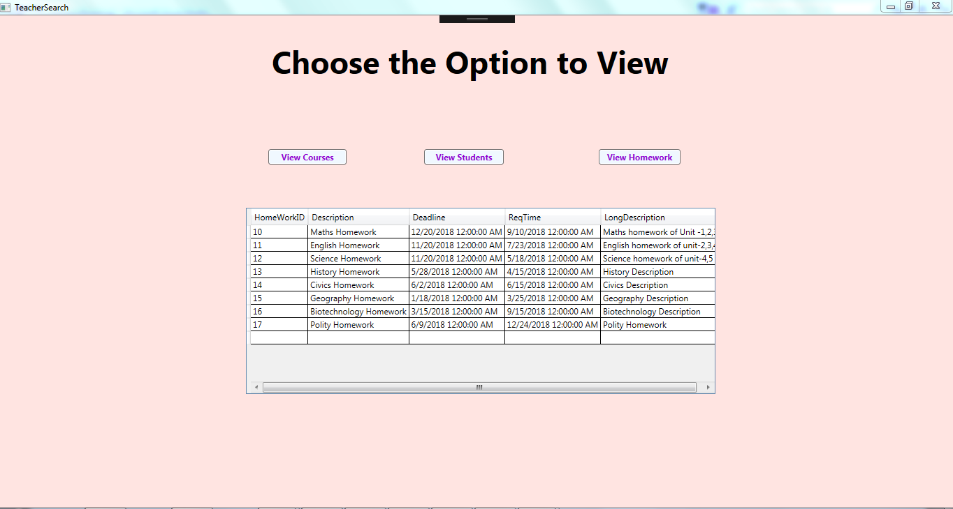
Screen shots ( Teacher )

Slide 23
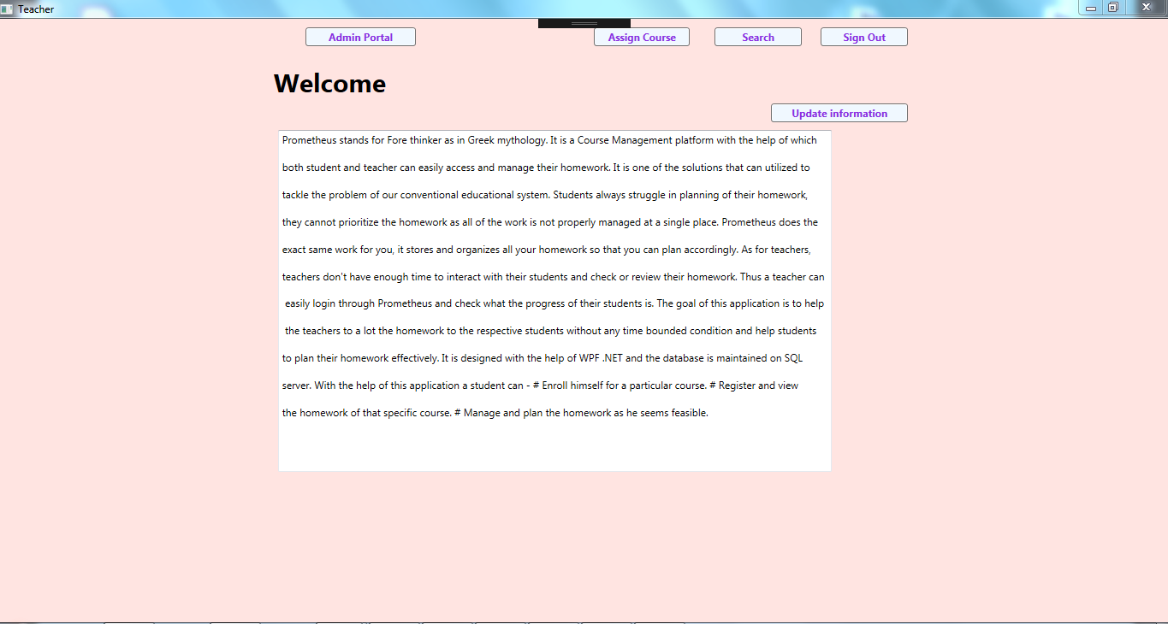
Screen shots ( Admin )

Slide 24
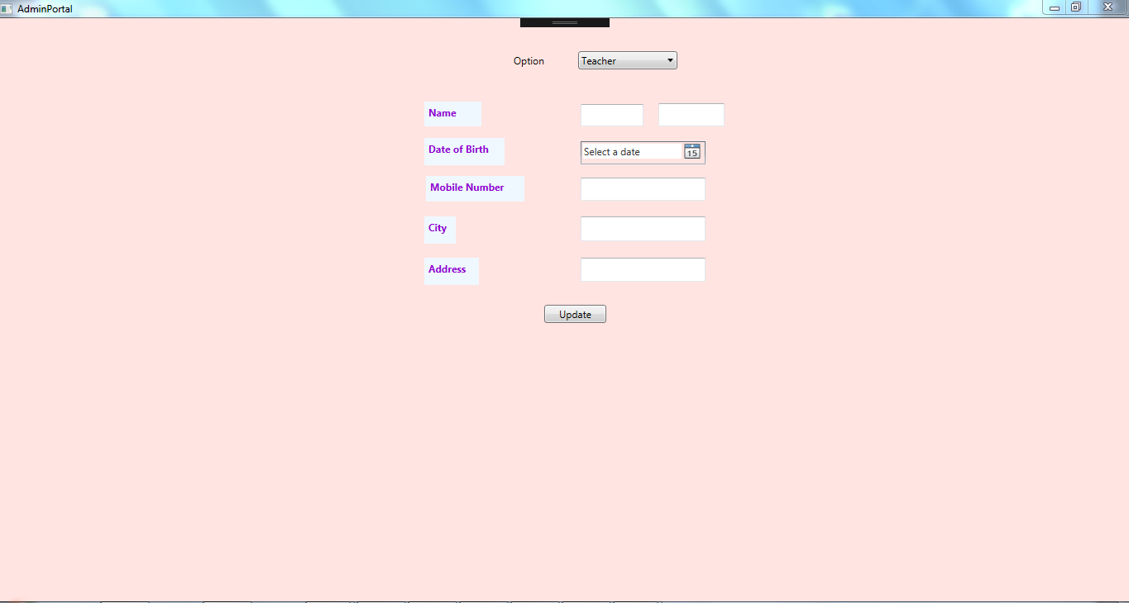
Screen shots ( Admin )

Slide 25
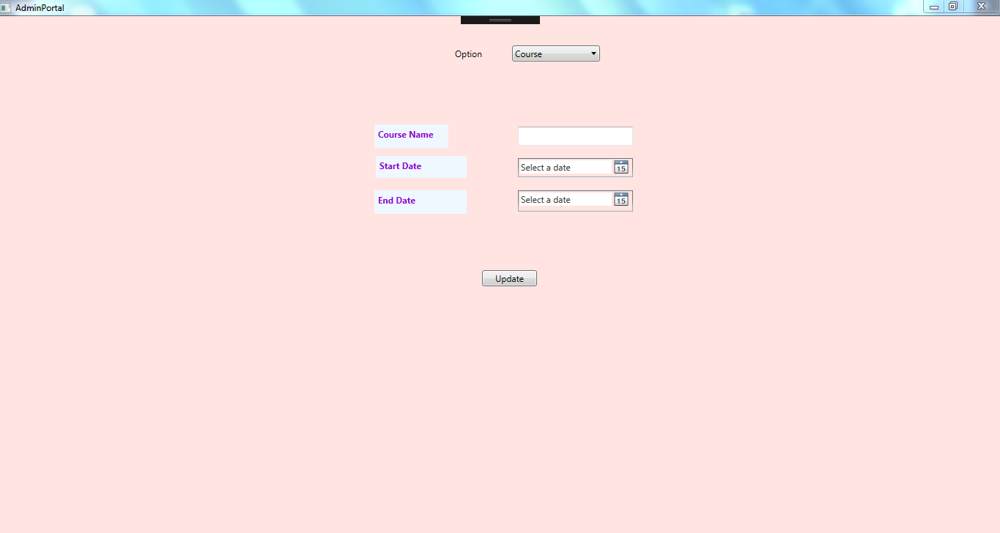
Screen shots ( Admin )

Slide 26
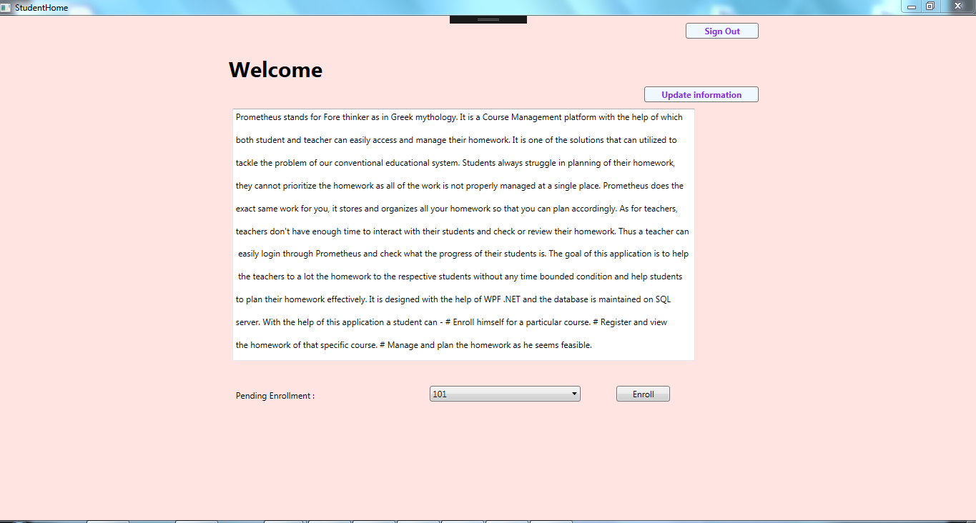
Screen shots ( Student )

Slide 27
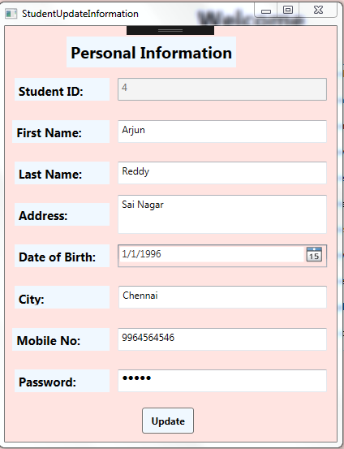
Screen shots ( Student )

Slide 28
Future Enhancements
For further enhancements ,practice tests can be organized on Prometheus where the teacher can allot test to students and appoint a start date and end date to appear for the test. Later teacher can evaluate the test and display the marks on common scoreboard or on personal login page.
The students are able to sort the homework according to the start date and end date and according to subjects.

Slide 29
Future Enhancements
The students can partially complete their homework , save it for time being and then complete the homework and then submit for evaluation.
The students automatically gets reminders before the end date of the assigned homework.

Slide 30
Thanks

