Slide 1


Mini Project-”Prometheus”
IGATE is now a part of Capgemini
Notes:
Copyright © 2011 IGATE Corporation (a part of Capegemini Group). All rights reserved.
No part of this publication shall be reproduced in any way, including but not limited to photocopy, photographic, magnetic, or other record, without the prior written permission of IGATE Corporation (a part of Capegemini Group).
IGATE Corporation (a part of Capegemini Group) considers information included in this document to be confidential and proprietary.

Slide 2

Team Members :
Aakash Dhande
Megha Kaushik
Mounika T
Rajkumar Gupta
Suchitra
Supreetha Bade

Slide 3
Project Details
It is a Course Management platform with the help of which both student and teacher can easily access and manage their homework. It is one of the solutions that can utilized to tackle the problem of our conventional educational system.
The goal of this application is to help the teachers to allot the homework to the respective students anytime and help students to plan their homework effectively.

Slide 4
Project Details
With the help of Prometheus , we can store , process, retrieve and analyze the homework and students as well as teachers to the database and administrative inventory.
This makes it lot easier for the teacher as well as the student to manage their homework and assignment , since everything is available online any time.

Slide 5
Roles Of Teacher
Can schedule homework assignments for the courses they teach .
Can view all the homework assignments for their students.
Teacher cant view the planning of the students.

Slide 6
Roles Of Student
Can enroll for Courses.
Can view their Homework.
Devise a planning for their Homework.

Slide 7
Roles of ADMIN
Manage the application.
Can add Teachers, Students and courses to the system.
Can search Teachers, Students and courses to the system.

Slide 8
Scope
Students always struggle in planning of their homework, they cannot prioritize the homework as all of the work is not properly managed at a single place. Prometheus does the exact same work for you, it stores and organizes all your homework so that you can plan accordingly. As for teachers, teachers don’t have enough time to interact with their students and check or review their homework. Thus a teacher can easily login through Prometheus and check what the progress of their students is. This makes it lot easier for a institute to appoint and review the homework allotted to students.

Slide 9
Diagram Depicting Entire Project

Slide 10
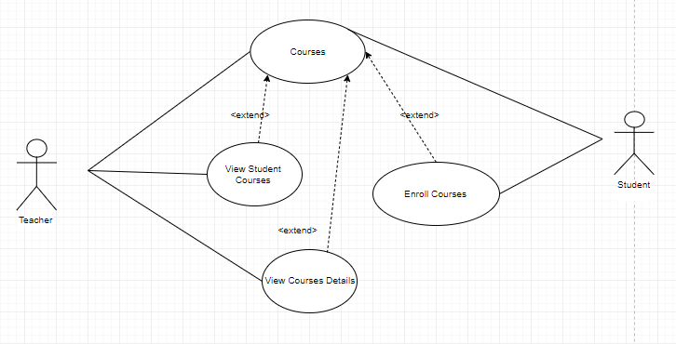
Use Case Diagram for Courses

Slide 11
Use case Diagram for Courses
Actor - Student , Teacher
System Functionalities –
Teacher can view course details
Teacher can view student courses
Student can enroll for the courses

Slide 12
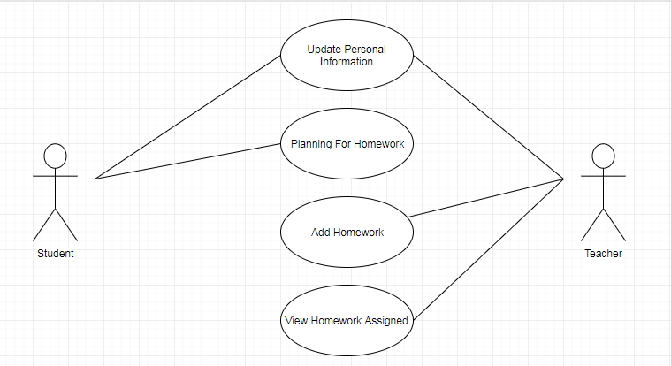
Use Case Diagram for Homework

Slide 13
Use Case Diagram for Homework
Actor – Teacher , Student
System functionalities –
Teacher can update personal information
Teacher can add homework
Teacher can view assigned homework
Student plans the assigned homework

Slide 14
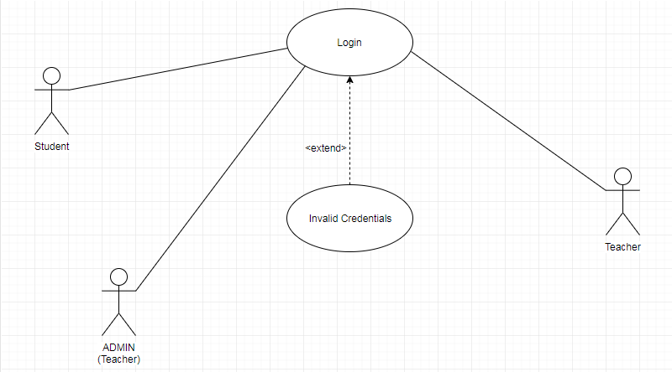
Use Case Diagram for Login

Slide 15
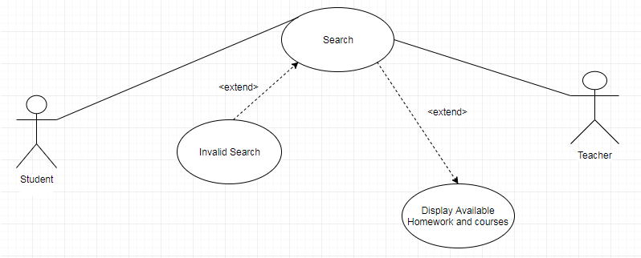
Use Case Diagram for Search Homework

Slide 16
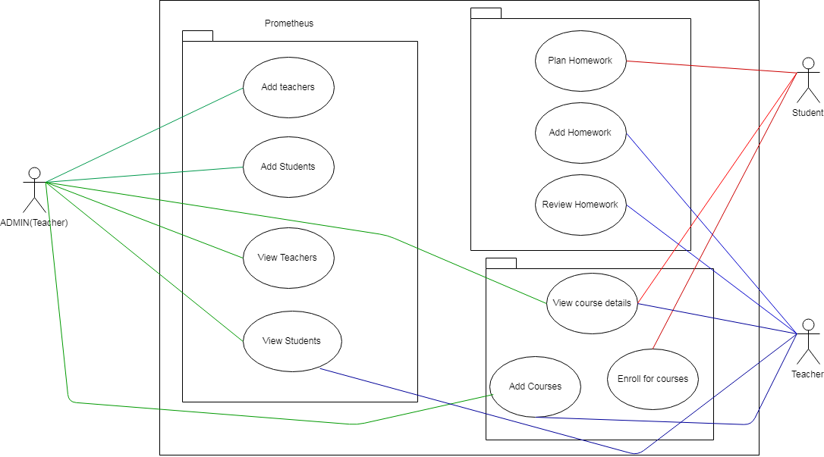
Use Case for Structure

Slide 17
Class Diagram

Slide 18
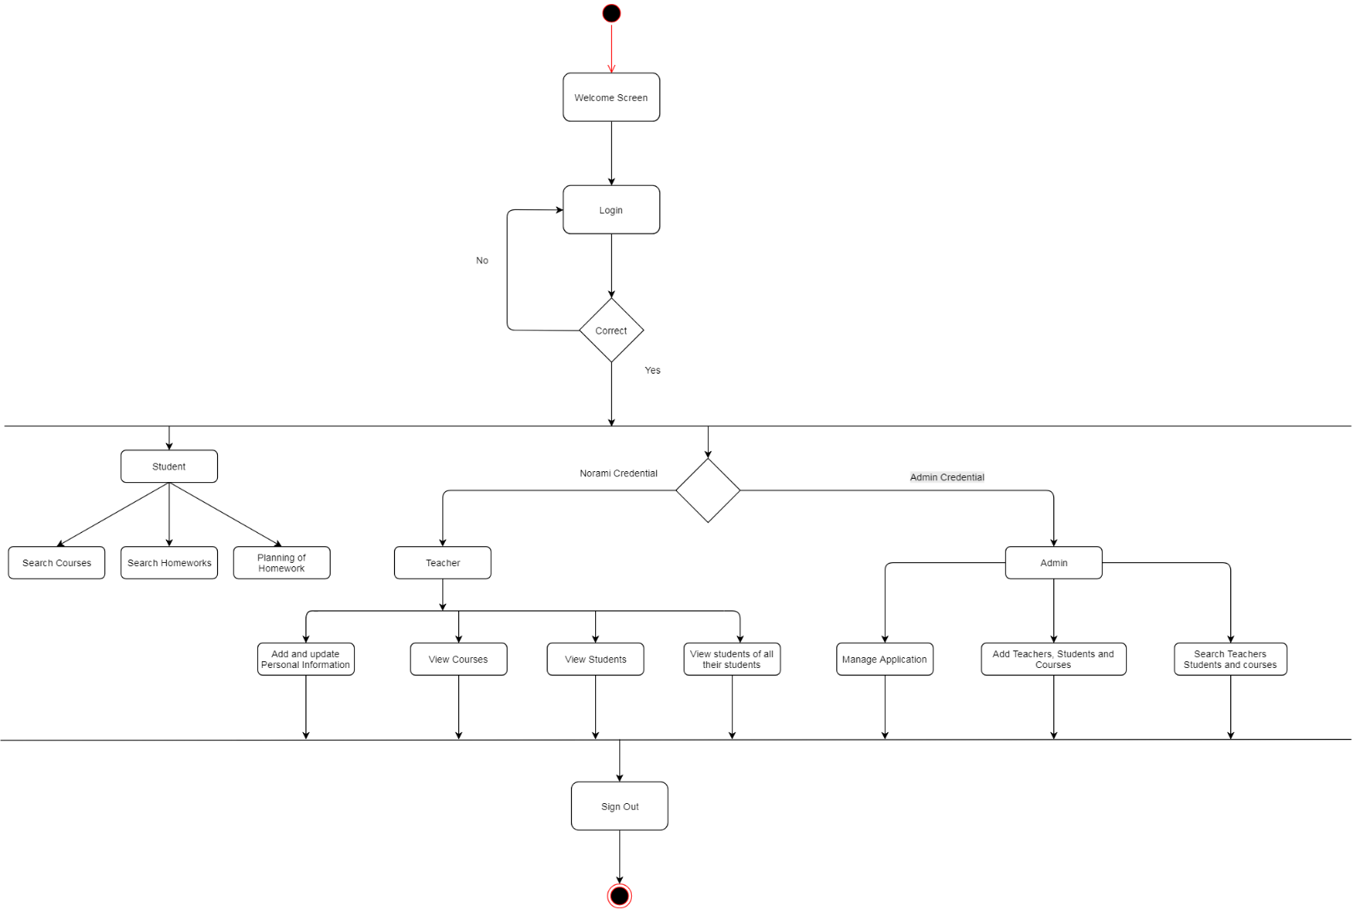
Sequence/Activity Diagram

Slide 19
Screen shots

Slide 20
Screen shots

Slide 21
Future Enhancements
For further enhancements ,practice tests can be organized on Prometheus where the teacher can allot test to students and appoint a start date and end date to appear for the test. Later teacher can evaluate the test and display the marks on common scoreboard or on personal login page.
The students are able to sort the homework according to the start date and end date and according to subjects.

Slide 22
Future Enhancements
The students can partially complete there homework , save it for time being and then complete the homework and then submit for evaluation.
The students automatically gets reminders before the end date of the assigned homework.

Slide 23
Thanks

