Slide 1
Strikethrough
Whiteboard
A Group 5 Production
Hussam Hashem
James Clark

Slide 2
Motivation
Leverage mobile computing and web services to enhance education
Inspired by
GoodNotes
Google Drive
Khan Academy

Slide 3
Objectives
Web-based digital whiteboard
Group membership
Homework
assignment
collection
evaluation

Slide 4
Technology
ASP.NET, HTML5
C#, JavaScript
JQuery, JQuery Mobile, Sketch.js
Windows Server 2008 R2
SQL Server 2008 R2
IIS 7.5
Web Services

Slide 5
Approach
ASP.NET Web Forms
User sketches in the canvas
JavaScript parse canvas to base 64 string
Store JSON object array in hidden HTML
C# retrieve from hidden HTML
Call web service for data storage/retrieval

Slide 6
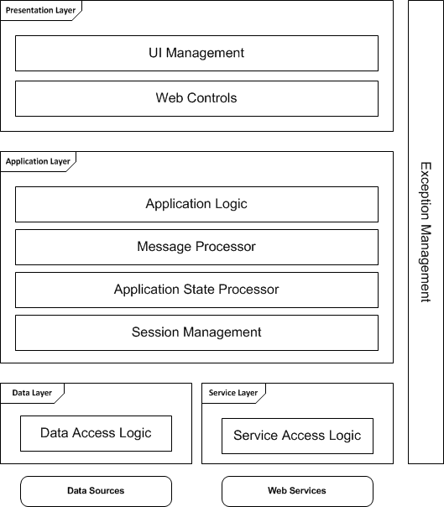
Architecture

Slide 7
Evaluation
Canvas drawing in this way is a unique application, but it does not scale well.
Application performance quickly degrades while parsing
Mobile canvas experiences poor performance in general
ASP.NET web forms require disabling AJAX in some cases
Navigation with JQuery Mobile has its own unique API
JQuery Mobile can interrupt the scope of in-page JavaScript
ASP.NET MVC is recommended over web forms
Pure client-side HTML + JavaScript and AJAX web service calls would likely improve user performance over server side processing

