Slide 1
Code Coverage
Reporting for PowerShell and DSC Resources

Slide 2
Agenda
DSC Resource
Travis Plunk
GitHub - @TravisEz13
Twitter - @TravisPlunk
PowerShell Core
James Truher
GitHub - @JamesWTruher
Twitter - @jwtruher

Slide 3
Introduction
PowerShell Desired State Configuration Resources
Open Source Software (OSS)
GitHub
AppVeyor is used for Continuous Integration (CI)
PowerShell Script and Class based
Goals
Make it easier for Pull Request (PR) Reviewers to decide if a PR meets the bar.
Make it easier for Contributors to find what code is not covered.

Slide 4
Before the Change
Results are buried is CI log
Results are not very readable
For the reviewer difficult to answer:
Did the author cover the code they changed?
For the author difficult to answer:
What code have I not covered?

Slide 5
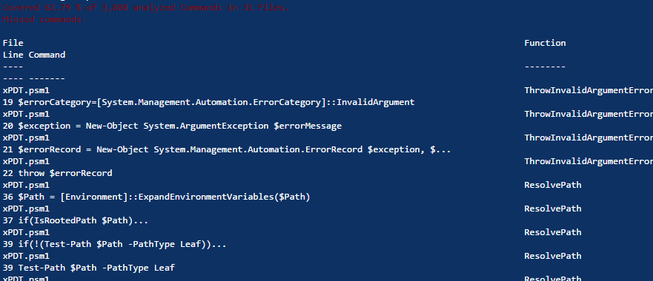
Before the Change

Slide 6
The Work
Update Pester (PowerShell OSS test framework) to output all the data needed.
Add Hit Lines.
A common module used to run and process Pester results (OSS community contribution.)
This code include detection of code files in a way that was specific to the DSC Resources and did not belong in Pester.
Convert the code coverage object produced by Pester into the JSON format supported by CodeCov.io.
This could be put in Pester, but being a proprietary format probably should remain separate.
CodeCov.io provided components needed to integrate AppVeyor with the their viewer so that uploads are as automated as possible.
I worked with CodeCov.io to ensure they were not blocked.

Slide 7
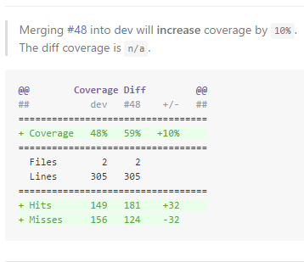
After the change
Made it easier for PR Reviewers to decide if a PR meets the bar.
More actionable report added the Pull Request.

Slide 8
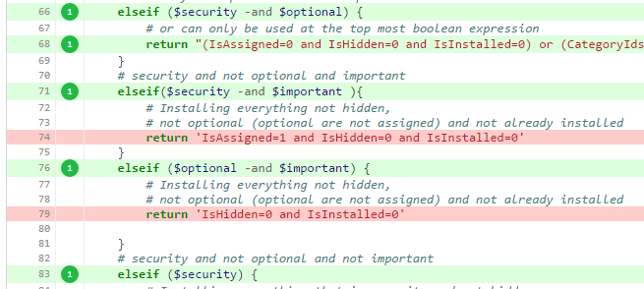
After the change
Made it easier for Contributors to find what code is not covered.
Link to detailed file coverage.

Slide 9
After the change - Demo
Examples
Branch overview
PR to Increase Coverage
Decreasing coverage PR
File coverage report

Slide 10
Future Work
Identify coverage from Unit vs Integration tests separately.

Slide 11
PowerShell Core

Slide 12
Getting Code Coverage in PowerShell Core
PowerShell Core
OSS on Github
Using AppVeyor and Travis-CI for continuous integration
Goals
Measure and publish coverage as part of release criteria
Provide coverage on daily builds to measure progress
Enable easier generation of coverage data by developers
Notes:
Why not every build?

Slide 13
Work
Search for tools
Code coverage tools not yet available on non-Windows platforms
Run in CI?
Nope – first run of tools took 4 hours
Run in Azure
Azure function
VM
Improve Developer Experience

Slide 14
Implementation Details
Where to Run?
Azure VM
Automate Execution
Install daily PowerShell Core package
Install tests
Execute tests
Upload results to Coveralls
Developer Experience
Create OpenCover module

Slide 15
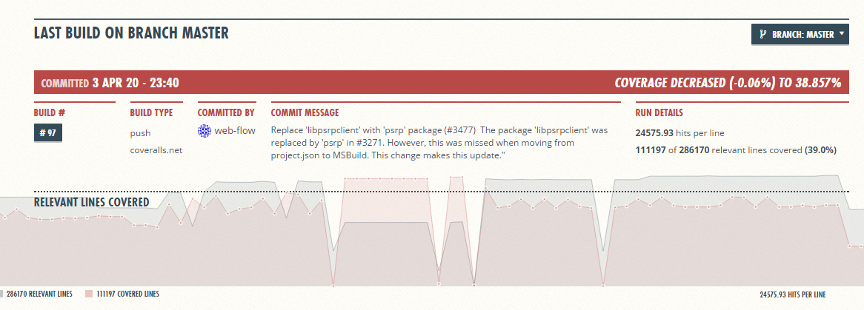
Results
https://coveralls.io/github/PowerShell/PowerShell?branch=master

Slide 16
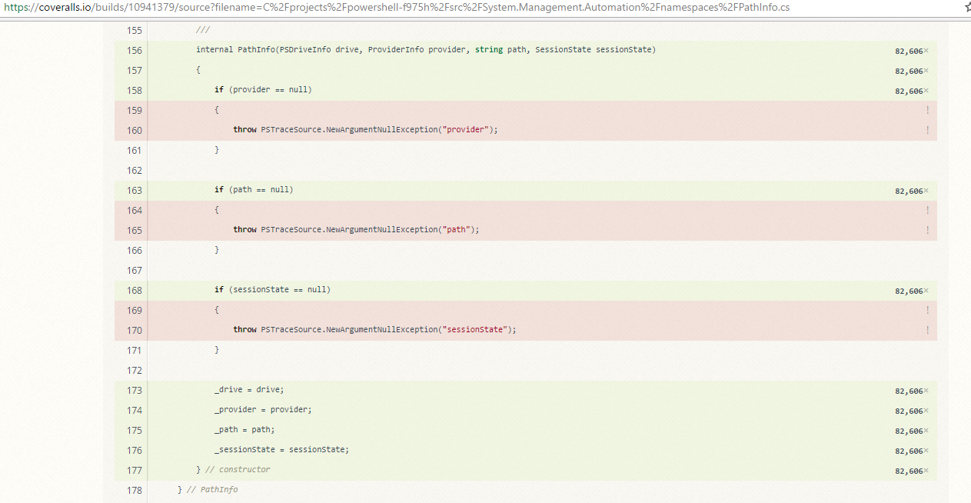
Results

Slide 17
Developer Experience
OpenCover module
Install-OpenCover
Invoke-OpenCover
Improves consistency in executing local coverage runs
Partial run execution
OpenCover Reports
Get-CodeCoverage
Assembly or Class
Measures Branch or Sequence
Compare-CodeCoverage
Compare 2 different coverage runs

Slide 18
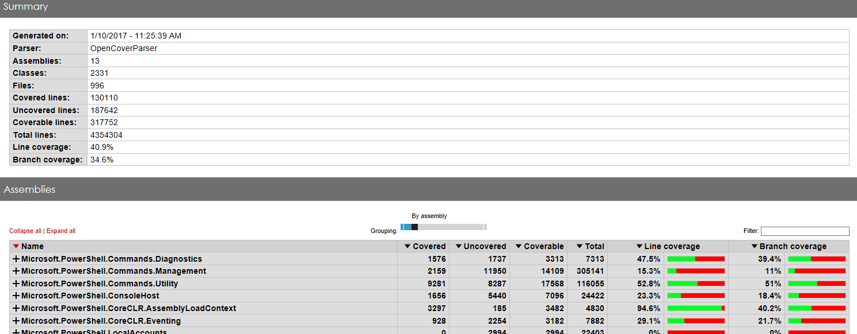
Dev Experience – OpenCover Reporting

Slide 19
Demo

Slide 20
Resources
DSC
Pester Pull Request - #341
Code coverage Report – Before
Code Coverage Converter
PowerShell
https://github.com/OpenCover/opencover
https://coveralls.io/github/PowerShell/PowerShell?branch=master
https://github.com/PowerShell/PowerShell/tree/master/test/tools/OpenCover

