Slide 1
8 Tips for Success: Introduction to Data Analysis w/ Python
James Wilson

Slide 2

Download Anaconda
Download version 3.7 from https://www.anaconda.com/distribution/
Once downloaded – open up Jupiter Notebooks

Slide 3
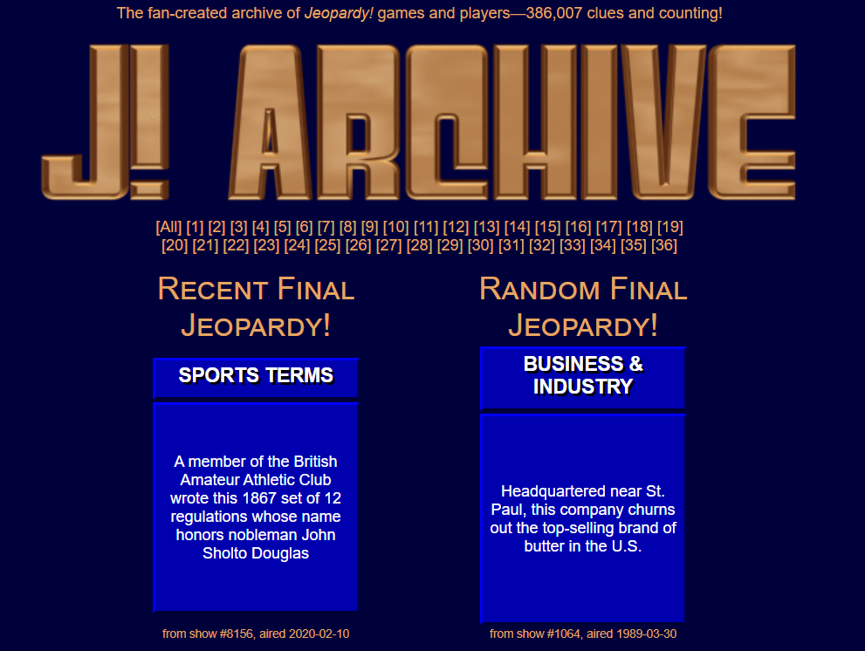
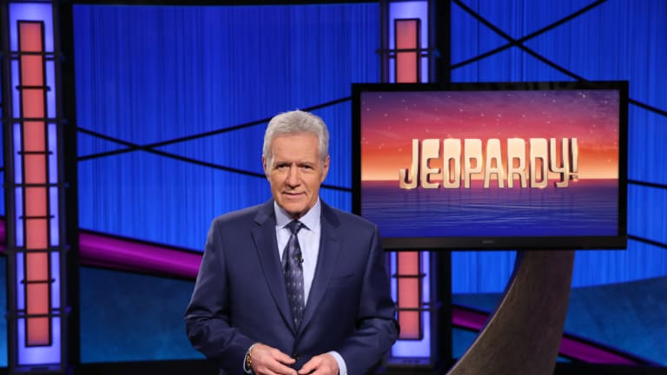

The Data: Jeopardy Player Details
Jeopardy Archive
@CoolJeopardyStories Twitter Account

Slide 4
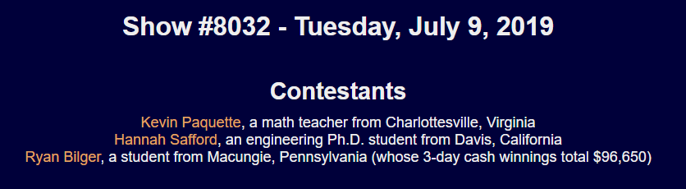
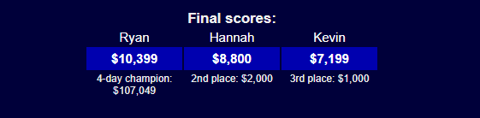
Creating the Data: Archive
Can extract the show date, player names, occupations, hometowns, final scores, and other details.

Slide 5

Creating the Data: Twitter
Can extract fun facts and the show date the players shared them.
We can also deduce who said which fact!

Slide 6
Tip #1: Evaluate column names and types
Consistent names are easier to read
Lower case
Remove special characters and spaces
Make your life simpler!
Code:
df.shape
df.info()
df.dtypes()
df.columns

Slide 7
Tip #2: Detect NA’s & Duplicates; why are they there?
Need to understand what data is present
Are you missing important information ?
What will you be able to work with?
Code:
df.isnull()
df.isna()
df.drop_duplicates()

Slide 8
Tip #3: String cleaning & variable creation
Cleaning variables early is essential for later success
Allows you to quality control the data as you go
Creating features and more granular variables allows for more detailed analytics
str.replace()
astype()
split()
strip()
And more!

Slide 9
Tip #4: Date conversions
Using the correct format is helpful for success
Dates can be entered in tricky formats
Can create features to make for more general analysis
pd.to_datetime()

Slide 10
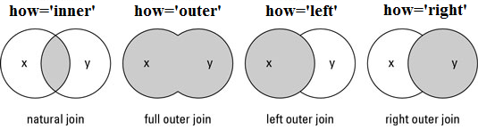
Tip #5: Join relevant data fields
Combine datasets to have a full picture of the data
Code:
pd.melt()
pd.merge()

Slide 11
Tip #6: Numeric summaries and outlier detection
Evaluate the spread and shape of the numerical fields
Search for outliers that may indicate problems with data collection – will be an issue for model building
df_sub = df[‘numeric’] > x
df_sub.sum() & df_sub.mean()

Slide 12
Tip 7: Evaluating categorical variables with frequency tables
nunique()
groupby()
agg([‘count’])

Slide 13
Tip #8: Build graphics to explore ideas
Visualize and communicate your results

Slide 14

Thank you

