Slide 1
7 Tips for Success: Introduction to Data Analysis w/ Python
James Wilson

Slide 2


Download Anaconda
Download version 3.7 from https://www.anaconda.com/distribution/
Once downloaded, please open Jupyter Notebooks

Slide 3



Libraries
Pandas
A fast, powerful, flexible and easy to use open source data analysis and manipulation tool.
Numpy
Tool to support working with large, multi-dimensional arrays and matrices, along with a large collection of high-level mathematical functions to operate on these arrays
Plotly
Provides online graphing, analytics, and statistics tools for individuals and collaboration

Slide 4
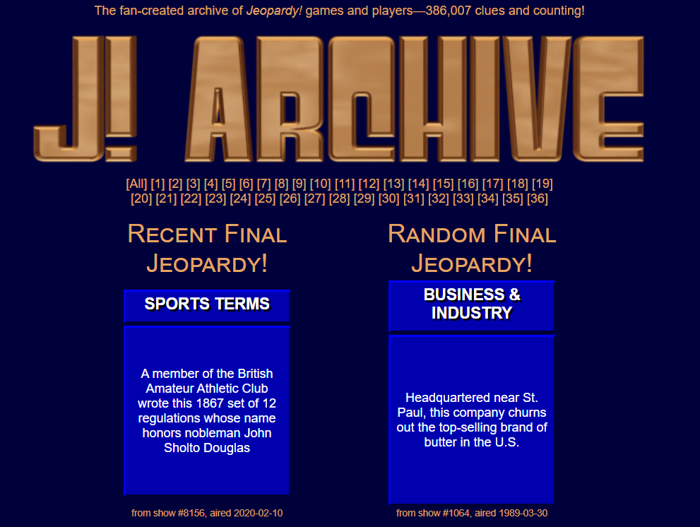


The Data: Jeopardy Player Details
Jeopardy Archive
@CoolJeopardyStories Twitter Account

Slide 5
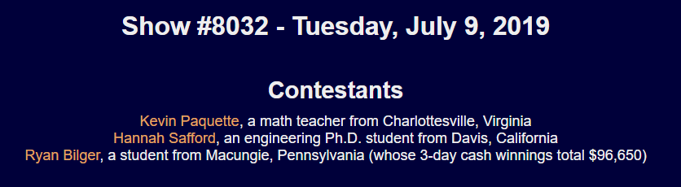
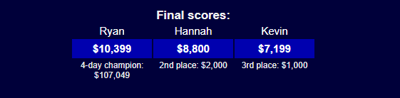
Creating the Data: Archive
Can extract the show date, player names, occupations, hometowns, final scores, and other details.

Slide 6

Creating the Data: Twitter
Can extract fun facts and the show date the players shared them.
We can also deduce who said which fact!

Slide 7
Python Tips!
Tip #1 – Evaluate column names and types
Tip #2 – Detect NA's & duplicates; why are they there?
Tip #3 - String Cleaning & Variable Creation
Tip #4 - Join and reshape data
Tip #5 - Numeric summaries and outlier detection
Tip #6 - Evaluating categorical variables with frequency tables
Tip #7 - Build graphics to explore ideas

Slide 8
Tip #1: Evaluate column names and types
Consistent names are easier to read
Lower case is the best case
Remove special characters and spaces
Make your life simpler!
Code:
df.shape
df.info()
df.dtypes()
df.columns

Slide 9
Tip #1: Evaluate column names and types
Consistent names are easier to read
Lower case is the best case
Remove special characters and spaces
Make your life simpler!
Returns dimensions of the DataFrame (df)
Code:
df.shape
df.info()
df.dtypes()
df.columns

Slide 10
Tip #1: Evaluate column names and types
Consistent names are easier to read
Lower case is the best case
Remove special characters and spaces
Make your life simpler!
Returns summary of the DataFrame (df)
Code:
df.shape
df.info()
df.dtypes()
df.columns

Slide 11
Tip #1: Evaluate column names and types
Consistent names are easier to read
Lower case is the best case
Remove special characters and spaces
Make your life simpler!
Returns the data type (dtype) of each column in the given dataframe
Code:
df.shape
df.info()
df.dtypes()
df.columns

Slide 12
Tip #1: Evaluate column names and types
Consistent names are easier to read
Lower case is the best case
Remove special characters and spaces
Make your life simpler!
Code:
df.shape
df.info()
df.dtypes()
df.columns
Returns the column names contains in the data frame

Slide 13
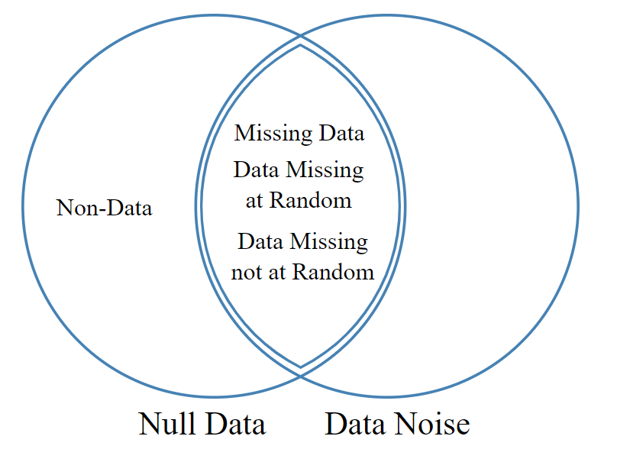
Tip #2: Detect NA’s & Duplicates; why are they there?
Need to understand what data is present
Are you missing important information ?
What will you be able to work with?
Code:
df.isnull() / df.isna()
df.fillna()
df.duplicated()
df.drop_duplicates()

Slide 14
Tip #2: Detect NA’s & Duplicates; why are they there?
Need to understand what data is present
Are you missing important information ?
What will you be able to work with?
Detect Null values in the DF
Code:
df.isnull() / df.isna()
df.fillna()
df.duplicated()
df.drop_duplicates()

Slide 15
Tip #2: Detect NA’s & Duplicates; why are they there?
Need to understand what data is present
Are you missing important information ?
What will you be able to work with?
Fill Missing Values in Date Frame
Code:
df.isnull() / df.isna()
df.fillna()
df.duplicated()
df.drop_duplicates()

Slide 16
Tip #2: Detect NA’s & Duplicates; why are they there?
Need to understand what data is present
Are you missing important information ?
What will you be able to work with?
Code:
df.isnull() / df.isna()
df.fillna()
df.duplicated()
df.drop_duplicates()
Detect duplicated rows

Slide 17
Tip #2: Detect NA’s & Duplicates; why are they there?
Need to understand what data is present
Are you missing important information ?
What will you be able to work with?
Code:
df.isnull() / df.isna()
df.fillna()
df.duplicated()
df.drop_duplicates()
Drop duplicated rows

Slide 18
Tip #3: String cleaning & variable creation
Cleaning variables early is essential for later success
Allows you to quality control the data as you go
Creating features and more granular variables will make for more detailed analytics
Code:
df.[‘x’].str.replace()
df.[‘x’].astype()
df.[‘x’].split()
df.[‘x’].strip()
And more!

Slide 19
Tip #3: String cleaning & variable creation
Cleaning variables early is essential for later success
Allows you to quality control the data as you go
Creating features and more granular variables will make for more detailed analytics
Replace specified characters in string
Code:
df.[‘x’].str.replace()
df.[‘x’].astype()
df.[‘x’].split()
df.[‘x’].strip()
And more!

Slide 20
Tip #3: String cleaning & variable creation
Cleaning variables early is essential for later success
Allows you to quality control the data as you go
Creating features and more granular variables will make for more detailed analytics
Change the data type of a variable
Code:
df.[‘x’].str.replace()
df.[‘x’].astype()
df.[‘x’].split()
df.[‘x’].strip()
And more!

Slide 21
Tip #3: String cleaning & variable creation
Cleaning variables early is essential for later success
Allows you to quality control the data as you go
Creating features and more granular variables will make for more detailed analytics
Code:
df.[‘x’].str.replace()
df.[‘x’].astype()
df.[‘x’].split()
df.[‘x’].strip()
And more!
Split a variable at a specified delimeter

Slide 22
Tip #3: String cleaning & variable creation
Cleaning variables early is essential for later success
Allows you to quality control the data as you go
Creating features and more granular variables will make for more detailed analytics
Code:
df.[‘x’].str.replace()
df.[‘x’].astype()
df.[‘x’].split()
df.[‘x’].strip()
And more!
String a variable of white space

Slide 23
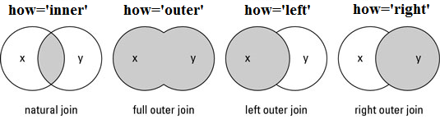
Tip #4: Join and reshape data Merge
Combine datasets to have a full picture of the data
Make sure not to lose any data in the process
Code:
pd.merge()
Combine data sets
on specified keys

Slide 24
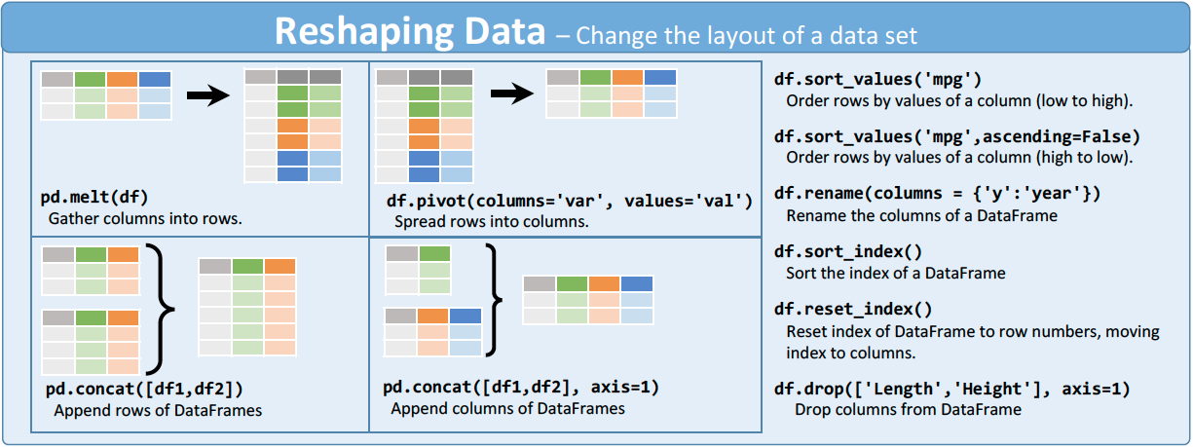
Tip #4: Join and reshape data Melt
Code:
pd.melt()
Massage dataframe into a format where one or more columns are identifiers, where all other columns are considered unpivoted, measured variables

Slide 25
Tip #5: Numeric summaries and outlier detection
Evaluate the spread and shape of the numerical fields
Search for outliers that may indicate problems with data collection – will be an issue for model building
Code:
df[‘x’] > y
df[‘x’].sum()
df[‘x’].describe()
df[‘x’].transform(‘function’)
np.where(x, a, b)

Slide 26
Tip #5: Numeric summaries and outlier detection
Evaluate the spread and shape of the numerical fields
Search for outliers that may indicate problems with data collection – will be an issue for model building
Subset data frame on conditional
Code:
df[‘x’] > y
df[‘x’].sum()
df[‘x’].describe()
df[‘x’].transform(‘function’)
np.where(x, a, b)

Slide 27
Tip #5: Numeric summaries and outlier detection
Evaluate the spread and shape of the numerical fields
Search for outliers that may indicate problems with data collection – will be an issue for model building
Create summary stats on specified variable (e.g. sum)
Code:
df[‘x’] > y
df[‘x’].sum()
df[‘x’].describe()
df[‘x’].transform(‘function’)
np.where(x, a, b)

Slide 28
Tip #5: Numeric summaries and outlier detection
Evaluate the spread and shape of the numerical fields
Search for outliers that may indicate problems with data collection – will be an issue for model building
Generate ALL summary statistics for specified variable
Code:
df[‘x’] > y
df[‘x’].sum()
df[‘x’].describe()
df[‘x’].transform(‘function’)
np.where(x, a, b)

Slide 29
Tip #5: Numeric summaries and outlier detection
Evaluate the spread and shape of the numerical fields
Search for outliers that may indicate problems with data collection – will be an issue for model building
Create a new variable based on transformation of a variable
Code:
df[‘x’] > y
df[‘x’].sum()
df[‘x’].describe()
df[‘x’].transform(‘function’)
np.where(x, a, b)

Slide 30
Tip #5: Numeric summaries and outlier detection
Evaluate the spread and shape of the numerical fields
Search for outliers that may indicate problems with data collection – will be an issue for model building
Subset an array on a specific condition
Code:
df[‘x’] > y
df[‘x’].sum()
df[‘x’].describe()
df[‘x’].transform(‘function’)
np.where(x, a, b)

Slide 31
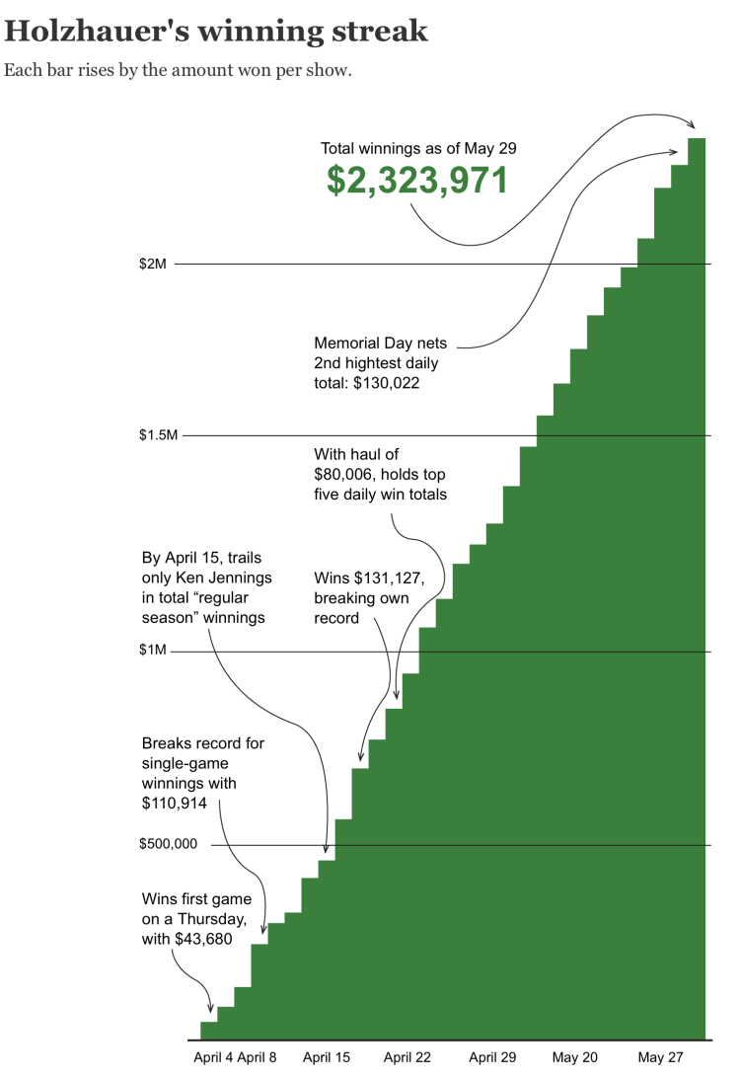
Outlier! James Holzhauer

Slide 32
Tip 6: Evaluating categorical variables
Determine the scope of variables at your disposal
What unique groupings are there?
Any relevant frequency counts?
What story can be told ?
Code:
df[‘x’].nunique()
df[‘x’].apply(function)
df[‘x’].groupby()
df[‘x’].agg([‘count’])
df[‘x’].sort_values()

Slide 33
Tip 6: Evaluating categorical variables
Determine the scope of variables at your disposal
What unique groupings are there?
Any relevant frequency counts?
What story can be told ?
Calculate number of unique groups in a variable
Code:
df[‘x’].nunique()
df[‘x’].apply(function)
df[‘x’].groupby()
df[‘x’].agg([‘count’])
df[‘x’].sort_values()

Slide 34
Tip 6: Evaluating categorical variables
Determine the scope of variables at your disposal
What unique groupings are there?
Any relevant frequency counts?
What story can be told ?
Apply a function to a specified variable
Code:
df[‘x’].nunique()
df[‘x’].apply(function)
df[‘x’].groupby()
df[‘x’].agg([‘count’])
df[‘x’].sort_values()

Slide 35
Tip 6: Evaluating categorical variables
Determine the scope of variables at your disposal
What unique groupings are there?
Any relevant frequency counts?
What story can be told ?
Group by a specified variable
Code:
df[‘x’].nunique()
df[‘x’].apply(function)
df[‘x’].groupby()
df[‘x’].agg([‘count’])
df[‘x’].sort_values()

Slide 36
Tip 6: Evaluating categorical variables
Determine the scope of variables at your disposal
What unique groupings are there?
Any relevant frequency counts?
What story can be told ?
Create a summary table breakout
Code:
df[‘x’].nunique()
df[‘x’].apply(function)
df[‘x’].groupby()
df[‘x’].agg([‘count’])
df[‘x’].sort_values()

Slide 37
Tip 6: Evaluating categorical variables
Determine the scope of variables at your disposal
What unique groupings are there?
Any relevant frequency counts?
What story can be told ?
Sort a table
Code:
df[‘x’].nunique()
df[‘x’].apply(function)
df[‘x’].groupby()
df[‘x’].agg([‘count’])
df[‘x’].sort_values()

Slide 38
Tip #7: Build graphics to explore ideas
Visualize and communicate your results
Simple and to the point
Clearly label you axes and titles!
Code:
px.bar()
px.line()
plt.box()
plt.scatter()
chloropleth()

Slide 39
Tip #7: Build graphics to explore ideas
Visualize and communicate your results
Simple and to the point
Clearly label you axes and titles!
Create a barplot
Code:
px.bar()
px.line()
plt.box()
plt.scatter()
chloropleth()

Slide 40
Tip #7: Build graphics to explore ideas
Visualize and communicate your results
Simple and to the point
Clearly label you axes and titles!
Create a line plot
Code:
px.bar()
px.line()
plt.box()
plt.scatter()
chloropleth()

Slide 41
Tip #7: Build graphics to explore ideas
Visualize and communicate your results
Simple and to the point
Clearly label you axes and titles!
Create a boxplot
Code:
px.bar()
px.line()
plt.box()
plt.scatter()
chloropleth()

Slide 42
Tip #7: Build graphics to explore ideas
Visualize and communicate your results
Simple and to the point
Clearly label you axes and titles!
Code:
px.bar()
px.line()
plt.box()
plt.scatter()
chloropleth()
Create a scatter plot

Slide 43
Tip #7: Build graphics to explore ideas
Visualize and communicate your results
Simple and to the point
Clearly label you axes and titles!
Code:
px.bar()
px.line()
plt.box()
plt.scatter()
chloropleth()
Create a map

Slide 44
Additional Resources
Reticulate Package (use Python in R!)
https://rstudio.github.io/reticulate/index.html
Install Packages in Anaconda
https://www.geeksforgeeks.org/python-add-packages-to-anaconda-environment/
When in doubt, try using conda forge command
Attributes vs methods in Python
https://stackoverflow.com/questions/28798781/differences-between-data-attributes-and-method-attributes

Slide 45

Thank you

