Slide 1
IMAGE PROCESSING
Lecture 2

Slide 2
Outline
Gray image smoothing
a. Smoothing spatial filtering
1. Mean filter
2. Median filter
b. Smoothing frequency filtering
1. Ideal lowpass filter
2. Gaussian lowpass filter
Binary image

Slide 3
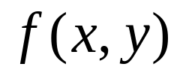
Digital Image
What is a digital image
An image can be defined as a 2D function,
finite, discrete quantities.
-Gray image
-Binary image
Why do we need smoothing?
- Noise manifests itself as an unevenness in
background and foreground regions
- Imparts a bumpy or jagged appearance

Slide 4
Convolution
One of the fundamental operations in image processing
- Enhancement techniques based on the pixels of an image are often referred to as spatial filtering.
- Enhancement techniques based on the Fourier transform for signal processing are often referred to as frequency filtering.

Slide 5
Convolution
Convolution works with the values of the image pixels in the neighborhood and the corresponding values of a subimage that has the same dimensions as the neighborhood.
Subimage is called “filter” “mask” “kernel” “template” or “window”

Slide 6
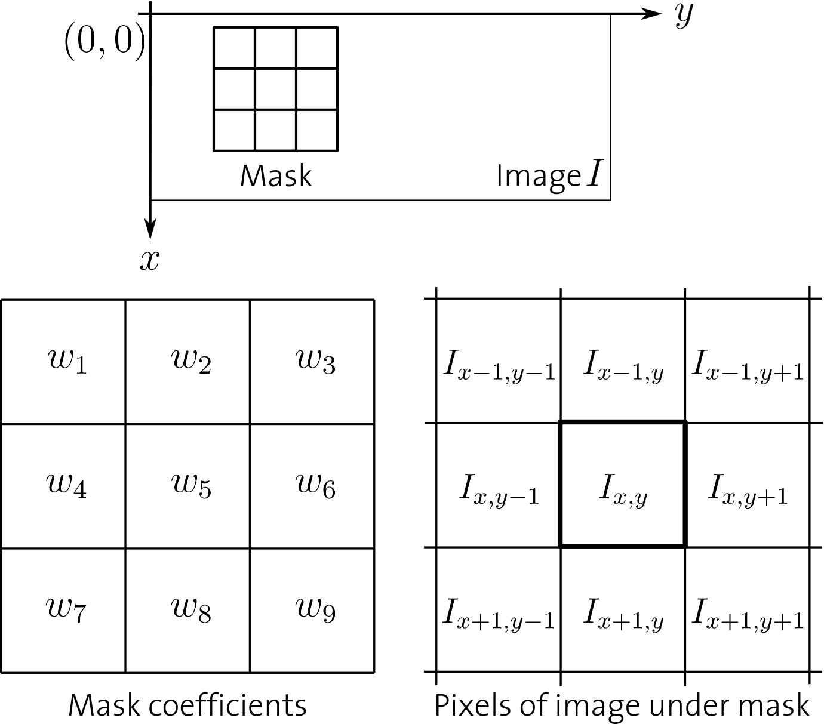
Convolution

Slide 7

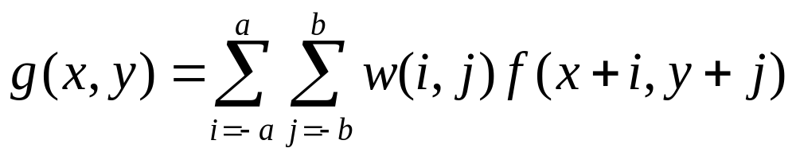
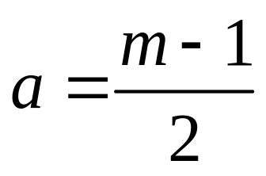
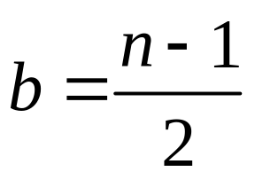
Convolution
For a kernel of size , both odd:

Slide 8
Image Borders
Question??
Along the borders of an image it is not
possible to compute a convolution, because
part of the kernel lies beyond the image.

Slide 9
Image Borders
No processing at the border -> the filtered image will be smaller than the original
“padding” the images by adding rows and columns

Slide 10
Smoothing Spatial Filters
Smoothing filters are used for blurring and for noise reduction (lowpass filters)
- Linear filter: Mean
- Non-linear filter: Median

Slide 11
Mean Filter
Mean filtering is a simple, intuitive and easy to implement method of smoothing images
The idea of mean filtering is simply to replace each pixel value in an image with the mean (`average') value of its neighbors, including itself.

Slide 12
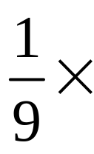
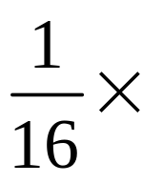
Mean Filters
Box filter
Weighted filter
1 | 1 | 1
1 | 1 | 1
1 | 1 | 1
1 | 2 | 1
2 | 4 | 2
1 | 2 | 1

Slide 13
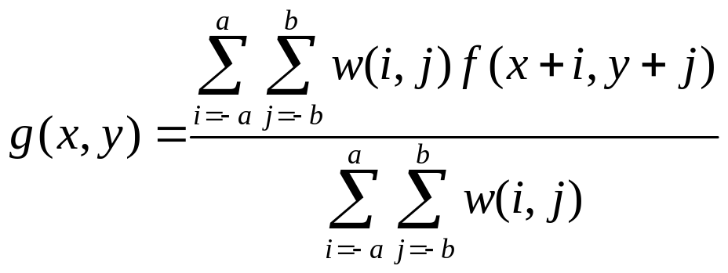
Mean Filters

Slide 14
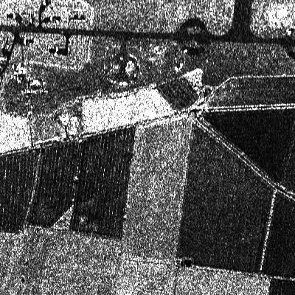
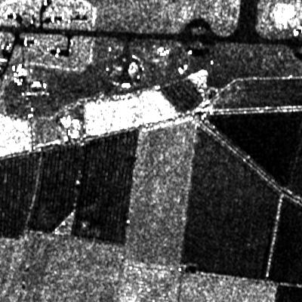
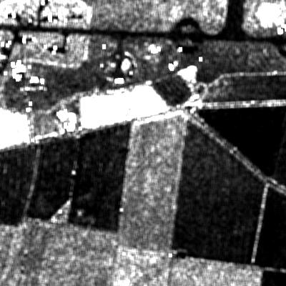


Mean filter
Original image filtered image( ) filtered image( )

Slide 15
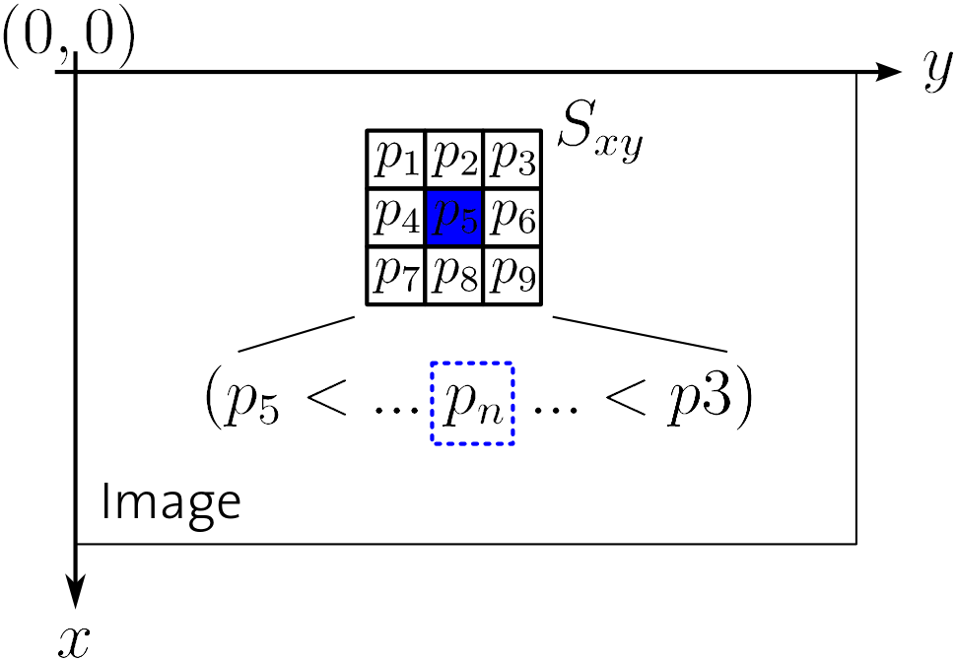
Median Filter
Better job than Mean Filter
Replace the value of the center pixel by the median of the gray levels in the neighborhood.

Slide 16
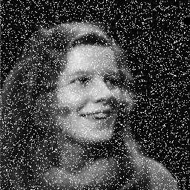
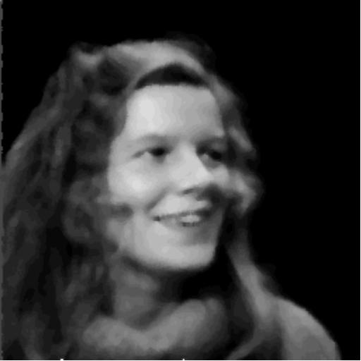
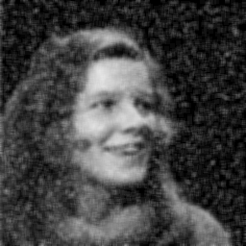
Median Filter
Less blurring
Effective in the salt-and-pepper noise
More extensive computation
noise image 5x5 median filter 5x5 box filter

Slide 17
Smoothing Frequency-Domain Filters
Edges and other sharp transitions in the gray levels of an image contributes significantly to the high-frequency content of its Fourier transform.
Aim to attenuate a specified range of high-frequency components

Slide 18
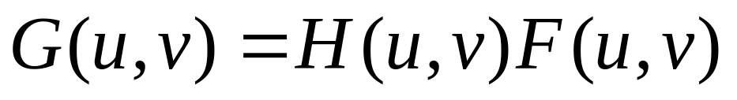
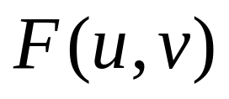
Smoothing Frequency-Domain Filters
Basic model
is the Fourier transform of the image to be smoothed.

Slide 19
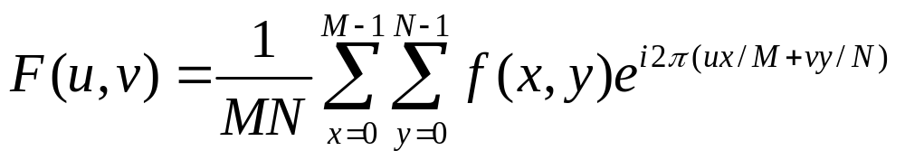
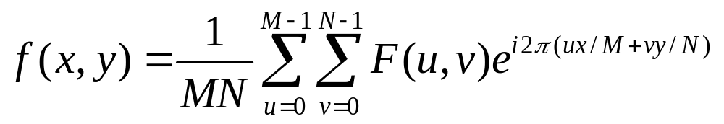
Fourier Transform
Function can be expressed as the integral of sines and cosines multiplied by a weighting function.
2D DFT
2D IDFT

Slide 20
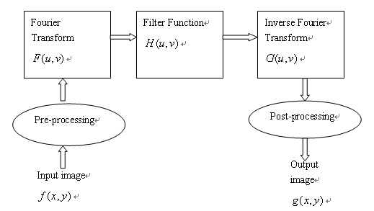
Basic Steps

Slide 21
Smoothing Frequency-Domain Filters
Ideal Lowpass Filters
Gaussian Lowpass Filters

Slide 22
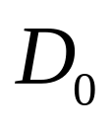
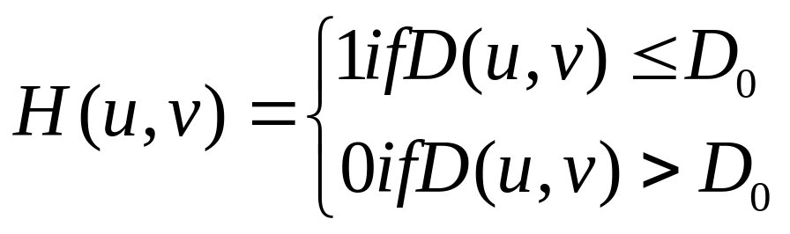
Ideal Lowpass Filters
The simplest lowpass filter is a filter that “cut off” all high-frequency components of the Fourier transform that are at a distance greater than a specified distance from the origin of the (centered) transform.

Slide 23
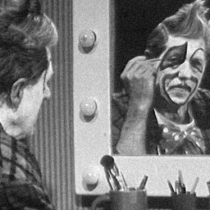


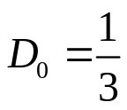
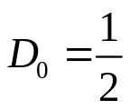
Ideal Lowpass Filters
“ringing” characteristic
Noise image IDPF( ) IDPF( )

Slide 24
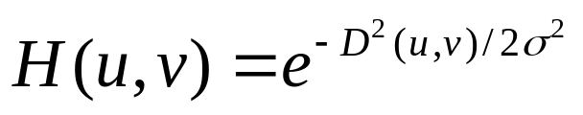
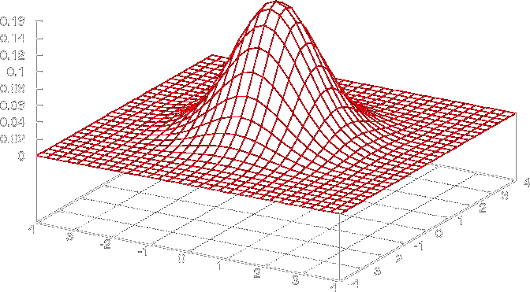

Gaussian Lowpass Filters
The filter given in 2D dimensions:
is a measure of the spread of the Gaussian curve.

Slide 25
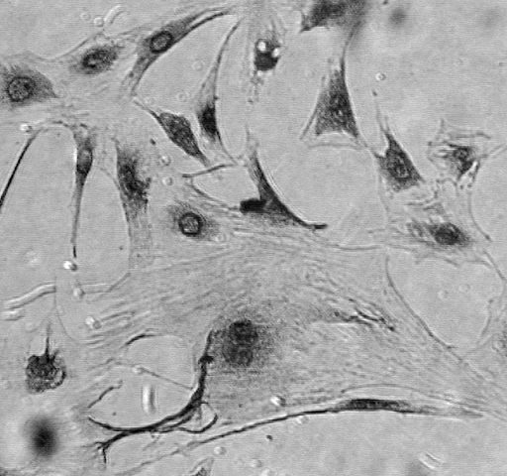
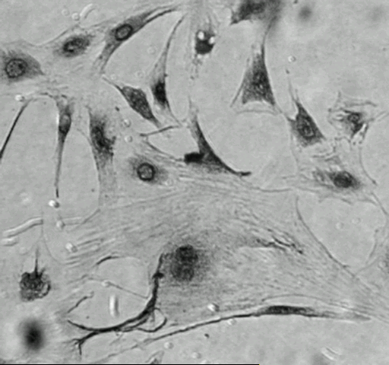
Gaussian Lowpass Filters
Noise image GLPF image

Slide 26
Gaussian Lowpass Filters
Gaussian characteristics:
- More weight is given to central pixels than to those in the periphery of the neighborhood
- Require more computation time than Ideal lowpass filter
- solve the “ringing” problem: the only one that has the same shape in the spatial and frequency domain

Slide 27
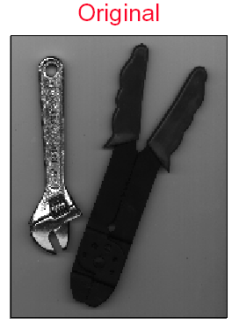
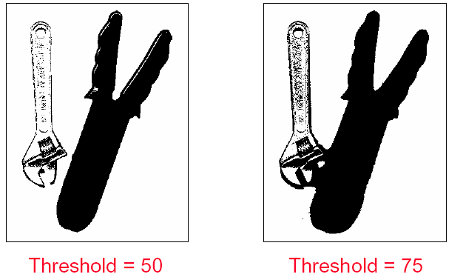

Slide 28
Binary
Automatic Thresholding(Otsu’s Binarization)
    In global thresholding, we used an arbitrary value for threshold value, right? So, how can we know a value we selected is good or not? Answer is, trial and error method. But consider a bimodal image (In simple words, bimodal image is an image whose histogram has two peaks). For that image, we can approximately take a value in the middle of those peaks as threshold value, right ?
    That is what Otsu binarization does. So in simple words, it automatically calculates a threshold value from image histogram for a bimodal image. (For images which are not bimodal, binarization won’t be accurate.)
    Otsu’s thresholding chooses the threshold to minimize the intraclass variance of the thresholded black and white pixels.

Slide 29



Otsu’s Methold
Otsu’s thresholding method is based on selecting the lowest point between two classes (peaks).
Frequency and Mean value:
    Frequency: N: total pixel number
    Mean: n_{i}: number of pixels in level i
Analysis of variance (variance=standard deviation²)
    Total variance:

Slide 30
Otsu’s Methold
between-classes variance (δ_{b}² ):
The variation of the mean values for each class from the overall intensity mean of all pixels:
δ_{b}² = ω₀ (μ₀ - μ_{t} ) ² + ω₁(μ₁ - μ_{t} ) ²,
Substituting μ_{t} = ω₀ μ₀ + ω₁μ₁, we get:
δ_{b}² = ω₀ω₁(μ₁ - μ₀ )²
  ω_{0,} ω_{1,} μ_{0,} μ₁ stands for the frequencies and mean
  values of two classes, respectively.
Notes:
The between classes variance is the separability measure for the two classes

Slide 31
Otsu’s Method
The criterion function involves between-classes variance to the total variance is defined as:
  η = δ_{b}² / δ_{t}²
All possible thresholds are evaluated in this way, and the one that maximizes η is chosen as the optimal threshold

Slide 32
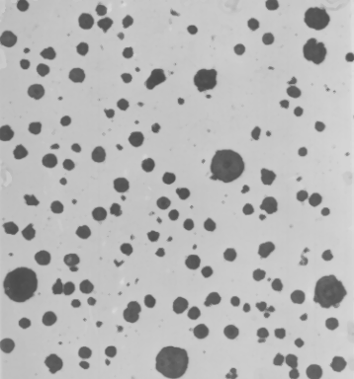
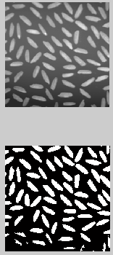


Slide 33
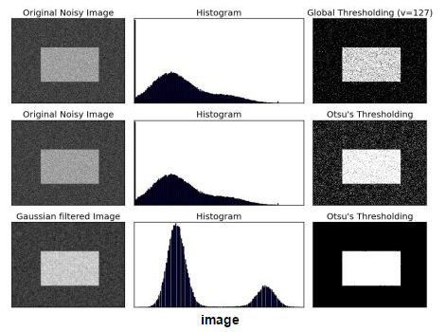

Slide 34
Global vs. Local Binarization
By 'local' here is meant that the threshold is computed for each pixel according to the image characteristics within a window of radius r around it. The segmented phase is always shown as white (255).

Slide 35
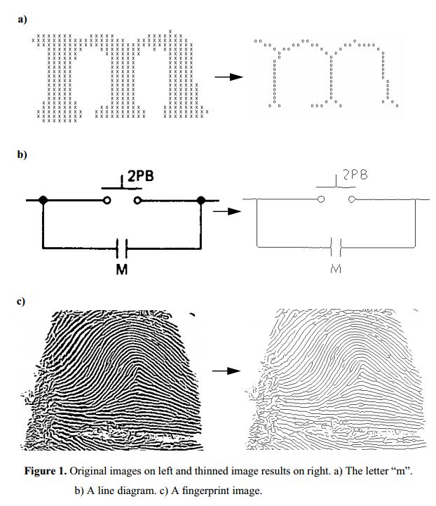
Thinning (Skeleton)

Slide 36
Reference
Digital image processing (second edition),
Rafael C.Gonzalez and Richard E. Woods, Prentice-Hall Inc. 2002
Practical algorithms for image analysis-description examples and code, Micheal Seul Lawrence O’Gorman Micheal J. Sammon, Cambridge University Press 2000
Removing Salt-and-Pepper Noise in Text/Graphics Images, K Chinnasarn, Y Rangsanseri and P Thitimajshima, IEEE Asia-Pacific conference 1998

