Slide 1
Neuroanatomy imaging lab
Notes:
Note that all the images in this presentation are “Author Owned”

Slide 2
Goals for this lab
Identify cranial nerve nuclei based on important anatomic landmarks on cross-sectional imaging.
Name important anatomic relationship of cisternal portions of CNs and nearby structures.
Identify the foramina through which the cranial nerves exit the skull base on cross-sectional imaging.
Discuss the innervation and action of the extraocular muscles. ​
Describe major anatomic relationships of the cranial nerves in the cavernous sinus.
Notes:
Here are the goals for this lab

Slide 3
Outline
5 min – Lab start-up and Introduction
27 min – Brain
20 min – Brain MR
7 min – Cases
32 min – Upper cranial nerves
5 mins – Cavernous sinuses
20 mins - Upper cranial nerves MR/CT
7 min – Cases
35 min – Lower cranial nerves
15 min- Temporal bone structures
15 min - Lower cranial nerves MR/CT
5 min - Cases
7 min - Questions
Notes:
Time-line for todays lab

Slide 4
Brain
Notes:
The brain radiology anatomy was included as part of out lab and included here for completeness.

Slide 5
20 min
Brain structures list
Frontal lobe
Parietal lobe
Temporal lobe
Occipital lobe
Sylvian fissure
Central sulcus
Putamen
Caudate
Globus pallidus
Thalamus
External capsule
Insula
Anterior commissure
Internal capsule
anterior limb genu posterior limb
Lateral ventricles
Third ventricle
Sylvian aqueduct
Fourth ventricle
Foramen of Luschka
Corpus callosum Splenium Body Genu Rostrum
Midbrain Cerebral peduncles Superior colliculus Inferior colliculus
Pons
Medulla
Cerebellar hemisphere
Cerebellar vermis
Superior cerebellar peduncle
Middle cerebellar peduncle
Inferior cerebellar peduncle
Meckel’s cave
Middle cerebral artery
Internal carotid artery
Basilar artery
Vertebral artery
Superior sagittal sinus
Notes:
The students will spend 20 minutes identifying the structures on the list using the provided T1 sagittal and T2 axial images.
Work in groups of ~3.
Teachers will assist as needed with questions.
Please extract the provided zipped “Normal Scans” file.
Within the folder you will find the “! - INTRUCTIONS – READ ME FIRST - !” file. Open it for guidance to using the files.

Slide 6
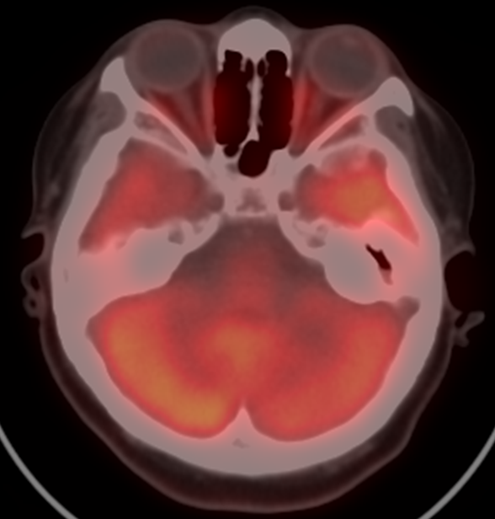
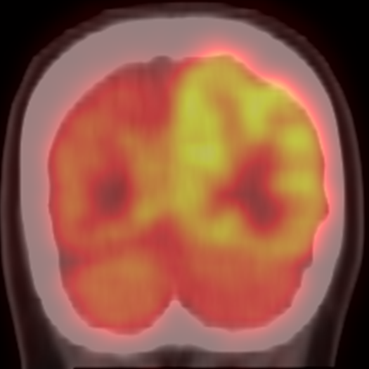
Case 1
Which areas of the brain demonstrate hypometabolism?
What part of the brainstem connects the supratentorial cerebral lobes with the contralateral cerebellum?
What structure separates the parietal and occipital lobes?
Axial PET- CT
Coronal PET- CT
Notes:
Students will spend 2 min discussing these questions as a small group after which the teacher will reveal and discuss the answers
Which areas of the brain demonstrate hypometabolism? Left cerebellar hemisphere, right parietal and occipital lobes.
What part of the brainstem connects the supratentorial cerebral lobes with the contralateral cerebellum? The Pons
What structure separates the parietal and occipital lobes? Parieto-occipital sulcus.
FDG (fluorodeoxyglucose) PET demonstrates metabolism as tracer is taken up wherever glucose is utilized. The brain utilizes glucose and is typically fairly hypermetabolic.

Slide 7
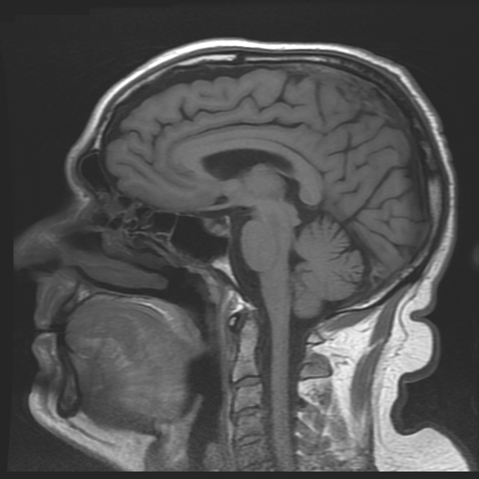
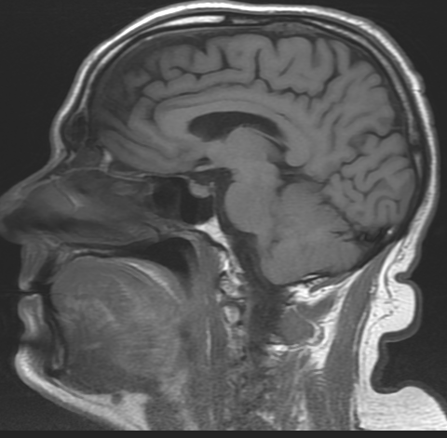
Case 1: Answers
Sagittal T1 without contrast- midline
Sagittal T1 without contrast- para midline
Notes:
Which areas of the brain demonstrate hypometabolism? Left cerebellar hemisphere, right parietal and occipital lobes.
What part of the brainstem connects the supratentorial cerebral lobes with the contralateral cerebellum? The Pons
What structure separates the parietal and occipital lobes? Parieto-occipital sulcus.
FDG (fluorodeoxyglucose) PET demonstrates metabolism as tracer is taken up wherever glucose is utilized. The brain utilizes glucose and is typically fairly hypermetabolic.
The parieto-occipital sulcus (purple line) separates the parietal lobe (yellow) anteriorly from the occipital lobe (blue) posteriorly and inferiorly. Blue line – calcarine fissure

Slide 8
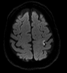
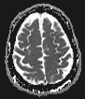
Case 2 - MRI
In which lobe is the infarct denoted by the arrow?
What anatomic structure separates the frontal and parietal lobes?
Is this motor or sensory?
What is the hand motor knob?
Diffusion weighted image
Apparent diffusion
coefficient (ADC) map
Notes:
Students will spend 2 min discussing these questions as a small group after which the teacher will reveal and discuss the answers
1. What lobe is involved? Frontal Lobe.
2. What anatomic structure separates the frontal and parietal lobes? Central sulcus. This can be located by finding the pars marginalis with the central sulcus immediately anterior to this structure.
3. Is this motor or sensory? The precentral gyrus (motor strip) is the posterior most aspect of the frontal lobe. The central sulcus separates it from the postcentral gyrus (part of the parietal lobe).
4. What is the hand motor knob? Structure with the appearance of an inverted omega within the medial precentral gyrus which is motor to the hand. This is best seen on the right on the diffusion weighted image.

Slide 9
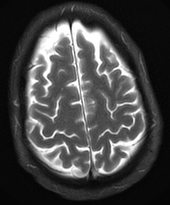
Case 2: Answers
Diffusion weighted image
Axial T2
Notes:
1. What lobe is involved? Frontal Lobe.
2. What anatomic structure separates the frontal and parietal lobes? Central sulcus. This can be located by finding the pars marginalis with the central sulcus immediately anterior to this structure.
3. Is this motor or sensory? The precentral gyrus (motor strip) is the posterior most aspect of the frontal lobe. The central sulcus separates it from the postcentral gyrus (part of the parietal lobe).
4. What is the hand motor knob? Structure with the appearance of an inverted omega within the medial precentral gyrus which is motor to the hand. This is best seen on the right on the diffusion weighted image.
The pars marginalis (light green) has been likened to a moustache or smiley face and can be located on axial imaging. The central sulcus (blue line) is immediately anterior to the pars marginalis and separates the motor cortex of the frontal lobe anteriorly from the sensory cortex of the parietal lobe posteriorly. The hand motor knob (HMK- yellow line) has the appearance of an inverted greek symbol omega and supplies motor function to the contralateral hand.

Slide 10
Upper Cranial nerves

Slide 11
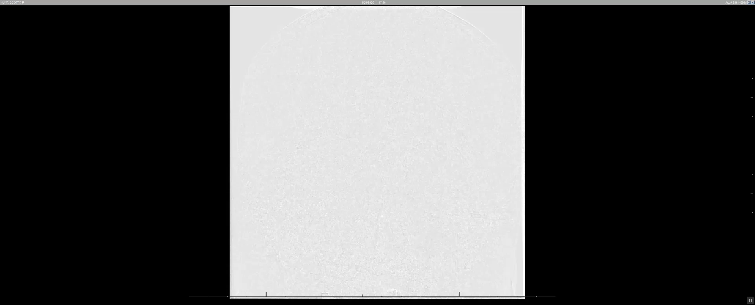
Normal side: Left ICA injection
Notes:
Normal left ICA catheter angiogram shows the location of the cavernous ICA.

Slide 12
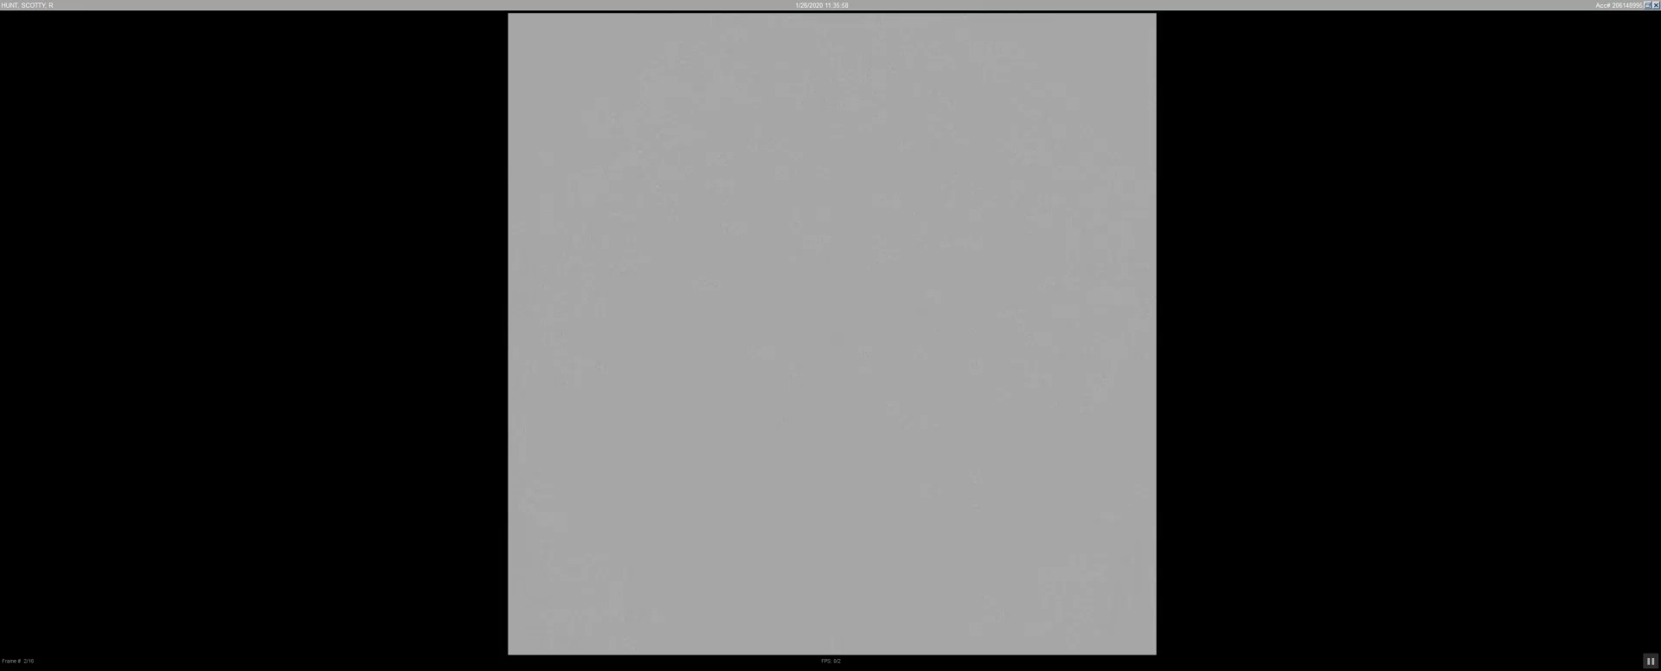
Abnormal side: Right ICA injection
Notes:
Abnormal catheter directed injection of the right ICA shows a fistula between the right ICA and the cavernous sinus. Around 02:00 sec, note the contrast within the bilateral cavernous sinuses and associated venous tributaries.

Slide 13
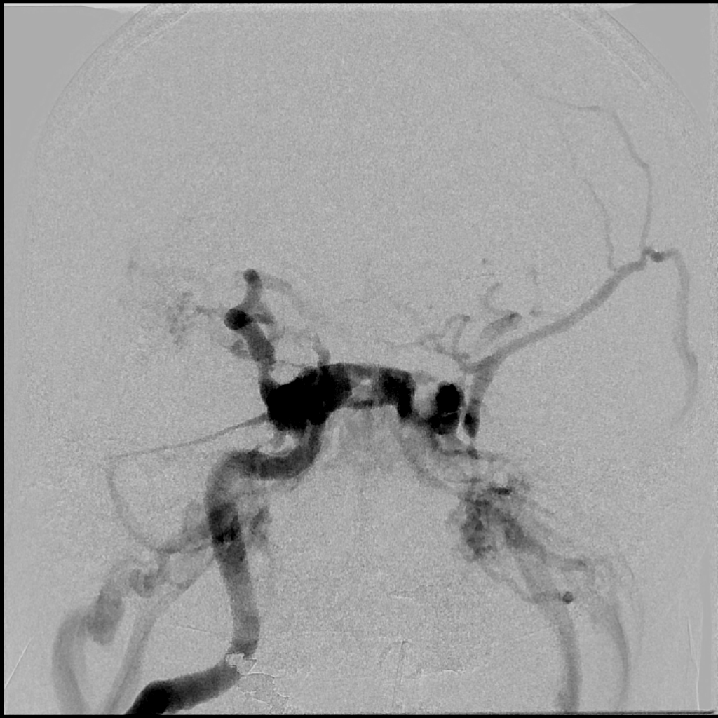
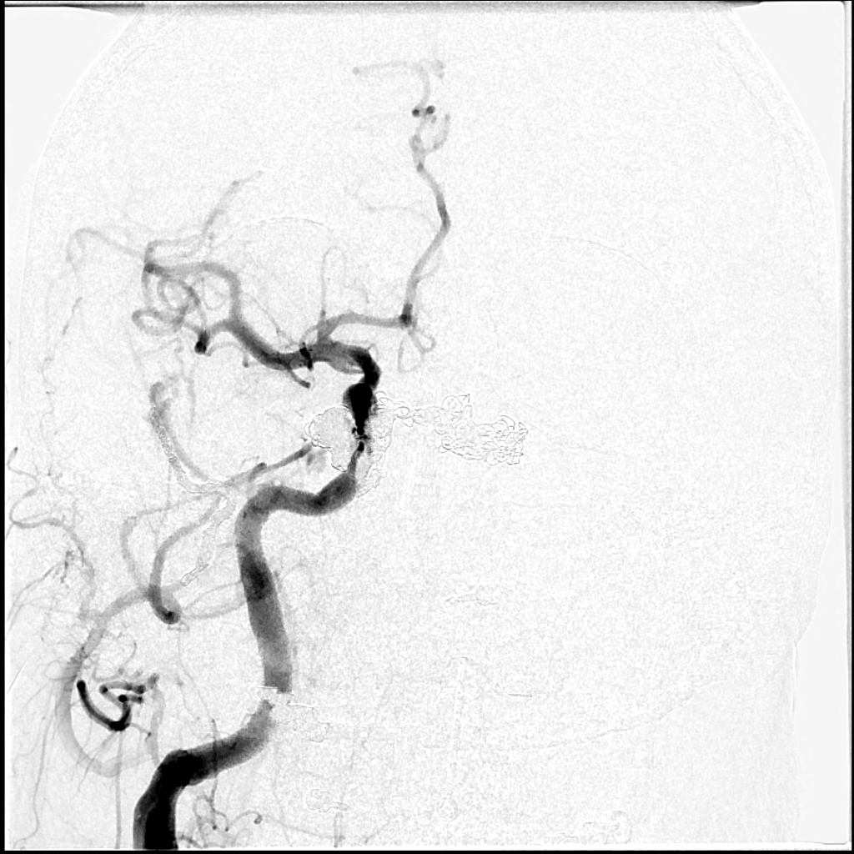
Notes:
Right internal carotid injection before (right) and after (left) endovascular coiling of carotid cavernous fistula.

Slide 14
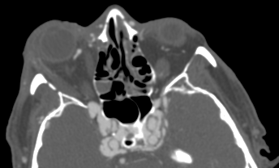
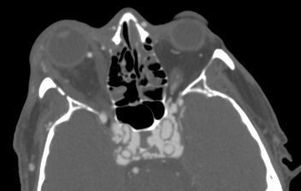
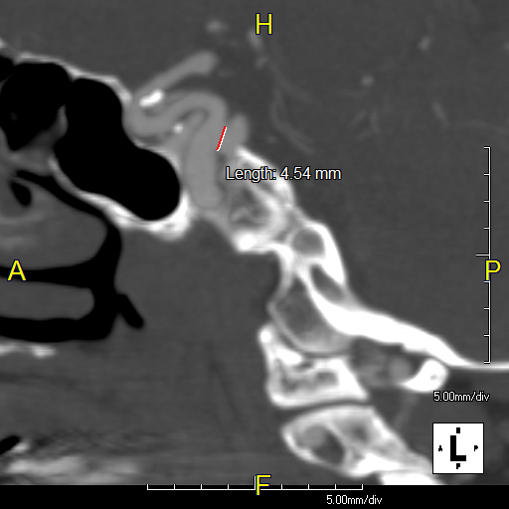
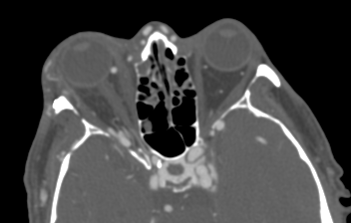
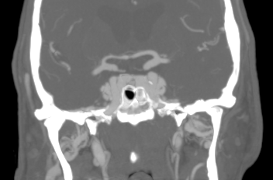
Notes:
Carotid cavernous fistula by CTA showing the contrast in the cavernous sinus surrounding the ICAs.

Slide 15
20 min
MRI (FIESTA/SPACE)
CT
CN I - cisternal segment
CN II - optic tracts, chiasm, cisternal segment
CN III - oculomotor nucleus, cisternal segment,
oculomotor cistern, cavernous sinus
CN IV - nucleus, superior medullary velum,
expected course of cisternal segment,
cavernous sinus
CN V - motor nucleus, cisternal segment,
Meckel’s cave, cavernous sinus
CN VI - nucleus, cisternal segment,
cavernous sinus
CN I - cribriform plate
CN II - optic canal, anterior clinoid
CN III - superior orbital fissure
CN IV - superior orbital fissure
CN V - superior orbital fissure,
foramen rotundum
foramen ovale
CN VI - superior orbital fissure
Notes:
The students will spend 20 minutes identifying the structures on the list using the provided T2 Space and CT images.

Slide 16
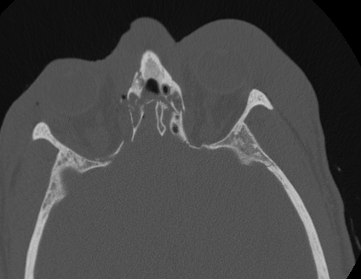
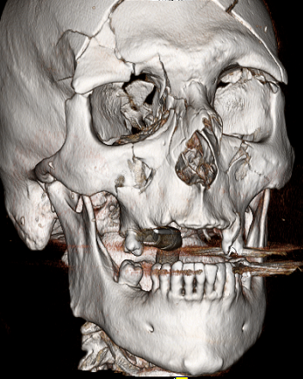
Case 3 - CT
What cranial nerve is at risk?
Which lobes of the brain are most susceptible to injury due to deceleration such as seen in an MVC? Why?
Axial CT
3D reformat
Notes:
Students will spend 2 min discussing these questions as a small group after which the teacher will reveal and discuss the answers
What cranial nerve is at risk? Olfactory Nerve
Inferior frontal and anterior temporal lobes will impact upon the skullbase.

Slide 17
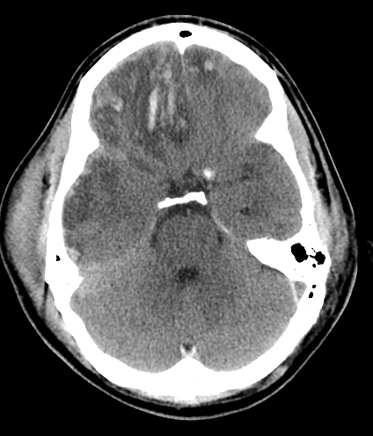
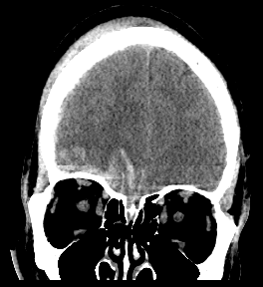
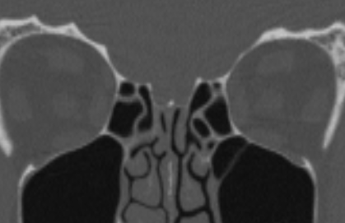
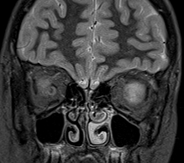
Case 3: Answers
Coronal CT
Coronal MR
g
o
Axial CT
Coronal CT
Notes:
What cranial nerve is at risk? Olfactory Nerve
Inferior frontal and anterior temporal lobes will impact upon the skullbase.

Slide 18
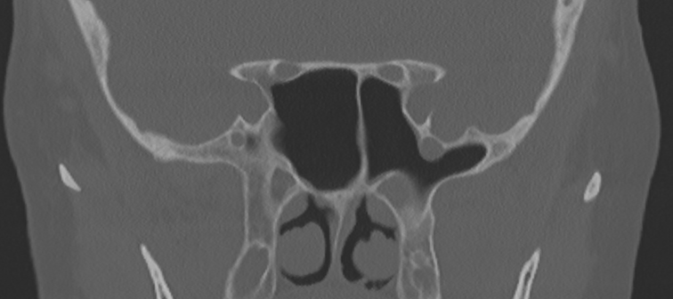
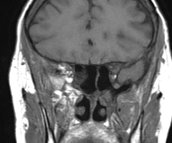
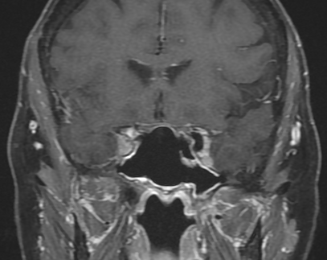
Case 4 – CT/MRI
Coronal CT
Name the skull base foramen labelled by the arrow.
What nerve passes through this structure?
What would be the distribution of this patient’s pain?
Coronal T1
Coronal T1 FS +C
Notes:
Students will spend 2 min discussing these questions as a small group after which the teacher will reveal and discuss the answers
Name the skullbase foramina labelled by the arrow. Foramen rotundum.
What nerve passes through this structure? Maxillary nerve (2nd division of the trigeminal nerve)
What would be the distribution of this patient’s pain? Right maxilla and upper teeth

Slide 19
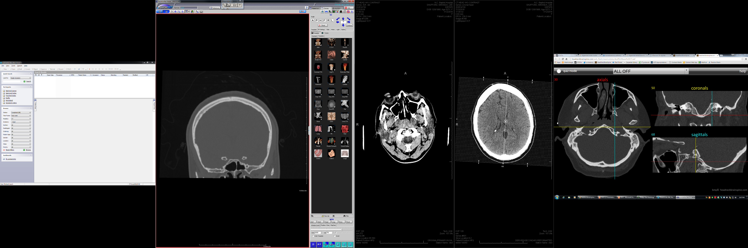
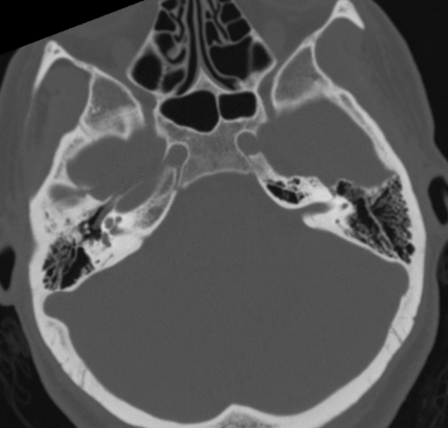
Case 4: Answer
Coronal CT
Axial CT
Foramen Rotundum
Notes:
Name the skullbase foramina labelled by the arrow. Foramen rotundum.
What nerve passes through this structure? Maxillary nerve (2nd division of the trigeminal nerve)
What would be the distribution of this patient’s pain? Right maxilla and upper teeth

Slide 20
Lower Cranial nerves

Slide 21
10 min
Temporal bone structures list
IAC porus acusticus fundus
Cochlear aperture
Cochlea
Vestibule
Semicircular canals Lateral (horizontal) Superior Posterior
Facial nerve Labyrinthine Geniculate ganglion Tympanic Mastoid
Stylomastoid foramen
Notes:
The students will spend 10 minutes identifying the structures on the list using the provided CT

Slide 22
15 min
MRI (FIESTA/SPACE)
CT
CN VII - motor nucleus, cisternal segment, IAC
CN VIII - nucleus, cisternal segment, IAC, cochlea, vestibule, semicircular canals
CN IX - olive/postolivary sulcus, cisternal segment
CN X - olive/postolivary sulcus, cisternal segment
CN XI - foramen magnum,cisternal segment
CN XII - olive/preolivary sulcus, cisternal segment
CN VII - IAC, geniculate ganglion, stylomastoid foramen
CN VIII - IAC, cochlea, vestibule, semicircular canals
CN IX - pars nervosa
CN X - pars vascularis
CN XI - pars vascularis
CN XII - hypoglossal canal
Notes:
The students will spend 15 minutes identifying the structures on the list using the provided T2 SPACE and CT images

Slide 23
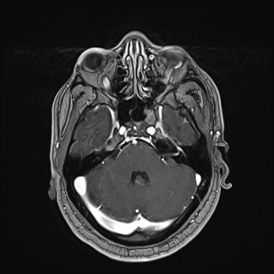
Case 5 - MRI
What cranial nerve abnormally enhances in this patient with facial weakness?
Would this patient be expected to be able to lift his eyebrows or wrinkle his forehead?
Axial T1 FS +C
Notes:
Students will spend 2 min discussing these questions as a small group after which the teacher will reveal and discuss the answers
What cranial nerve is involved in this patient with facial weakness? Left Facial Nerve
Would this patient be expected to be able to lift his eyebrows or wrinkle his forehead? No, peripheral facial nerve lesions do not spare the forehead.

Slide 24
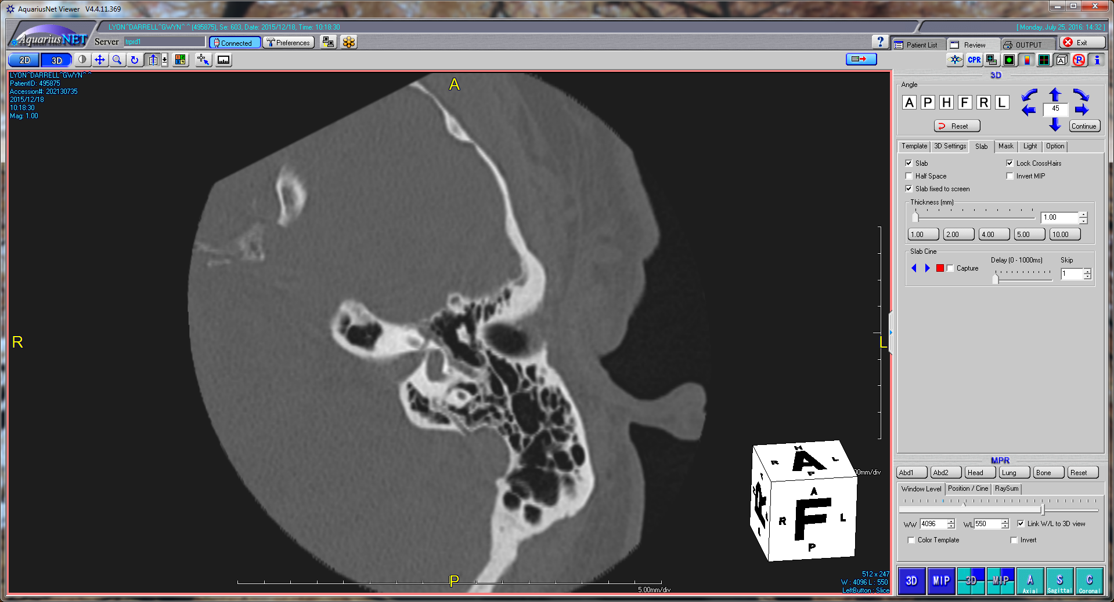
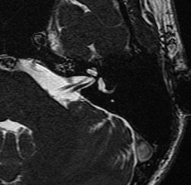
Case 5: Answer
Axial CT
Axial T1 +C
Axial FIESTA
Facial nerve segments: Intracranial (cisternal) → meatal (IAC) → labyrinthine → geniculate ganglion → tympanic (horizontal)→
Notes:
What cranial nerve is involved in this patient with facial weakness? Left Facial Nerve. There is enhancement along the intracanalicular segment of the facial nerve at the fundus extending into the labyrinthine and visualized tympanic segments of the left facial nerve with involvement of the greater superficial petrosal nerve extending anteromedially from the geniculate ganglion.
Would this patient be expected to be able to lift his eyebrows or wrinkle his forehead? No, peripheral facial nerve lesions do not spare the forehead.

Slide 25
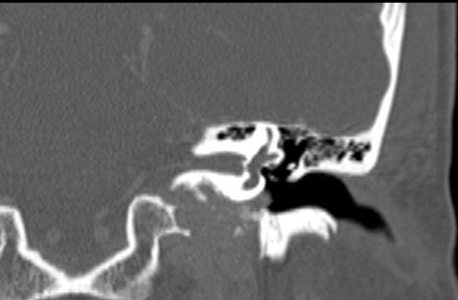
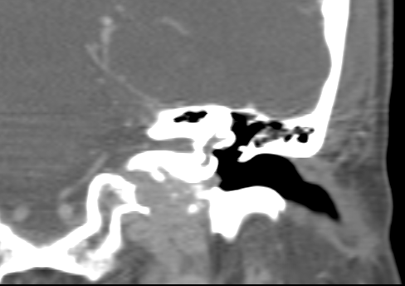
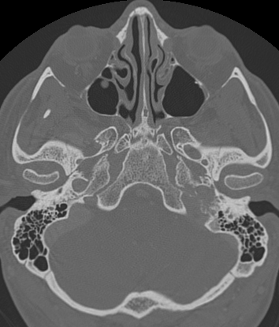
Case 6
Coronal CT
Coronal CT
Where is this lesion centered anatomically?
Which cranial nerves pass through this anatomic region?
Axial CT
Notes:
Where is this lesion centered anatomically? The jugular foramen.
What cranial nerves pass through this anatomic region? Glossopharyngeal, Vagus, Spinal Accessory, and Hypoglossal Nerves (IX-XII). This is the carotid space through which pass the internal carotid artery, internal jugular vein, sympathetic chain and cranial nerves IX-XII

Slide 26
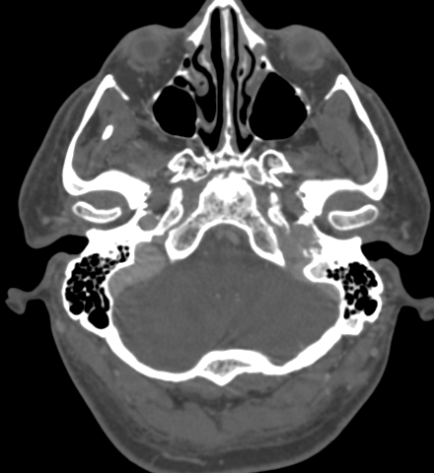
Case 6 - Answers
Coronal CT
Axial CT
Notes:
Where is this lesion centered anatomically? The jugular foramen.
What cranial nerves pass through this anatomic region? Glossopharyngeal, Vagus, Spinal Accessory, and Hypoglossal Nerves (IX-XII). This is the carotid space through which pass the internal carotid artery, internal jugular vein, sympathetic chain and cranial nerves IX-XII
The jugular spine (purple arrow) separates the pars vascularis posteriorly from the pars nervosa anteriorly. The jugular vein passes through the pars vascularis along with cranial nerves X and XI. The inferior petrosal sinus passes through pars nervosa along with cranial nerve IX. This lesion extends superolaterally into the middle ear (coronal image) and represents a glomus jugulotympanicum.

Slide 27
Thank you!

