Slide 1
Imaging of the Cranial Nerves

Slide 2
Preparation for lab
Watch the supplied cranial nerve video (~20 minutes)
Review the labelled MRI brain (CISS) for cranial nerves
During the lab, we will have unlabeled imaging on which you will identify structures with our assistance and work through cases together.
Come prepared!

Slide 3
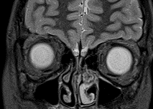
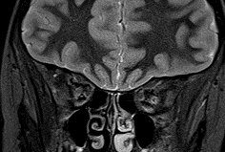
Normal Anatomy – Olfactory Nerve
Notes:
The paired olfactory bulbs are best visualized on coronal T2WI’s where they are seen conspicuously in cross-section given the CSF in the olfactory groove.
Axial imaging could result in confusing the olfactory nerve with the overlying gyrus rectus.
More posteriorly, the olfactory tracts (arrows) are seen overlying the olfactory sulci.
Images are author owned

Slide 4
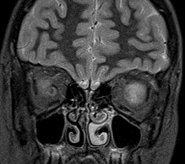
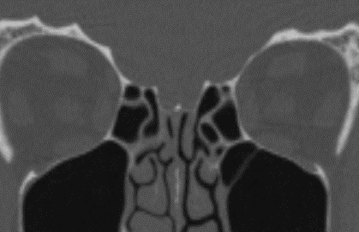
Normal Anatomy – Olfactory Nerve
g
o
Notes:
The olfactory sulci (white arrow) are visible separating the gyrus rectus (g) medially from the medial orbit gyrus (o) laterally.
The optic nerve (red arrow) and ethmoid sinus (gold arrow) are annotated for reference.
Images are author owned

Slide 5
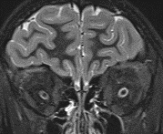
Normal Anatomy – Optic Nerve
Notes:
The paired optic nerves (green arrows) are well seen in cross-section on coronal T2WI. The nerves are surrounded by CSF in the dural sheath (red arrows).
Images are author owned

Slide 6
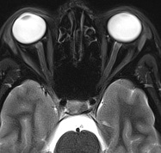
Normal Anatomy – Optic Nerve
Notes:
The retinal segment (gold arrow) leaves the globe through the optic foramen of the sclera.
The orbital segment passes through the center of the fat-filled intraconal orbit (red arrows).
The orbital segment is surrounded by CSF within a dural sheath which contains all 3 dural layers, including arachnoid.
Images are author owned

Slide 7
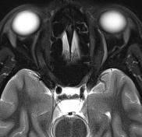
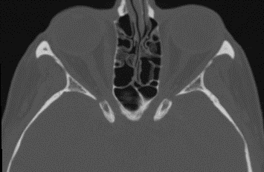
Normal Anatomy – Optic Nerve
Notes:
The canalicular segment is the portion of the optic nerve within the optic canal (red arrow).
The ophthalmic artery is immediately superior to the optic nerve in the optic canal.
Fibrous adhesions between the dura and pia of the sheath are present in this segment, which is highly variable among patients and determines the degree of connection between the subarachnoid space of the optic nerve sheath and remainder of the intracranial compartment.
Images are author owned

Slide 8
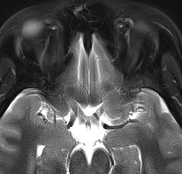
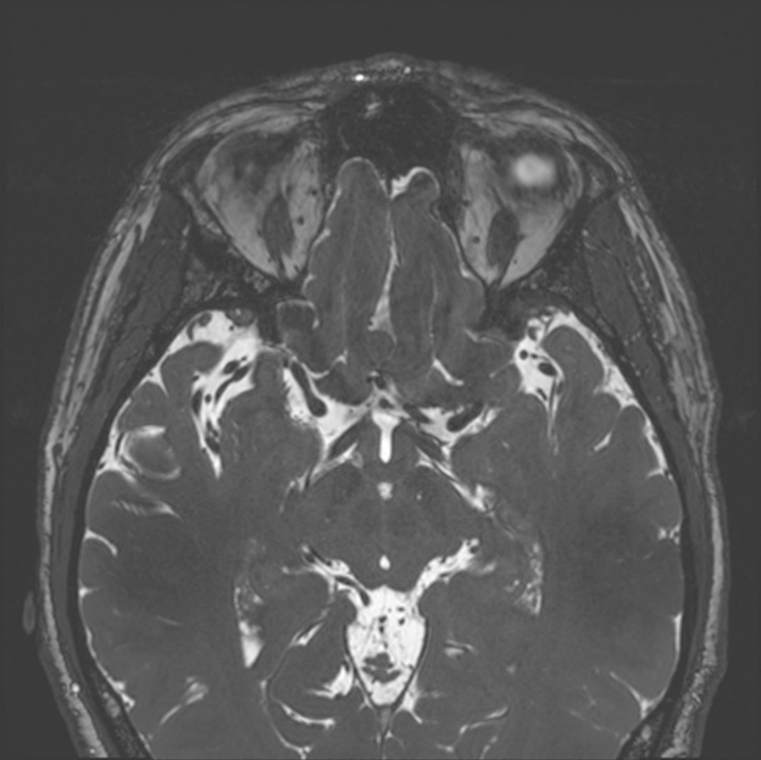
Normal Anatomy – Optic Nerve
Image of optic tract?
Notes:
The cisternal (or intracranial, prechiasmatic) segment is seen in the suprasellar cistern (paired red arrows).
The optic chiasm is also seen on this T2WI (gold arrow).
The anterior cerebral artery is adjacent to the superolateral aspect of the cisternal portion of the optic nerve.
Optic tracts yellow arrows
Images are author owned

Slide 9
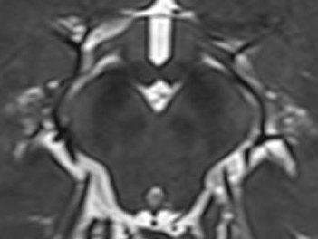
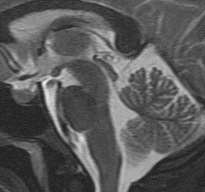
Normal Anatomy: CN III
Red nucleus
Substantia nigra
Oculomotor nucleus
Crus cerebri
Path of the oculomotor nerve
Edinger - Westphal nucleus
Notes:
Oculomotor nerve nucleus is anterior to the cerebral aqueduct within the periaqueductal grey at the level of the superior colliculus (yellow arrow). Oculomotor nerve’s fibers course through the red nucleus and the medial aspect of the substantia nigra.
The Edinger-Westphal nucleus is the preganglionic nucleus of the parasympathetic fibers that run alongside CN3 and innervate the iris sphincter muscles and ciliary muscles.
Images are author owned

Slide 10
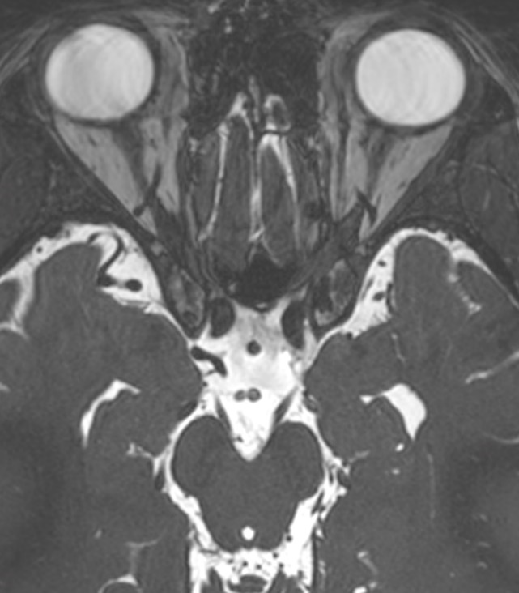
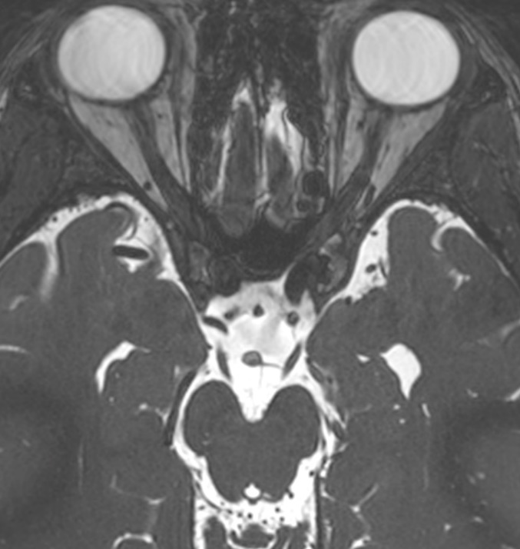
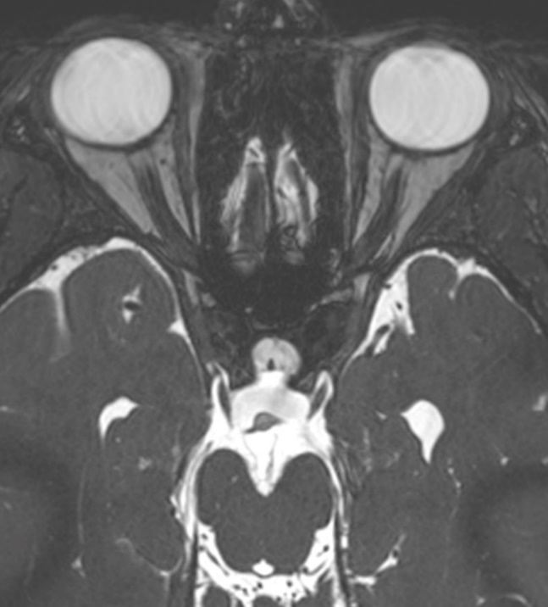
Normal Anatomy: CN III
Notes:
The oculomotor nerve (yellow arrows) emerges from the medial aspect of the cerebral peduncle (blue arrows) into the interpeduncular cistern (orange arrow). CN3 continues anteriorly surrounded by CSF as the cisternal segment, coursing anteriorly into a dural lined outpouching known as the oculomotor cistern (green arrow), piercing the dura and entering the superior aspect of the lateral wall of the cavernous sinus.
Images are author owned

Slide 11
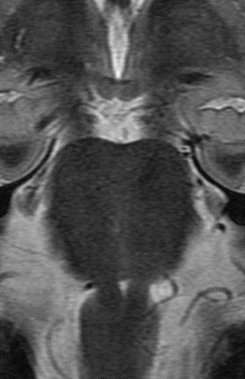
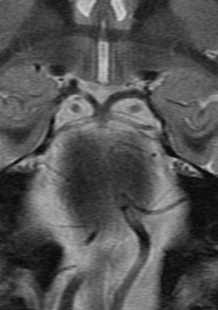
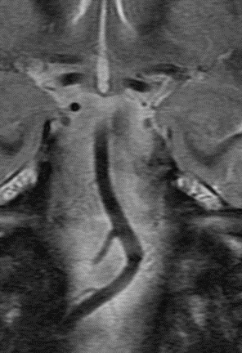
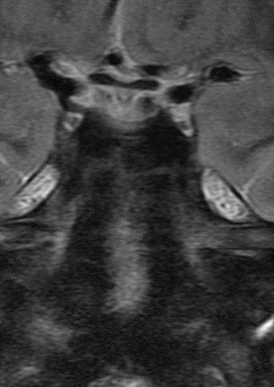
Cisternal course: CN III
pons
Basilar artery
1
2
3
4
Notes:
Coronal T2 images posterior to anterior along course of CN3 demonstrate the cisternal segment of the oculomotor nerve (yellow arrows) traversing between the P1 segments of the posterior cerebral arteries (PCA- blue arrow) and (duplicated) superior cerebellar arteries (SCA) on image #2. CN3 extends anteriorly into the oculomotor cistern on image #4 (best seen on the right). Note the proximity of the cisternal course of the oculomotor nerve to the posterior communicating artery (green arrow- image #3). Cranial nerve 4 (trochlear) also passes between the PCA and SCA more laterally but are much smaller and not well seen on this image (possibly indicated by red arrows).
Images are author owned

Slide 12
Cisternal course: CN III
Notes:
Coronal T2 image along course of CN3 demonstrates the cisternal segment of the oculomotor nerve (yellow arrows) traversing between the P1 segments of the posterior cerebral arteries (PCA- blue arrow) and (duplicated) superior cerebellar arteries (SCA) on image. Cranial nerve 4 (trochlear) also passes between the PCA and SCA more laterally but are much smaller and not well seen on this image (red arrows).

Slide 13
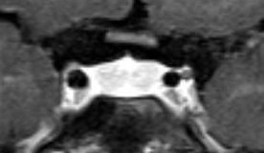
Cavernous sinus: Cranial nerve III
III
pituitary
ICA
IV
VI
V1
Venous space
V2
Meningeal layer of dura
Periostic layer of dura
V3
Notes:
In the cavernous sinus, the oculomotor nerve is the most superior nerve, above the trochlear nerve, and in the lateral wall.
The yellow dot marks the expected location of the oculomotor nerve in the cavernous sinus on the coronal T1 postcontrast MR image.
Coronal graphic of cavernous sinus demonstrating CNIII, IV, V1 and V2 (oculomotor, trochlear, ophthalmic, maxillary) embedded within the lateral wall of the cavernous sinus within the periostic layer of dura. CN VI (abducens) is the only cranial nerve which truly passes through the cavernous sinus, i.e. surrounded by venous sinusoids. CN V3 (mandibular) does not enter the cavernous sinus wall.
Images are author owned

Slide 14
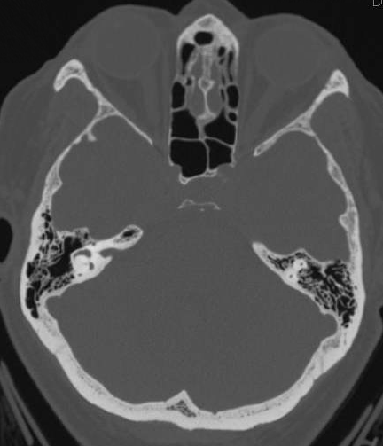
Normal Anatomy: CN III
Notes:
The oculomotor nerve enters the orbit via the superior orbital fissure (black arrow). The superior orbital fissure is located lateral to the anterior clinoid process (green).
The oculomotor nerve innervates the levator palpebrae superioris, pupillary constrictor, superior rectus, medial rectus, and inferior rectus muscles in the orbit.
Images are author owned

Slide 15
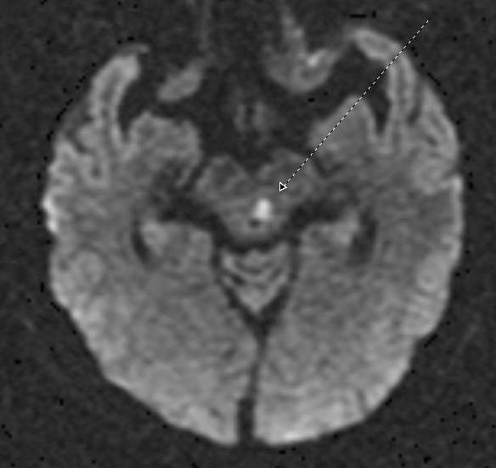
60 year old male with acute onset left CN III palsy.
Case 1: CN III
Notes:
Axial diffusion weighted sequence shows a focus of restricted diffusion (red arrow, confirmed on ADC map – not shown) at the level of the superior colliculus, anterior to the cerebral aqueduct (i.e. location of the oculomotor nucleus).
Acute infarct involving the oculomotor nucleus.
Imaging:
Restricted diffusion with corresponding decreased ADC.
Apparent within minutes and lasts for ~ 10-14 days after infarction.
Edema (hyperintense T2 and hypointense T1) develops by 12-24 hours
This small acute infarct would be nearly impossible to detect on CT, and yet because of its location at the oculomotor nucleus, it causes a significant neurologic deficit.
Images are author owned

Slide 16
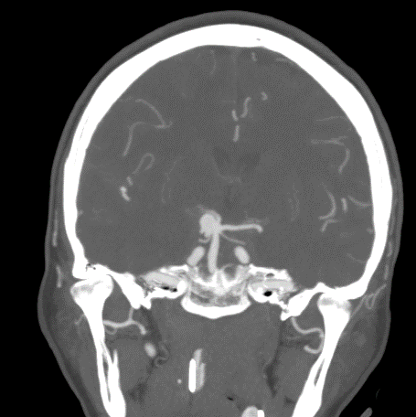
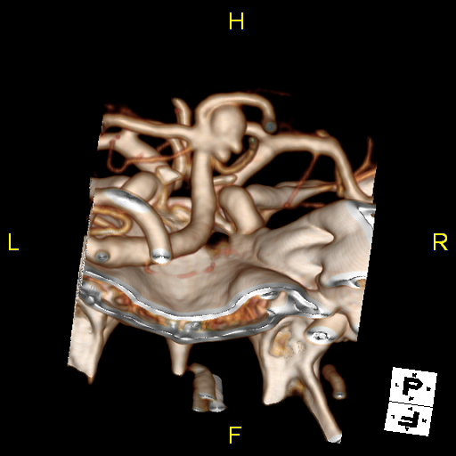
60 year old male with acute onset right CN III palsy.
Case 2: CN III
R
Notes:
Reformatted MIP images and a 3D reconstruction from a CTA shows a large saccular aneurysm (red arrow) arising between the posterior cerebral artery (blue arrow) and superior cerebellar artery (white arrow)
Superior Cerebellar Artery Aneurysm
Aneurysm located at the origin of the superior cerebellar artery.
These are uncommon aneurysms that more typically present with subarachnoid hemorrhage.
Because CN III courses between the superior cerebellar artery and the posterior cerebral artery, a superior cerebellar aneurysm could present as a CN III palsy as it did in this patient.
Images are author owned

Slide 17
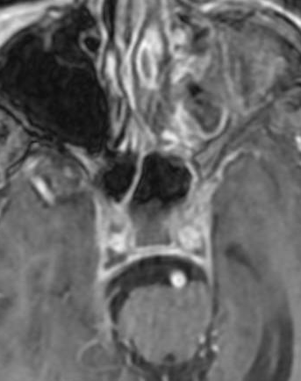
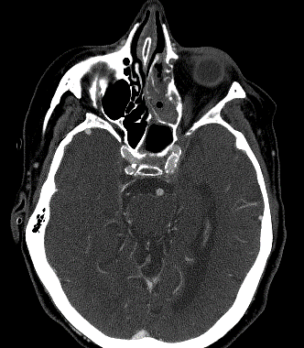
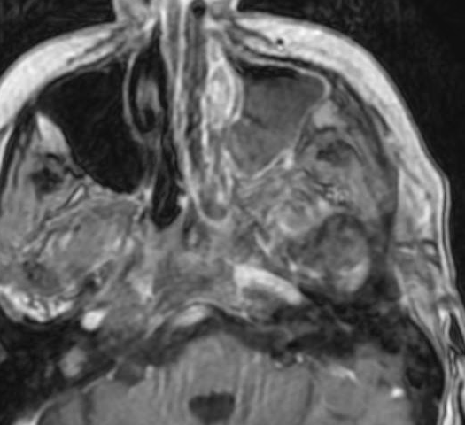
50 year old female with fever, face pain, left CN III palsy, and proptosis.
Case 3: CN III
Notes:
Axial T1 +C imaging demonstrates filling defects (black arrows) within the cavernous sinuses consistent with clot. CT venogram shows lack of enhancement within the cavernous sinus as a complication of sinusitis (red arrow).
Cavernous Sinus Thrombosis/Thrombophlebitis
Most frequently a complication of sinusitis and less commonly from a dental abscess due to cavernous sinus receiving blood from valveless veins of the face.
Imaging:
Contrast enhanced CT (CECT): Findings can be subtle. Convex margins of the cavernous sinus with thrombosed/enlarged superior ophthalmic veins, proptosis and enlarged extraocular muscles.
CT venogram (CTV): Filling defects in the cavernous sinus. The cavernous sinus should be completely opacified on a normal CTV.
MRI: Heterogeneous high signal in cavernous sinus on T1 and T2. There may be hyperintense clot on DWI and filling defects in the cavernous sinus on T1 +C.
Images are author owned

Slide 18
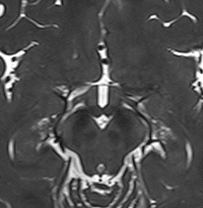
Normal Anatomy: CN IV
Thin section high resolution T2 MR sequence
Sagittal T2 MR sequence
Notes:
The trochlear nerve nucleus (white circle) is located anterior to the cerebral aqueduct in the midbrain at the level of the inferior colliculus (yellow arrow).
The trochlear nerve courses posteriorly (white line), decussating in the superior medullary velum (blue arrow) to exit just below the inferior colliculus.
Images are author owned

Slide 19
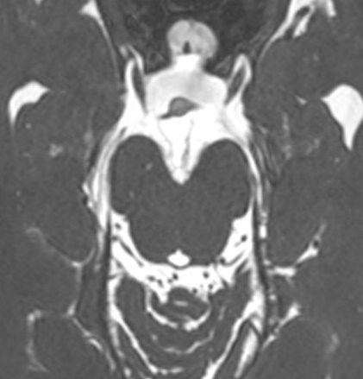
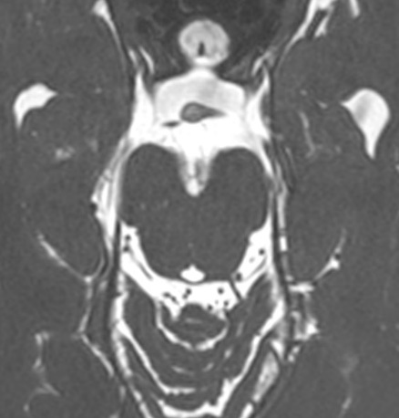
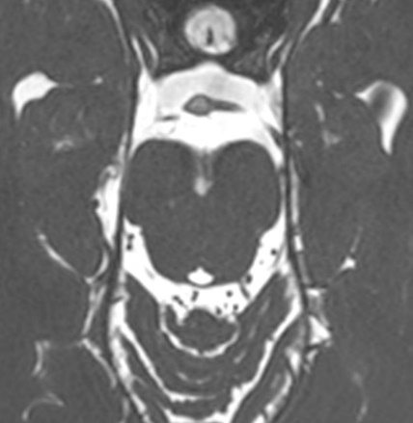
Normal Anatomy: CN IV
(Thin section high resolution T2 MR sequence)
CN III
.
Notes:
The trochlear nerve (yellow arrow) exits posteriorly just below the inferior colliculus. It decussates in the superior medullary velum (blue arrow).
It courses around the cerebral peduncles in the ambient cistern.
CNIV passes between the superior cerebellar and posterior cerebral arteries before piercing the dura and entering the cavernous sinus slightly inferior to CNIII.
Images are author owned

Slide 20
Normal Anatomy: CN IV- Cavernous sinus
III
pituitary
ICA
IV
VI
V1
Coronal T1 +c
Venous space
V2
Meningeal layer of dura
Periostic layer of dura
V3
Notes:
In the cavernous sinus , the expected location of the trochlear nerve (yellow dot) is just below the oculomotor nerve (blue arrow) in the lateral wall of the cavernous sinus demonstrated on coronal post contrast T1. The trochlear nerve is often too small to confidently identify by imaging at typically utilized magnetic field strengths (1.5, 3.0 Tesla).
Coronal graphic of cavernous sinus demonstrating CNIII, IV, V1 and V2 (oculomotor, trochlear, ophthalmic, maxillary) embedded within the lateral wall of the cavernous sinus within the periostic layer of dura. CN VI (abducens) is the only cranial nerve which truly passes through the cavernous sinus, i.e. surrounded by venous sinusoids. CN V3 (mandibular) does not enter the cavernous sinus wall.
Images are author owned

Slide 21
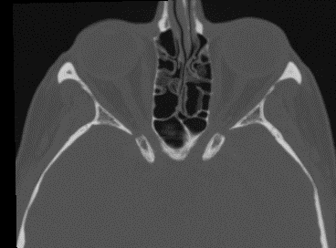
Normal Anatomy: CN IV
SOF
Optic canal
Anterior clinoid
Notes:
The trochlear nerve also enters the orbit via the superior orbital fissure (black arrow) and supplies the superior oblique muscle. The superior oblique muscle is innervated by the contralateral trochlear nucleus due to the decussation of the nerve.
Images are author owned

Slide 22
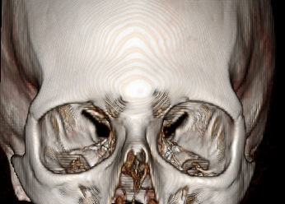
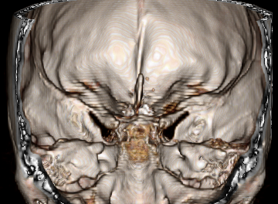
Normal Anatomy: CN IV: Superior orbital fissure
Superior orbital fissure
Superior orbital fissure
Anterior
Posterior
Notes:
Superior orbital fissure conveys CNIII, IV, ophthalmic (1st) division of CNV and CNVI
Images are author owned

Slide 23
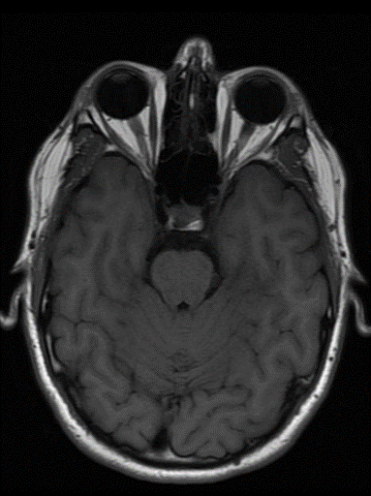
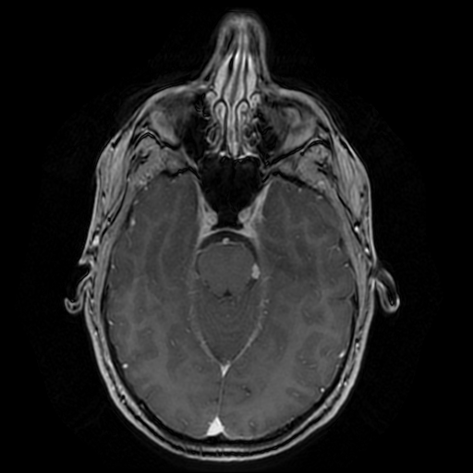
Case 4: CN IV
32 year old male presents with diplopia. Neurologic exam demonstrates left CN IV palsy.
Notes:
Axial T1 and T1 +C demonstrate a small slightly T1 low signal (black arrow) and enhancing (white arrow) lesion located in the left ambient cistern near the tentorial incisura (red arrow).
CN IV Schwannoma
Benign tumor of nerve sheath origin.
Relative incidence of CN schwannomas: CN VIII > CN V. All other CN schwannomas are uncommon in patients without Neurofibromatosis Type II.
Imaging:
CT: +enhancement, usually isodense to brain. May demonstrate smooth remodeling of adjacent bone.
MRI: T2 hyperintense and avid, sometimes heterogeneously enhancing. CN III, IV and VI schwannomas tend to be small; however, when other CN schwannomas grow large, they often show heterogeneity from cystic degeneration and/or hemorrhage.
Images are author owned

Slide 24
Normal Anatomy of CN V
4 Nuclei
3 sensory
Mesencephalic
Main Sensory
Spinal
1 motor
3 Nerve roots
Ophthalmic division - V1
Maxillary division - V2
Mandibular division - V3
1 Ganglion and a cave
Notes:
Images are author owned

Slide 25

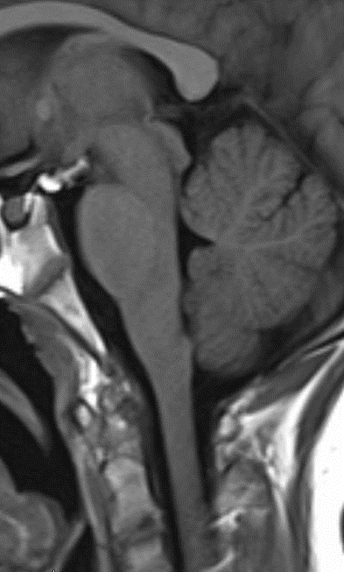
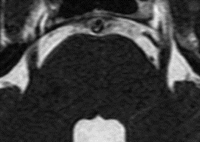

Normal Anatomy V: Nuclei
Mesencephalic nucleus
Anterior to superior aspect of the 4th ventricle/aqueduct extending from the pons to the inferior colliculus
Facial proprioception and control of bite force
Main sensory (pontine) nucleus
Lateral to entering trigeminal root
Facial tactile sensation
Spinal nucleus
Extends from principal sensory root in pons into upper cervical cord (between C2 to C4 level)
Facial pain and temperature
Motor Nucleus
Anteromedial to main sensory nucleus in the pons
Supplies muscles of mastication, tensor veli palatini, tensor tympani, mylohyoid and anterior belly of digastric
Notes:
Images are author owned

Slide 26
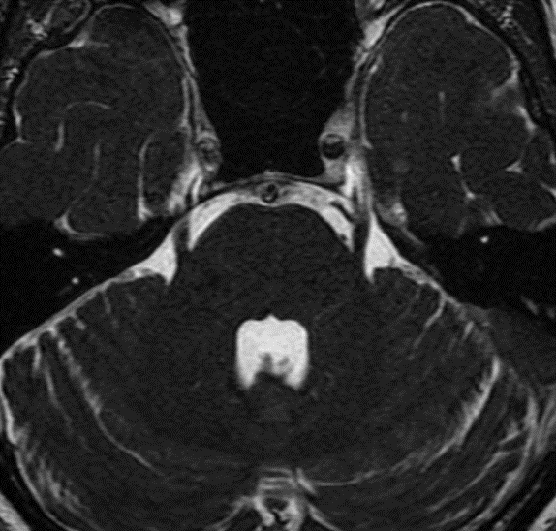
Normal Anatomy V: Central Course
Main motor nucleus
Main sensory nucleus
Notes:
Images are author owned

Slide 27
Normal Anatomy V: Root Entry Zone
Notes:
Images are author owned

Slide 28
Normal Anatomy V: Cisternal Segment
Notes:
Images are author owned

Slide 29
Normal Anatomy V: Meckel’s Cave
Notes:
Meckel’s cave is a dural outpouching containing CSF which contains the trigeminal (Gasserian) ganglion. The trigeminal nerve will branch into three divisions at the ganglion. V1 is the ophthalmic division, V2 the maxillary division and V3 the mandibular division.
Images are author owned

Slide 30
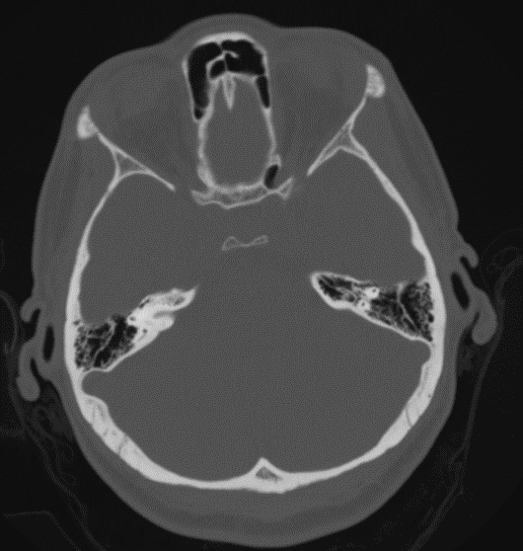
Normal Anatomy: V1 – cavernous sinus
Superior
Orbital
Fissure
III
pituitary
ICA
IV
VI
V1
Venous space
V2
Meningeal layer of dura
Periostic layer of dura
V3
Notes:
Ophthalmic Division - Sensory innervation for scalp, forehead, nose, globe
Travels along the lateral wall of the cavernous sinus inferior to CN4 before exiting the skull via the superior orbital fissure
Coronal graphic of cavernous sinus demonstrating CNIII, IV, V1 and V2 (oculomotor, trochlear, ophthalmic, maxillary) embedded within the lateral wall of the cavernous sinus within the periostic layer of dura. CN VI (abducens) is the only cranial nerve which truly passes through the cavernous sinus, i.e. surrounded by venous sinusoids. CN V3 (mandibular) does not enter the cavernous sinus wall.
Images are author owned

Slide 31
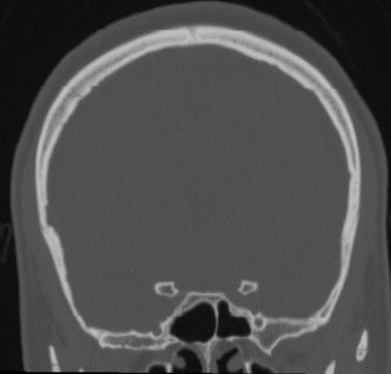
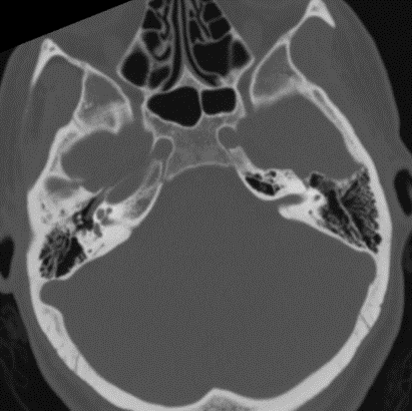
Normal Anatomy: V2 – cavernous sinus
III
pituitary
ICA
IV
VI
V1
Foramen
Rotundum
Venous space
V2
Meningeal layer of dura
Periostic layer of dura
V3
Notes:
Maxillary Division - sensory to cheek and upper teeth
Travels along lateral wall of cavernous sinus inferior to CNV1 before exiting the skull via the foramen rotundum into the pterogopalatine fossa.
Coronal graphic of cavernous sinus demonstrating CNIII, IV, V1 and V2 (oculomotor, trochlear, ophthalmic, maxillary) embedded within the lateral wall of the cavernous sinus within the periostic layer of dura. CN VI (abducens) is the only cranial nerve which truly passes through the cavernous sinus
Images are author owned, i.e. surrounded by venous sinusoids. CN V3 (mandibular) does not enter the cavernous sinus wall.

Slide 32
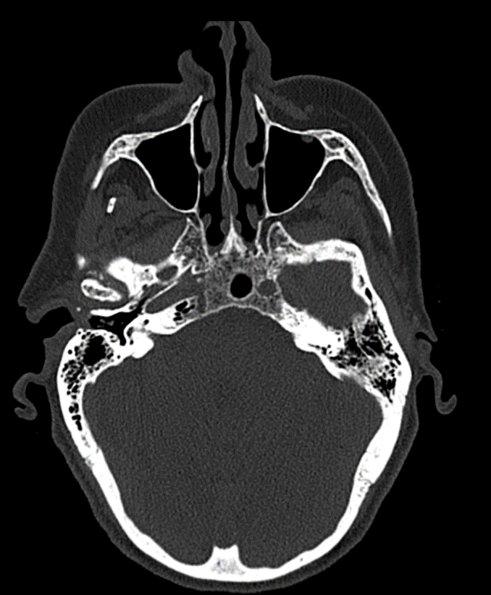
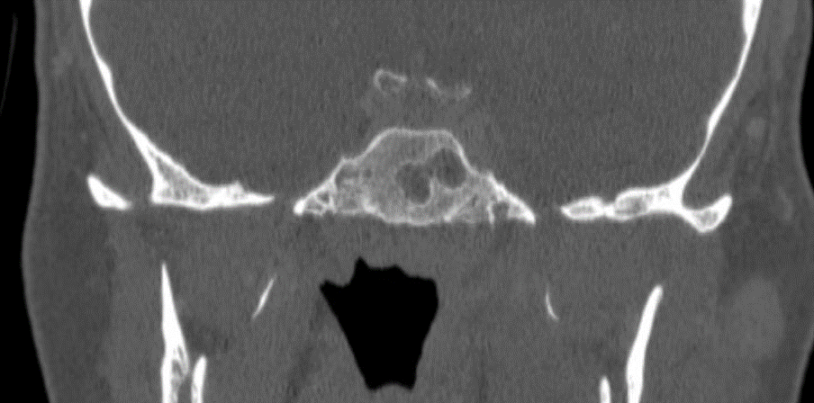
Normal Anatomy: V3
Foramen
Ovale
Notes:
Mandibular Division - carries sensory supply for jaw and motor fibers for mastication.
Exits the skull through the foramen ovale directly from Meckels cave (does not enter cavernous sinus)
Images are author owned

Slide 33
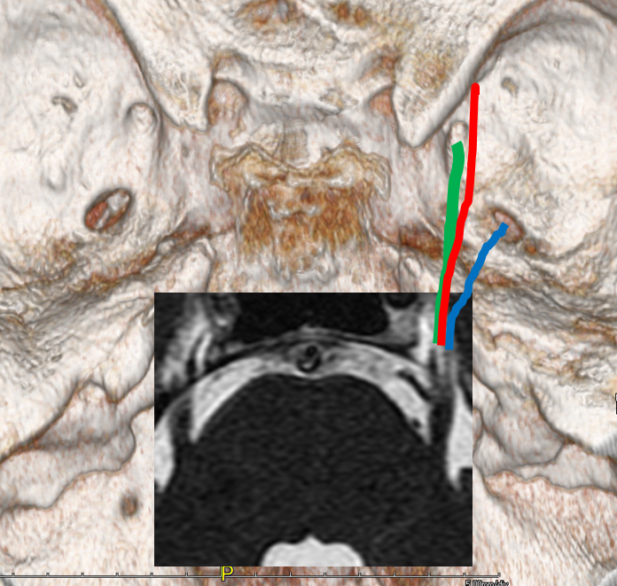
Normal Anatomy: Cranial exit sites
V1 exits through the
Superior orbital fissure
(not pictured)
V2 exits through
Foramen rotundum
V3 exits through
Foramen ovale
Notes:
Images are author owned

Slide 34
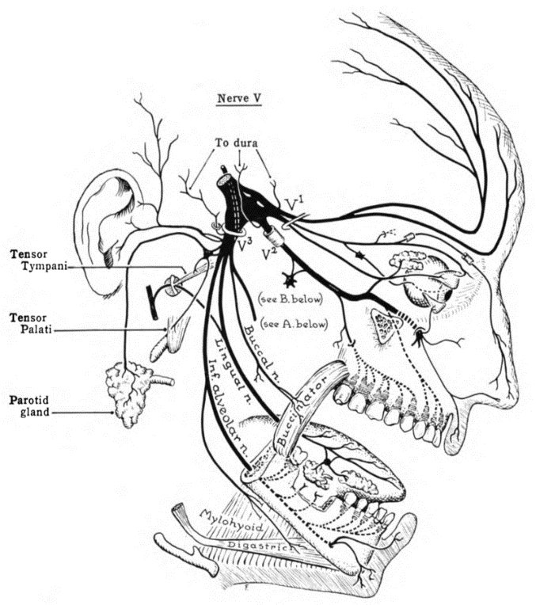
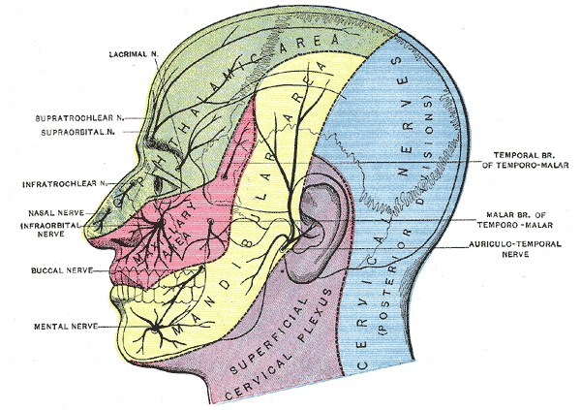
Normal Anatomy: Extracranial Branches
Grant, John Charles Boileu - An atlas of anatomy, / by regions 1962
Henry Vandyke Carter and one more author - Henry Gray (1918) Anatomy of the Human Body
Notes:
“Image by Grant, John Charles Boileu - An atlas of anatomy, / by regions 1962 , retrieved from: https://commons.wikimedia.org/wiki/File:Grant_1962_654.png on 9/4/21. Creative Commons License associated: N/A.”
This work is in the public domain because it was published in the United States between 1926 and 1963, and although there may or may not have been a copyright notice, the copyright was not renewed.
– public domain
“Image by Henry Vandyke Carter and one more author - Henry Gray (1918) Anatomy of the Human Body retrieved from: https://commons.wikimedia.org/wiki/File:Gray784.png. Creative Commons License associated: N/A.”
Sensory areas of the head, showing the general distribution of the three divisions of the fifth nerve. (Modified from Testut.) – public domain
This work is in the public domain in its country of origin and other countries and areas where the copyright term is the author's life plus 100 years or fewer.
This work is in the public domain in the United States because it was published (or registered with the U.S. Copyright Office) before January 1, 1926.

Slide 35
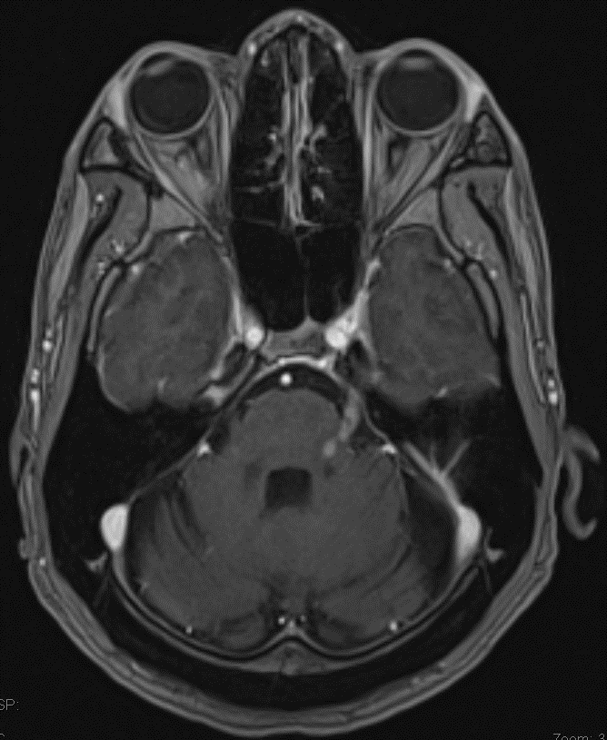
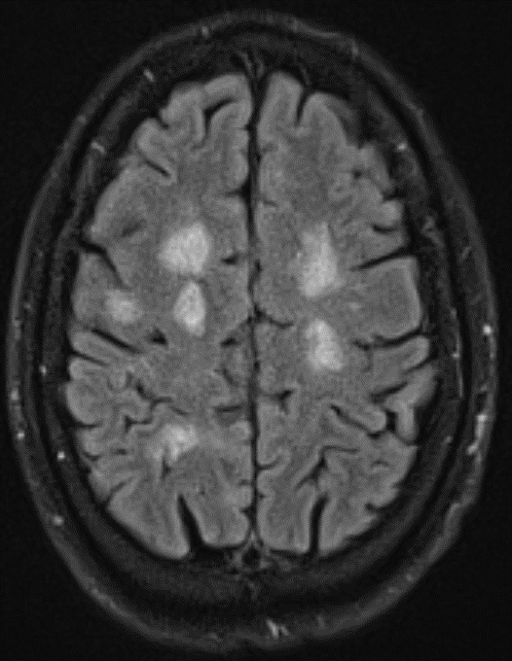
Case #5
T1 Post-contrast
T2 FLAIR
Notes:
Enhancement and thickening of the cisternal segment of the left trigeminal nerve.
Enhancement of the intra-axial segment of the left trigeminal nerve within the pons.
Multiple asymmetric ovoid T2/FLAIR hyperintense lesions involving the white matter of bilateral hemispheres. Several of these demonstrated incomplete rim enhancement (not shown)
Differential considerations for cranial nerve enhancement would include infectious, inflammatory, neoplastic, and vascular conditions.
MS is a chronic, autoimmune, inflammatory, demyelinating disease that typically presents with multiple perpendicular callososeptal T2 hyperintense lesions demonstrating varying degrees of enhancement.
Although demyelination is typically seen in the supratentorial white matter, these changes may also occur in the brachium pontis, brainstem, or spinal cord. Infratentorial involvement is seen in <10% of adults with MS.
Rarely, cranial nerve roots can be involved. The trigeminal nerve in particular may be involved in up to 2.8% of patients with active demyelination.
Images are author owned

Slide 36
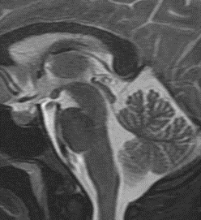

Normal Anatomy: CN VI
Notes:
The abducens nucleus (white circle) is within the dorsal pons at the facial colliculus.
The abducens nerve courses inferiorly and anteriorly before it exits at the ponto-medullary junction into the prepontine cistern. It then courses superiorly and anteriorly and pierces Dorello’s canal, located at the medial most aspect of the petrous apex.
Of note, the seventh nerve nucleus (red circle) and nerve (red line) courses around the abducens nucleus before exiting laterally and more superiorly. Thus, pathology affecting the abducens nucleus will often also affect the facial nerve.
Images are author owned

Slide 37


Normal Anatomy: CN VI
MEDULLA
PONS
MEDULLA
Thin section high resolution T2 MR sequence
Notes:
The abducens nerve (black arrow) exits at the ponto-medullary junction (blue arrow) into the prepontine cistern.
It then courses superiorly and anteriorly and pierces Dorello’s canal (red arrow).
Images are author owned

Slide 38

Normal Anatomy: VI – cavernous sinus
III
pituitary
ICA
IV
VI
V1
Post contrast T1 coronal
Venous space
V2
Meningeal layer of dura
Periostic layer of dura
V3
Notes:
The abducens nerve travels within Dorello’s canal to the cavernous sinus. In the cavernous sinus, the abducens nerve is the most medial nerve.
The yellow circle marks the expected location of the abducens nerve in the cavernous sinus, which is often too small to confidently identify.
Coronal graphic of cavernous sinus demonstrating CNIII, IV, V1 and V2 (oculomotor, trochlear, ophthalmic, maxillary) embedded within the lateral wall of the cavernous sinus within the periostic layer of dura. CN VI (abducens) is the only cranial nerve which truly passes through the cavernous sinus, i.e. surrounded by venous sinusoids. CN V3 (mandibular) does not enter the cavernous sinus wall.
Images are author owned

Slide 39
Normal Anatomy: CN VI
Notes:
The abducens nerve also enters the orbit via the superior orbital fissure (black arrow) and innervates the lateral rectus muscle.
Images are author owned

Slide 40

Case #6: 22 YOF w/ bilateral abduction deficit.
Notes:
T1, T1 post contrast, coronal and axial FLAIR demonstrate symmetric non-enhancing FLAIR hyperintense lesions involving the bilateral facial colliculi in the expected region of the abducens nuclei. Initial presentation for patient subsequently diagnosed with multiple sclerosis.
Images are author owned

Slide 41




Case #6: CN III, IV, & VI
46 year old female with ophthalmoplegia.
Notes:
Axial T1 and axial and coronal T1 +C sequences demonstrate a T1 isointense, homogeneously enhancing mass involving the anterior right middle cranial fossa and right cavernous sinus. The mass invades the superior orbital fissure (white arrow). Note hyperostosis of right sphenoid wing (red arrow).
Sphenoid Wing Meningioma (with involvement of the cavernous sinus and superior orbital fissure)
Imaging:
Dural-based, diffusely enhancing mass
Extra-axial: CSF cleft around the mass confirms extra-axial location
Ca++ are common (high density on CT and susceptibility artifact on SWI/gradient MR imaging)
May have hyperostosis of adjacent skull (as seen in this case)
Differential for Meningioma
Dural based metastasis
Granulomatous Disease (sarcoid, TB)
Lymphoma
Note: Lesions of the superior orbital fissure or cavernous sinus can result in CN III, IV, V1, and VI palsies (as in this case).
Images are author owned

Slide 42

Normal Anatomy: CN VII
CN VII Nuclei: Located in the inferior pons
Motor Nucleus
Superior salivatory nucleus
Nucleus solitarius
CN VI nucleus
Axial FIESTA MRI at the level of the pons showing CN VII nuclei
Notes:
Images are author owned

Slide 43

Normal Anatomy: CN VII
CN VII branches:
Motor Nucleus
Branchial motor nerves innervate facial muscles
Superior salivatory nucleus
Parasympathetic nerves innervating lacrimal and salivary glands
Nucleus solitarius
Sensory innervation for anterior 2/3 of tongue (taste)
Lacrimal/nasal glands
Greater Petrosal N.
Pterygopalatine ganglion
Geniculate ganglion
Facial muscles
Salivary Glands
Submandibular ganglion
Chorda tympani
Tongue (anterior 2/3)
Notes:
Images are author owned

Slide 44


Normal Anatomy: CN VII
Notes:
The abducens nucleus (white circle) is within the dorsal pons at the facial colliculus.
The seventh nerve nucleus (red circle) and central course nerve (red line) courses around the abducens nucleus before exiting as the cisternal segment (yellow). Pathology affecting the abducens nucleus will often also affect the facial nerve.
Images are author owned

Slide 45



CN VII: Intracranial course
Axial CT
Stylomastoid foramen
Axial CT
Coronal CT
Facial nerve segments: Intracranial (cisternal) → intracanalicular/meatal (IAC) → labyrinthine → geniculate ganglion → tympanic (horizontal)→ mastoid (vertical)
Notes:
Images are author owned

Slide 46



CN VII: Intracranial course
Axial CT
Axial T1 MRI
Notes:
Normal bony appearance of the stylomastoid foramen (red arrow) and normal fat density/intensity (gold arrows).
Images are author owned

Slide 47


CN VII: Extracranial course
Notes:
Axial T1 MRI post contrast through the parotid gland demonstrates relationship of the main motor division of the facial nerve and the retromandibular vein
1st extracranial branch = posterior auricular nerve – motor to muscles around ear
Next are motor branches to posterior belly of digastric and stylohyoid muscles
Beyond this is main motor trunk coursing through the parotid gland, which runs just superficial to the retromandibular vein
Images are author owned

Slide 48

CN VII: Extracranial course
Main motor trunk divides into 5 terminal branches responsible for motor to muscles of facial expression:
Temporal
Zygomatic
Buccal
Marginal mandibular
Cervical
Patrick J. Lynch, medical illustrator; C. Carl Jaffe, MD, cardiologist. https://creativecommons.org/licenses/by/2.5/
Notes:
Terminal branching of the facial nerve within the parotid gland
Image by Patrick J. Lynch, medical illustrator; C. Carl Jaffe, MD, cardiologist. retrieved from: https://en.wikipedia.org/wiki/Facial_nerve#/media/File:Head_facial_nerve_branches.jpg on 9/4/21. Creative Commons Attribution 2.5 License 2006
https://creativecommons.org/licenses/by/2.5/
To Zanzibar By Motor Car is a mnemonic useful to remember the terminal branches of the facial nerve

Slide 49




Case 7: 38 y/o female with new facial palsy and esotropia
1
CN_06
Axial FLAIR
CN_06
3
2
Axial T1+C
4
Notes:
Image #1: Axial FLAIR shows edema within the dorsal pons corresponding to the facial nerve and abducens nuclei (gold arrow)
Image #2: Axial T1+C shows demonstrates a corresponding focal, solid enhancing lesion (red arrows)
Axial T1+C images show multiple enhancing lesions in the left thalamus (image #3) and bilateral cerebellum (image #4)
Images are author owned

Slide 50

Normal Anatomy: CN VIII
Notes:
Cochlear nuclei (red dots) within inferior cerebellar peduncles (restiform body) adjacent to foramen of Luschka (yellow arrow)
Images are author owned

Slide 51


Normal Anatomy: CN VIII
Notes:
The cochlear and vestibular nuclei of CN VIII are located in the superior aspect of the medulla and adjacent inferior pons, respectively. The nerve emerges from the pontomedullary junction as the cisternal segment (yellow), dividing into the cochlear nerve, inferior vestibular nerve and superior vestibular nerve in the region of the porus austicus, or opening to the internal auditory canal (IAC).
Images are author owned

Slide 52


Normal Anatomy: CN VIII
Axial FIESTA through the CP angle cistern showing ventral position of CN VII relative to more dorsal CN VIII
Notes:
Vestibulocochlear nerve splits into cochlear and vestibular divisions at porus acusticus
Carries special sensory afferent neurons for hearing (cochlear division) and balance (vestibular divisions)
Images are author owned

Slide 53


Normal Anatomy: CN VIII
Magnified sagittal oblique through the IAC
Inset shows anterior and superior position of the facial nerve, anterior inferior cochlear nerve, and posteriorly within the IAC are the superior and inferior divisions of the vestibular nerve
Notes:
Images are author owned

Slide 54


Normal Anatomy: CN VIII
Notes:
The cochlear nerve passes through the cochlear aperture (red) at the IAC fundus to enter the cochlear.
Images are author owned

Slide 55


Cranial nerves IX-XII
Notes:
Medullary pyramid: orange arrow
Pre-olivary sulcus: green arrow (CN XII)
Olive: yellow arrow
Post-olivary sulcus: blue arrow (CN IX, X, bulbar component of XI)

Slide 56



Normal Anatomy: Skull base
Axial CT through the jugular foramen. Note the jugular spine separating the
pars vascularis and pars nervosa.
Axial CT through the hypoglossal canal
Coronal CT through the jugular foramen and hypoglossal canal
Notes:
Jugular foramen
Pars nervosa
CN IX and the inferior petrosal sinus
Pars vascularis
CN X, CN XI and the jugular bulb
Hypoglossal canal
CN XII
Images are author owned

Slide 57

Normal Anatomy: Nuclei
CN IX and X nuclei
Motor: nucleus ambiguous
Sensory: nucleus solitarius
Parasympathetic: inferior
salivatory nucleus (CN IX)
and dorsal nucleus (CN X)
Glossopharyngeal nerve
Vagus nerve
Axial MRI through the upper medulla
Notes:
Images are author owned

Slide 58

Normal Anatomy: Nuclei
CN XI
Spinal nucleus: motor
Axial MRI through the upper cervical spinal cord demonstrating the spinal accessory nucleus along the posterolateral margin of the anterior horn. The nucleus extends from C1-C6.
Notes:
Images are author owned

Slide 59



Normal Anatomy: Cisternal CN IX, X
Axial MRI of the vagus nerve exiting from the post-olivary sulcus, just inferior to the glossopharyngeal nerve
Sagittal oblique MRI demonstrating the relationship between the glossopharyngeal nerve and vagus nerve
Axial MRI of the glossopharyngeal nerve, exiting the medulla from the post-olivary sulcus
Notes:
Images are author owned

Slide 60


Normal Anatomy: Cisternal CN XI
Axial MRI of the spinal accessory nerve exiting through the jugular foramen near the vagus nerve
Coronal CT myelogram demonstrating spinal accessory nerve roots arising from the cervical spine (C1-C6) and ascending through the foramen magnum
Notes:
Images are author owned

Slide 61


Case 8: CN XI
66 year old male status post left selective neck dissection
CN_06
1 years post-op
3 years post-op
Notes:
Trapezius and sternocleidomastoid muscle atrophy from iatrogenic CN XI injury
Iatrogenic CN XI injury in posterior triangle lymph node biopsy has been reported in 3-10% of patients.
CN XI is sacrificed in radical neck dissections, resulting in significant upper extremity dysfunction in up to 60% of cases.
If spared in modified or selective neck dissection, CN XI can still undergo traction injury. A case series of 714 patient that underwent nerve-sparing modified radical neck dissection had a 1.68% rate of CN XI paralysis.
Images are author owned

Slide 62

Normal Anatomy: Nuclei
CN XII
Hypoglossal nucleus: motor
Axial MRI through the middle medulla demonstrating the hypoglossal nucleus and nerve exiting at the pre-olivary sulcus
Axial MRI through the medulla
Notes:
Images are author owned

Slide 63

Normal Anatomy: CN XII
Notes:
Axial MRI demonstrating the hypoglossal nerve exiting the medulla from the pre-olivary sulcus, coursing posterior to the vertebral artery and entering the hypoglossal canal
Images are author owned

Slide 64
Contributors
Peter Will M.D., Christopher Lack M.D. Ph.D., Pui-Nn Ho M.D, Valerie Stine M.D., Carol Geer M.D., Michael Zapadka D.O., Scott Jones M.D., Zachary LoVerde MD, Vinay Bhatia MD, Jeffrey Sachs MD, Richard Leach M.D., Kevin Hiatt M.D.

