Slide 1
Qas Momentum score Analysis
Prepared by:
Adam De Bell
Conor Spicer
Damien Holliday
David Robson
Jack Cheetham-Blake
James Whitfield
An overview of work into predicting movements in the S&P 500 using QAS momentum scores
September 2018

Slide 2
Contents
01
02
03
04
Introduction
Assumptions
Rule-based Model
Neural Network
Results and Next Steps
Pages 3
Pages 4
Pages 5-9
Pages 10-13
Pages 14-17
Basic assumptions for conducting an analysis of QAS momentum scores
QAS momentum score rule based model
Risk zone matrix based model
Data preparation and choice of neural network
Model structure
Current results
Next steps

Slide 3
Introduction
Investigation into the use of QAS momentum scores in predicting the movement of stock market and industrial sector indexes
QAS uses a sophisticated algorithm which simultaneously calculates and compares quantitative ratings within three different time-frames – Long-Term, Intermediate-Term and Short-Term for every security or index in their Global Database.
This algorithm routinely classifies where in the cycle the charts suggest each of the leading stocks in its universe has reached.
These can help inform an investment strategy as they indicate where a stock is relative to its fair value.
Our aim is to investigate if there is a way to use the momentum scores generated by QAS to predict movements of stock market and industrial sector indexes, and build a model that can achieve this.

Slide 4
Assumptions
Modelling
Initially assume no costs to trading
Simplified trading costs of 0.1% are used when adding costs to trading
Perfect liquidity – can buy or sell an unlimited quantity at current market price
Model can run fast enough to produce predictions almost instantly
Timing
QAS momentum scores are calculated end of day using end of day prices
Trades can be implemented end of day using QAS momentum score and end of day pricing information
Trades are completed instantly
Shorting
If shorting we are ble to short amount equal to the value of your cash balance
Trading
Strategy is discrete; will always buy or sell everything
Assumptions made when modelling price movements in the S&P 500
*See appendix for details

Slide 5
Rule-Based Model
Two naïve approaches to predicting the S&P 500 with basic rules using QAS momentum scores

Slide 6
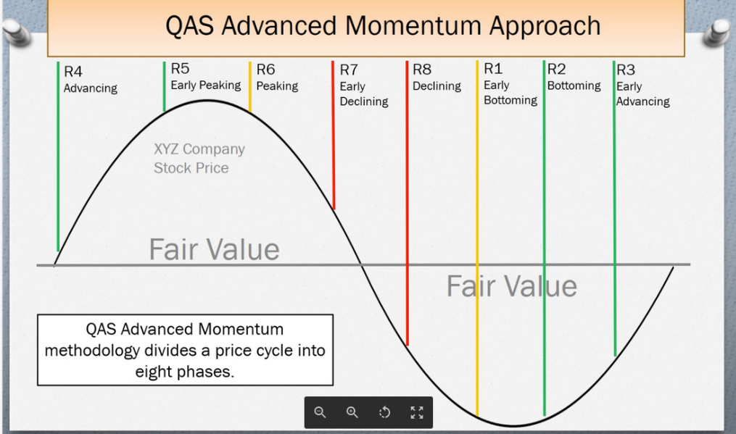
Rule-based Model
A model implementing a buy strategy when the previous periods short-term momentum score is either 2, 3 or 4, and a sell strategy at 6, 7 or 8.
A naïve model is one where the last period's actuals are used as this period's forecast, without adjusting them or attempting to establish causal factors.
Our first approach at analyzing the QAS momentum scores was to, using the information on the momentum scores, model a basic strategy of buying and selling stock in the S&P 500 that mimicked the information on scores provided by QAS.
Buying stock where the short-term momentum scores were either 2, 3 or 4, and selling when the short-term momentum scores were either 6, 7 or 8, and holding otherwise, yielded the following results.
This strategy performs poorly, ending lower than tracking the market. We believe this performs poorly as the strategy gives too few days in which the portfolio contains S&P 500 holdings.
Source: http://qas-service.com/Case_Study.mp4

Slide 7
Rule-based Model
A model implementing a buy strategy when the previous periods short-term momentum score is either 3, 4, 6, 7, and 8, and a sell strategy at 1, 2 or 5.
Performing some basic analysis on the average movement of price of the S&P 500 the period after each short-term momentum score for the first 90% of periods showed the real data didn’t quite follow the information on QAS momentum scores.
Using this to inform our strategy on the last 10% of periods yielded results marginally worse than tracking the S&P 500. However, these results are better than the previous strategy from using the QAS logic on momentum scores.
QAS Momentum Approach
A rule-based model based on analysis of average price movements after each short-term momentum score still performed worse than tracking the S&P 500.

Slide 8
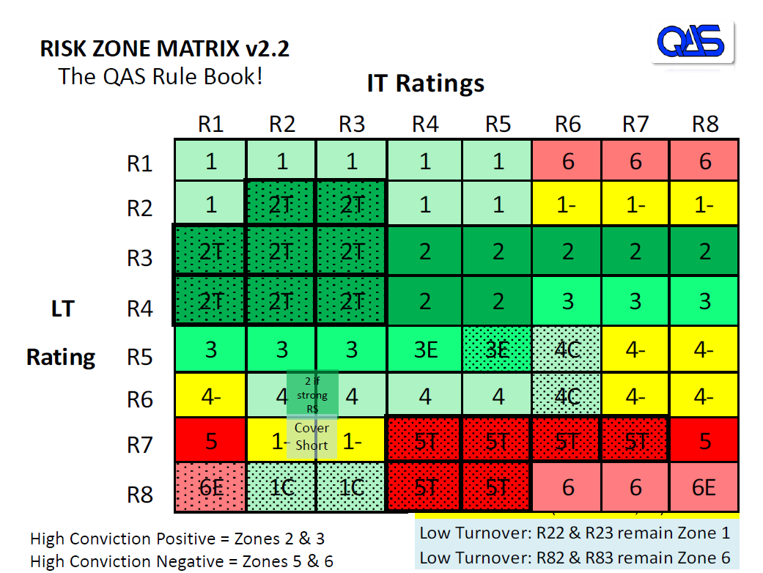
Rule-based Model
Updating our rule-based model uses the QAS risk zone matrix.
The rules for the model are as follows:
If the risk zone is a high conviction positive (2 & 3) we are fully invested in the market
If the risk zone is a high conviction negative (5 & 6) we are full out of the market
If the risk zone is neither of these (1 & 4) then half of our value is in the market, and half is held as cash
This strategy outperformed our previous rule-based models, but underperforms relative to tracking the market.

Slide 9
Rule-based Model
Applying the same logic to the intermediate and short term risk zones yields the following results:

Slide 10
Recurrent Neural Network
Our approach to using Long Short- Term Memory neural networks

Slide 11
Recurrent Neural Network
Long-Short Term Memory RNNs
“An LSTM is well-suited to classify, process and predict time series given time lags of unknown size and duration between important events”
A Recurrent Neural Network (RNN) is a type of deep learning model which, unlike traditional feed forward neural networks, holds an internal state which can be used in processing sequential inputs. In this case utilising the momentum scores and price movements over previous days. Specifically a Long Short Term Memory (LSTM) Neural Network was selected, a common form of RNN. This type of model allows for capturing the effects of previous values in preceding time periods and not just the most recent. To each periods different weights are assigned during the model training phase. A limitation of this type of modelling compared to more traditional approaches is that it tends to hide the actual determination of outputs so model interpretation can be difficult.
4th Law of Data Mining
“The right model for a given application can only be discovered by experiment. In data mining, models are selected through trail and error”
- Tom Khabaza
We have experimented with multiple different methods for utilising LSTM neural networks, using different combinations of the inputs, as well as using different predicted variables in the model. We began by experimenting with using just a window of previous price data to inform our neural network, and tried a few different models. The first models we experimented with predicted the price for a short window of time after each period, and then used the gradients of those predictions to inform our buy sell strategy.
After those models failed to beat tracking the market, we changed our predicted variable to just be tomorrow’s price change. Whether this prediction was positive or negative would then inform our buy sell strategy.
Once we had settle on this model we then added in the QAS momentum scores. We experimented again with combinations of scores, but the best results came from using just short-term scores.

Slide 12
Recurrent Neural Network – QAS
Using momentum scores as 1 – 8 inputs into a model would not be appropriate in this scenario. Scores of 1 and 8 are roughly similar but would be treated as opposites
1
2
3
4
5
6
7
8
Original:
Transformed:
Transforming the linear one- dimensional momentum scores into a 2 dimensional circle, much like hours on a clock face, allows the correct reflection of ‘differences’ between the scores.
Equation for calculating the coordinates are as follows:
X = sin(π/4 * QAS score)
Y = cos(π/4 * QAS score)
(1,0) 8
(-0.707,0.707) 7
1 (0.707,0.707)
(-1,0) 6
2 (0,1)
(-0.707,-0.707) 5
3 (0.707,-0.707)
4 (0,-1)

Slide 13
Recurrent Neural Network – QAS
The final Recurrent Neural Network (RNN) that we have used takes a combination of intraday price changes and the 2 dimensional short-term, intermediate-term and long-term momentum scores over a specific window of working days and uses that to predict the change in price the next day.
The RNN is trained on the inputs and the predicted variable which is tomorrow’s price change.
Once the model is trained, it takes the inputs for the specific window and generates a prediction for tomorrow’s price change for each period.
Inputs
Outputs
20 day window
Intraday price change
Short-term Momentum Score – X Dimension
Short-term Momentum Score – Y Dimension
Intermediate-term Momentum Score – X Dimension
Intermediate-term Momentum Score – Y Dimension
Long-term Momentum Score – X Dimension
Long-term Momentum Score – Y Dimension
Tomorrow’s price change prediction
Given the prediction of tomorrow’s price change, we buy or sell stock in line with the predicted movement.

Slide 14
Results
Applying our model to S&P 500 data

Slide 15
Recurrent Neural Network – QAS
The results of our first neural network appeared to be very good – particularly in times of high volatility.
Looking into the code we suspected that our code was suffering from data leakage, and so we adjusted the code and split our dataset into two separate files, training the model on one of the files and testing on a new file that the model couldn’t possibly have seen during training.

Slide 16
Recurrent Neural Network – QAS
These are the results of our current RNN with a 20 period window of price changes, short-term, intermediate-term and long-term momentum scores.

Slide 17
Next Steps
Areas with scope for further development and application of this work

Slide 18
Next Steps
Multi-armed bandit problem
“A problem in which a fixed limited set of resources must be allocated between competing (alternative) choices in a way that maximizes their expected gain.”
Development
We have had some success, however the initial assumptions made were large. Because of this, the door has been left open to several new angles of attack. In particular, taking account of:
Different market sectors – Different sectors behave in different ways. Training and applying independent models could positively impact performance. Furthermore, a weighted combination of these independent market sector models would allow for a deep strategy to be formed around this more accurate basis.
Different influencing factors – Combining further sources of data (e.g. performance of related sectors, political environment, oil prices, interest rates) may help to refine the model.
Non-binary trading – Allowing for proportional trading of your current holding would make the model more aligned with real-world trading strategies. It would also allow for lower risk strategies and hedging, and could improve performance.
GUI – Building out a simple tool based on this model to produce daily predictions
Fine tuning – Trying more model variations to determine if by fine tuning we can improve this model, for example, length of time held, or using a combination of long, intermediate and short term scores.
Cross-validation – In order to ensure we aren’t seeing a biased outcome we would apply cross-validation across the dataset, using a variety of different periods as the testing set, and the rest of the data as the testing set. This would ensure the model was accurate as possible

Slide 19
Appendix

Slide 20
Assumptions
Kenneth Tower
Timing:
Our only input is end of day prices. So the data for any specific day is created at the market close on that day. For trade timing we generally use that price and that date. Some object to that saying one couldn’t trade on the price because the market is closed. This is a legitimate concern, but after hour trading is often available. And if it were important to trade on that specific day we could calculate the rating using the price 15 minutes before the close. This “estimated” rating could then be used for trading before the market closes. If you prefer not to use the signal until the following day that’s OK. Just use the next day’s close.
The Weekly (IT) rating uses the Wednesday closing price (our 40 year old firm had to stagger the weekly calculations in the bad old days of limited data & computing power and we never changed it). Here we estimate what the next IT rating will be by entering each day’s closing price. This “estimated” IT rating does create the potential for a mid week rating change that then changes back to its original on the following Wednesday, but more often than not we find the estimated IT rating to be a valuable early warning of an upcoming rating change.
The Monthly (LT) rating uses the month end closing price. The rating only changes on the last day of the month. All prior days in the month repeat the prior month value.
Normally we calculate an estimated LT rating using a similar process described above for the IT estimate. But I see the data we sent you does not reflect the estimated rating. This was a mistake on our part, but doesn’t invalidate anything. Using only the actual LT rating will penalize results in fast moving markets such as the bottom in March 2009. Because you are well along in the analysis I’m not sure it makes sense to send you revised data at this point.
Transaction costs:
To assign a trading cost is arbitrary because costs vary widely among users.
The data we sent is based on the sector ETFs that trade here in the States. Here in USA transaction costs are tiny for most users. Basic retail trading accounts pay $5 per transaction or less. This is a fixed fee whether one buys 1 share or thousands of shares. Hedge and mutual funds trade for a fraction of a cent per share. Or one might create exposure to any of these ETFs using the option market where, again, trading costs vary from user to user.

Slide 21
Assumptions
Kenneth Tower
Because assigning a trading cost is arbitrary we do not include any transaction cost in our general modelling. Once we find a specific client who wants to use the model we learn their trading costs and run the model again factoring in those costs.
Turnover:
Another issue that comes up is turnover. The actual frequency or number of trades per week / month / year. Again, some clients prefer low turnover (particularly if their client’s money is in a taxable accounts) but many professional fund managers focus on performance and turnover is an afterthought.
So again, turnover is an arbitrary assignment until one finds a specific client and learns their specific needs. We sometimes restrict trading to once per week in our modelling which makes the process manageable for humans managing separate accounts, but if the accounts are pooled into a fund it wouldn’t be a factor.

Slide 22

Appendix
Robustness
We considered the robustness of the LSTM-momentum model to the training data. In particular, we investigated how much the ordering of the data being fed to the model fitting impacted its final performance. When initialising the neural network model a number of parameters are randomised, this includes sampling training batches and defining model weights. Depending on the value of these parameters it is possible that over multiple training runs the model converges to different optimal parameters and there are then significant differences in the model outputs.
Our conclusion was that, while the ordering did impact performance, the non-costed gains continued to outperform the market in the majority of cases.

