Slide 1
End of On-The Job Training (OJT) Report
James Wijaya Santoso
IT Development Program Batch-03
Digital Non Retail
Digital Delivery & Operation

Slide 2
Introduction about my Division
Unit : Digital Non Retail
Division : Digital Delivery & Operation
Mentor : Pak Rifqi Riadhi

Slide 3
6-Month On-The-Job (OJT) Training Journey
Monitoring and Maintenance of Production Apps
Monitoring and Support Maintenance in RDN(Rekening Dana Nasabah)
Participate and contribute in Initiative Project
Digital Lending Initiative Project (React Native)
eBizLoan Project
Training and Events
SME DL Delivery Inception Agile Workshop from GreyAmp
Joined 1st DRP
Git Workflow and Branching Strategy Workshop from GreyAmp
Dynamo Engine Training with Maybank KL

Slide 4
Initiative Project
Digital Lending Initiative Project (React Native)
eBizLoan (Digital Lending) Project

Slide 5
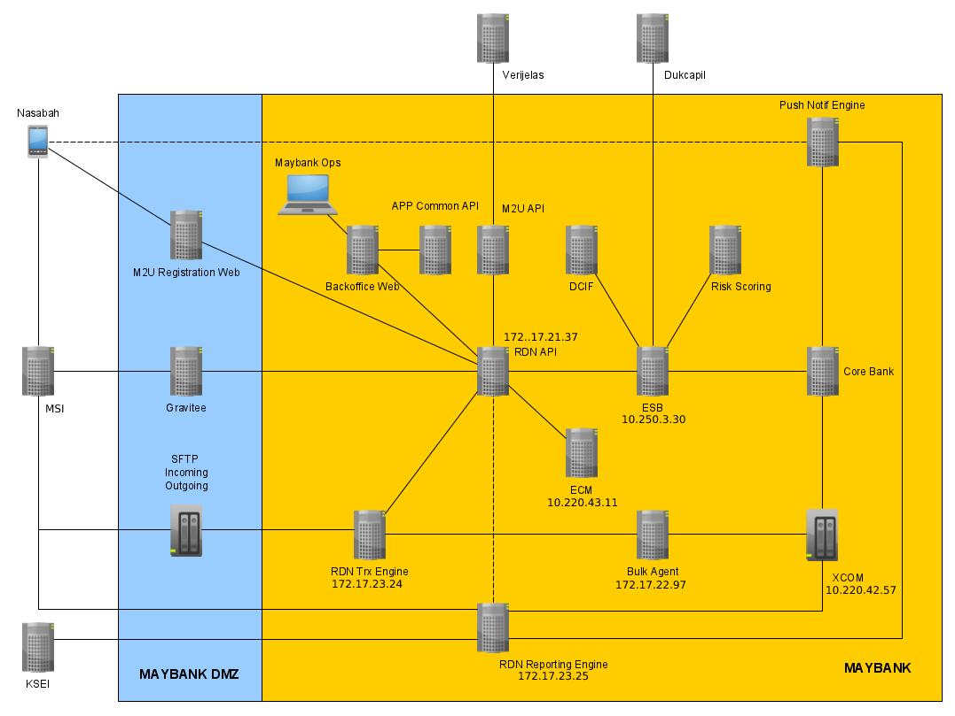

Monitoring and Support Maintenance in RDN Backend(Rekening Dana Nasabah)
RDN is Rekening Dana Nasabah that used for Transaction in Maybank Sekuritas
Tools Used :
Spring Boot
Postgre SQL

Slide 6
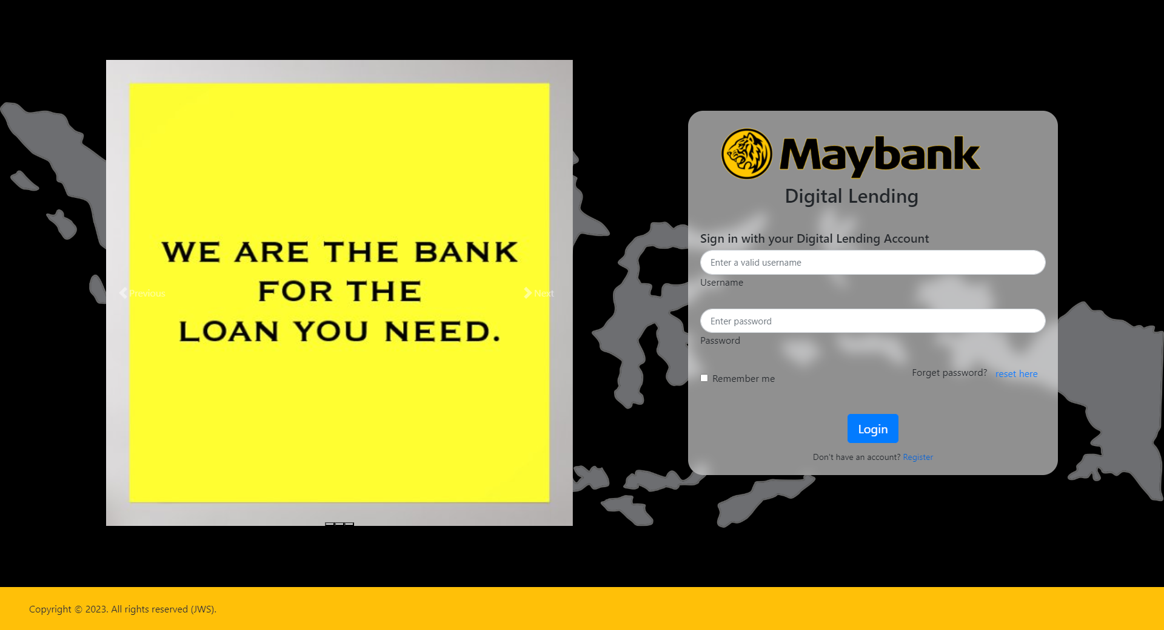
Demo Project Initiative

Slide 7
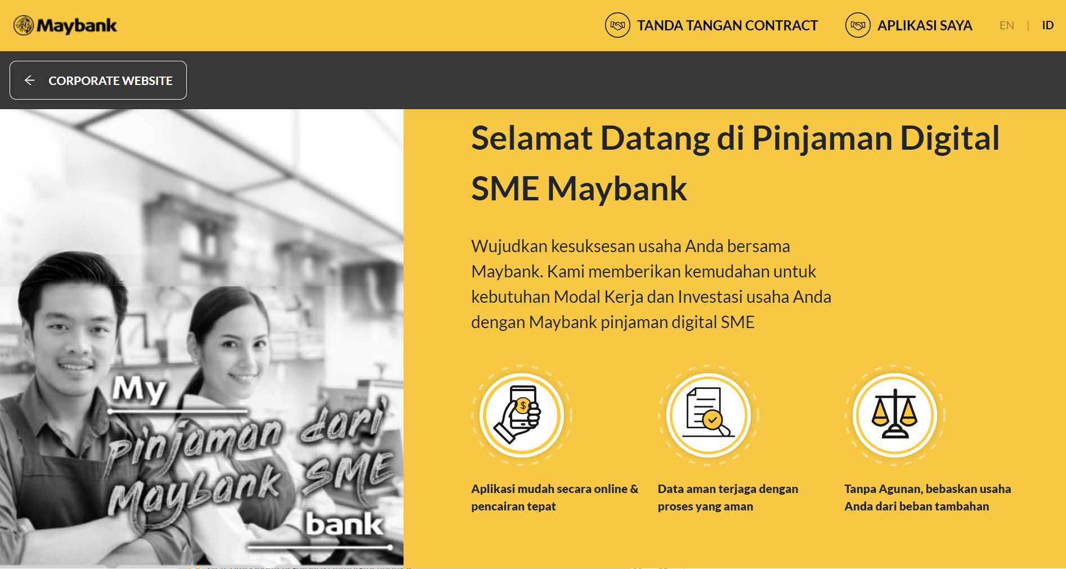


Project (1) – eBizLoan (Digital Lending) Project
During OJT period I collaborated with my division unit member and created eBizLoan.
Tools Used :
OracleDB
Spring-Boot
React JS

Slide 8
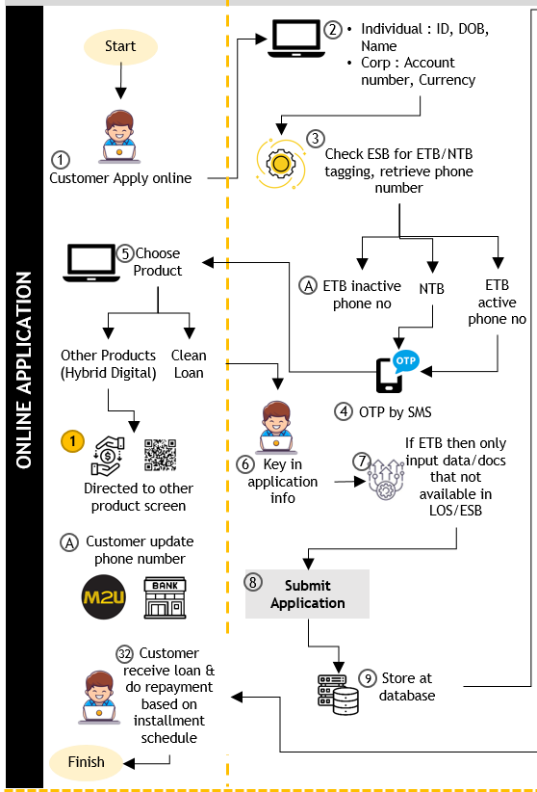
Project (2) – eBizLoan (Digital Lending) Project

Slide 9
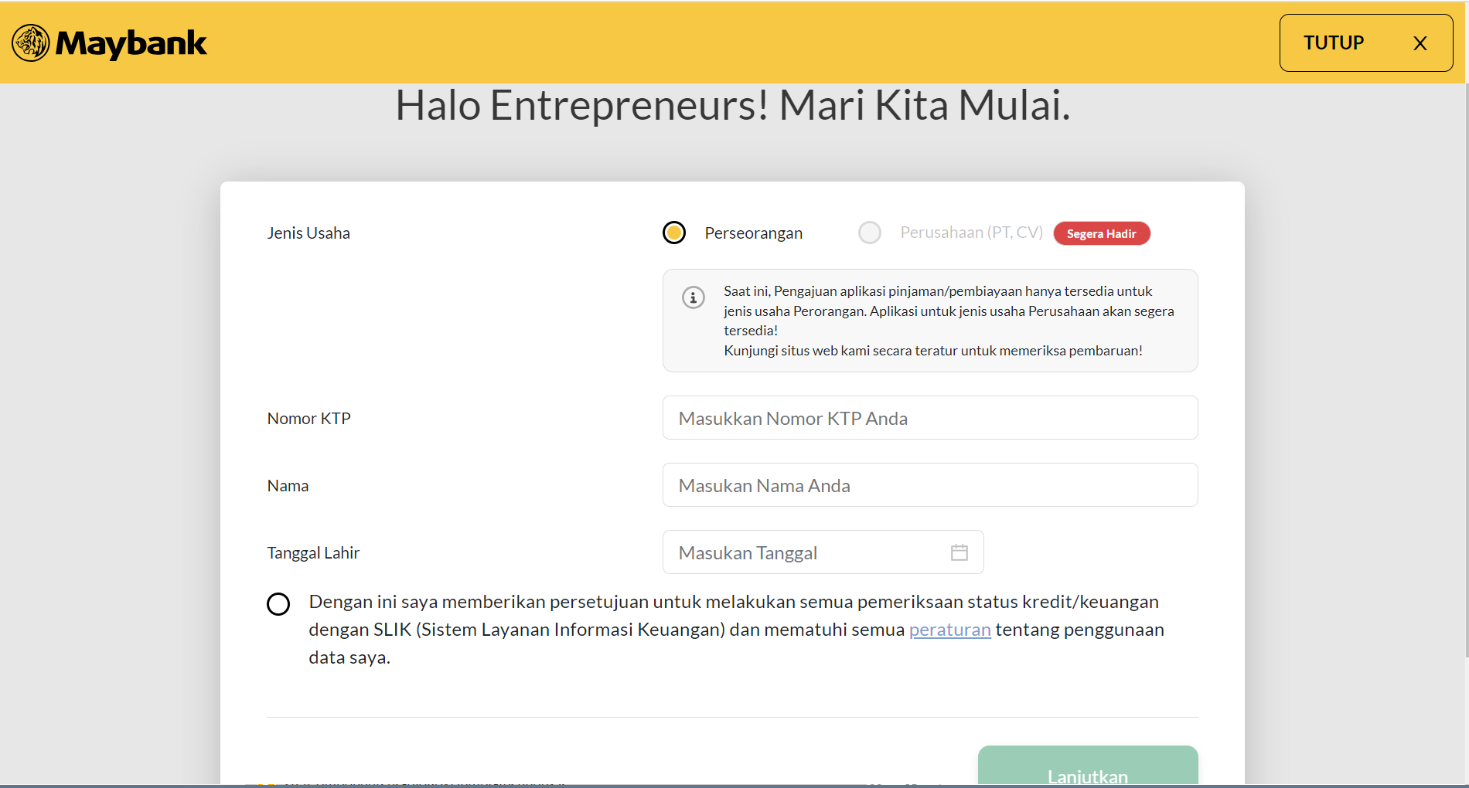
Project (3) – eBizLoan (Digital Lending) Project
Role:
Front End Developer
Tools:
Visual Studio Code (IDE)
React JS
Dynamo Engine
Cypress

Slide 10
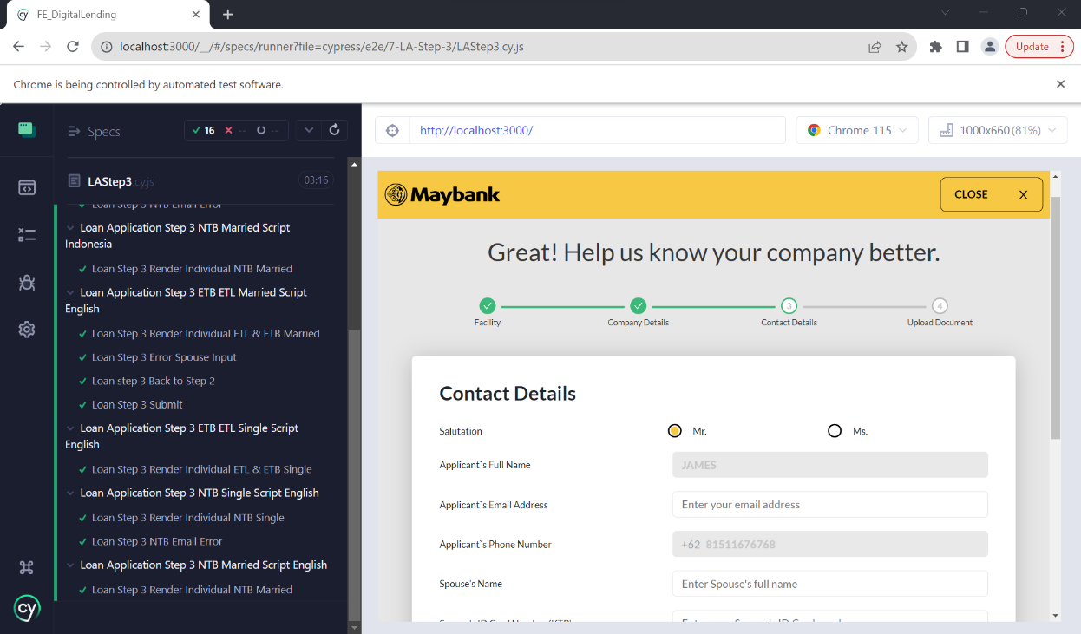
Project (4) – eBizLoan (Digital Lending) Project
Front End unit Testing

Slide 11
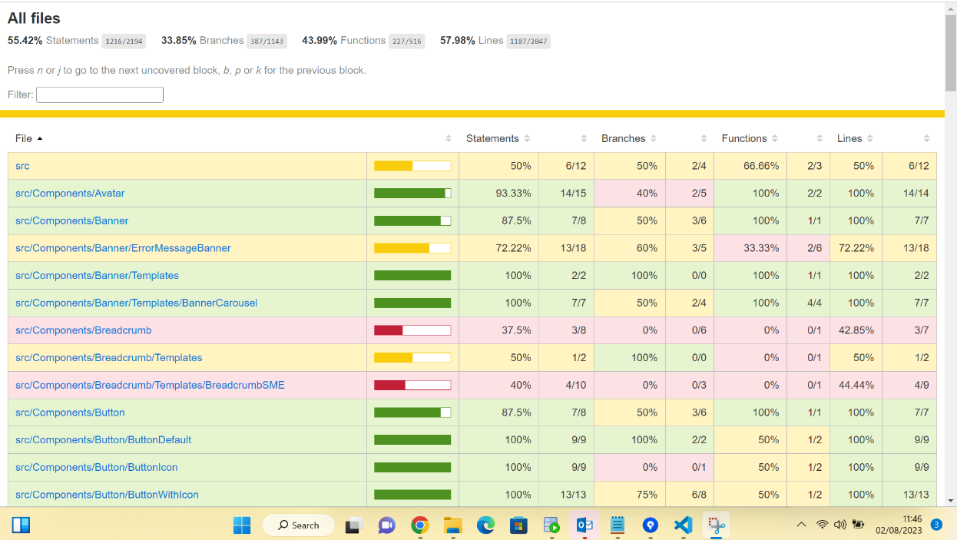
Project (5) – eBizLoan (Digital Lending) Project
Unit Testing Result (Code Coverage)

Slide 12
Initiative Project – Short Demo
eBizLoan Project
http://10.230.84.50:9000/

Slide 13
Output From On-The-Job Training (OJT)
Managed to gain understanding regarding technology that is used in banking industry through mentor and various workshop.
Attained live hands-on exposure regarding the internal system that is used by Maybank with provision of mentor and teammates.
Managed to gain experience working in banking project.

Slide 14
Improvement Ideas (1)
eBizLoan Application Story Planning must be consistent and clear

Slide 15
Big thanks to my awesome team !
My Mentor Mr. Rifqi
Digital non Retail Team
Digital SME
Human Capital Team for Coordinating OJT Program
And all Maybankers who helped me throughout my journey

