Slide 1
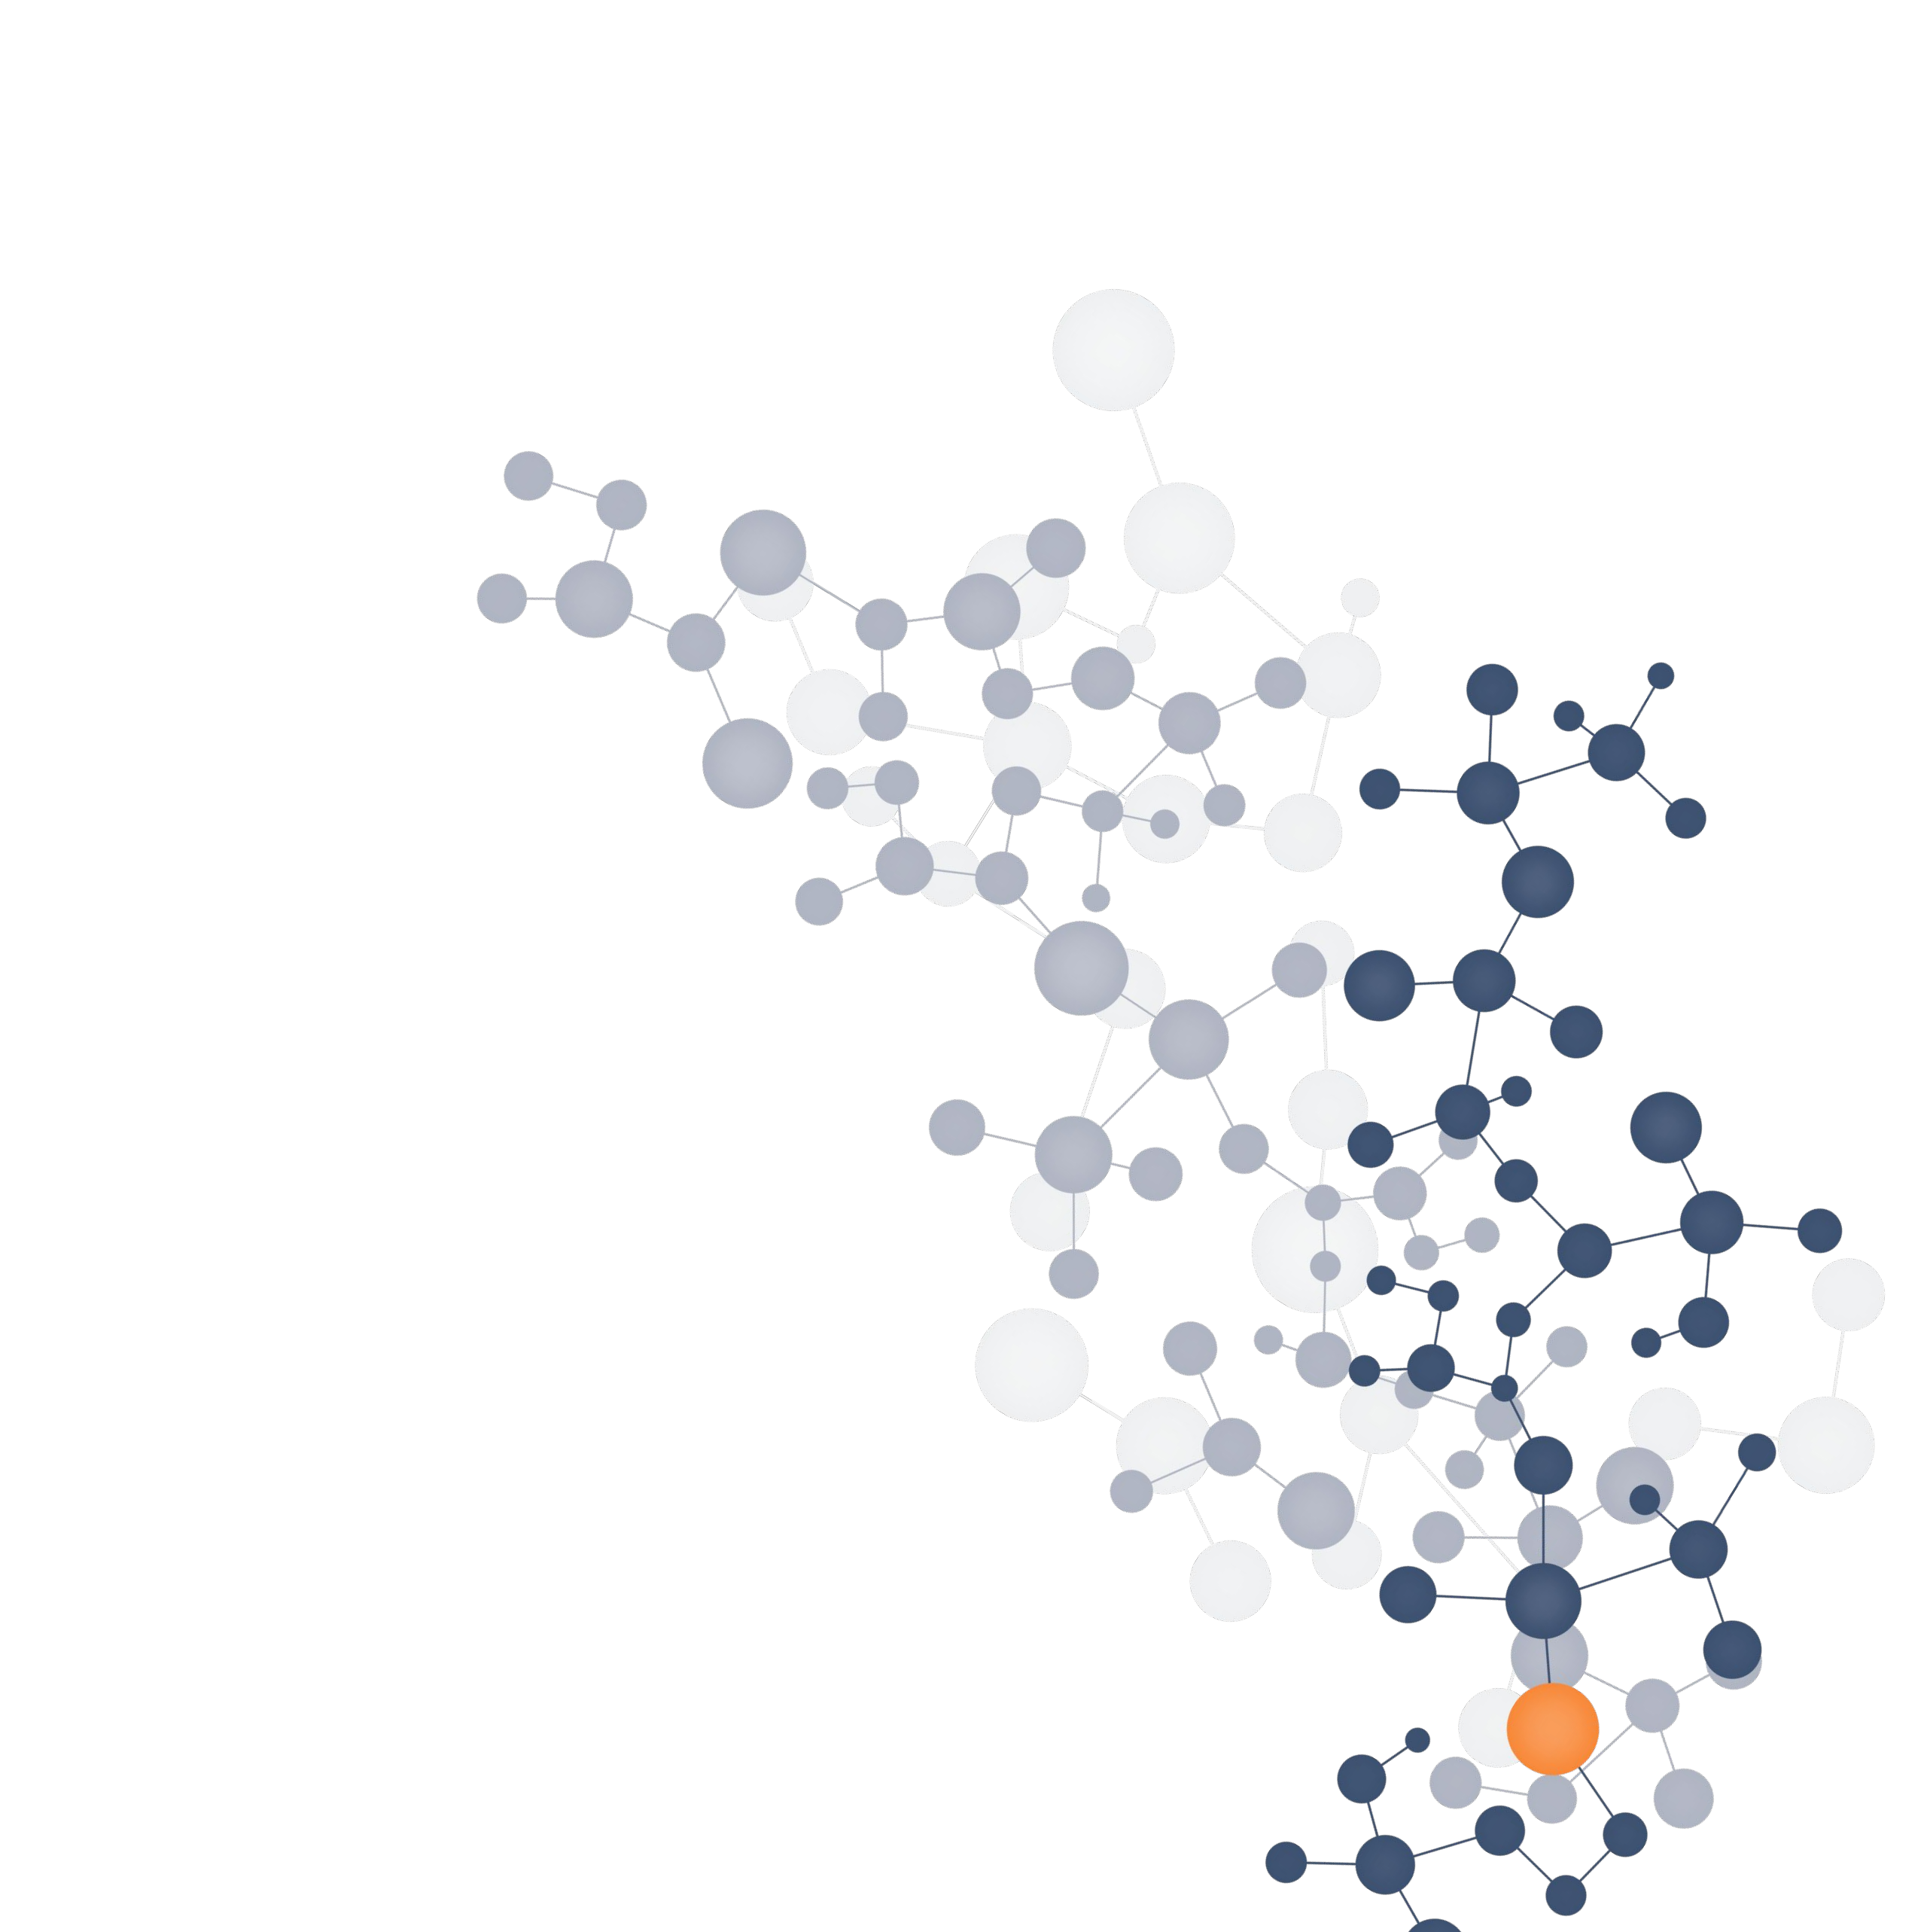
Disease Prediction from Lab Test Results
Guide by:
Group no :
Name & Details

Slide 2

Predicting diseases using blood test results
Problem statement
There are various types of blood tests and each type measures various components in the blood.
The measure of these components can be used to predict the possibility of various diseases.

Slide 3
Motivation and need
Proposed system
Different types of Blood Tests each have the capability to determine imbalances and disorders in human body.
Plenty of data where data analysis and ML has good roles to play.
According to a report by Grand View Research, Inc. global blood testing market is anticipated to reach USD 62.9 billion by 2024.
Complete blood count
- checks for levels of 10+ different components of every major cell in your blood: white blood cells, red blood cells, and platelets
- nutritional deficiencies, iron deficiency, marrow issues, tissue inflammation, infection, heart conditions, cancer
Basic and complete metabolic panels
- electrolytes, calcium, glucose, sodium, alkaline phosphatase (ALP), alanine aminotransferase (ALT)
-
bile duct blockage, gallstones, hepatitis

Slide 4
Motivation and need
Proposed system
Reduce human error
Provide a support system for diagnosis
A tool that can be used by people outside medical domain to interpret the test results

Slide 5
Proposed system
A tool that helps in analyzing lab test results

Slide 6
Architecture
System Design
Designed system works in a client server architecture.
User can specify the type of blood test. Measured feature values are submitted to server.
Server upon accepting request chooses the appropriate model out of many for prediction.
The predicted data or diagnosis result is then sent back to the user.

Slide 7

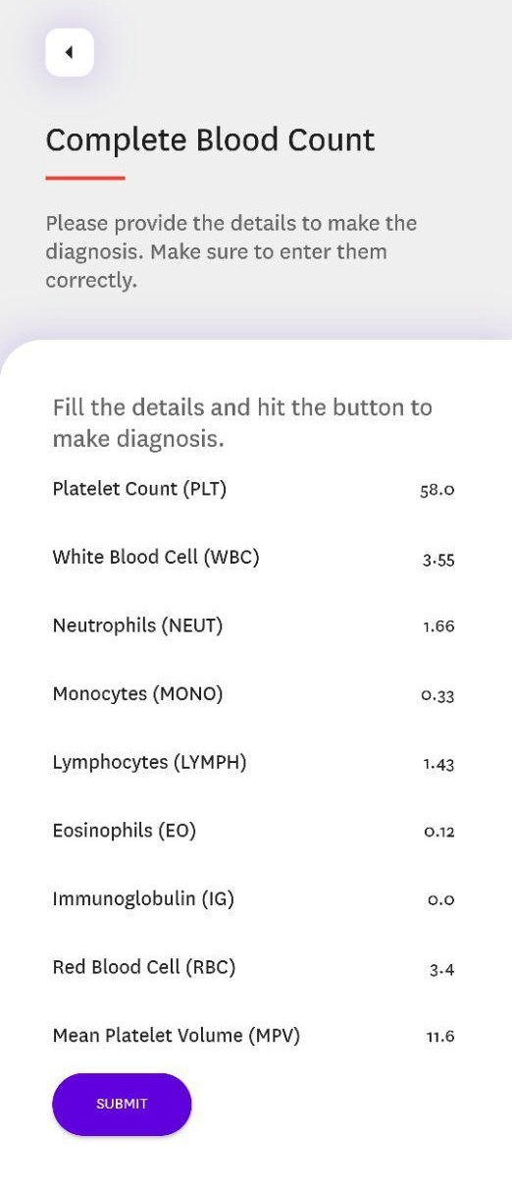


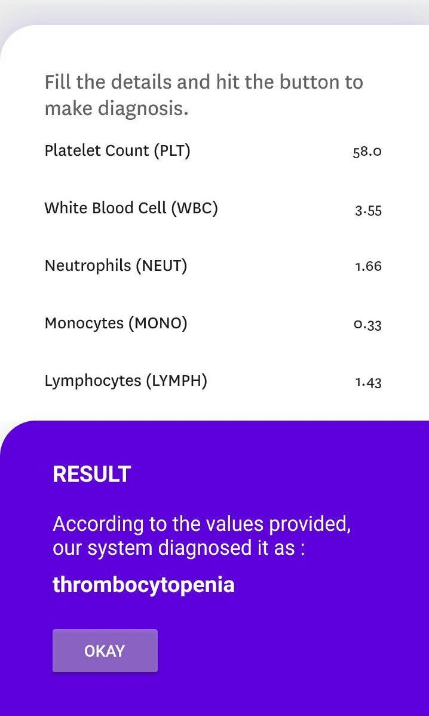
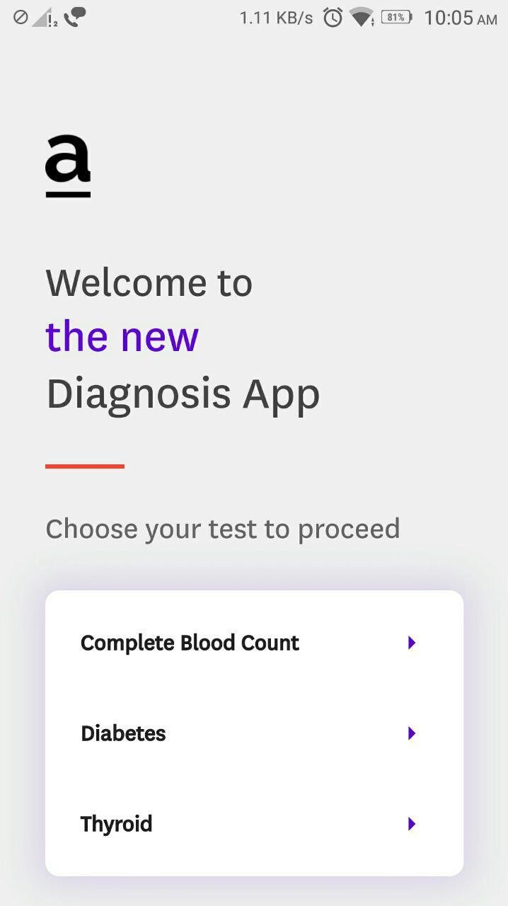
User interface of the System (App)

Slide 8
Complete Blood Count analysis is an essential indicator for many diseases; it contains several parameters which are a sign for speciﬁc blood diseases.
Analysis of CBC Test Result
With the models developed, we are able to diagnose 4 different health states.
Dataset
Information of 869 patient’s blood analysis.
22 features
4 classes

Slide 9

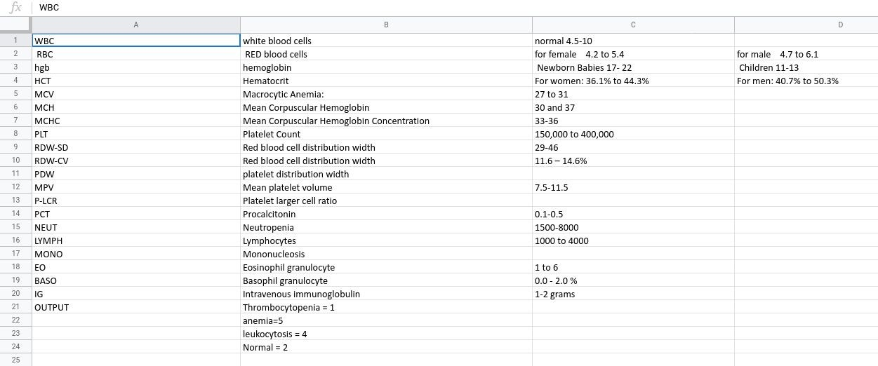
Dataset Used

Slide 10
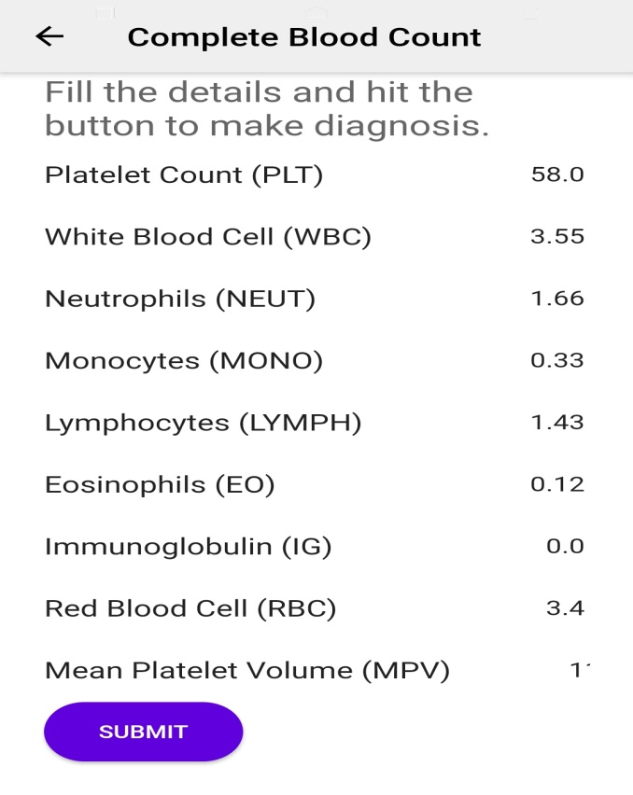
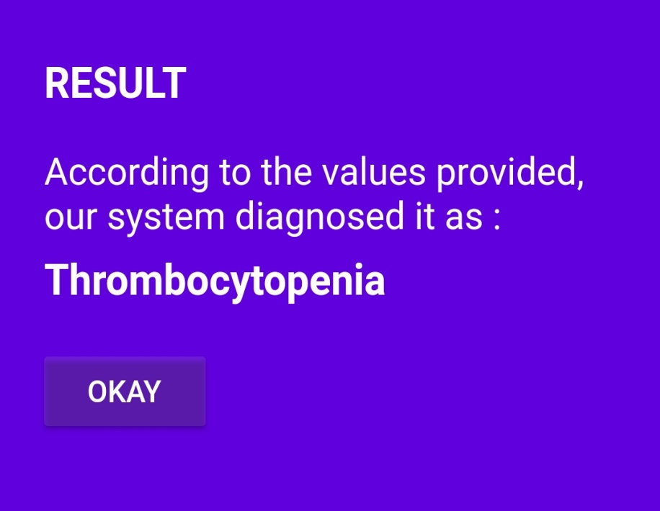
Analysis of CBC Test Result
Inputs

Slide 11
Abnormal thyroid function is common. It is seen in two to three percent of the entire population.
Diagnosis Of Thyroid
Some indicators or parameters used to detect the improper function of the thyroid gland are discussed below:
NAME | NORMAL RANGE
TSH - Thyroid Stimulating Hormone | 0.4 to 4.0 milli-international units per liter
T3 - Triiodothyronine | 0.4 – 5.5 mU/mL
T4 - Thyroxin | 0.8 to 1.8 nanograms per deciliter (ng/dL)

Slide 12
Globally total 21 variables are used for the diagnosis of Thyroid
Diagnosis Of Thyroid
Here Out of the 21 variables, we use only thyroid_surgery, pregnant, age, sex, TSH, T3, T4 are used.
Here the dataset used is from
UCI Machine Learning repository , Garavan
Institute Australia.

Slide 13
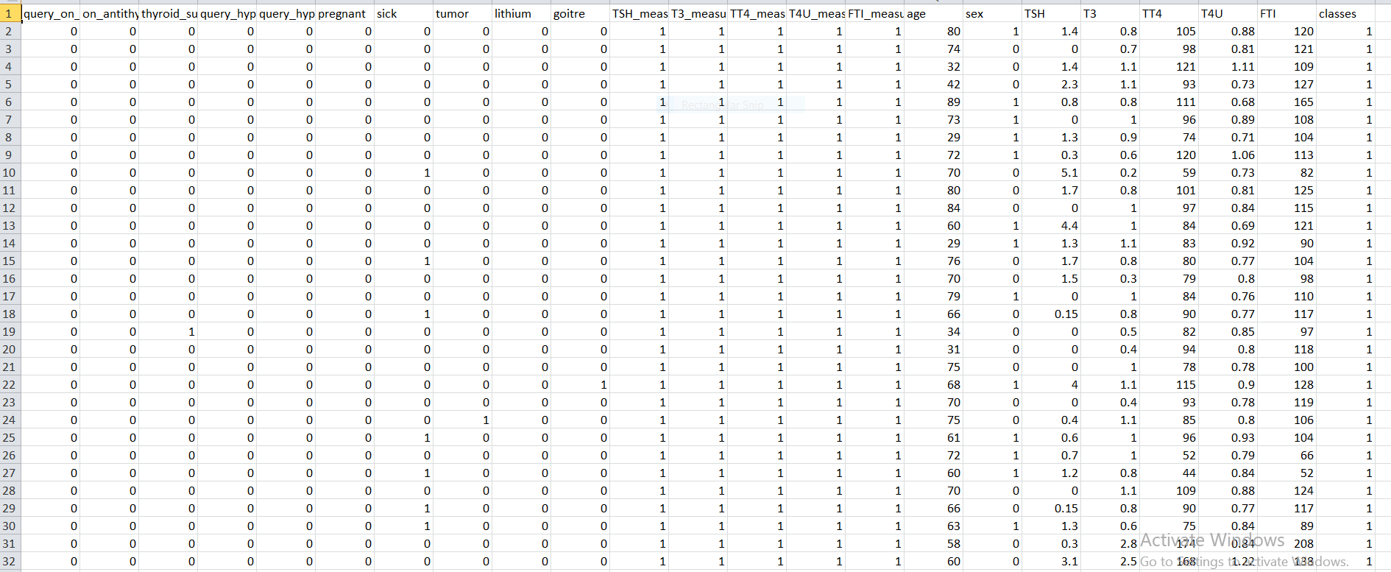
Data set used for Diagnosis Of Thyroid

Slide 14
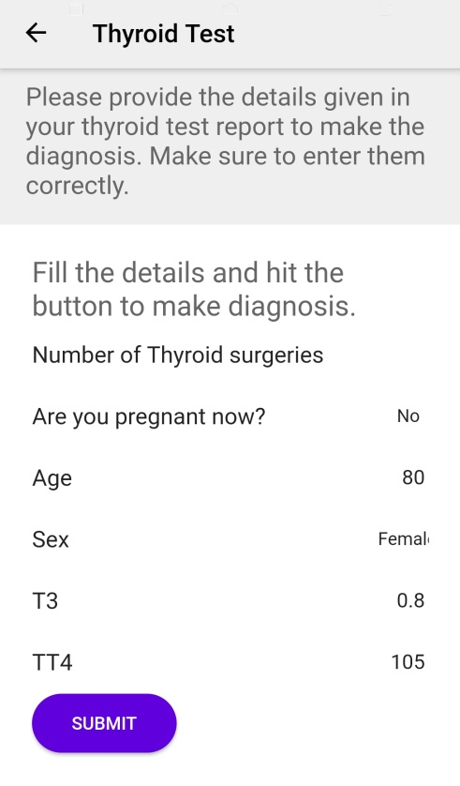

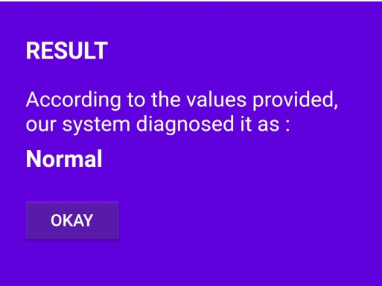
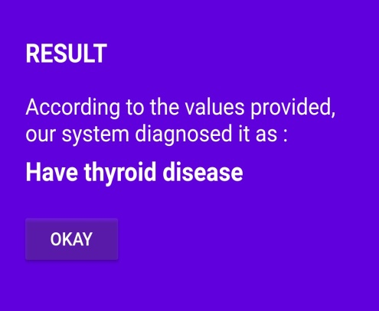
Diagnosis Of Thyroid

Slide 15
Diabetes is a chronic disease that occurs either when the pancreas does not produce enough insulin or when the body cannot effectively use the insulin it produces.
Diagnosis Of Diabetes
One of the common tests used to determine the presence of diabetes is Oral glucose tolerance test:
Diagnosis | A1C Level
Normal | less than 140 mg/dL (7.8 mmol/L)
Prediabetes | between 140 and 199 mg/dL (7.8 mmol/L and 11.0 mmol/L)
Diabetes | more than 200 mg/dL (11.1 mmol/L)

Slide 16
Diagnosis Of Diabetes
Information on 768 patients.
268 positive instance
500 negative instance
Attributes
Pregnancies,Glucose,Blood_pressure,skin
thickness,Insulin,BMI,Age,Outcome,Diabetes pedigree function.
Pregnancies , Glucose , Age, Blood pressure.
Dataset
Pima Indian Diabetes Dataset

Slide 17
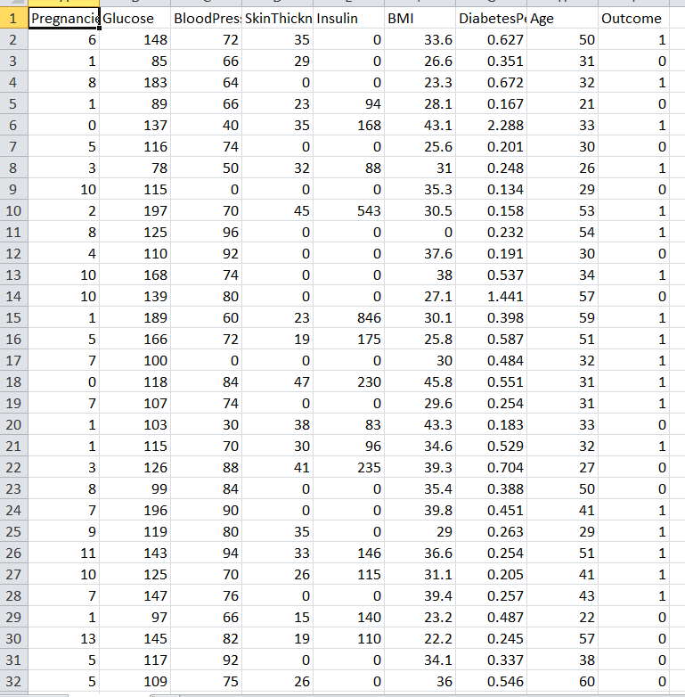
Data set used for Diagnosis Of Diabetes

Slide 18
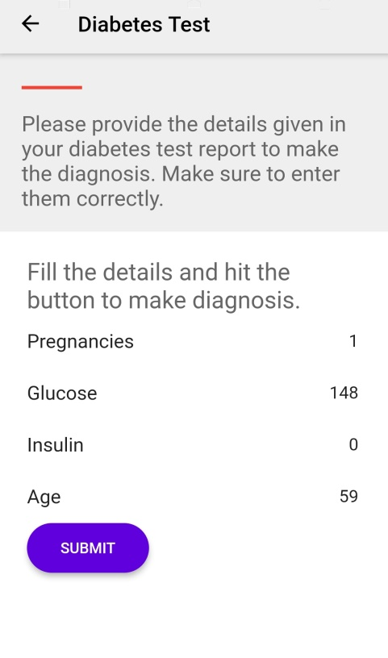
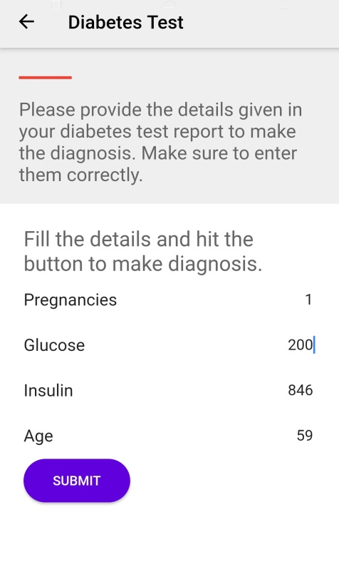
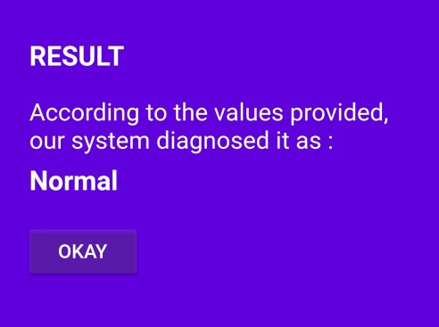
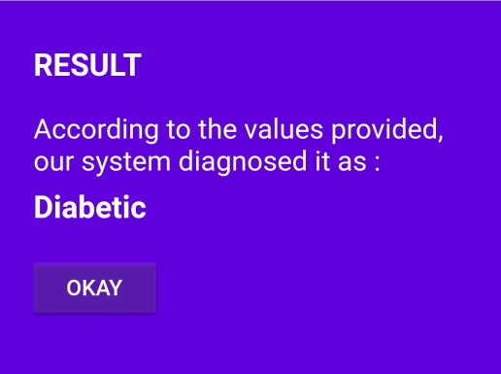
Diagnosis Of Diabetes

Slide 19
How is it better?
An easy to use tool that can be used by anyone(without any medical knowledge) to know and analyze their tests
Increase the accuracy in disease diagnosis

Slide 20
CONCLUSION
The aim of the project was to develop an accurate and easy to use disease prediction and detection system that utilizes the concepts of machine learning that could help patients and medical professionals in diagnosing and identifying diseases and predicting the chance of having a disease in the future .
The project utilizes various public and private datasets regarding clinical laboratory tests and can be used to train and develop useful machine learning models.
The generated model can be accessed by users through a user friendly end-to-end application available through the internet.
Laboratory test results can be fed into the application to get corresponding diagnosis and predictions.

Slide 21
Thank you

