Slide 1


G103 Capstone 1 Analysis of Reddit Scores and Comments by Hour of Day

Slide 2

James Skelton
BSc in Psychology from the University of St. Andrews
Since I graduated in 2018, I have been a self employed, private tutor for SAT/ACT tests, sciences, and writing
Outside interest: rock climbing, bluegrass and jam music, and manga
Inside interest: daily reddit use

Slide 3
Set up and Questions
I’ve noticed in my near decade of Reddit use that many posts with huge score values do not have a comparably large amount of comments. Thinking about this, I decided to make my scraper to test whether or not these values are indeed independent of one another. Furthermore, I wanted to see their relationship to time of day.
I created my scraper using the PRAW library that scraped datetime, ID, number of comments, title text, score, bodytext, and URLs from reddit/r/all. There was an error with the body text, so this was immediately dropped from the dataframe.
The scraper scraped the ‘Hot’ organization of posts on r/all from 2020-01-03 07:04:51 to 2020-01-06 06:00:00. Some posts incorrectly had datetime values after the time of scraping, and were removed due to impossibility.
After primary EDA, my main questions became clear: does hour of the day affect the amount of posts made per hour that are above the average comment or score threshold? Are their certain periods of the day where highly upvoted posts and highly commented posts are less likely to be made?

Slide 4
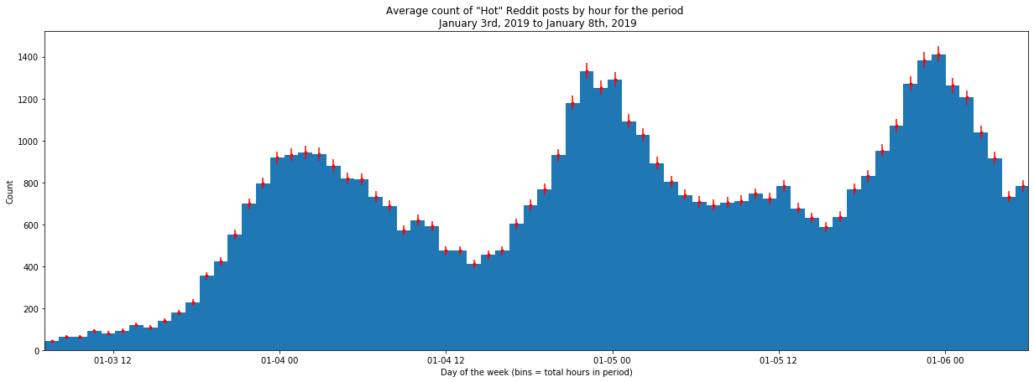
Preliminary findings
At the beginning of my analysis, I plotted the total count of posts by hour over the period I was scraping (time delta = 2 days, 22 hour, 55 minutes and 9 seconds). From this we can see the counts form a multinomial distribution with cresting occuring around 00:00 and troughing just after 12:00 on each day. This pattern inspired this study.

Slide 5
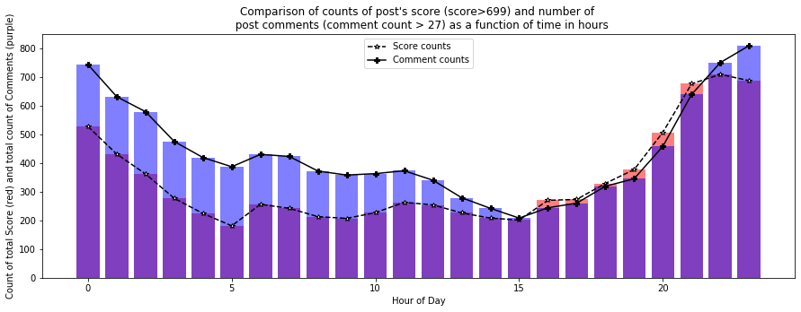
Preliminary findings
I saw that the distribution of the number of highly commented posts (threshold average comment value =27.23, all posts below this were removed from consideration) and high scoring posts (threshold average score value = 699.77) appeared similar.
To test if this was true, I performed a chi^2 test on the number of high scoring and heavily commented posts per hour of day. The null hypothesis was that they were independently distributed. The alternate hypothesis was that the distributions of the two values are not independent. Based on the results of the test, I was able to reject the null hypothesis, X² (23, N = 18573) = 291.300, p = 2.609e-48). Therefore, we can assert that the two sample distributions are not independently distributed.

Slide 6
Key Findings
Encouraged by the findings of the chi square-test, I performed 4 more independent samples t-tests:
-First, I determined that whether it is morning (0-11 hours) or afternoon (12-23) does not significantly effect the amount of posts made with scores, t(22) = -1.699, p=.103, and comments, t(22) = 0.783, pvalue=0.442.
- Secondly, I found that there was a significant difference in the mean posts made during working hours (9-18) and privately spent hours (measuring hours 0-8 and hours 19-23) for scores, t(22) =2.620, p=0.0156, and comments, t(22)=4.491, p=1.82e-4).

Slide 7
Take away and next steps
Its now evident that some factors associated with time of day are significantly associated with the rate at which highly upvoted posts and comments are made.
The next step would be to determine what these factors are, such as the work day effect indicated in this project, and incorporating those into a predictive model. This model could be modified to create a viable method for determining the best time of days for marketing on reddit.
My goal for my next capstone is to take the scraped title data I already have, incorporate it with newly scraped information as well as comment text data, and then use NLP to optimize my model of posting rates.

Slide 9
Questions: Effect of Afternoon and Morning hours
Is there a significant difference in the amount of posts which receive above average comment count (comment count average = 68.359865) during the morning (hour of day 0 -11) and the afternoon (hour of day range 11-23)?
-Null hypothesis: there is no significant difference between the mean number of highly commented posts made per hour during the morning hours and the afternoon hours
-Alternate hypothesis: the mean number of posts with above average comment count made per hour during the afternoon is significantly different than the mean number of posts made above the comment threshold in the morning.
Is there a significant difference in the amount of posts which receive above average amount of upvotes (score average = 2385.594459) during the morning (hour of day 0 -11) and the afternoon (hour of day range 11-23)?
-Null hypothesis: there is no significant difference between the mean number of highly scored posts made per hour during the morning hours and the afternoon hours
-Alternate hypothesis: the mean number of posts made per hour above the scoring average during the afternoon is significantly different than the mean number of posts made above the scoring threshold in the morning

Slide 10
Question: Effect of Work and Private hours
Is there a significant difference in the amount of posts which receive above average comment count (comment count average = 68.359865) during the workday (hour of day range 9-18) and the remaining private hours (0-8 and 19-23)?
-Null hypothesis: there is no significant difference between the mean number of highly commented posts made per hour during the typical work hours and the remaining private hours of the day.
-Alternate hypothesis: the mean number of posts made per hour during the work day is significantly different than the mean number of posts made above the comment threshold during private hours.
Is there a significant difference in the amount of posts which receive above average score (score average = 2385.594459) during work hours and private hours?
-Null hypothesis: there is no significant difference between the mean number of highly scored posts made per hour during the workday and the remaining private hours of the day.
-Alternate hypothesis: the mean number of posts made per hour above the score threshold during the workday is significantly lower than the mean number of posts made above the score threshold during private hours.

