Slide 1


G103 Capstone 1 Analysis of Reddit Scores and Comments by Hour of Day
Notes:
Hi, My name is James Skelton and I am a data scientist. This is my first capstone project: an analysis of Reddit Scores and Comments by Hour of Day

Slide 2

Bio
BSc in Psychology from the University of St. Andrews
Since I graduated in 2018, I have been a self employed, private tutor for SAT/ACT tests, sciences, and writing
Outside interest: rock climbing, bluegrass and jam music, and manga
Inside interest: daily reddit use
Notes:
I graduated in 2018 with a BSc in pyschology from the University of St. Andrews in Scotland. Before making a career change, I was a private tutor in the austin area.
I am a compulsive reddit browser, which naturally lead me to this topic.

Slide 3
Background and EDA
I created my scraper using the PRAW library that scraped datetime, ID, number of comments, title text, score, bodytext, and URLs from reddit/r/all. There was an error with the body text, so this was immediately dropped from the dataframe.
I scraped the ‘Hot’ organization of posts on r/all from 2020-01-03 07:04:51 to 2020-01-06 06:00:00. Some posts incorrectly had datetime values after the time of scraping, and were removed due to impossibility.
Data was also cleaned of all rows missing data.
Notes:
After 8 years of using reddit, I had always thought it was odd how their appeared to be an noticeable amount of posts that had a significant amounts of score (simply the number of upvotes minus the number of downvotes ), but did not have a comparable amount of comments, and vice versa. With that in mind, I focused on these two categories for scraping, as well as their created time. Scraping from the hot post organization on r/all allowed me to get posts that were suitably “seen” and had been generally given a chance to receive upvotes and comments before scraping.

Slide 4
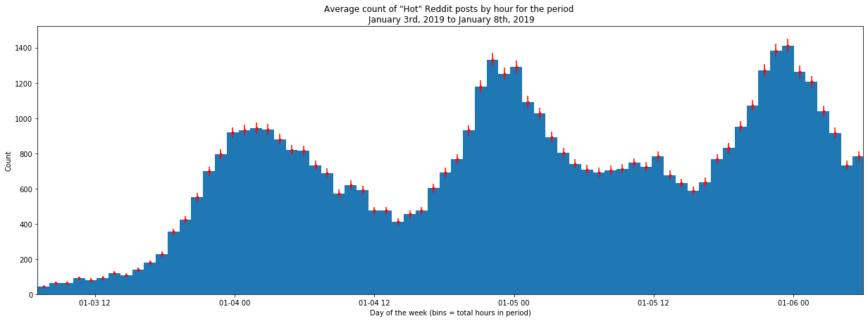
Preliminary findings
I plotted the total count of posts by hour over the period I was scraping (time delta = 2 days, 22 hour, 55 minutes and 9 seconds). From this we can see a clear pattern, with the counts cresting around 00:00 and troughing just after 12:00 on each day. This pattern inspired this study.
Notes:
To begin, I made a simple histogram of the total count of posts made per hour over my period of scraping. As you can see, a clear pattern forms where there is peak activity around midnight, and a trough of activity around 1 pm. This pattern is what inspired me to focus on the effects related to day time on the posts.
This led me to consider two possibilities: is there a difference in these values in the morning and the afternoon? What about the workday and the hours outside of the work day?

Slide 5
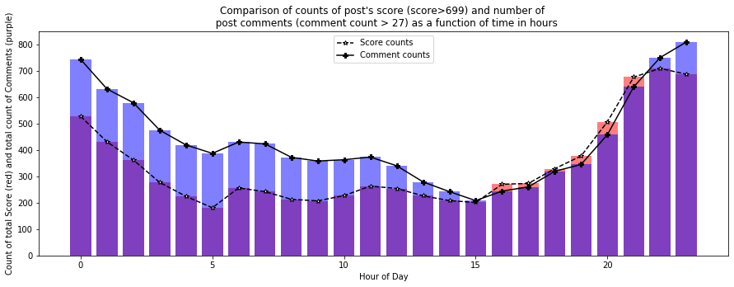
Preliminary findings
To test if the number of posts with above average comment counts(over 27 comments) and scores (above 699) were independently distributed, I performed a chi square test.
The null hypothesis was that they were independently distributed.
The alternate hypothesis was that the distributions of the two values are not independent.
Based on the results of the test, I was able to reject the null hypothesis, X² (23, N = 18573) = 291.300, p = 2.609e-48) and assert that the two sample distributions are not independently distributed.
Notes:
I wanted to see if the distribution of the counts of highly commented and highly upvoted posts were the same, so I performed a chi square analysis on the two sets of data. Based on these findings, i was able to reject the null hypothesis and assert the two variables were indeed dependent on one another.

Slide 6
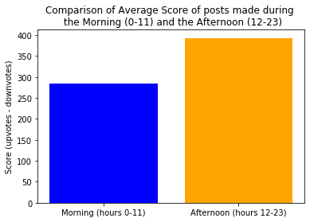
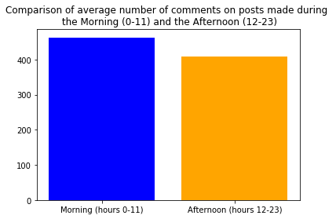
Findings: Does morning or afternoon have an effect on post values?
-Null hypothesis: there is not a significant difference in the post values in the morning (0-11 hours) or afternoon (12-23)
-Alternate hypothesis: posts made in the afternoon would have significantly different values than the afternoon.
-I found that Morning or afternoon does not significantly effect the amount of posts made with scores, t(22) = -1.699, p=.106, and comments, t(22) = 0.783, pvalue=0.442.
Notes:
Based on the two histograms I showed before, I first wanted to show if post values for the morning were significantly different than post values for the afternoon. Based on the data, I found no significant effect there. The average post values were therefore similar in the morning and afternoon.

Slide 7
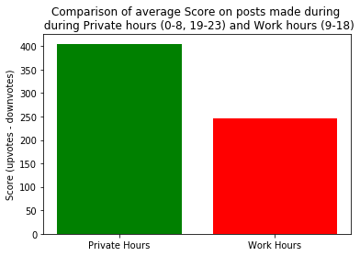
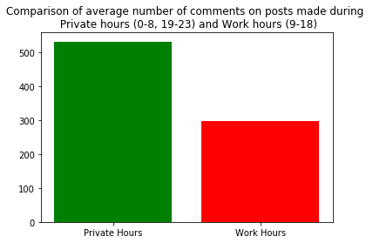
Findings: Do work hours effect post values?
- Null hypothesis: there is no significant difference in the comment and score values for posts made during work hours (9-18) than posts made outside of them (0-8 and 19-23)
- Alternate hypothesis: posts made during work hours were significantly less likely to be highly upvoted or highly commented on.
- I found that there was a significant difference in the mean posts made during working hours and privately spent hours for scores, t(22) = 2.620, p=0.0156, and comments, t(22)=4.491, p=1.82e-4).
Notes:
Noticing the pattern of the histograms, It appeared to me that typical work hours (9-18) looked to be lower than posts made outside of those hours. To test this, I performed a chi square analysis. My null hypothesis was that there was no significant difference in the average post values above the threshold between the two periods. My alternate hypothesis was that posts made during work hours would have significantly lower values than outside of those hours. Based on the t-test results, I was able to reject the null hypothesis and show that there was indeed a significant effect of the work day.

Slide 8
Take away and next steps
In conclusion, there appears to be a correlation between time of day and the rate at which highly upvoted and highly commented posts are made
The next step would be to determine some of the other factors at play, using information like what is gleaned here about work hours, and incorporating those into a predictive model. Potential uses for this model would be heavily focused on marketing to redditors.
Notes:
In conclusion, posting during working hours is significantly less likely to garner an above average amount of comments or score.
My goal for my next capstone is to take the scraped title data I already have, incorporate it with newly scraped information as well as comment text data, and then use NLP to optimize my model of posting rates.

Slide 10
Questions: Effect of Afternoon and Morning hours
Is there a significant difference in the amount of posts which receive above average comment count (comment count average = 68.359865) during the morning (hour of day 0 -11) and the afternoon (hour of day range 11-23)?
-Null hypothesis: there is no significant difference between the mean number of highly commented posts made per hour during the morning hours and the afternoon hours
-Alternate hypothesis: the mean number of posts with above average comment count made per hour during the afternoon is significantly different than the mean number of posts made above the comment threshold in the morning.
Is there a significant difference in the amount of posts which receive above average amount of upvotes (score average = 2385.594459) during the morning (hour of day 0 -11) and the afternoon (hour of day range 11-23)?
-Null hypothesis: there is no significant difference between the mean number of highly scored posts made per hour during the morning hours and the afternoon hours
-Alternate hypothesis: the mean number of posts made per hour above the scoring average during the afternoon is significantly different than the mean number of posts made above the scoring threshold in the morning

Slide 11
Question: Effect of Work and Private hours
Is there a significant difference in the amount of posts which receive above average comment count (comment count average = 68.359865) during the workday (hour of day range 9-18) and the remaining private hours (0-8 and 19-23)?
-Null hypothesis: there is no significant difference between the mean number of highly commented posts made per hour during the typical work hours and the remaining private hours of the day.
-Alternate hypothesis: the mean number of posts made per hour during the work day is significantly different than the mean number of posts made above the comment threshold during private hours.
Is there a significant difference in the amount of posts which receive above average score (score average = 2385.594459) during work hours and private hours?
-Null hypothesis: there is no significant difference between the mean number of highly scored posts made per hour during the workday and the remaining private hours of the day.
-Alternate hypothesis: the mean number of posts made per hour above the score threshold during the workday is significantly lower than the mean number of posts made above the score threshold during private hours.

