Slide 1
Wine Quality Logistic Model
Jameson Buie

Slide 2
Overview
Use logistic modeling to determine if wine being tested is “Good” or “Bad”
Explore correlation between different independent variables
Determine if model is efficient in predicting wine quality

Slide 3
Data Source
Data set includes almost 1600 different subjects of wine
Created by UC Irvine Machine Learning Repository to practice modeling
Determine what variables are most significant in predicting wine quality
Found on Kaggle

Slide 4
Introduction to the Data
11 different independent variables that will be used as predictor values
1 dependent variable
This variable is the class that the wine is put into
Discrete variable

Slide 5
Data Cleaning and Preprocessing
Since this data set was carefully created, there were no missing values
The dependent variable was an object data type
“Good” or “Bad”
Needed to be changed to integer type
Used binary numbers as wine quality class
1 is “Good”
0 is “Bad”

Slide 6
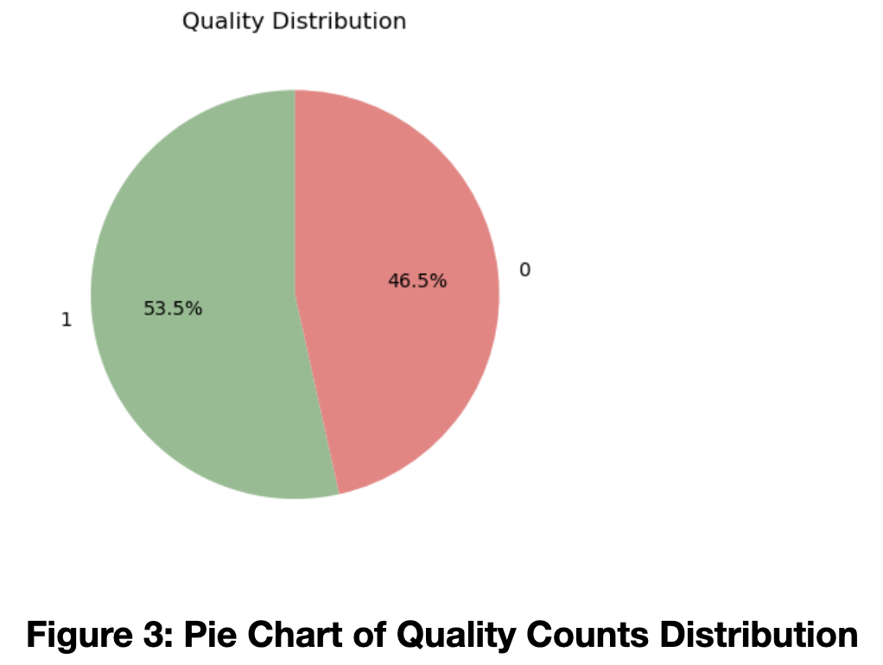
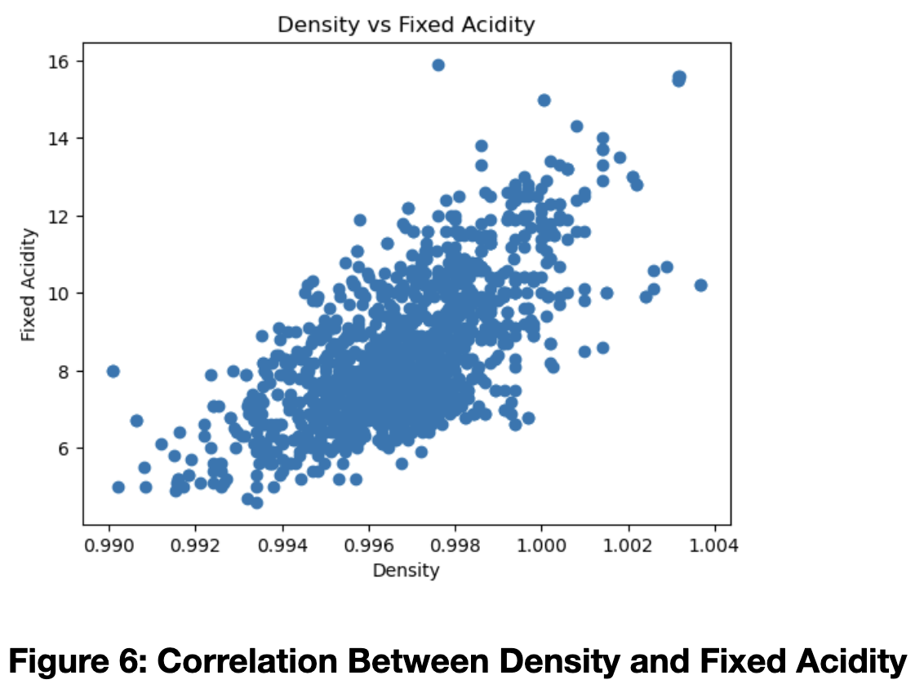
Data Exploration
Used Matplotlib and Seaborn
Seaborn Heatmap and Pairplot
Matplotlib Violinplot, Scatterplot, and Pie Chart

Slide 7
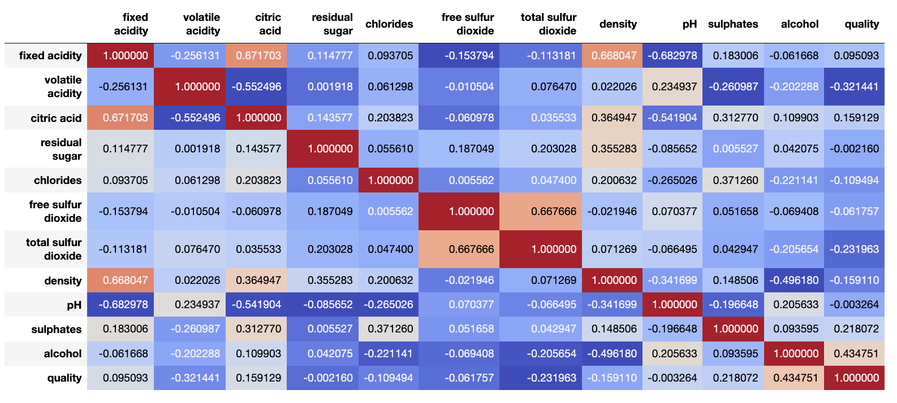
Correlation Between Predictor Variables

Slide 8
Logistic Models Created
Used LogisticRegression from SKLearn to create models
Model 1 – Used all independent variables as predictor values. 80/20 data split.
Model 2 – Used all independent variables as predictor values. 70/30 data split.
Model 3 – Used only statistically significant values determined by R significance test. 80/20 data split.

Slide 9
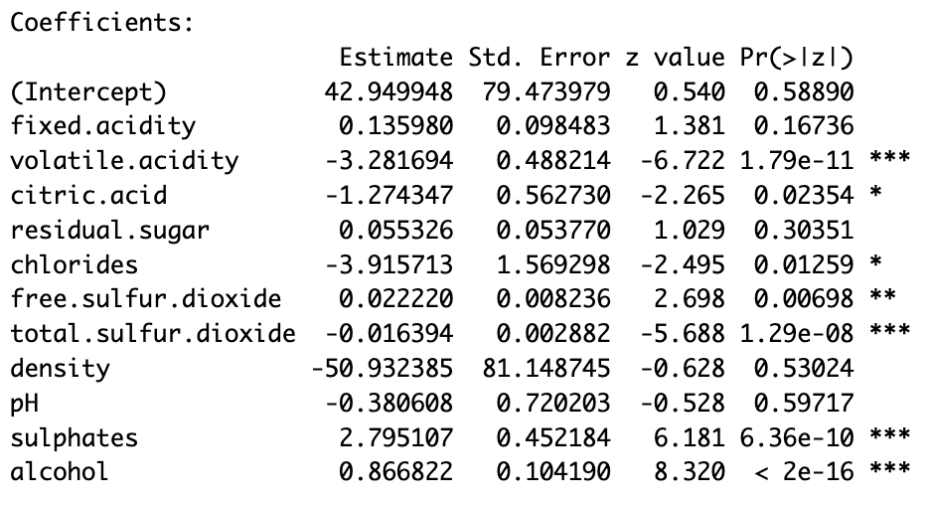
Using R to Determine Significant Values
Not all independent variables were necessary for predicting the wine quality
Used R to determine which variables were significant predictors
Created third model by using only these values as predictors

Slide 10
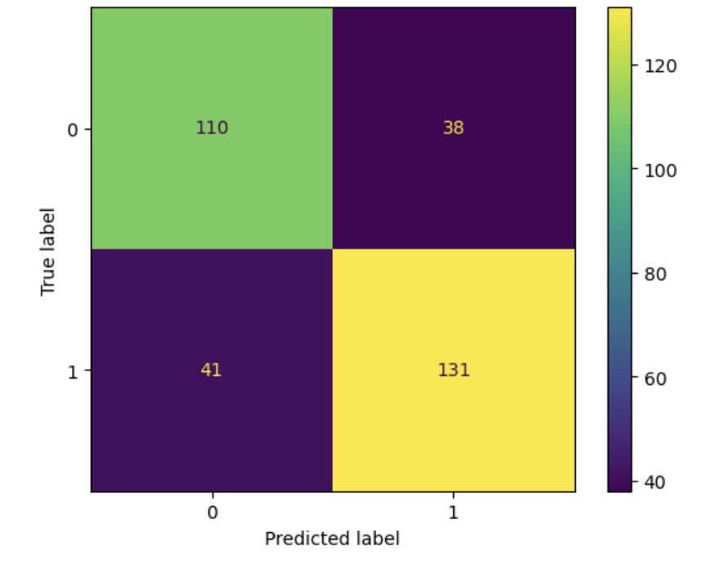
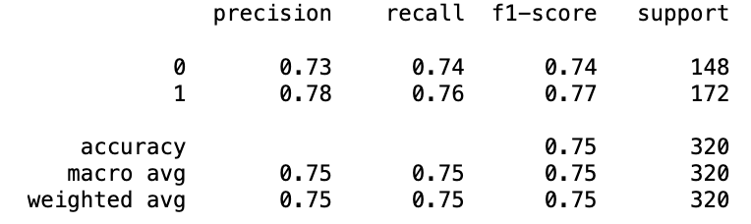
Model 1 Results
75% Accuracy
74% True Positives
76% True Negatives

Slide 11
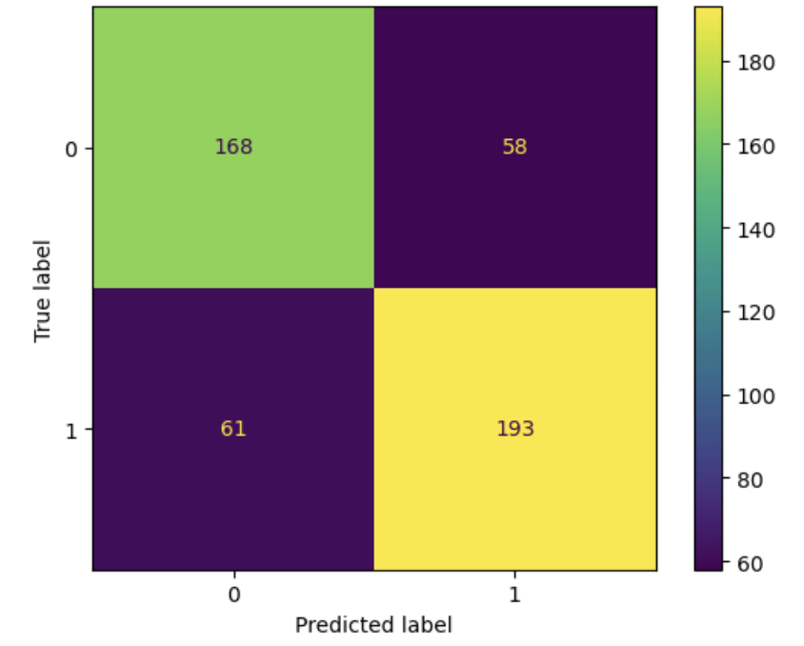
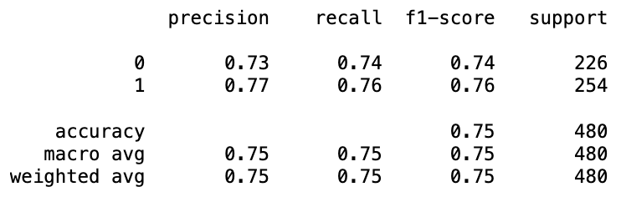
Model 2 Results
Very similar to first model
75% Accuracy
74% True Negatives
76% True Positives

Slide 12
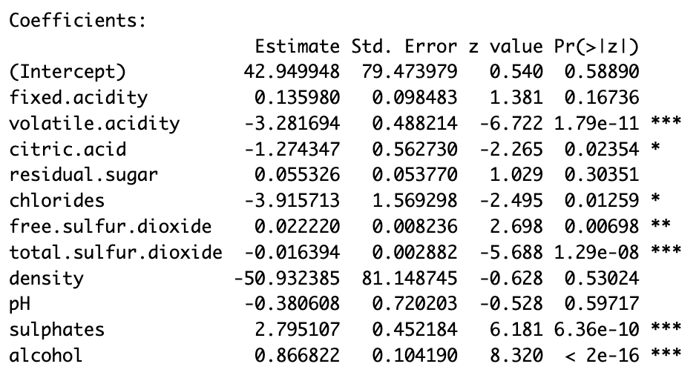
R Logistic Regression Model
Preset functions in R to do logistic regression
Analysis shows which variables are significant predictors
Hypothesis: creating a classification model with only significant predictors will result in a more accurate model

Slide 13
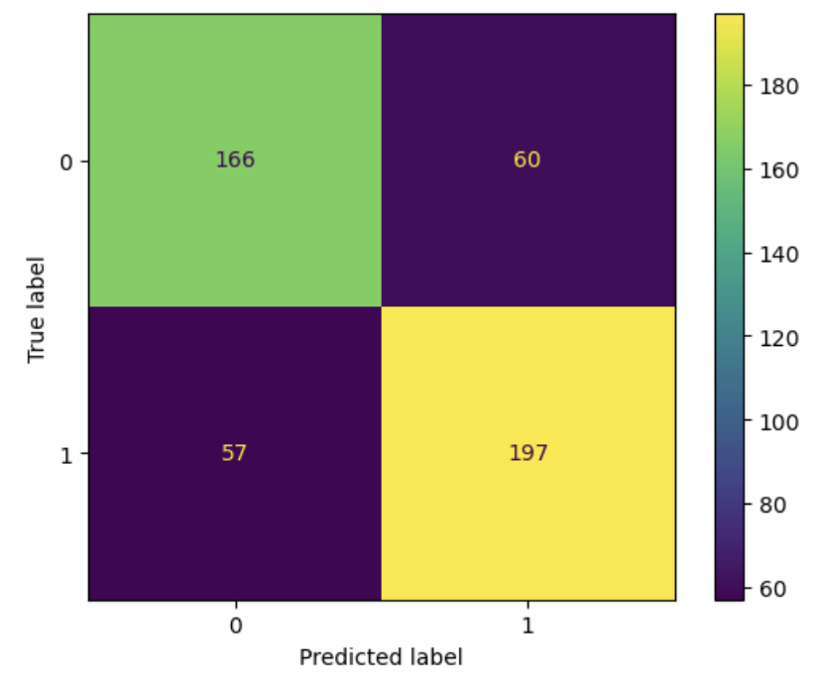
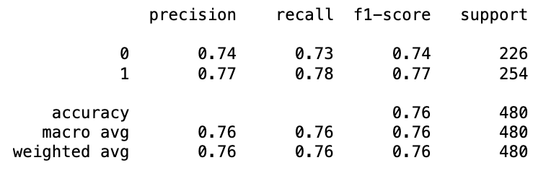
Model 3 Results
Most accurate model
76% Accuracy

Slide 14
Conclusion
Met main objective of creating a model that can classify wine as good or bad
Limitations
Things to change

