Slide 1
Python Reserved Keywords
Jameson Buie

Slide 2
What are reserved keywords?
Words that designate a certain language functionality
No object can have the same identifier as a keyword
Using them wrong can cause errors
Keywords are a green color, so they are easily identifiable

Slide 3
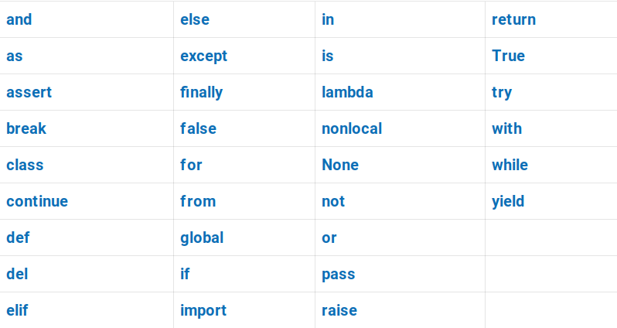
There are 33 keywords in Python 3.6
https://betterprogramming.pub/all-33-reserved-keywords-in-python-98e55f6c8ded

Slide 4
Which keywords have we used the most?
def, class
for, while, if
break, continue
import, as

Slide 5
How you can access these words in Python
There is no need to remember each reserved keyword
You can access a list of all keywords in the notebook you are programming on
help("keywords")

Slide 6
Tricks for keywords
If you import a module that has a long name, you can change the name of it by using as to reference it as something shorter.
import numpy as np
import datetime as dt
Keywords are case-sensitive, the only keywords that are capital are:
True
False
None

