Slide 1
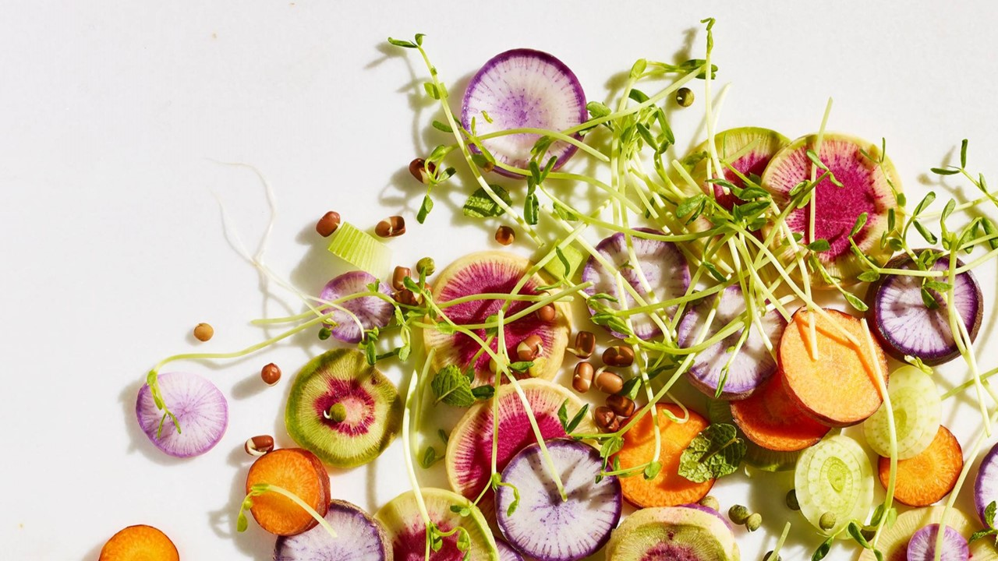
MealPrepMatch
By Daniel Son,
Jameson Teeters

Slide 2
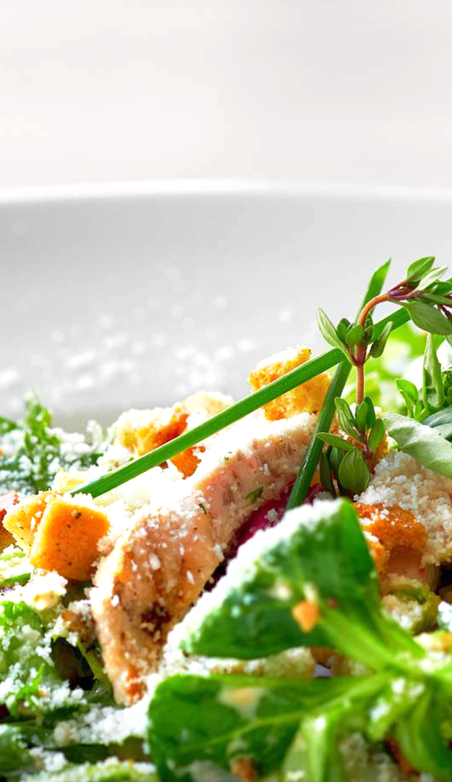
Customer(Consumer)
Starts from index page
Register if no account exists, login if account exists.
Leads to consumerDashboard, which shows info such as how long the subscription has been going for, and how many meals have been planned for that week. Also shows what meals you have added, and the reviews you have written.
Go to the pantry from there
The pantry is the catalog of food available to order through subscription. You can see the details of a particular meal by pressing the View Meal button. That leads you to a page describing contents and nutritional facts of that meal box.
You can add a meal to your dashboard to receive and/or write a review about foods you've tried with the service already.

Slide 3
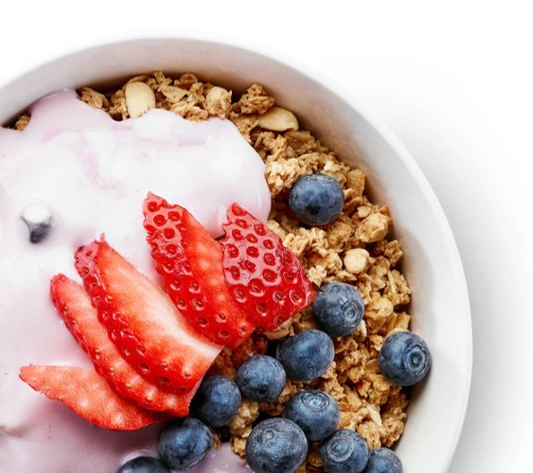
Greek yogurt parfait
ingredients
Greek yogurt
Fresh berries (such as strawberries, blueberries, or raspberries)
Honey or maple syrup
Granola or crushed nuts
5 minutes • 1-2 servings
preparation
1
In a glass or bowl, layer Greek yogurt, fresh berries, and a drizzle of honey or maple syrup.
2
Repeat the layers until you reach the desired amount.
3
Top the parfait with a sprinkle of granola or crushed nuts for added crunch.
4
Enjoy immediately or refrigerate for a refreshing and healthy snack.
TIP
Add a sprinkle of spirulina or bee pollen for a boost of antioxidants.
Calories approx. 670-790; total fat 35g; saturated fat 2.6g; cholesterol 2.5mg; sodium 310mg; total carbohydrate 55-65g; dietary fiber 5.5g; protein 12g

Slide 4
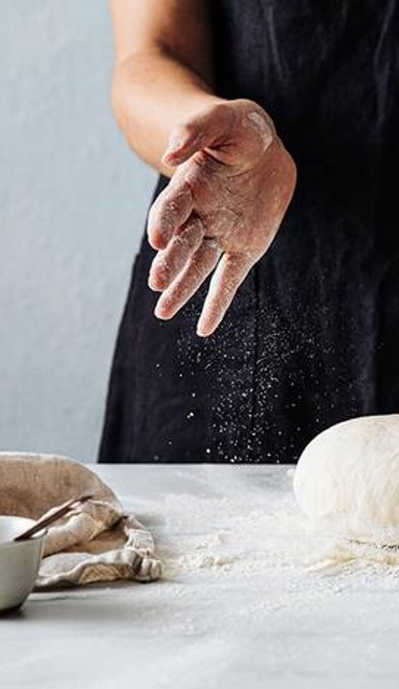
Contributors
Daniel Son
Jameson Teeters

