Slide 1
Advanced Programming – Message Server
James Richardson – S15121033
Travis Smith – S15126971
Ryan Howes – S15118048

Slide 2
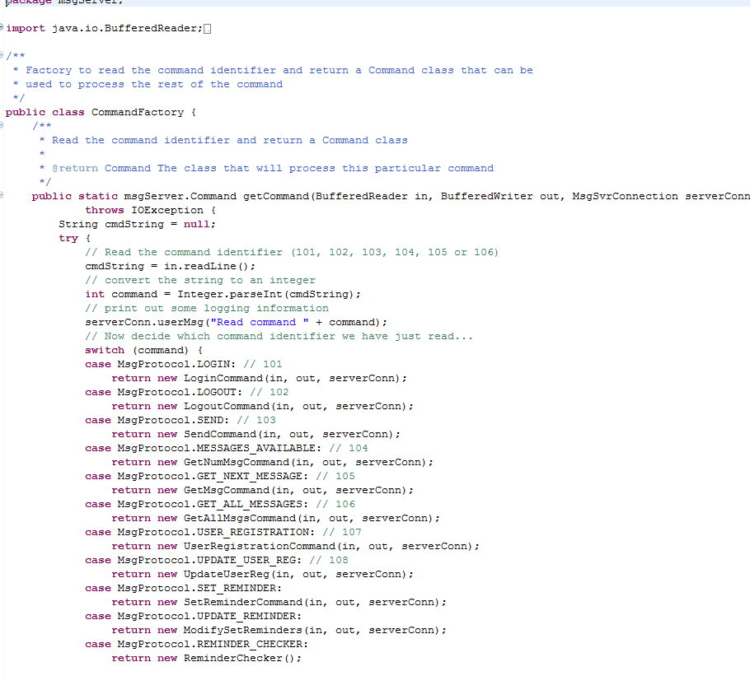
Command Factory

Slide 3
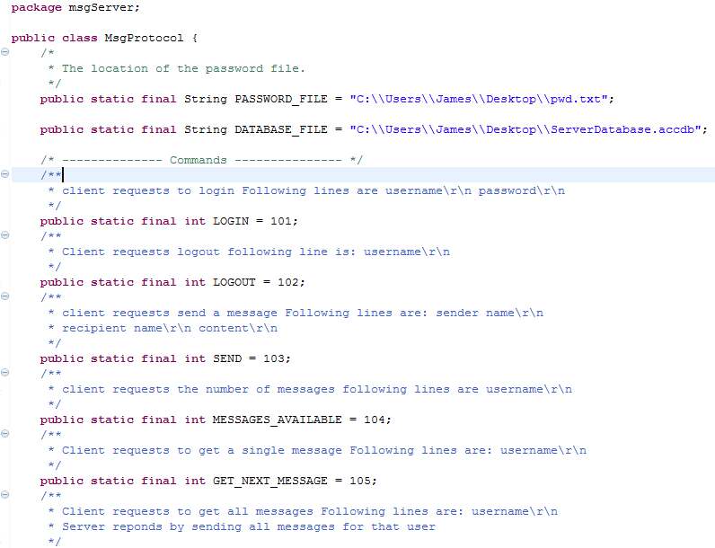
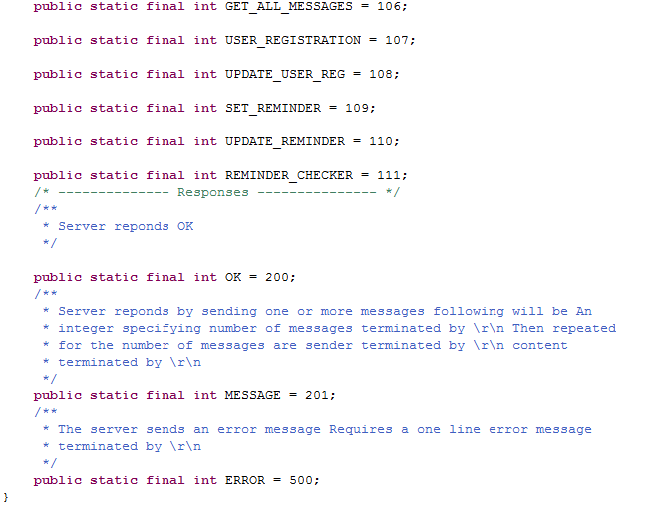
Msg Protocol

Slide 4
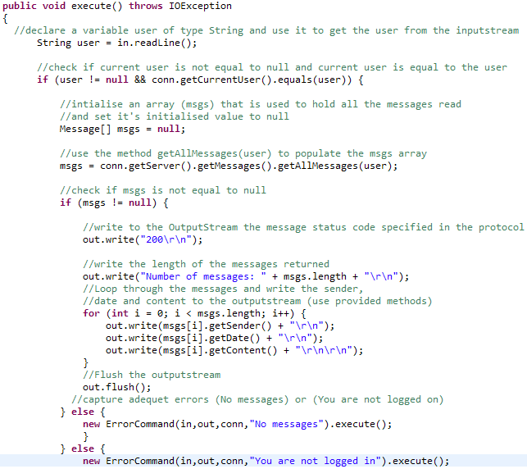
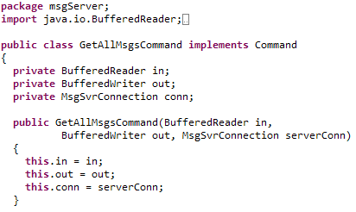
GETTING ALL MESSAGES
Task 1 involved receiving all messages sent through the messaging server.
We decided to implement a new protocol (106) to refer to in the message server when needed.
File: MessageProtocol.java
File: GetAllMsgsCommand.java
File: CommandFactory.java
File: GetAllMsgsCommand.java

Slide 5
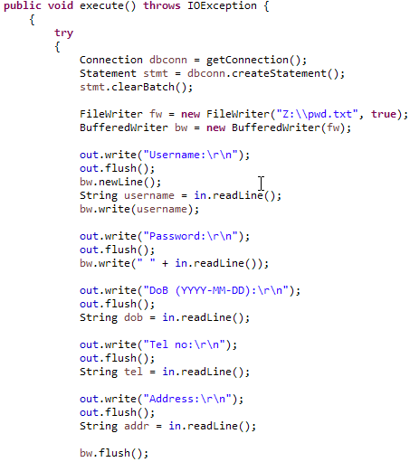

REGISTRATION
File: UserRegistration.java
File: UserRegistration.java

Slide 6
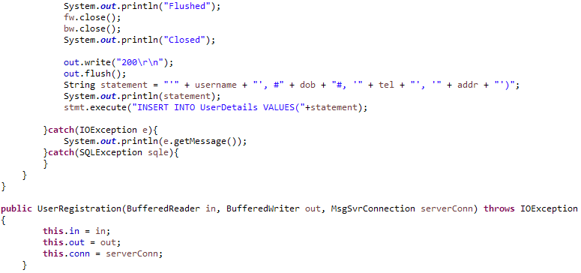
File: UserRegistration.java

Slide 7

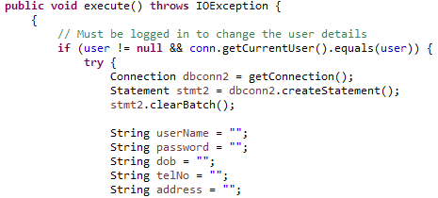
UPDATING REGISTRATION
File: UpdateUserReg.java
File: UpdateUserReg.java

Slide 8
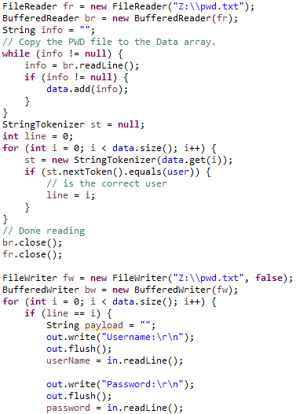
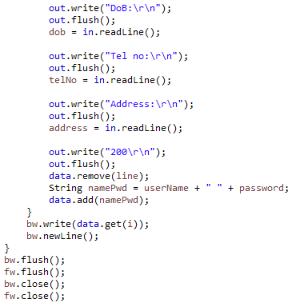
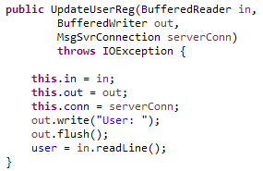
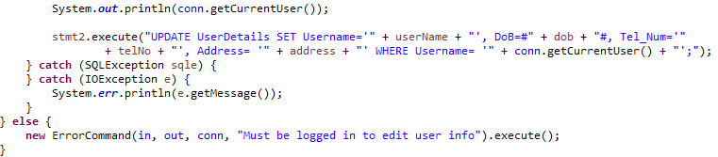
File: UpdateUserReg.java
File: UpdateUserReg.java
File: UpdateUserReg.java
File: UpdateUserReg.java

Slide 9
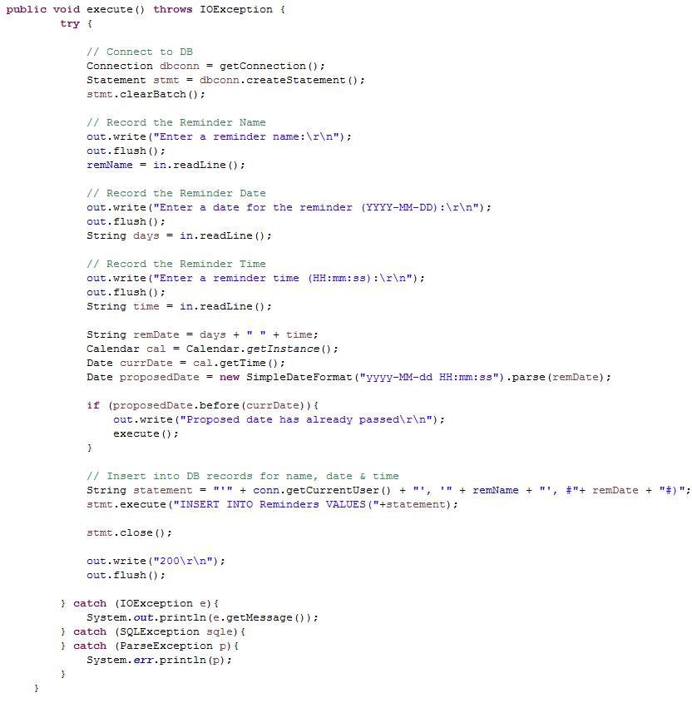
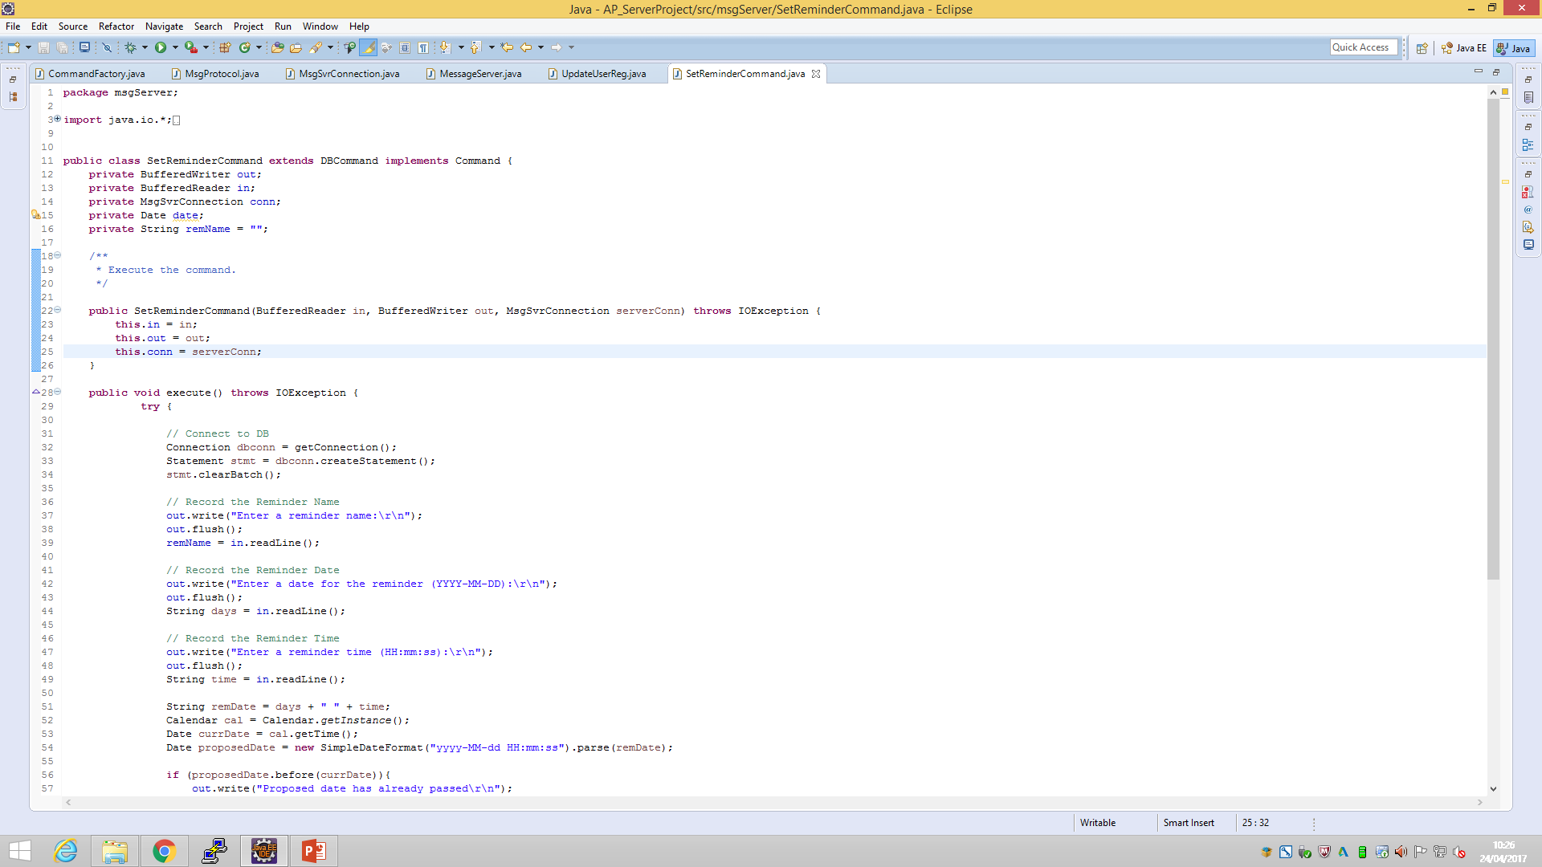
SETTING REMINDERS
File: SetReminderCommand.java

Slide 10
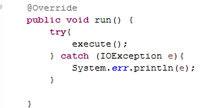
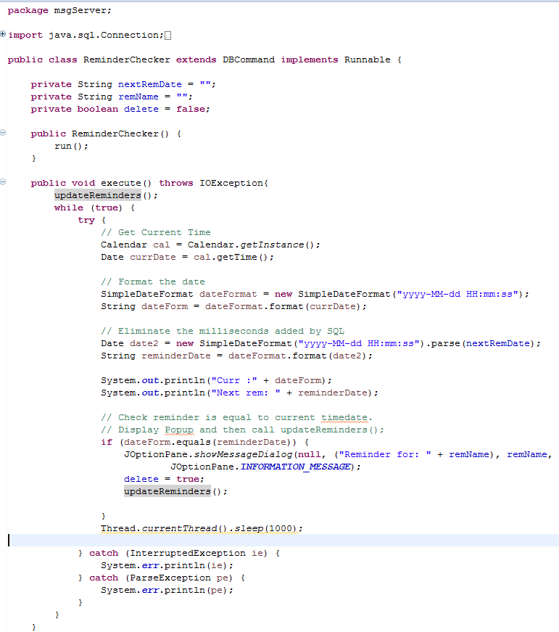
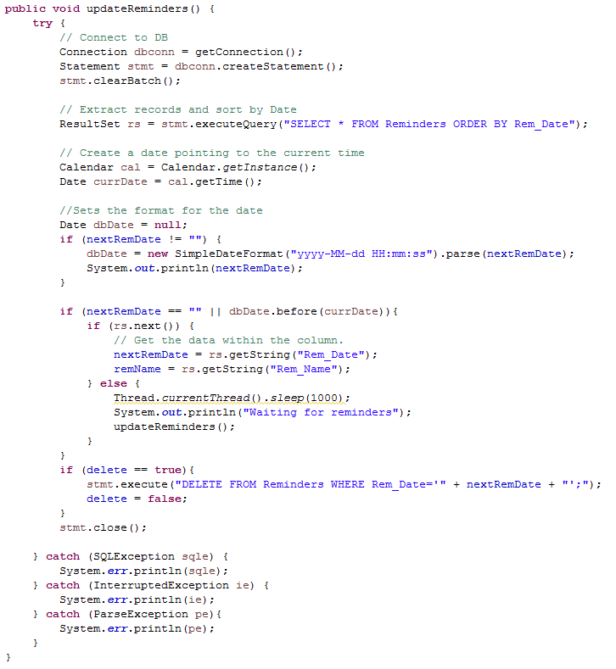
Checking Reminders
File:ReminderChecker.java

Slide 11
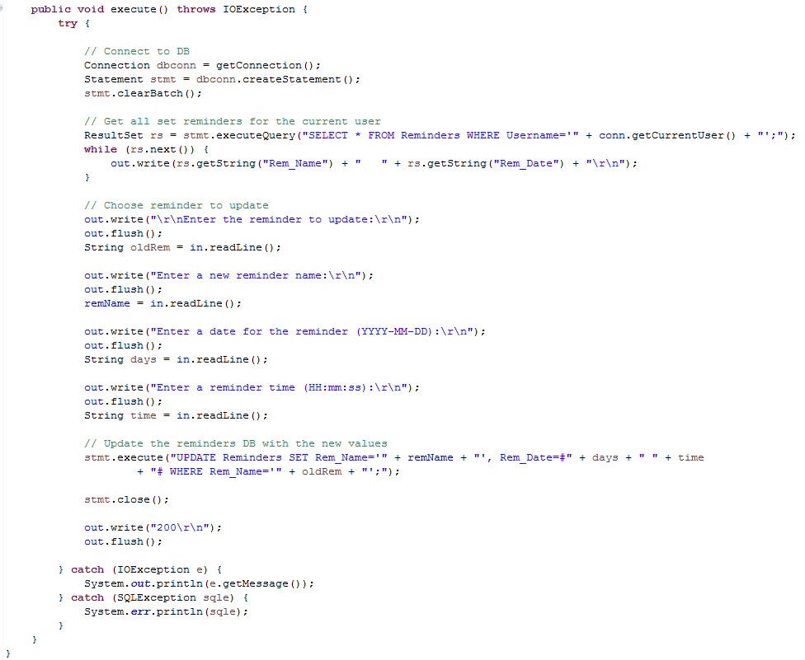
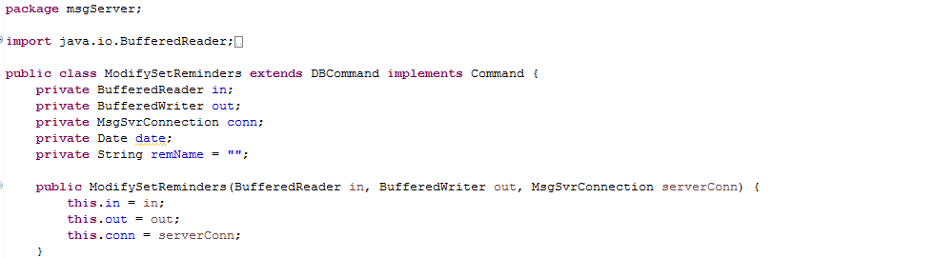
Modifying Set REMINDERS
File:ModifySetReminders.java

Slide 12
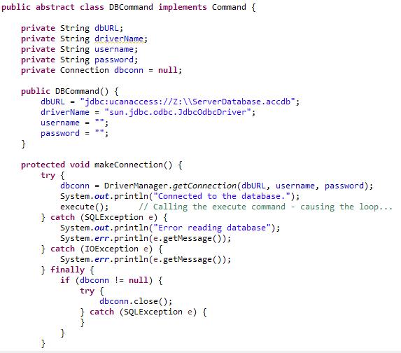
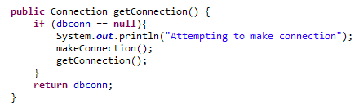
JDBC CONNECTION
File: DBCommand.java
File: DBCommand.java

