Slide 1
Advanced Programming – Message Server
James Richardson –
Travis Smith – S15126971
Ryan Howes – S15118048

Slide 2
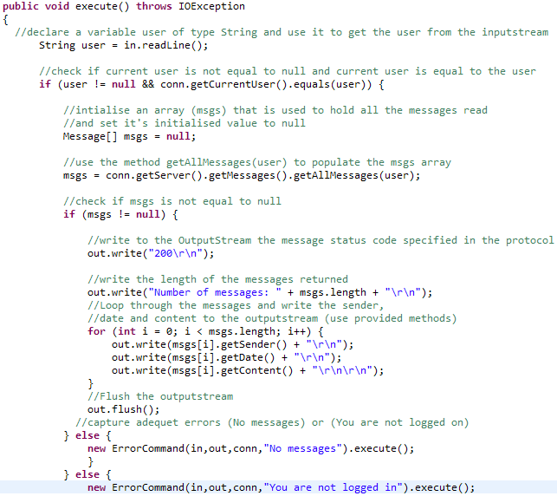
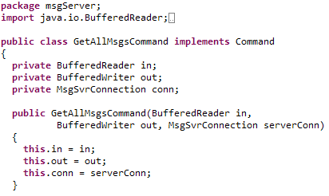
GETTING ALL MESSAGES
Task 1 involved receiving all messages sent through the messaging server.
We decided to implement a new protocol (106) to refer to in the message server when needed.
File: MessageProtocol.java
File: GetAllMsgsCommand.java
File: CommandFactory.java
File: GetAllMsgsCommand.java

Slide 3
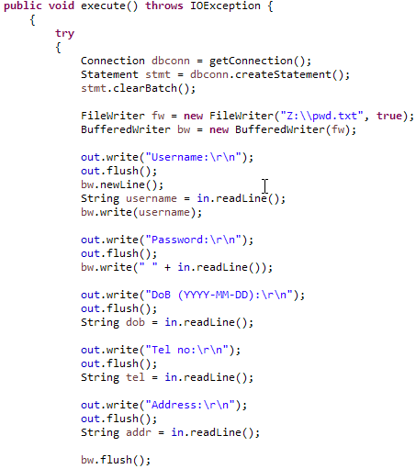

REGISTRATION
File: UserRegistration.java
File: UserRegistration.java

Slide 4
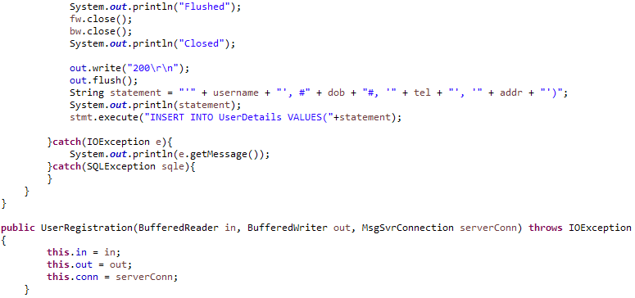
File: UserRegistration.java

Slide 5

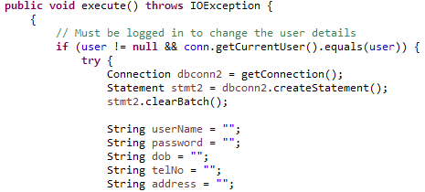
UPDATING REGISTRATION
File: UpdateUserReg.java
File: UpdateUserReg.java

Slide 6
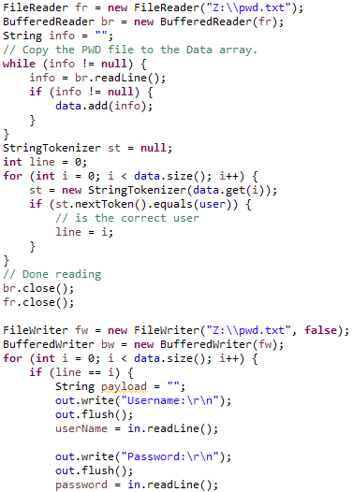
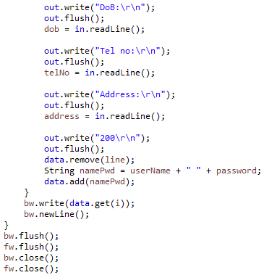
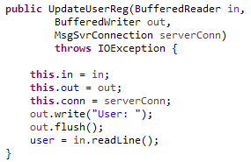
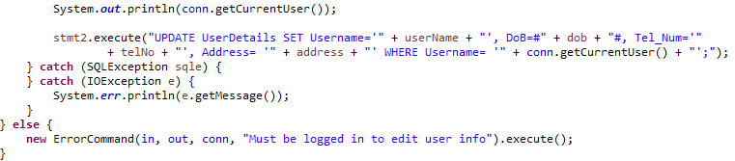
File: UpdateUserReg.java
File: UpdateUserReg.java
File: UpdateUserReg.java
File: UpdateUserReg.java

Slide 7
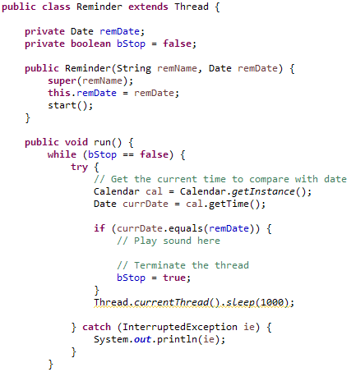
SETTING REMINDERS
File: Reminder.java

Slide 8
UPDATING REMINDERS

Slide 9
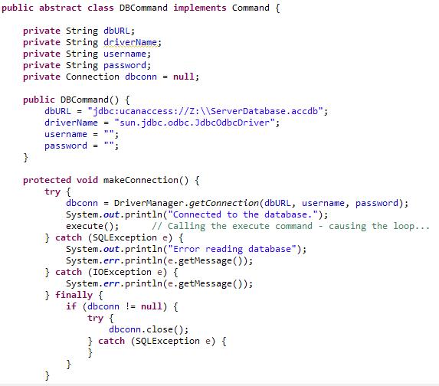
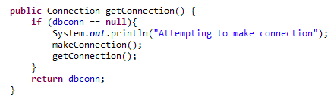
JDBC CONNECTION
File: DBCommand.java
File: DBCommand.java

Slide 10
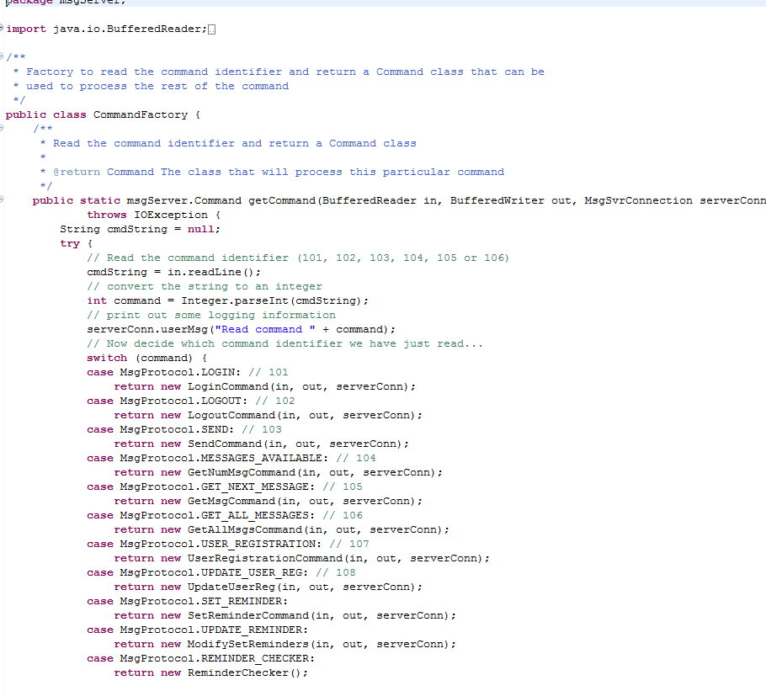
Command Factory

Slide 11
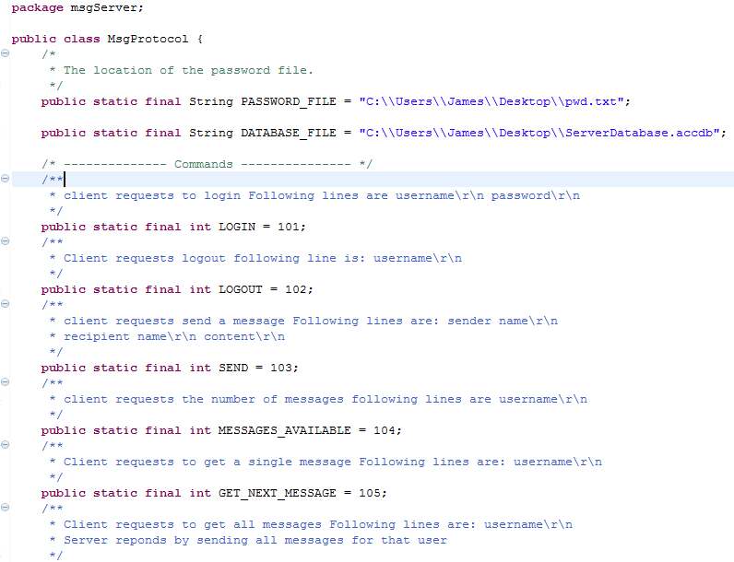
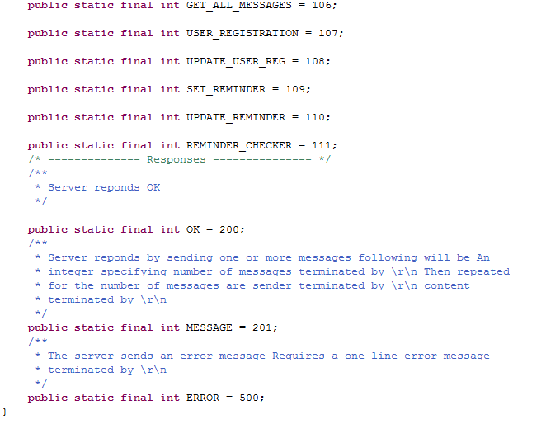
Msg Protocol

