Slide 1
Naive Bayes Classifier
Abigail Allen & James Sanford-Luevano

Slide 2
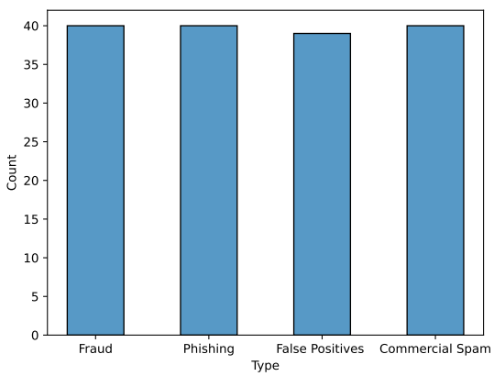
Introduction & Dataset
Reasons for development:
Help elderly/less tech-savvy
Increase efficiency
Increase productivity
Phishing Email Data by Type - Kaggle
160 Emails
Subject line
Content of Email
Classification Type
Fraud
Phishing
Spam
False Positive (Legit)

Slide 3
Analysis
Used list of keywords
act now!
information you requested
once in lifetime
time limited
urgent
print out and fax
Determined if scam or not scam
Grouped Fraud and Phishing
Multinomial Naive Bayes
Used the train_test_split() function
75/25

Slide 4
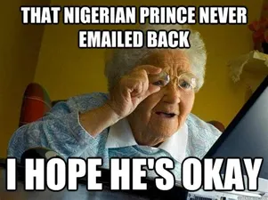

Results
Precision for 'Valid' ranged from 0.65 to 0.825, with a of 0.7525
Model predicted 75.25% of 'Valid' instances correctly.
Recall for 'Valid' was 1
All ‘Valid' instances were correctly identified.
F1-score for 'Valid' ranged from 0.788 to 0.90, with an average of 0.8576.

