Slide 1
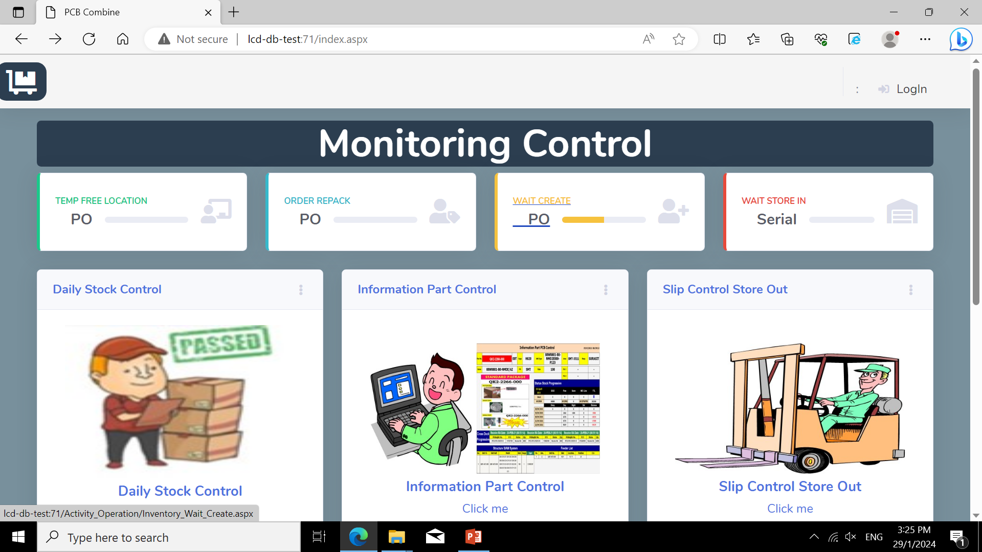
Strategic
Combine

Slide 2

Location:
Zone:
List serial in po_no :

Slide 3
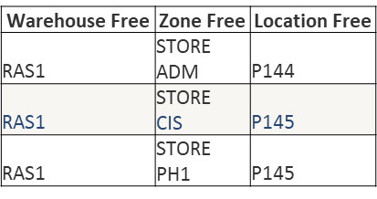

ตัดstork siso in

Slide 4
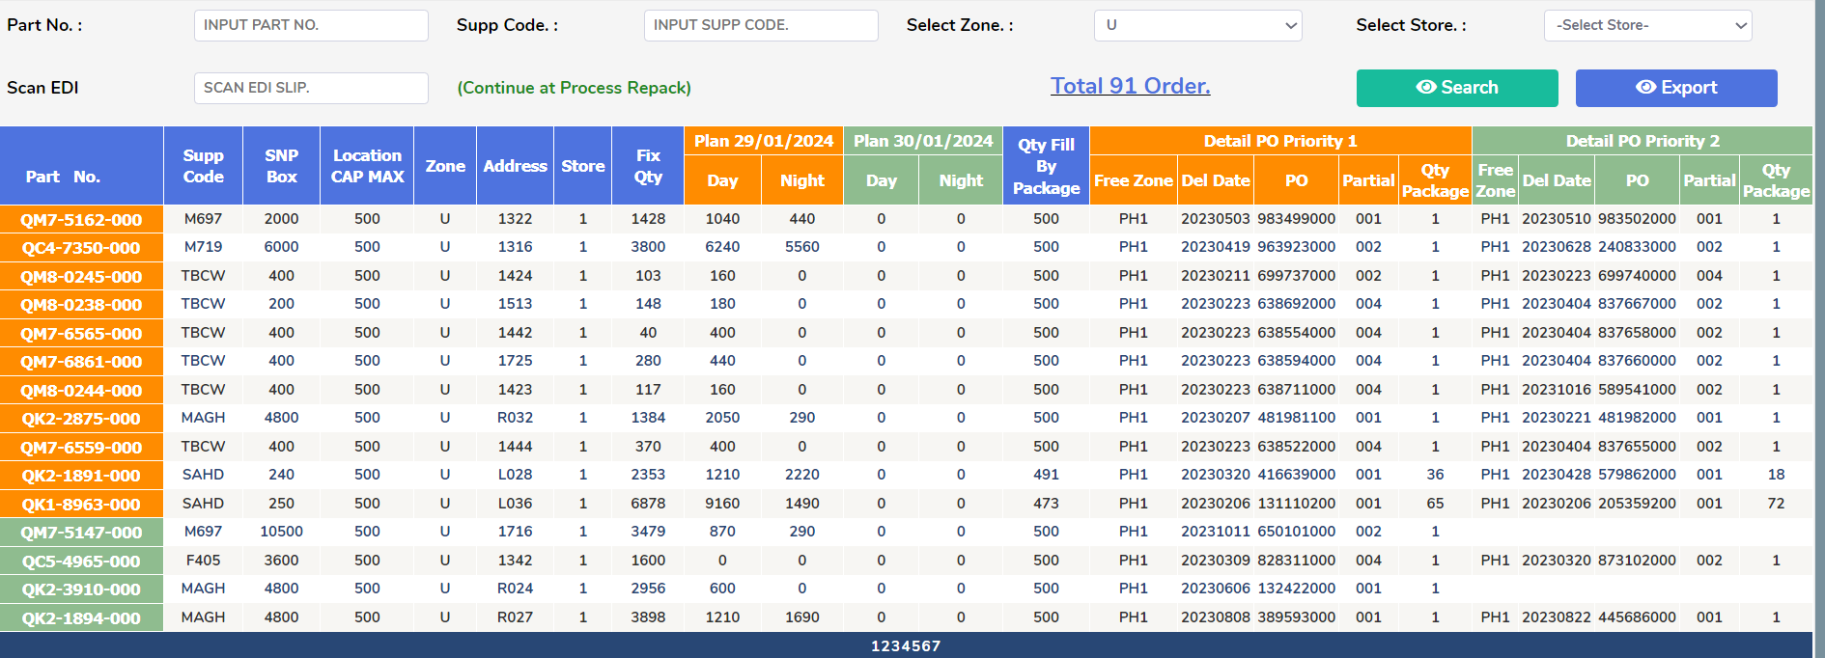
Combine

