Slide 1
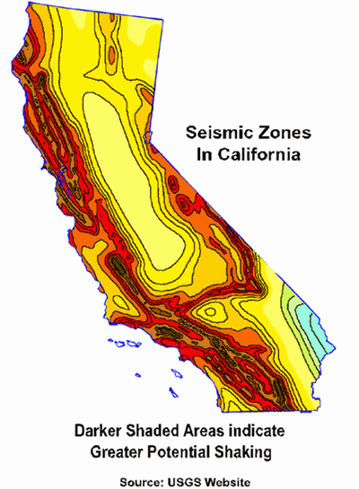
Earthquakes in California: A Builder’s Perspective
Jamey Weare
University of San Diego (Student)
Data Analytics and Visualization Capstone
August 15, 2022

Slide 2
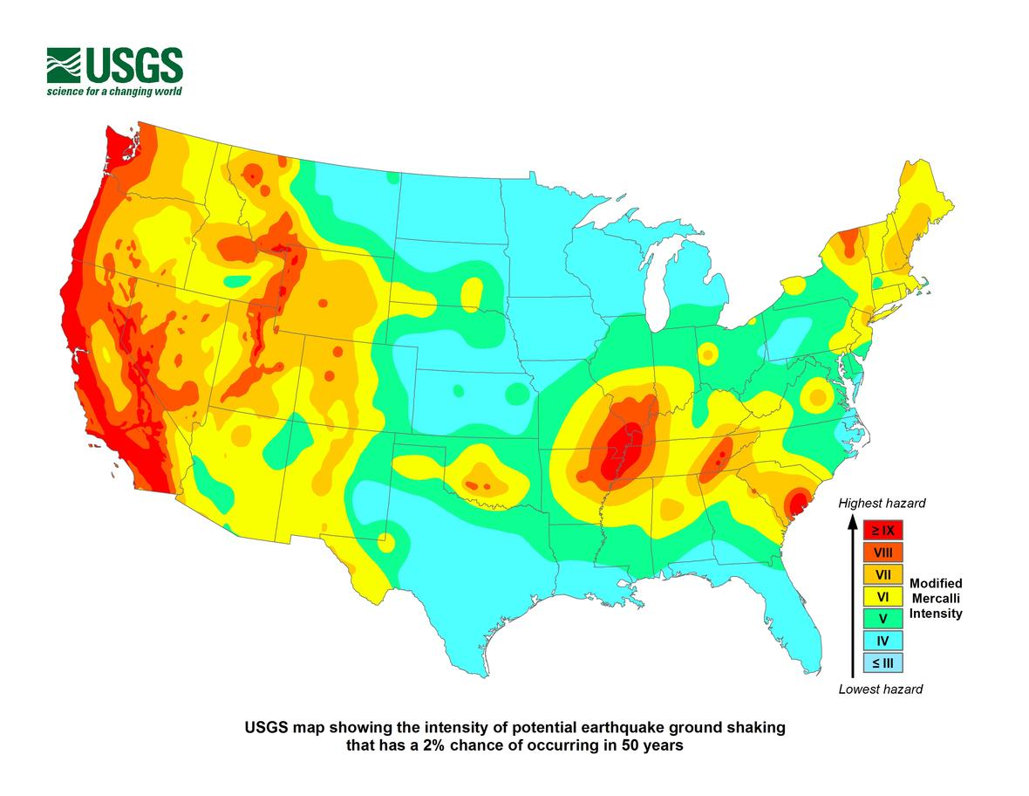
California accounted for 43% of earthquakes in the USA. Most earthquakes occur in a small number of states.
5,127 Earthquakes in California out of
11,869 in the USA.
California and Alaska together account
for 2/3 of all USA earthquakes.
The top 10 states/territories account for
About 96% of all USA Earthquakes
Notes:
Top 10: CA, AK, MT, HI, NV, OK, PR, TX, WA, NM

Slide 3
California and the USA have similar average magnitudes.
California Average Magnitude: 1.2
USA Average Magnitude: 1.3

Slide 4
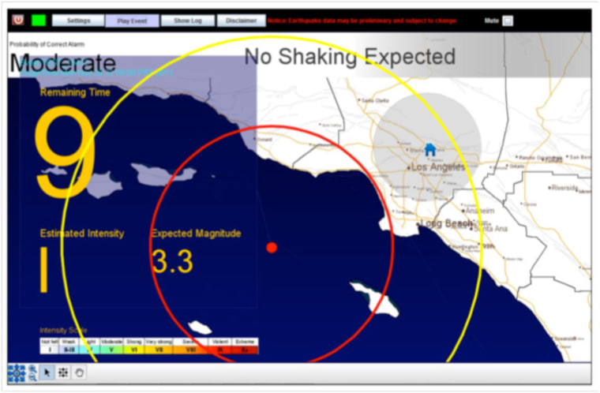
Very few occurring earthquakes are significant.
Notes:
64 or about 1.2% of earthquakes occurring in California during the observed period were magnitude 3 or greater. Their average depth was around 5.7 miles and average magnitude was 3.54. This is not enough energy to cause any structural damage to buildings.

Slide 5
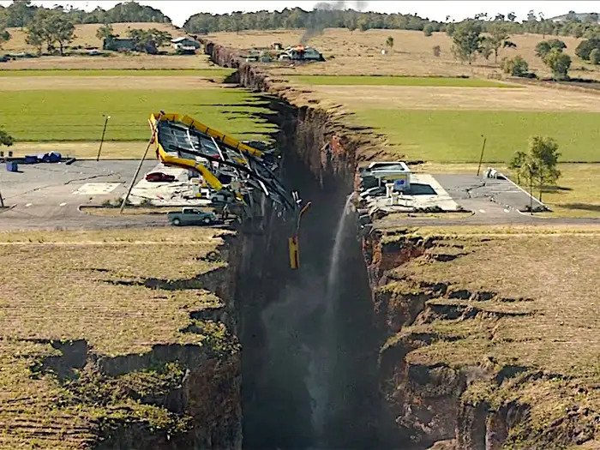
What magnitude earthquakes will
cause significant damage?
Notes:
According to the USGS “There is not one magnitude above which damage will occur. It depends on other variables, such as the distance from the earthquake, what type of soil you are on, building construction, etc. That being said, damage does not usually occur until the earthquake magnitude reaches somewhere above 4 or 5.” (USGS FAQ, 2022)

Slide 6
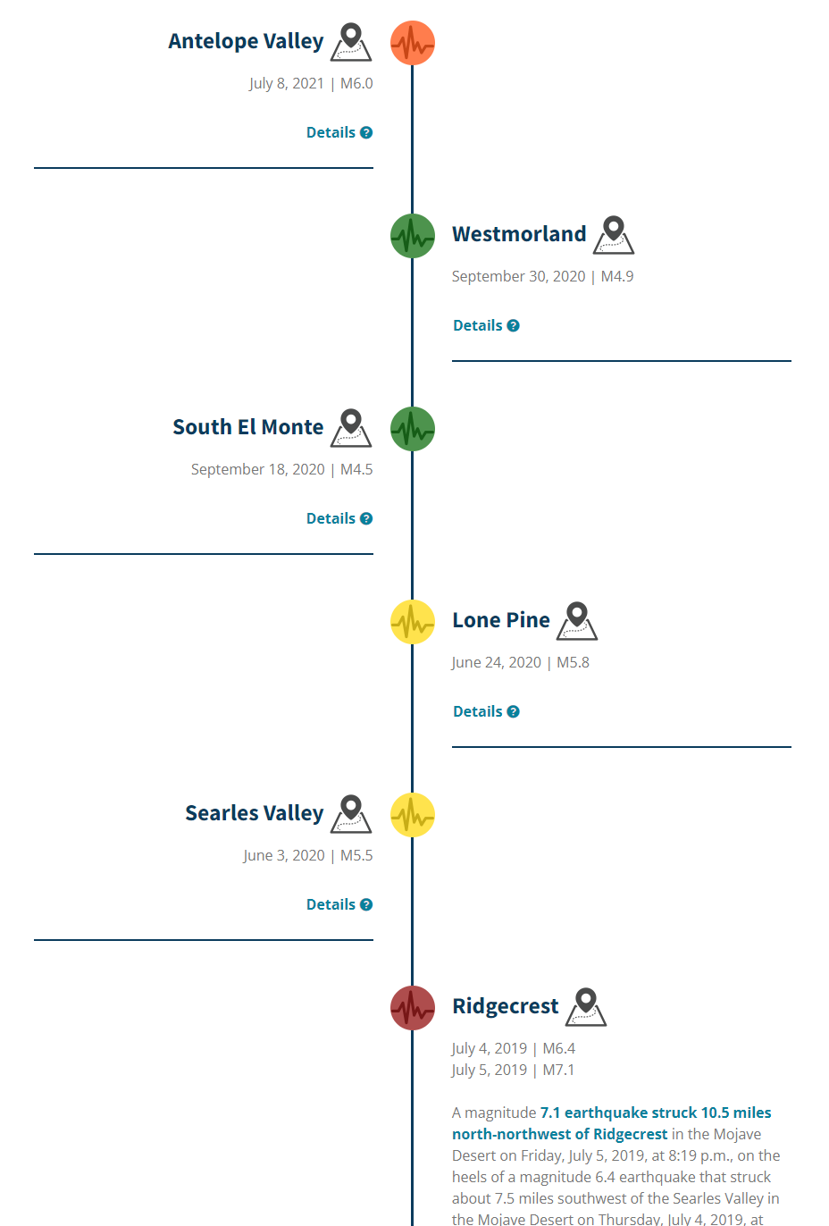
California has more than 100 earthquakes a day, and significant ones occur occasionally.
22 major earthquakes
since 2000
Notes:
The California Earthquake Authority has a well-designed timeline of all major earthquakes occurring in California dating all the way back to the 1800’s. There have been 22 significant earthquakes in California since the year 2000. One of them, the Antelope Valley with magnitude 6.0 occurred within the observed data.

Slide 7
The distribution of earthquakes in California shows just how rare major earthquakes are.
Notes:
Only .21% are greater than 4.
4 - 5 8 0.16%
5 - 6 2 0.04%
6 - 7 1 0.02%

Slide 8
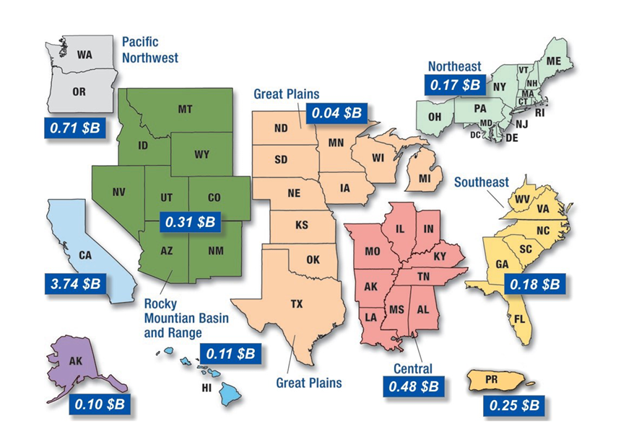
The majority of economic costs from earthquakes is in California.
Notes:
According to an analysis by FEMA 61% of annualized earthquake loss, which amounts to 3.74 $B, occurs in California.

Slide 9
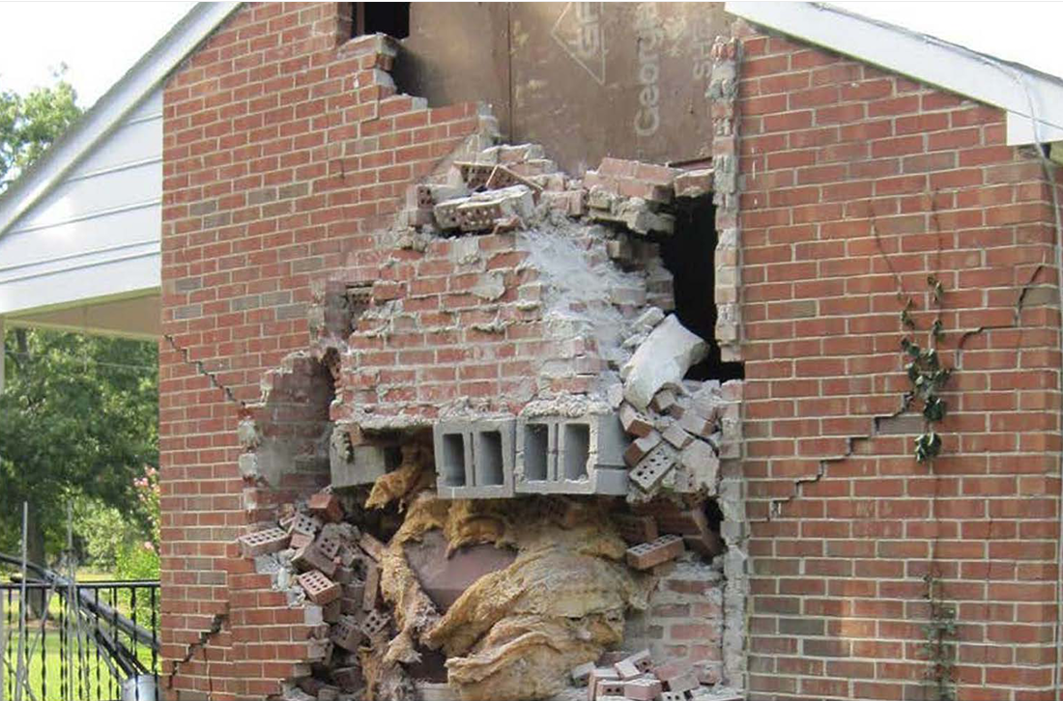
California earthquake building codes are designed to protect life but allow for damage.
Notes:
EXPECTED EARTHQUAKE PERFORMANCE OF BUILDINGS DESIGNED TO THE CALIFORNIA BUILDING CODE
The California Building Code is a minimum requirement intended to protect life safety and prevent collapse. It allows damage, which means buildings may not be habitable or functional after a moderate or large earthquake.
PEER - Pacific Earthquake Engineering Research Center, headquartered at the University of California, Berkeley.

Slide 10
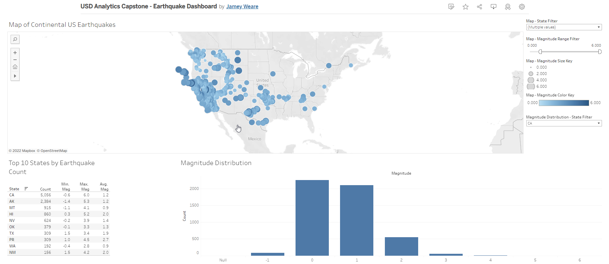
Would you like to explore the data presented today?

Slide 11
References
California Earthquake Authority. (n.d.). List of Notable and Major California Earthquakes. https://www.earthquakeauthority.com/California-Earthquake-Risk/California-Earthquake-History-Timeline
Hazus. (2017, April). Estimated Annualized Earthquake Losses for the United States. https://www.fema.gov/sites/default/files/2020-07/fema_earthquakes_hazus-estimated-annualized-earthquake-losses-for-the-united-states_20170401.pdf
PEER - Pacific Earthquake Engineering Research Center. (n.d.). Expected Earthquake Performance of Buildings Designed to the California Building Code. https://peer.berkeley.edu/sites/default/files/peer2019-05_ssc19-01.pdf
USGS. (n.d.). USGS Frequently Asked Questions. https://www.usgs.gov/faqs/what-magnitude-does-damage-begin-occur-earthquake

