Slide 1
LEDs
Why were LEDs so long to appear in household lighting?
Why was the development of blue LEDs so important?
Who won the 2014 Nobel prize for physics and why?

Slide 2
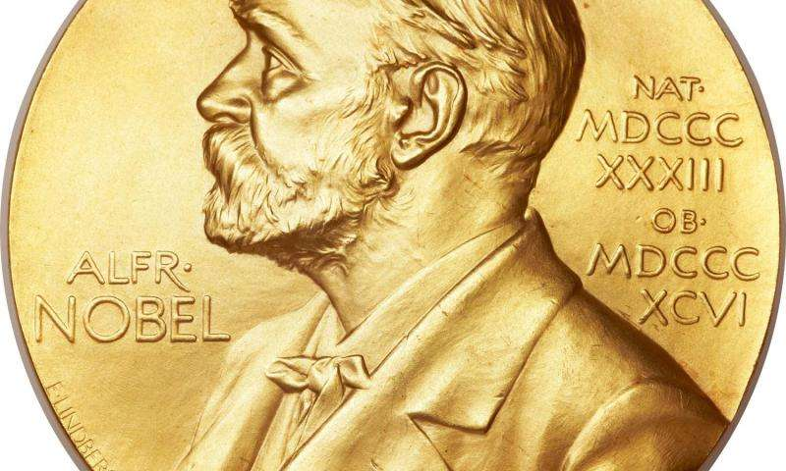
Who won the 2014 Nobel prize for physics and why?
Hiroshi Amano, Isamu Akasaki, and Shuji Nakamura were the 2014 Nobel prize winners for physics, “for the invention of efficient blue light-emitting diodes which has enabled bright and energy-saving white light sources”
https://en.wikipedia.org/wiki/Nobel_Prize_in_Physics

Slide 3
Why were LEDs so long to appear in household lighting?
LEDs took so long to appear in household lighting because the light they emitted was too sharp.
Blue light was also only recently discovered, and without the blue light, they could only make colours from red to green, but could not make white
This meant that LED lights were no comparison to lights already in use in the home

Slide 4
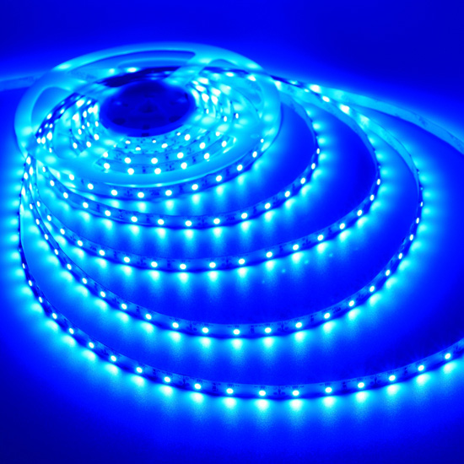
Why was the development of blue LEDs so important?
As already said, the development of blue LEDs enabled the production of white lights.
This meant that they could be used in many more scenarios than they previously had been used in.
For example, LEDs are used in electronic devices such as TVs and computer monitors.
http://www.ledbulbs123.com/blue-led-ribbon-lights-bedroom-decorative-lighting

