Slide 1


AI TRAINING SERIES · PART 1 OF 3
MCP & Agentic AI
Architecture and Mechanics
How the Model Context Protocol connects models, tools, and data — the mental model behind agentic AI applications.

Slide 2
THE PROBLEM MCP SOLVES
Why MCP exists
Before MCP, every model-to-tool connection was a custom integration. M models × N tools means M×N bespoke connectors to build and maintain.
WITHOUT MCP
WITH MCP
M × N custom connectors
One standard interface
"USB-C for AI"
AI
Tool
AI
Tool
AI
Tool
AI
Tool
MCP
AI
Tool
AI
Tool
MCP & Agentic AI · Deck 1 of 3 · Architecture & Mechanics
2

Slide 3




THE CAST
The core actors
Four roles do all the work. The relationships between them are the foundation everything else builds on.
User
Host + LLM
Client
Server
The person with a goal. Interacts only with the host application.
The application the user runs. Embeds the LLM and orchestrates one or more clients.
A connector inside the host. Holds one session with exactly one server.
Exposes capabilities — tools, resources, prompts — and does the work.
THE FOUNDATIONAL RULE
One host runs many clients — but each client maintains a 1:1 session with a single server. That isolation boundary is why a server only ever sees its own connection, and it shapes the entire security model.
MCP & Agentic AI · Deck 1 of 3 · Architecture & Mechanics
3

Slide 4



HOW IT FITS TOGETHER
High-level architecture
Following our example: the analyst's request flows down through the host and clients to servers, which reach external systems and return results back up.
User App / UI
REQUEST
flows down
The analyst's entry point
RESULTS
flow back up
Host + LLM
Interprets intent, decides what to call
MCP Clients
Middleware — one session per server
MCP Server A
MCP Server B
MCP Server C
get_transactions
customer_lookup
policy_docs
→ external systems: core banking, databases, document stores
MCP & Agentic AI · Deck 1 of 3 · Architecture & Mechanics
4

Slide 5
WHAT A SERVER OFFERS
The three server primitives
The clearest way to keep these straight is to ask who is in control of each.
Tools
Resources
Prompts
Model-controlled
App / user-controlled
User-controlled
Functions the LLM can choose to execute — e.g. run a query, call an API. The model decides when to invoke.
Context and data the app or user pulls in for the model to read — files, records, documents.
Reusable templates and workflows a user can invoke deliberately — e.g. a canned analysis.
get_transactions()
customer://1234/txns
/flag-unusual-activity
MCP & Agentic AI · Deck 1 of 3 · Architecture & Mechanics
5

Slide 6
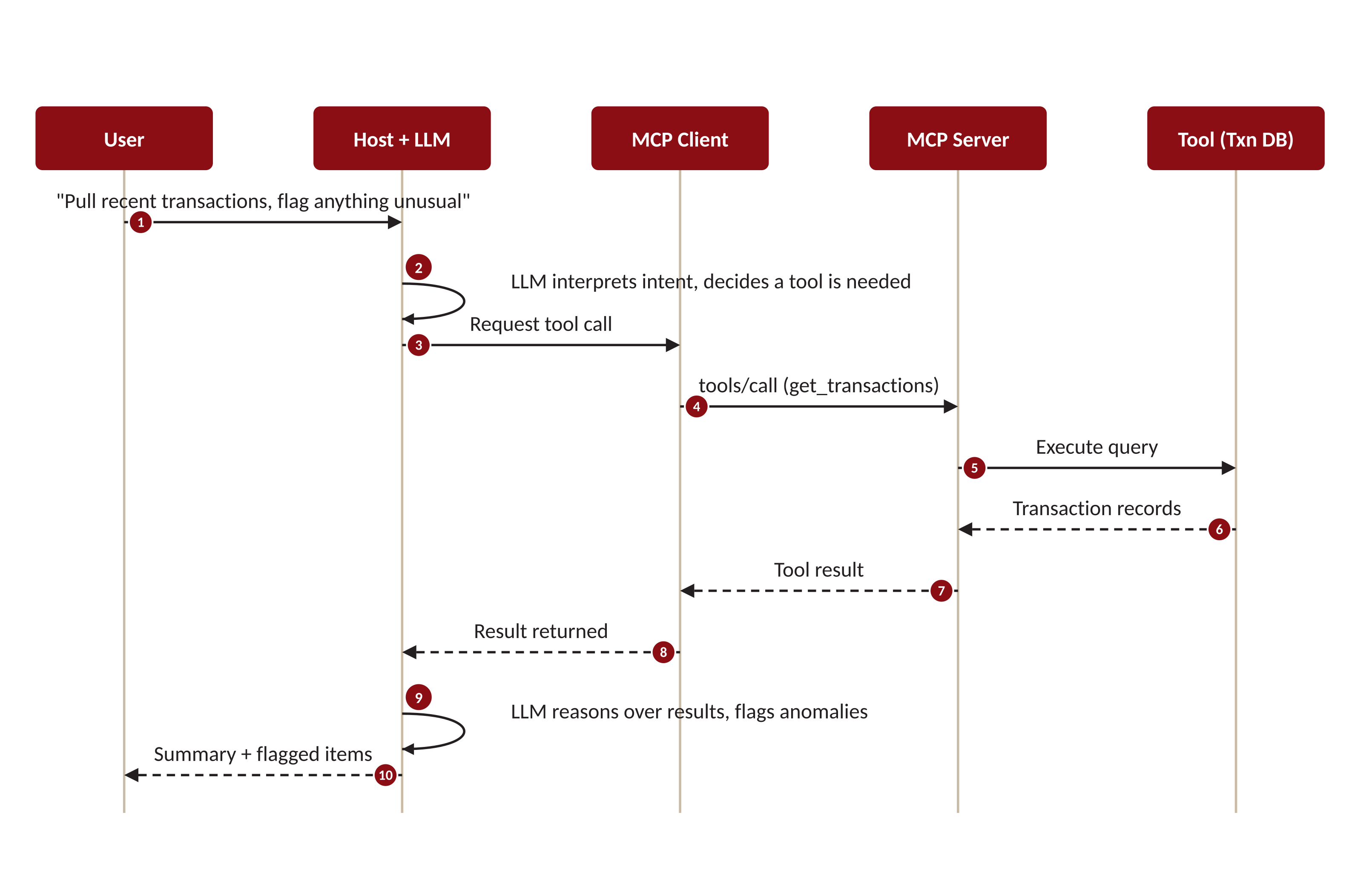
THE AGENTIC LOOP — END TO END
What actually happens on one request
READ IT AS
Intent
The LLM decides a tool is needed (steps 1–2).
Route & call
Client translates and calls the server (3–5).
Return
Results travel back up the chain (6–8).
Reason & answer
The LLM interprets and responds (9–10).
MCP & Agentic AI · Deck 1 of 3 · Architecture & Mechanics
6

Slide 7


A WRINKLE IN THE LOOP
Why servers need to talk back
In the loop we just saw, the client always speaks first. But real tool calls aren't instant — and that creates two things a server needs to send on its own initiative, mid-request.
Progress updates
Logs & notifications
A long-running tool — querying months of transactions, scanning documents — may take many seconds. Without interim signals the client (and user) just sees a frozen spinner. The server needs to report “40% done” while the work continues.
The server has useful things to say before it finishes: diagnostic logs, a notice that its tool list changed, an updated resource. These are one-way messages the server must push to the client when they happen — not when asked.
THE COMMON THREAD
Both cases require the server to send a message to the client without the client having just asked for it. That is the capability the next slide is about — and the reason MCP's transport has to do something ordinary web requests cannot.
MCP & Agentic AI · Deck 1 of 3 · Architecture & Mechanics
7

Slide 8


THE TRANSPORT PROBLEM — AND THE FIX
Plain HTTP can't; Streamable HTTP can
Ordinary HTTP is strictly request–response: the client asks, the server answers once, the exchange closes. There is no channel for the server to speak up later. MCP's remote transport solves exactly this.
Plain HTTP
Streamable HTTP
Client
request
Server
Client
request
Server
one response
stream of messages
✕ then the connection closes. If the server wants to send progress or a log a moment later, it has no way to reach the client.
✓ the connection stays open. Using Server-Sent Events (SSE), the server pushes many messages over one channel — progress, logs, and its own requests.
Result: a session-based, two-way channel. This is what makes server-initiated messaging possible — and it sets up the inversion on the next slide.
MCP & Agentic AI · Deck 1 of 3 · Architecture & Mechanics
8

Slide 9

WATCH THIS — WE RETURN TO IT IN DECK 3
The interaction inversion
In the familiar web model, clients request and servers respond. MCP reverses this: servers can query, drive tool calls, and act on the client's side of the conversation.
FAMILIAR PATTERN
MCP'S INVERSION
Client asks → server answers
Server can query & act
Trust flows one way. The server is a passive responder. Attack paths are well understood after decades of web security.
A server influences what the model does and reaches back toward the user's environment. These are new, poorly-traced attack paths — the seed of nearly every MCP security concern.
Keep this in mind — it is exactly where the NSA security guidance in Deck 3 begins.

Slide 10


THE REVERSE DIRECTION
Client features: when the server reaches back
The inversion in practice. Beyond responding, a server can initiate three things — each routed through the client, each a deliberate trust decision.
Sampling
Roots
Elicitation
The server asks the client's LLM to run a completion on its behalf — recursive, agentic behavior.
The server asks which files or URI boundaries it's allowed to operate within.
The server requests additional information directly from the user mid-task.
A server influencing model calls is powerful and a real trust consideration.
Probing the boundaries of the user's environment.
A server-driven prompt to the human — handle with care.
MCP & Agentic AI · Deck 1 of 3 · Architecture & Mechanics
10

Slide 11

THE LOCAL TRANSPORT
stdio — local, in-process
The client launches the server as a local subprocess and talks to it over standard input/output. No network involved.
How it works
CHARACTERISTICS
BEST FOR
Local, single-user tools and desktop apps.
Host machine
Host + Client
Both processes live on the same host. Messages are piped over stdin/stdout — fast, simple, no ports.
ISOLATION
Naturally contained to the host; no network exposure by default.
stdin /
stdout
Server (subprocess)
TRADE-OFF
Doesn't scale across machines or users; one subprocess per client.
MCP & Agentic AI · Deck 1 of 3 · Architecture & Mechanics
11

Slide 12


THE VOCABULARY
MCP message types
Under the hood, MCP speaks JSON-RPC 2.0. Conceptually there are just four kinds of message. (Deck 2 covers the formal structure.)
Request
Response
Notification
Error
Expects a reply
The reply
Fire-and-forget
Something failed
Carries an id so the response can be matched back. e.g. "call this tool."
Returns a result — or an error — for a specific request id.
No id, no reply expected. e.g. "initialization complete."
A structured error code and message, tied to a request.
Requests and responses pair up by id; notifications travel one-way. That's the whole grammar.
MCP & Agentic AI · Deck 1 of 3 · Architecture & Mechanics
12

Slide 13
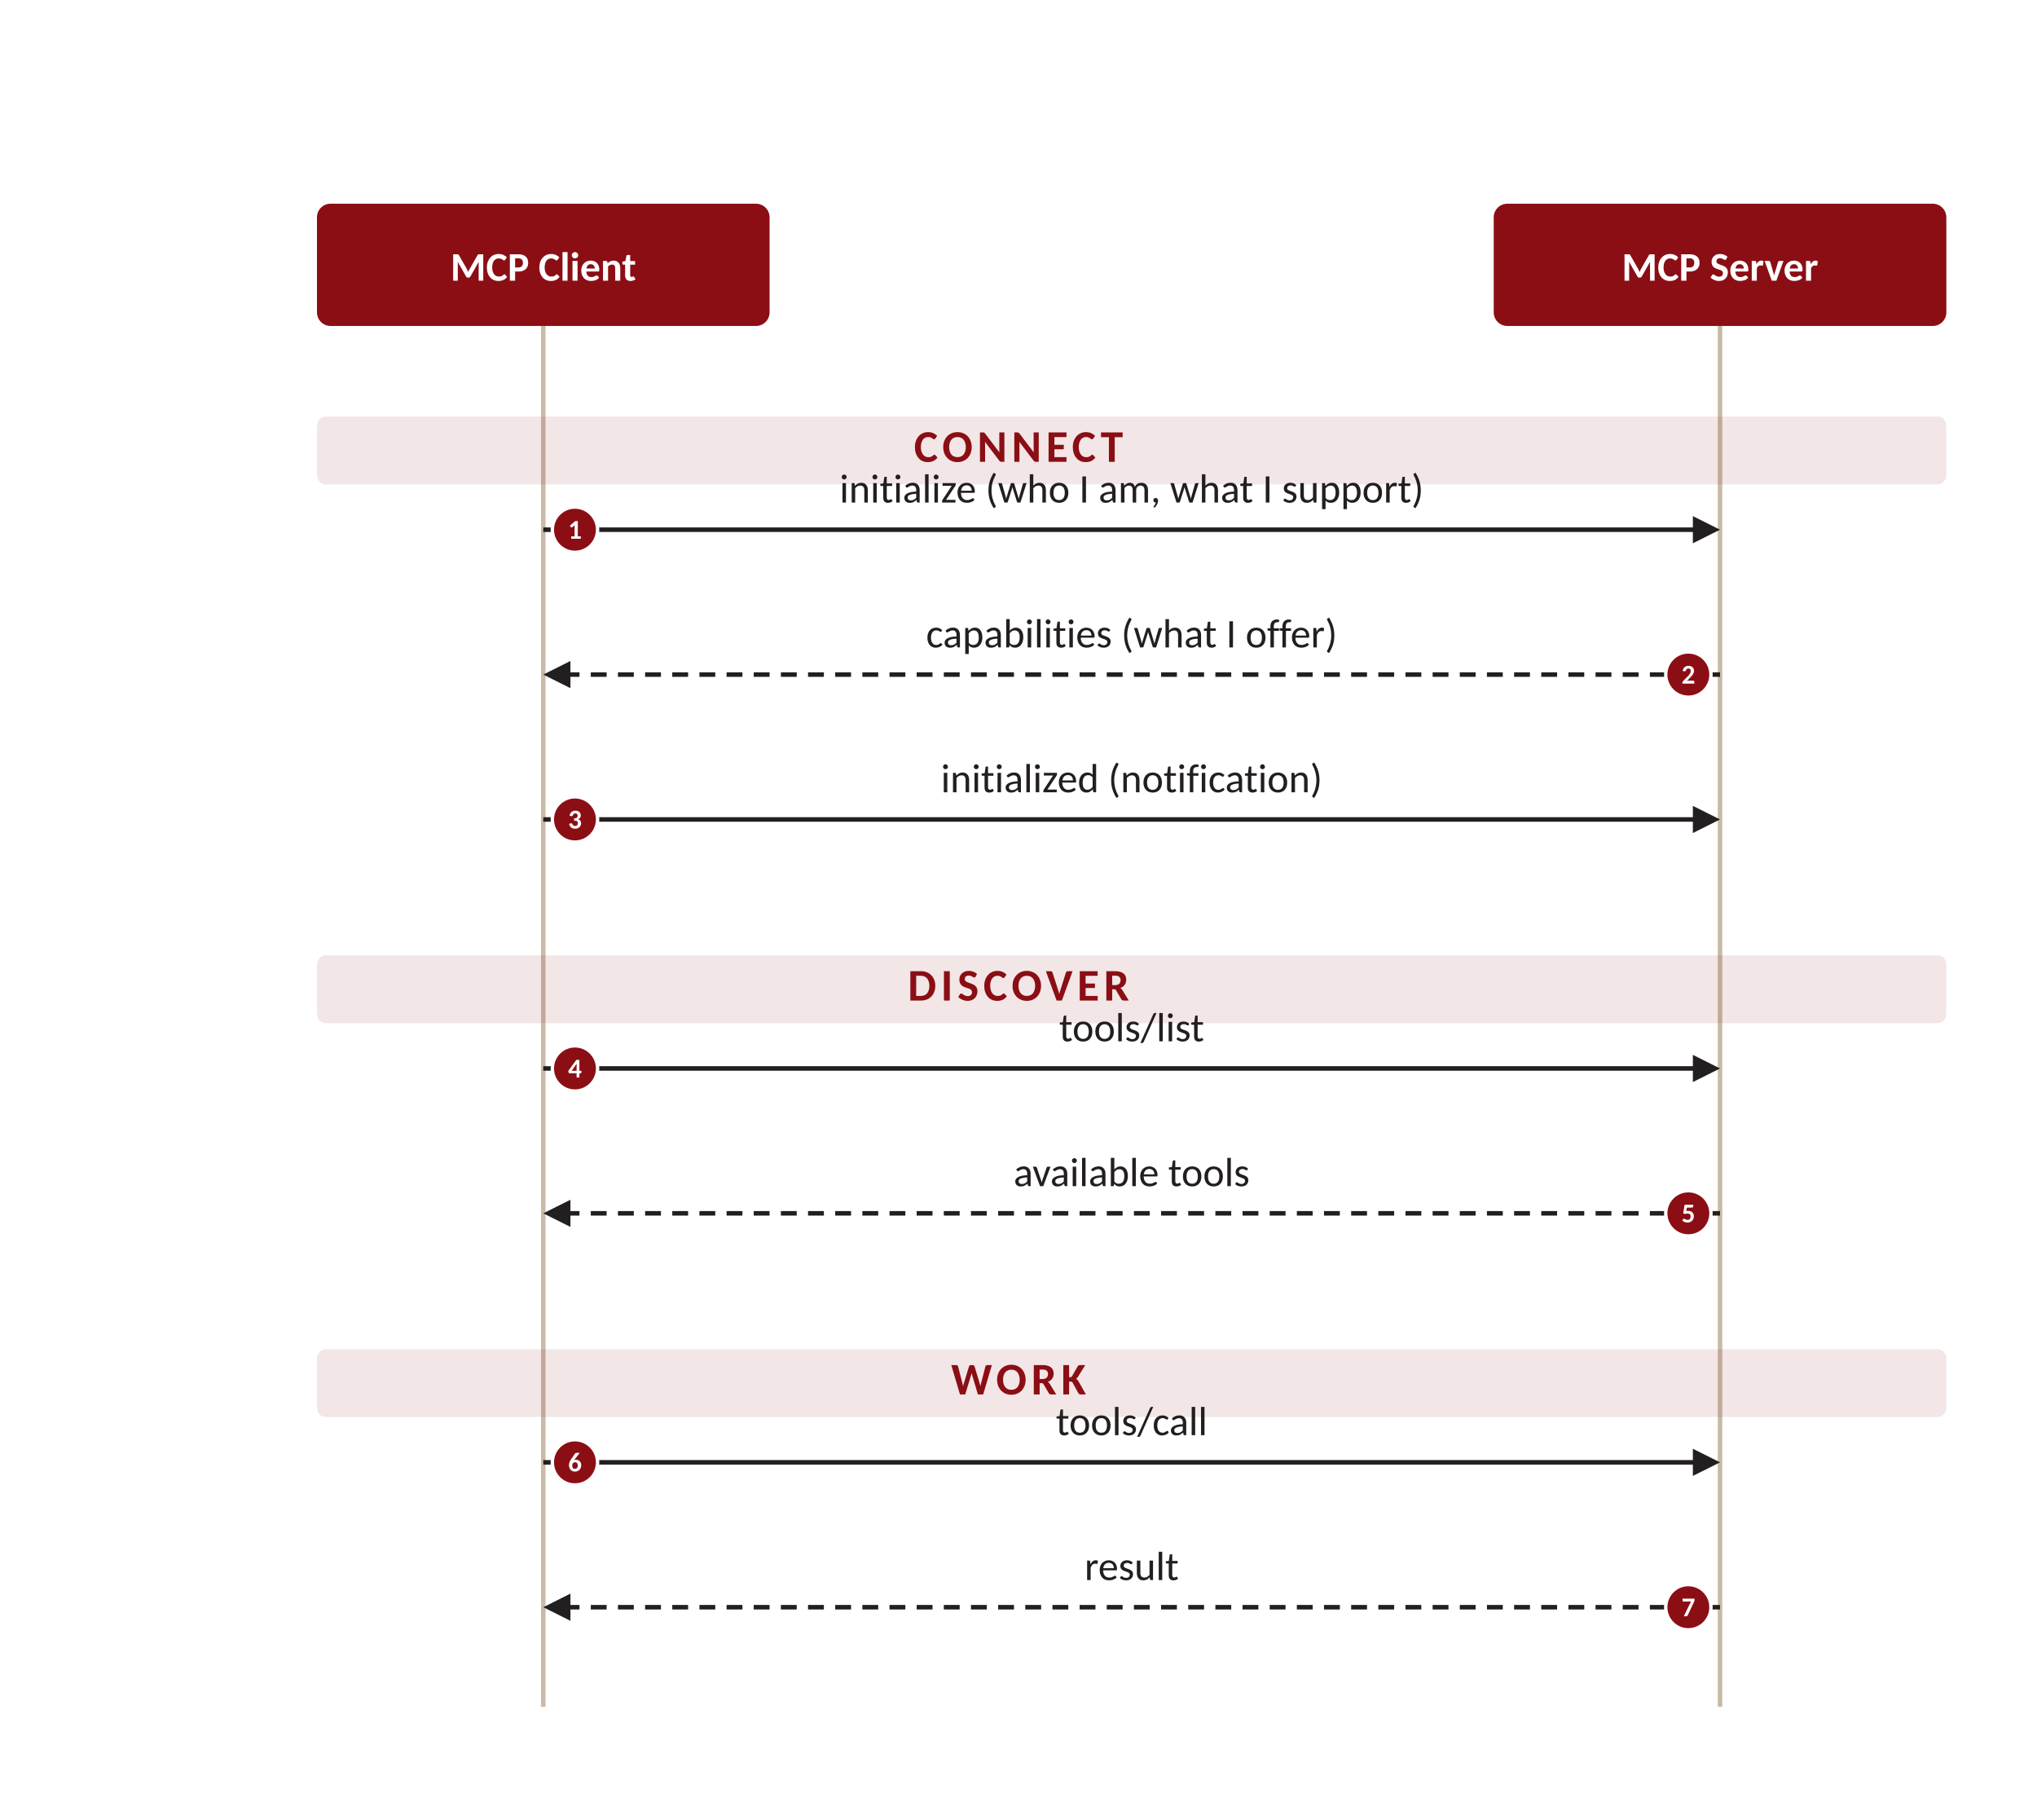
PUTTING THE GRAMMAR TO WORK
A typical exchange: connect, discover, work
Every MCP session follows the same shape — a handshake to agree on capabilities, discovery of what's available, then the actual work.
1
Connect
The client introduces itself and the two sides negotiate what each supports. Nothing happens until they agree.
2
Discover
The client asks what the server offers — listing tools (and resources, prompts).
3
Work
Only now does the real task run: call a tool, get a result. Repeat as needed.
MCP & Agentic AI · Deck 1 of 3 · Architecture & Mechanics
13

Slide 14
A PRODUCTION DEPLOYMENT NOTE
Stateless mode — trading the channel for scale
Slide 8 made the persistent connection the point. But the SDK lets you deliberately turn it off — and in a load-balanced deployment, that's often the right call.
THE TWO SETTINGS
WHY: HORIZONTAL SCALE
FastMCP("server",
stateless_http=True
json_response=True
)
Load
balancer
replica 1
replica 2
replica 3
stateless_http=True
A fresh transport per request — no session is kept between calls.
json_response=True
Reply with a single JSON response instead of an SSE stream.
Any replica can serve any request, because none of them needs to remember a prior one.
Solves: the "session not found" error you hit when a load balancer routes a follow-up request to a replica that never held the session.
The trade-off: you give up server-initiated messaging (slide 8) — progress, logs, sampling. Fine for simple request/response tools; wrong for long-running or interactive ones.
MCP & Agentic AI · Deck 1 of 3 · Architecture & Mechanics
14

Slide 15


RECAP
The mental model, in one slide
Four actors
Three primitives
User, Host+LLM, Client, Server — one host, many clients, each 1:1 with a server.
Tools (model), Resources (app/user), Prompts (user).
The inversion
One exchange shape
Servers can query and act — the root of the security story.
Connect → discover → work, spoken in JSON-RPC messages.
NEXT — Deck 2: The MCP Specification. From this mental model to what the spec actually requires.

