Slide 1


AI TRAINING SERIES · PART 1 OF 3
MCP & Agentic AI
Architecture and Mechanics
How the Model Context Protocol connects models, tools, and data — the mental model behind agentic AI applications.

Slide 2
THE PROBLEM MCP SOLVES
Why MCP exists
Before MCP, every model-to-tool connection was a custom integration. M models × N tools means M×N bespoke connectors to build and maintain.
WITHOUT MCP
WITH MCP
M × N custom connectors
One standard interface
"USB-C for AI"
AI
Tool
AI
Tool
AI
Tool
AI
Tool
MCP
AI
Tool
AI
Tool
MCP & Agentic AI · Deck 1 of 3 · Architecture & Mechanics
2

Slide 3




THE CAST
The core actors
Four roles do all the work. The relationships between them are the foundation everything else builds on.
User
Host + LLM
Client
Server
The person with a goal. Interacts only with the host application.
The application the user runs. Embeds the LLM and orchestrates one or more clients.
A connector inside the host. Holds one session with exactly one server.
Exposes capabilities — tools, resources, prompts — and does the work.
THE FOUNDATIONAL RULE
One host runs many clients — but each client maintains a 1:1 session with a single server. That isolation boundary is why a server only ever sees its own connection, and it shapes the entire security model.
MCP & Agentic AI · Deck 1 of 3 · Architecture & Mechanics
3

Slide 4



HOW IT FITS TOGETHER
High-level architecture
Following our example: the analyst's request flows down through the host and clients to servers, which reach external systems and return results back up.
User App / UI
REQUEST
flows down
The analyst's entry point
RESULTS
flow back up
Host + LLM
Interprets intent, decides what to call
MCP Clients
Middleware — one session per server
MCP Server A
MCP Server B
MCP Server C
get_transactions
customer_lookup
policy_docs
→ external systems: core banking, databases, document stores
MCP & Agentic AI · Deck 1 of 3 · Architecture & Mechanics
4

Slide 5
WHAT A SERVER OFFERS
The three server primitives
The clearest way to keep these straight is to ask who is in control of each.
Tools
Resources
Prompts
Model-controlled
App / user-controlled
User-controlled
Functions the LLM can choose to execute — e.g. run a query, call an API. The model decides when to invoke.
Context and data the app or user pulls in for the model to read — files, records, documents.
Reusable templates and workflows a user can invoke deliberately — e.g. a canned analysis.
get_transactions()
customer://1234/txns
/flag-unusual-activity
MCP & Agentic AI · Deck 1 of 3 · Architecture & Mechanics
5

Slide 6
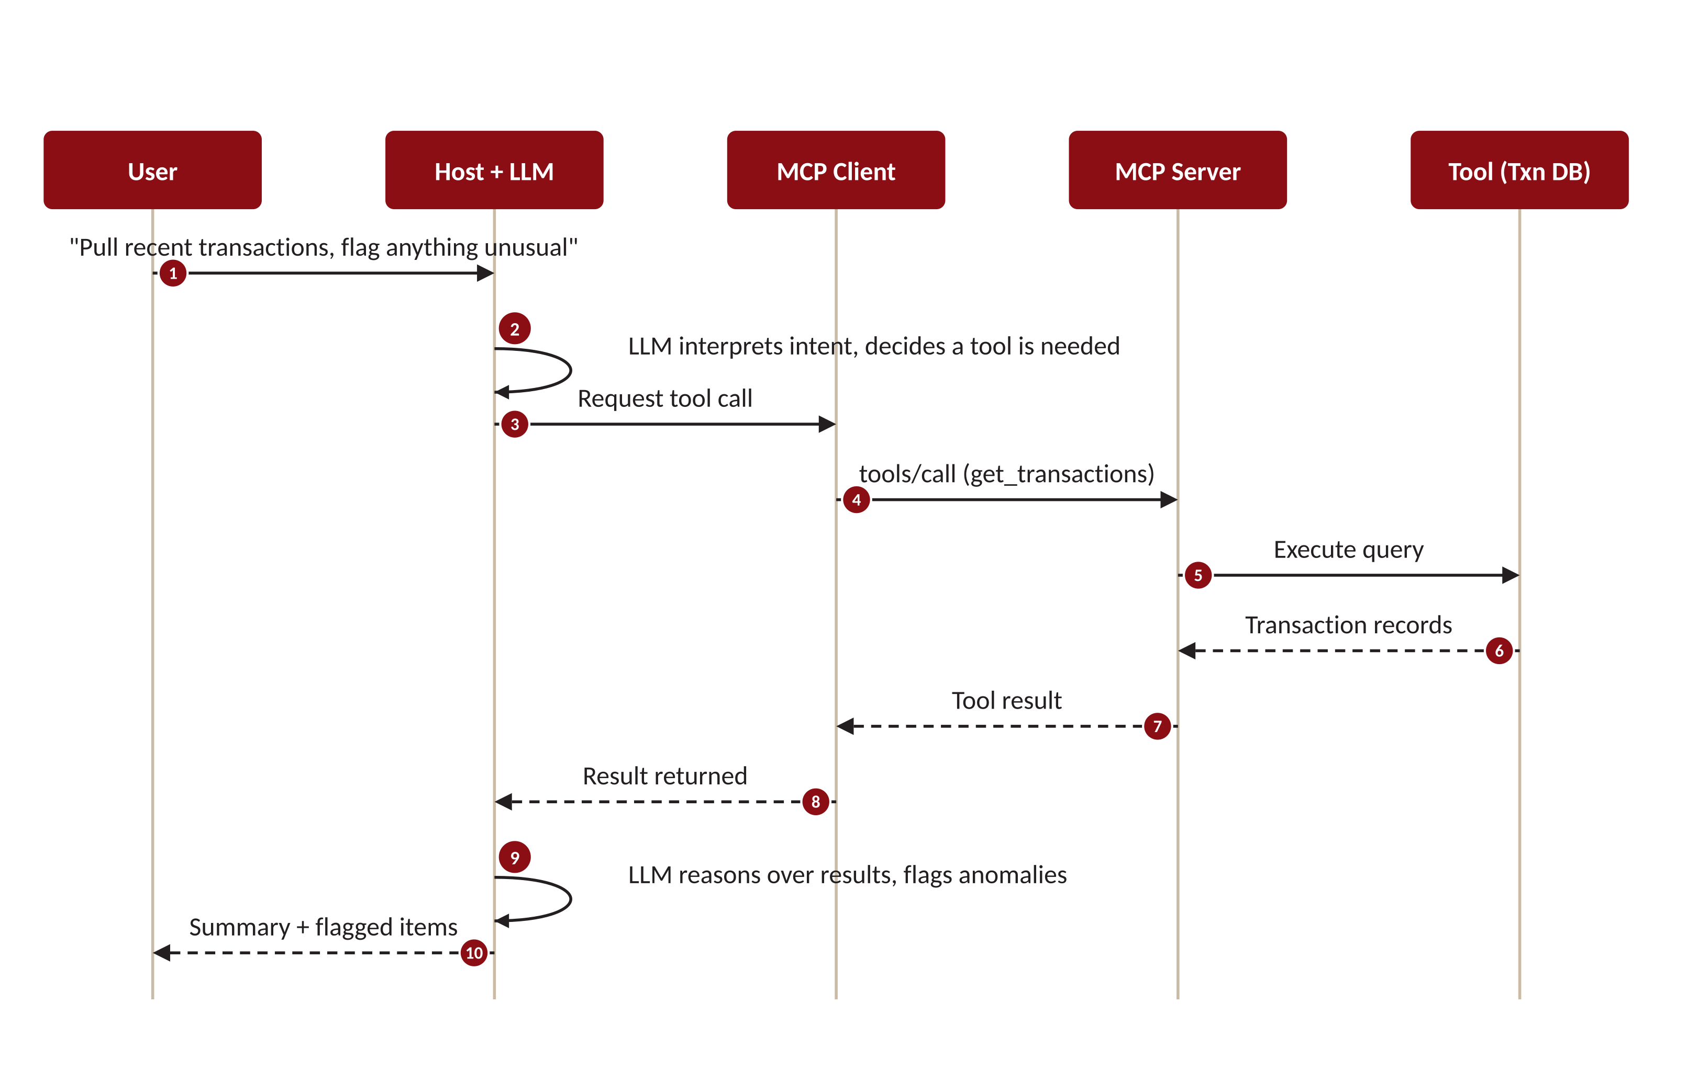
THE AGENTIC LOOP — END TO END
What actually happens on one request
READ IT AS
Intent
The LLM decides a tool is needed (steps 1–2).
Route & call
Client translates and calls the server (3–5).
Return
Results travel back up the chain (6–8).
Reason & answer
The LLM interprets and responds (9–10).
MCP & Agentic AI · Deck 1 of 3 · Architecture & Mechanics
6

Slide 7


A WRINKLE IN THE LOOP
Why servers need to talk back
In the loop we just saw, the client always speaks first. But real tool calls aren't instant — and that creates two things a server needs to send on its own initiative, mid-request.
Progress updates
Logs & notifications
A long-running tool — querying months of transactions, scanning documents — may take many seconds. Without interim signals the client (and user) just sees a frozen spinner. The server needs to report “40% done” while the work continues.
The server has useful things to say before it finishes: diagnostic logs, a notice that its tool list changed, an updated resource. These are one-way messages the server must push to the client when they happen — not when asked.
THE COMMON THREAD
Both cases require the server to send a message to the client without the client having just asked for it. That is the capability the next slide is about — and the reason MCP's transport has to do something ordinary web requests cannot.
MCP & Agentic AI · Deck 1 of 3 · Architecture & Mechanics
7

Slide 8


THE TRANSPORT PROBLEM — AND THE FIX
Plain HTTP can't; Streamable HTTP can
Ordinary HTTP is strictly request–response: the client asks, the server answers once, the exchange closes. There is no channel for the server to speak up later. MCP's remote transport solves exactly this.
Plain HTTP
Streamable HTTP
Client
request
Server
Client
request
Server
one response
stream of messages
✕ then the connection closes. If the server wants to send progress or a log a moment later, it has no way to reach the client.
✓ the connection stays open. Using Server-Sent Events (SSE), the server pushes many messages over one channel — progress, logs, and its own requests.
Result: a session-based, two-way channel. This is what makes server-initiated messaging possible — and it sets up the inversion on the next slide.
MCP & Agentic AI · Deck 1 of 3 · Architecture & Mechanics
8

Slide 9

WATCH THIS — WE RETURN TO IT IN DECK 3
The interaction inversion
In the familiar web model, clients request and servers respond. MCP reverses this: servers can query, drive tool calls, and act on the client's side of the conversation.
FAMILIAR PATTERN
MCP'S INVERSION
Client asks → server answers
Server can query & act
Trust flows one way. The server is a passive responder. Attack paths are well understood after decades of web security.
A server influences what the model does and reaches back toward the user's environment. These are new, poorly-traced attack paths — the seed of nearly every MCP security concern.
Keep this in mind — it is exactly where the NSA security guidance in Deck 3 begins.

Slide 10


THE REVERSE DIRECTION
Client features: when the server reaches back
The inversion in practice. Beyond responding, a server can initiate three things — each routed through the client, each a deliberate trust decision.
Sampling
Roots
Elicitation
The server asks the client's LLM to run a completion on its behalf — recursive, agentic behavior.
The server asks which files or URI boundaries it's allowed to operate within.
The server requests additional information directly from the user mid-task.
A server influencing model calls is powerful and a real trust consideration.
Probing the boundaries of the user's environment.
A server-driven prompt to the human — handle with care.
MCP & Agentic AI · Deck 1 of 3 · Architecture & Mechanics
10

Slide 11

THE LOCAL TRANSPORT
stdio — local, in-process
The client launches the server as a local subprocess and talks to it over standard input/output. No network involved.
How it works
CHARACTERISTICS
BEST FOR
Local, single-user tools and desktop apps.
Host machine
Host + Client
Both processes live on the same host. Messages are piped over stdin/stdout — fast, simple, no ports.
ISOLATION
Naturally contained to the host; no network exposure by default.
stdin /
stdout
Server (subprocess)
TRADE-OFF
Doesn't scale across machines or users; one subprocess per client.
MCP & Agentic AI · Deck 1 of 3 · Architecture & Mechanics
11

Slide 12


THE VOCABULARY
MCP message types
Under the hood, MCP speaks JSON-RPC 2.0. Conceptually there are just four kinds of message. (Deck 2 covers the formal structure.)
Request
Response
Notification
Error
Expects a reply
The reply
Fire-and-forget
Something failed
Carries an id so the response can be matched back. e.g. "call this tool."
Returns a result — or an error — for a specific request id.
No id, no reply expected. e.g. "initialization complete."
A structured error code and message, tied to a request.
Requests and responses pair up by id; notifications travel one-way. That's the whole grammar.
MCP & Agentic AI · Deck 1 of 3 · Architecture & Mechanics
12

Slide 13
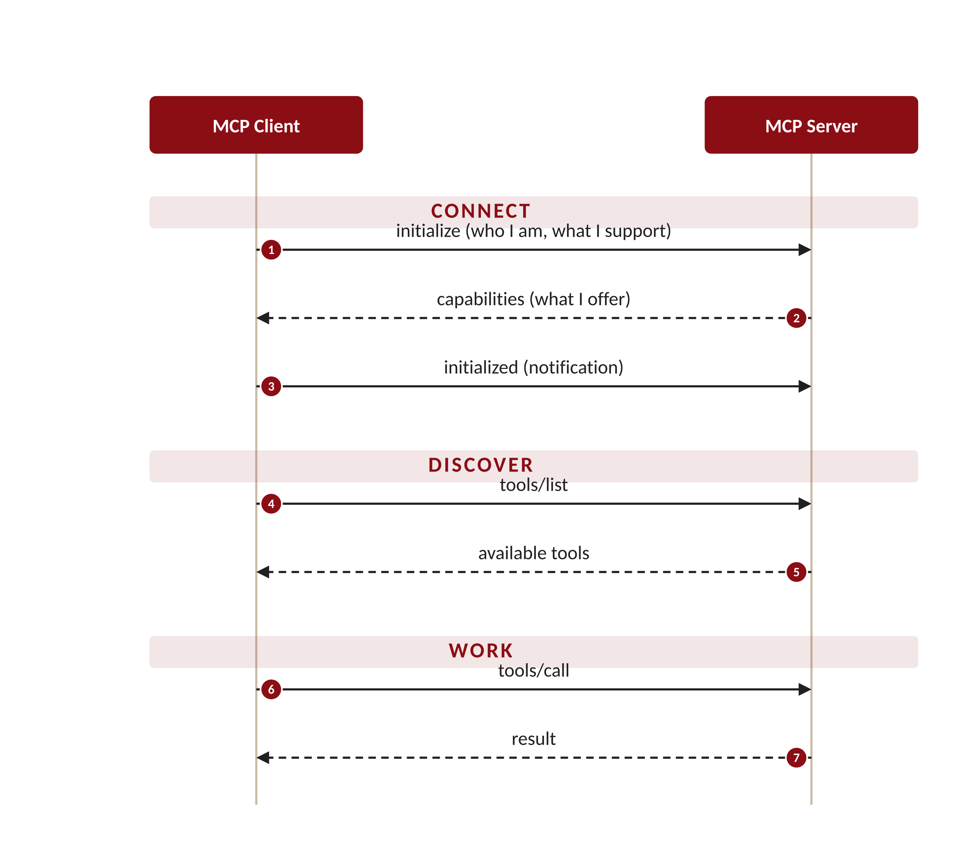
PUTTING THE GRAMMAR TO WORK
A typical exchange: connect, discover, work
Every MCP session follows the same shape — a handshake to agree on capabilities, discovery of what's available, then the actual work.
1
Connect
The client introduces itself and the two sides negotiate what each supports. Nothing happens until they agree.
2
Discover
The client asks what the server offers — listing tools (and resources, prompts).
3
Work
Only now does the real task run: call a tool, get a result. Repeat as needed.
MCP & Agentic AI · Deck 1 of 3 · Architecture & Mechanics
13

Slide 14
A PRODUCTION DEPLOYMENT NOTE
Stateless mode — trading the channel for scale
Slide 8 made the persistent connection the point. But the SDK lets you deliberately turn it off — and in a load-balanced deployment, that's often the right call.
THE TWO SETTINGS
WHY: HORIZONTAL SCALE
FastMCP("server",
stateless_http=True
json_response=True
)
Load
balancer
replica 1
replica 2
replica 3
stateless_http=True
A fresh transport per request — no session is kept between calls.
json_response=True
Reply with a single JSON response instead of an SSE stream.
Any replica can serve any request, because none of them needs to remember a prior one.
Solves: the "session not found" error you hit when a load balancer routes a follow-up request to a replica that never held the session.
The trade-off: you give up server-initiated messaging (slide 8) — progress, logs, sampling. Fine for simple request/response tools; wrong for long-running or interactive ones.
MCP & Agentic AI · Deck 1 of 3 · Architecture & Mechanics
14

Slide 15


RECAP
The mental model, in one slide
Four actors
Three primitives
User, Host+LLM, Client, Server — one host, many clients, each 1:1 with a server.
Tools (model), Resources (app/user), Prompts (user).
The inversion
One exchange shape
Servers can query and act — the root of the security story.
Connect → discover → work, spoken in JSON-RPC messages.
NEXT — Deck 2: The MCP Specification. From this mental model to what the spec actually requires.

Slide 16

AI TRAINING SERIES · PART 2 OF 3
The MCP Specification
From mental model to normative spec
What the protocol actually requires — primitives, lifecycle, capabilities, transports, and the security model the spec defines.
Revision 2025-11-25 (latest)
Deck 1 gave us the mental model. This deck is the rulebook.

Slide 17

READING A NORMATIVE SPEC
What a specification gives you
https://github.com/modelcontextprotocol
MUST / REQUIRED / SHALL
An absolute requirement. A conformant implementation has no choice — omitting it means it isn't MCP.
SHOULD / RECOMMENDED
Strongly advised. Deviation is allowed only with a clear, considered reason — and that reason is where risk often hides.
MAY / OPTIONAL
Genuinely discretionary. Two conformant implementations may differ here — which is exactly why behavior varies in the wild.
These keywords follow RFC 2119 / RFC 8174 — and they appear in all-caps in the spec for exactly this reason.
MCP Specification · Deck 2 of 3 · The 2025-11-25 Revision
2

Slide 18
THE BASE PROTOCOL
Built on JSON-RPC 2.0
Every MCP message is one of four JSON-RPC types. The presence or absence of an id is what distinguishes them — and determines whether a reply is expected.
Message type | Has id? | Reply expected? | What it is
Request | Yes | Yes | Asks the other side to do something and return a result. Carries a method name and params.
Response | Matches request | — | The result for a specific request id. Exactly one per request.
Error | Matches request | — | A structured failure (code + message) for a request, instead of a result.
Notification | No | No | One-way signal. No id, no reply — e.g. "initialization complete."
Stateful by design. Unlike stateless REST, an MCP connection is a session — context persists across messages until shutdown.
MCP Specification · Deck 2 of 3 · The 2025-11-25 Revision
3

Slide 19

THE CONNECTION LIFECYCLE
Initialize → operate → shut down
Every session moves through three phases. Nothing useful happens until initialization completes — capability negotiation gates everything.
1 · Initialization
2 · Operation
3 · Shutdown
Client sends initialize (its protocol version + capabilities). Server replies with its own. Client sends an initialized notification to signal readiness.
Normal request/response and notification traffic — bounded by what was negotiated. Tools called, resources read, prompts fetched.
Either side can terminate cleanly. The transport closes; the session ends.
WHY IT MATTERS
The handshake isn't a formality — it's the moment both sides commit to a protocol version and a capability set. Everything that follows is constrained by that agreement.
MCP Specification · Deck 2 of 3 · The 2025-11-25 Revision
4

Slide 20

THE GATE
Capability negotiation
During initialization, each side declares what it supports. You cannot use a feature that wasn't negotiated — which makes this the spec's first security boundary.
Server declares
Client declares
tools
— and whether the list can change
resources
— with optional subscriptions
prompts
— reusable templates
sampling
— server may request LLM completions
roots
— server may ask about FS/URI boundaries
elicitation
— server may request user input
Security read: negotiation is an allow-list. A capability never offered can't be invoked — so minimizing what each side declares is a concrete way to shrink the attack surface.
MCP Specification · Deck 2 of 3 · The 2025-11-25 Revision
5

Slide 21
SERVER FEATURES · 1 OF 3
Tools — functions the model can call
Tools are the most-used primitive: actions with side effects the LLM may choose to invoke. The spec defines two methods.
Method | Direction | Purpose
tools/list | Client → Server | Discover available tools, each with a name, description, and input schema.
tools/call | Client → Server | Invoke a named tool with arguments; the server executes and returns a result.
The spec's own warning
Tool descriptions and annotations should be treated as untrusted unless they come from a server you trust. A tool represents arbitrary code execution — the host must obtain explicit user consent before invoking one. This is the spec telling you, in its own words, where the danger lives.
New in 2025-11-25: sampling can now itself call tools (tools / toolChoice), and input-validation errors return as tool execution errors so the model can self-correct.
MCP Specification · Deck 2 of 3 · The 2025-11-25 Revision
6

Slide 22
SERVER FEATURES · 2 OF 3
Resources — context and data
Resources are read-only data the app or user brings in for the model: files, records, documents. Each is addressed by a URI.
Method | Direction | Purpose
resources/list | Client → Server | Enumerate available resources (and resource templates for dynamic URIs).
resources/read | Client → Server | Fetch the contents of a resource by URI.
resources/subscribe | Client → Server | Ask to be notified when a resource changes (optional capability).
notifications/… | Server → Client | Server signals list changes or updates to a subscribed resource.
In our example: the customer's transaction records would be exposed as a resource (e.g. customer://1234/txns) — read-only context the model reads, not an action it triggers. Control sits with the app, not the model.
MCP Specification · Deck 2 of 3 · The 2025-11-25 Revision
7

Slide 23
SERVER FEATURES · 3 OF 3
Prompts — reusable templates
Prompts are user-controlled: parameterized templates and workflows a person invokes deliberately, not something the model triggers on its own.
Method | Direction | Purpose
prompts/list | Client → Server | Discover available prompt templates and the arguments each accepts.
prompts/get | Client → Server | Retrieve a prompt, with arguments filled in, ready to send to the model.
THE CONTROL AXIS — A QUICK RECAP
Tools
Resources
Prompts
Model-controlled
App / user-controlled
User-controlled
MCP Specification · Deck 2 of 3 · The 2025-11-25 Revision
8

Slide 24
CLIENT FEATURES
What the client offers the server
The reverse direction, formalized. These are capabilities the client exposes — each gated by user consent the spec explicitly requires.
Capability | Method (direction) | What it enables — and the required control
Sampling | sampling/createMessage (S→C) | Server requests an LLM completion through the client. User must approve; server's view of the prompt is intentionally limited.
Roots | roots/list (S→C) | Server asks which filesystem/URI boundaries it may operate in. The client defines the fence.
Elicitation | elicitation/create (S→C) | Server requests additional input from the user mid-task. Routed and mediated by the client.
S→C = server-initiated, surfaced through the client. The consent requirements aren't optional niceties — they're in the spec's security principles.
MCP Specification · Deck 2 of 3 · The 2025-11-25 Revision
9

Slide 25

THE SUPPORTING CAST
Base utilities
Beyond features, the base protocol defines cross-cutting utilities every implementation can rely on.
Progress
Cancellation
Logging
Long-running calls can report incremental progress back to the client.
Either side can cancel an in-flight request it no longer needs.
Servers emit structured log messages the client can surface or record.
Error reporting
Configuration
Ping
Standardized JSON-RPC error codes make failures consistent and parseable.
Negotiated settings and metadata exchanged during initialization.
A simple liveness check to confirm the connection is still healthy.
MCP Specification · Deck 2 of 3 · The 2025-11-25 Revision
10

Slide 26
TRANSPORTS, FORMALLY
Two transports the spec defines
The spec defines how messages move. Deck 1 covered the intuition; here is the normative shape and the session rules.
Transport | Where it runs | Spec notes
stdio | Local subprocess, same machine | Client launches the server; messages over stdin/stdout. Servers may use stderr for logging of any kind.
Streamable HTTP | Remote, multi-client over HTTPS | Supports SSE streaming and sessions.
Deprecated: the older HTTP+SSE transport. Streamable HTTP replaced it as the recommended remote transport in the 2025-03-26 revision.
MCP Specification · Deck 2 of 3 · The 2025-11-25 Revision
11

Slide 27

THE HINGE INTO DECK 3
The spec's own security model
The specification states four security principles — then admits it cannot enforce them at the protocol level.
1
User Consent & Control
2
Data Privacy
Users must explicitly consent to data access and operations, and stay in control of what's shared.
Hosts must get consent before exposing user data to servers, and must not transmit it elsewhere freely.
3
Tool Safety
4
LLM Sampling Controls
Tools are arbitrary code execution. Consent required before invoking; descriptions are untrusted.
Users must approve sampling requests and control what the server can see.
“MCP itself cannot enforce these security principles at the protocol level.” — the spec, in its own words. That gap between principle and enforcement is the entire subject of Deck 3.

Slide 28

RECAP
The spec, in one slide
JSON-RPC base
Lifecycle & capabilities
Four message types over a stateful session; requirement language is MUST / SHOULD / MAY.
Initialize → operate → shut down; you can only use what was negotiated.
Five primitives
Honest about limits
Server: tools, resources, prompts. Client: sampling, roots, elicitation.
Four security principles the protocol openly cannot enforce on its own.
NEXT — Deck 3: MCP Security. The spec told us what it can't enforce. The NSA guidance is how you cover that gap.

Slide 29
AI TRAINING SERIES · PART 3 OF 3
MCP Security
What the spec can't enforce
The design gaps, demonstrated exploits, and concrete controls for adopting MCP in a high-stakes environment.
Source NSA Cybersecurity Information Sheet — “Model Context Protocol (MCP): Security Design Considerations,” May 2026.
Deck 2 ended on the spec's own admission. This deck is the answer to it.

Slide 30


WHY THIS IS DIFFERENT
Old controls still apply — but they're not enough
Authentication, authorization, and input validation remain necessary. But agentic systems introduce novel, systemic risks that traditional cyber defense doesn't address.
Dynamic tool invocation
Implicit trust
Context sharing
Agents can autonomously call new tools at runtime — the set of actions isn't fixed or known in advance.
One agent's output is assumed valid by the next, with no explicit verification between them.
Long-lived or overlapping context windows can leak, blend, or misalign across tasks.
THE LIFECYCLE IS THE ATTACK SURFACE
These aren't endpoint bugs you patch in isolation. They span the whole lifecycle — protocol design, agent behavior, runtime scheduling, external integration, and monitoring. A subtle inconsistency at any stage can propagate and compound into an exploitable condition.
MCP Security · Deck 3 of 3 · NSA Guidance (May 2026)
2

Slide 31

A NOVEL AGENTIC RISK
Context sharing — memory bleeding across tasks
The previous slide named context sharing as one of the novel risks. It deserves its own treatment: when long-lived or overlapping context windows are reused across tasks and servers, the boundaries that normally isolate one piece of work from another quietly disappear.
Leak
Blend
Misalign
Data from one task surfaces in another. Context gathered for a privileged operation lingers and becomes visible to a later, unrelated request — or to a different server sharing the window.
Two tasks' context merge. The model can no longer tell which instructions and data belong to which job, so one task's intent contaminates another's execution.
Stale or mismatched context drives the wrong action. The model acts on assumptions that were true for an earlier task but no longer hold for the current one.
WHY IT COMPOUNDS IN MCP
In multi-agent workflows, one agent's output becomes the next agent's input. Shared or poisoned context doesn't stay put — it propagates down the chain, letting hidden instructions in an earlier result steer how later agents interpret and act. A single contaminated window can subvert an entire pipeline.
MCP Security · Deck 3 of 3 · NSA Guidance (May 2026)
3

Slide 32
CALLBACK TO DECK 1
The inversion is where it all starts
Remember the interaction inversion from Deck 1?
In a normal client-server world, the client requests and the server responds — trust flows one way. MCP often expects the server to query, and sometimes act, on the client's side. That reversal creates new, poorly-traced attack paths that decades of web-security intuition don't cover.
Server-influenced model behavior
Reach toward the user's environment
Underspecified by design
A connected server can shape what the LLM does next.
Sampling (sampling/createMessage) is the primary feature enabling this — the server asks the client's own LLM to run a completion. Roots and elicitation also point back at the client.
The protocol leaves security to implementers — so gaps are the default, not the exception.
MCP Security · Deck 3 of 3 · NSA Guidance (May 2026)
4

Slide 33


DESIGN & IMPLEMENTATION CONCERNS · A
Access control & trust boundaries
The protocol doesn't bind a session to an identity — it's left to the implementer. The result is ambiguous, often untraceable access to data and context.
No required identity
No RBAC at instantiation
Context shared freely
Sessions need not be tied to any identity. Many implementations omit authentication entirely.
MCP doesn't support the exchange of role-based permissions when a connection starts — so CRUD-level enforcement is hard to implement.
Multiple servers can be exposed to information the client shares broadly, inviting leakage and unverified task propagation.
Unverified task propagation: a task passed between servers without checking its origin, scope, or intent can trigger unrelated downstream tools or overreach.
MCP Security · Deck 3 of 3 · NSA Guidance (May 2026)
5

Slide 34

DESIGN & IMPLEMENTATION CONCERNS · A
Insecure serialization & injection
MCP passes structured objects — context, configuration, payloads — through serialization that often lacks strict schema enforcement. That's an injection path.
The mechanism
WHY IT'S WORSE IN MCP
Content is parsed by a model, not just a machine.
An embedded instruction that a traditional parser would ignore can be read by an LLM as a command. The boundary between “data” and “instruction” — already fragile in serialization bugs — nearly disappears when natural language is in the payload.
Serialized content can carry comments or prompts that embed executable code or model calls.
Permissive deserialization without isolation between code and data opens the door — the classic insecure-deserialization risk (OWASP A08), now with a language-model twist.
MCP Security · Deck 3 of 3 · NSA Guidance (May 2026)
6

Slide 35

DESIGN & IMPLEMENTATION CONCERNS · A
Token & session security
Authorization in MCP is optional, and where it exists, the spec doesn't mandate token lifecycle management. That leaves room for replay and hijacking.
Auth is optional
No mandated lifecycle
Replay & hijack
Not every implementation uses it. Bearer tokens are common but not required.
Refresh, revocation, and reuse control aren't required by the core spec — only recommended in places.
Without lifecycle control, valid sessions can be reused or hijacked — a malicious actor impersonates a legitimate client.
Idempotency isn't enforced either. MCP leaves it to the underlying JSON-RPC and message-queue layers — so the same operation may execute more than once if no one implements the guard.
MCP Security · Deck 3 of 3 · NSA Guidance (May 2026)
7

Slide 36

THE PRIMARY AUTH MECHANISM
OAuth 2.1 — how MCP does authorization
When auth IS implemented, OAuth 2.1 is the standard. The MCP server is a resource server: it validates tokens issued by a separate authorization server — it never runs the login itself.
THE FLOW, SIMPLIFIED
1
Client requests
2
Discover & authorize
3
Token issued
4
Validated calls
No valid token yet → the server replies 401 with WWW-Authenticate.
Client reads resource metadata, finds the auth server, and authorizes.
Auth server returns an access token audience-scoped to this MCP server.
Client sends Bearer token each request; server checks signature, expiry, and audience.
WHERE IT GOES WRONG IN MCP
Missing audience validation
Token passthrough → confused deputy
If the server doesn't check the token's audience claim, it accepts tokens minted for other services — a valid signature on the wrong token.
Forwarding the client's token to an upstream API makes the server a confused deputy. It must instead get its own separate token for each downstream call.
Real instance: the mcp-remote OAuth proxy (400k+ environments) accepted a malicious authorization_endpoint that injected shell commands — RCE on the developer's machine.
MCP Security · Deck 3 of 3 · NSA Guidance (May 2026)
8

Slide 37

THE OTHER HALF OF SLIDE 7
Idempotency — why “exactly once” matters
Slide 7 noted MCP leaves idempotency to the lower layers. Here's why that gap matters: in an agentic system, the same operation can fire more than once — and whether that's harmless or harmful depends entirely on the tool.
What it means
Why duplicates happen
An operation is idempotent if running it twice has the same effect as running it once.
“Read the balance” is naturally idempotent. “Transfer $500” is not — do it twice and the customer is out $1,000.
A network retry, an agent that re-issues a call it thinks failed, a replayed message, or a queue that delivers twice. In agentic chains these are routine — not edge cases. Without a guard, each duplicate re-executes the action.
THE SECURITY ISSUES
Duplicate state changes
Replay attacks
Inconsistent state
Repeated transfers, double-posted records, doubled orders — direct financial and data-integrity harm.
With no idempotency key or nonce, an attacker can resend a captured request and have it executed again.
Partial re-execution leaves records out of sync, which is hard to detect and harder to unwind after the fact.
The fix lives below MCP: idempotency keys, nonces with expiry, and dedup at the tool or API layer. The protocol won't do it for you — so it's a design requirement, not an assumption.
MCP Security · Deck 3 of 3 · NSA Guidance (May 2026)
9

Slide 38
DESIGN & IMPLEMENTATION CONCERNS · A
Approval workflow gaps
Even when a server is approved once, its behavior can change later — silently. Users are rarely re-prompted, so a benign tool can quietly become something else.
1
2
3
4
Approved once
Behavior changes
No informed consent
Quietly elevated
User grants a server access and clicks “allow” on its actions.
The server adds a capability or new data access — no re-approval is required.
The user is never prompted to accept the change, benign or not.
A previously benign service can now reach sensitive resources on demand.
The change can be a legitimate background improvement — or a deliberate switch flipped after trust was earned. The workflow can't tell the difference.
MCP Security · Deck 3 of 3 · NSA Guidance (May 2026)
10

Slide 39


DESIGN & IMPLEMENTATION CONCERNS · A
Operational gaps
Four more weaknesses that show up once MCP is actually running in production.
Weak isolation
Inconsistent behavior
A trivial server (say, weather lookup) deployed without limits can be repurposed to reach sensitive data. Servers often lack task or data isolation.
Implementations interpret context and messages differently. Non-deterministic outcomes create blind spots an attacker can precondition.
Poor audit logs
DoS & fatigue
Many implementations log little or nothing. Without a traceable action sequence, incident response and accountability collapse.
Prompt storms, malformed inputs, or “lethargy” — overly complex but legitimate tasks — can exhaust resources and stall the workflow.
MCP Security · Deck 3 of 3 · NSA Guidance (May 2026)
11

Slide 40


THIS IS NOT HYPOTHETICAL · B
Demonstrated exploits
Researchers have already shown these in the wild. The throughline: legitimate functionality manipulated, implicit trust abused.
Tool parameter injection
Tool-name collision
GitHub MCP over-reach
Unsanitized parameters in malformed messages reached execution — arbitrary commands via a legitimate interface.
Similarly-named tools from different sources resolve unpredictably; an attacker's code loads in place of the real tool.
Blanket repo access let compromised tools read private repos and publish their contents to public ones.
WhatsApp exfiltration
Output poisoning
MCP-Inspector RCE
A co-connected malicious server coerced the client into leaking message history — benign at install, malicious later.
One agent's output, blindly trusted downstream, carries hidden instructions that hijack the next agent.
CVE-2025-49596: crafted messages triggered remote code execution in the testing tool.
Note: CVE-2025-49596 was in MCP-Inspector — Anthropic's dev/testing tool, fixed in 0.14.1 — not a production runtime component.
MCP Security · Deck 3 of 3 · NSA Guidance (May 2026)
12

Slide 41


RECOMMENDATIONS · C
Architect for containment
The first line of defense is structural — decide what can reach what before a single message flows.
Choose supported projects
Design for trust boundaries
Contain egress
Prefer actively-maintained servers; apply your most stringent code-audit profile to new integrations. Many popular servers are now archived.
Treat agents, plugins, models, and users as separate trust zones. Align tools with data-classification: public tools for public data, segregated access for regulated data.
Prefer local servers for sensitive data. Put a filtering proxy or DLP in front of outbound connections to named resources only.
MCP Security · Deck 3 of 3 · NSA Guidance (May 2026)
13

Slide 42


RECOMMENDATIONS · C
Harden execution & messages
Once data is flowing, constrain what each component can do and prove that messages are what they claim to be.
Validate parameters
Sandbox tool execution
Check inputs against schemas, ranges, and the intended execution context — not just the value. Block parameter forwarding when the source is ambiguous.
Treat every tool call as high-risk and isolate it; enforce least privilege; deny unneeded paths at runtime.
Sign & verify messages
Filter output pipelines
Add cryptographic signatures in the message payload, with expiry and replay-protection metadata. Bind requests to time and context (OWASP ASVS V7).
Treat each tool's output as untrusted input to the next stage. Scan for indirect prompt injection and toolchain-pivot attempts in chained execution.
MCP Security · Deck 3 of 3 · NSA Guidance (May 2026)
14

Slide 43


RECOMMENDATIONS · C
Operate with visibility
You can't defend what you can't see. Instrument, track, and scan — continuously.
Instrument for detection
Track & patch
Scan the network
Log every tool and model invocation — parameters, identities, and (where feasible) cryptographic hashes of output. Feed it into your SIEM and detection pipelines.
Keep an inventory of deployed MCP agents and tools with versions and patch history. Subscribe to CVE feeds and vendor advisories; triage fast.
Regularly scan for open, unauthenticated, or unauthorized MCP servers — they may change ports. Tools like MCP Scanner, Ramparts, CyberMCP, Proximity help.
MCP Security · Deck 3 of 3 · NSA Guidance (May 2026)
15

Slide 44

BRINGING IT HOME · D
What this means for a bank
Data-classification alignment
Third-party / vendor risk
Map MCP servers to data zones. Public-data tools never share an instance with anything touching customer or regulated data.
An MCP server is a vendor. It belongs in vendor risk management — assessed, inventoried, and re-reviewed when its capabilities change.
Loggability for examiners
Least privilege as policy
Audit logs aren't just for IR — they're evidence. Capture the traceable action sequence regulators and examiners will expect.
“Deny unneeded paths” becomes a written control with an owner — not a deployment-time afterthought.
MCP Security · Deck 3 of 3 · NSA Guidance (May 2026)
16

Slide 45
CONCLUSION
Discipline, not protocol guarantees
MCP is a promising foundation for agentic AI — but its security posture is uneven and depends on how it's implemented, not on what the protocol guarantees.
1
2
3
Proceed with caution
Borrow hard-won lessons
Security is your job, not the spec's
Apply heightened scrutiny to the novel integration and automation patterns MCP introduces.
Treat MCP like distributed systems — the failure modes are similar.
The protocol openly can't enforce its own principles. Layer the controls in this deck on top.

