Slide 1

Andrea, Jamie, Jason, Tina

Slide 2
Coffee?
Red bull?
FRIENDS?!

Slide 3
Just What You Need

Slide 4
Better lecture experience
Spend time more efficiently
Better grade (potentially)

Slide 5
How it works

Slide 6
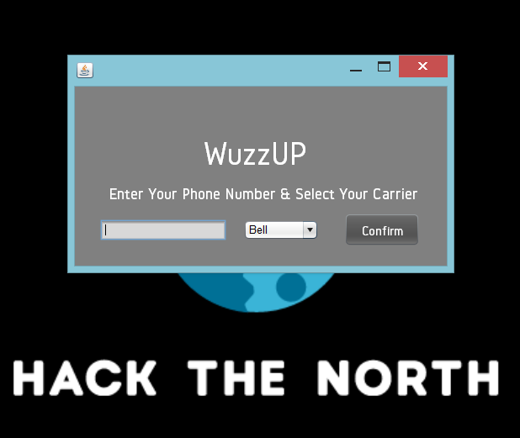

Slide 7
See Matlab

Slide 8
Just What You Need

