Slide 1

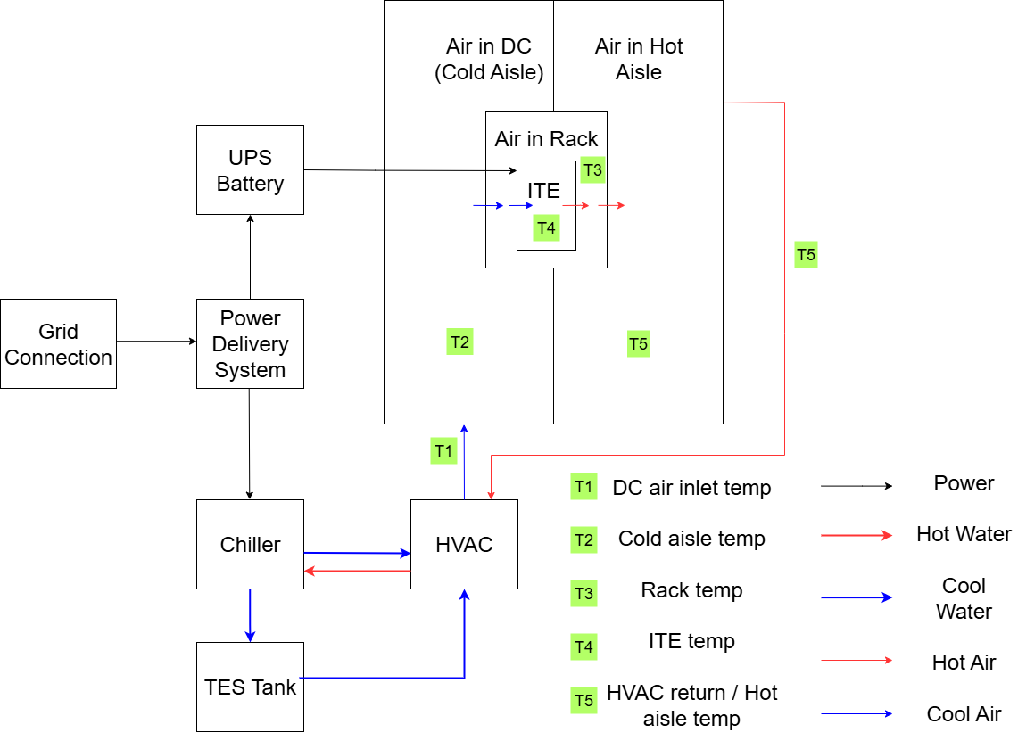
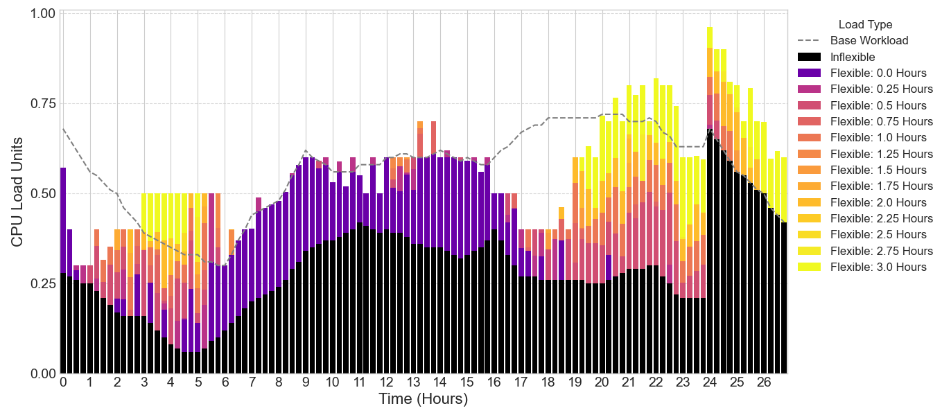
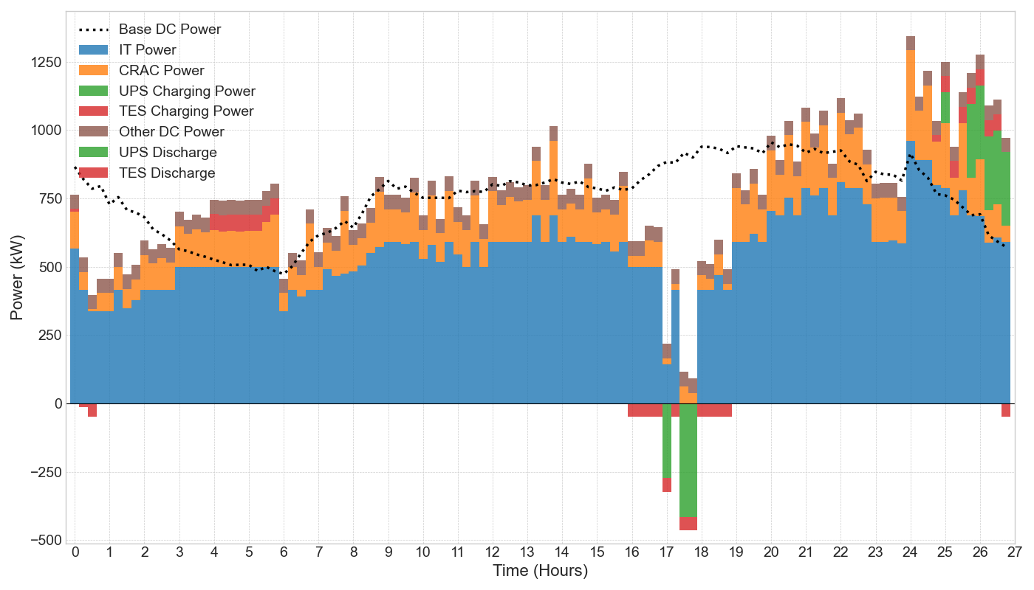
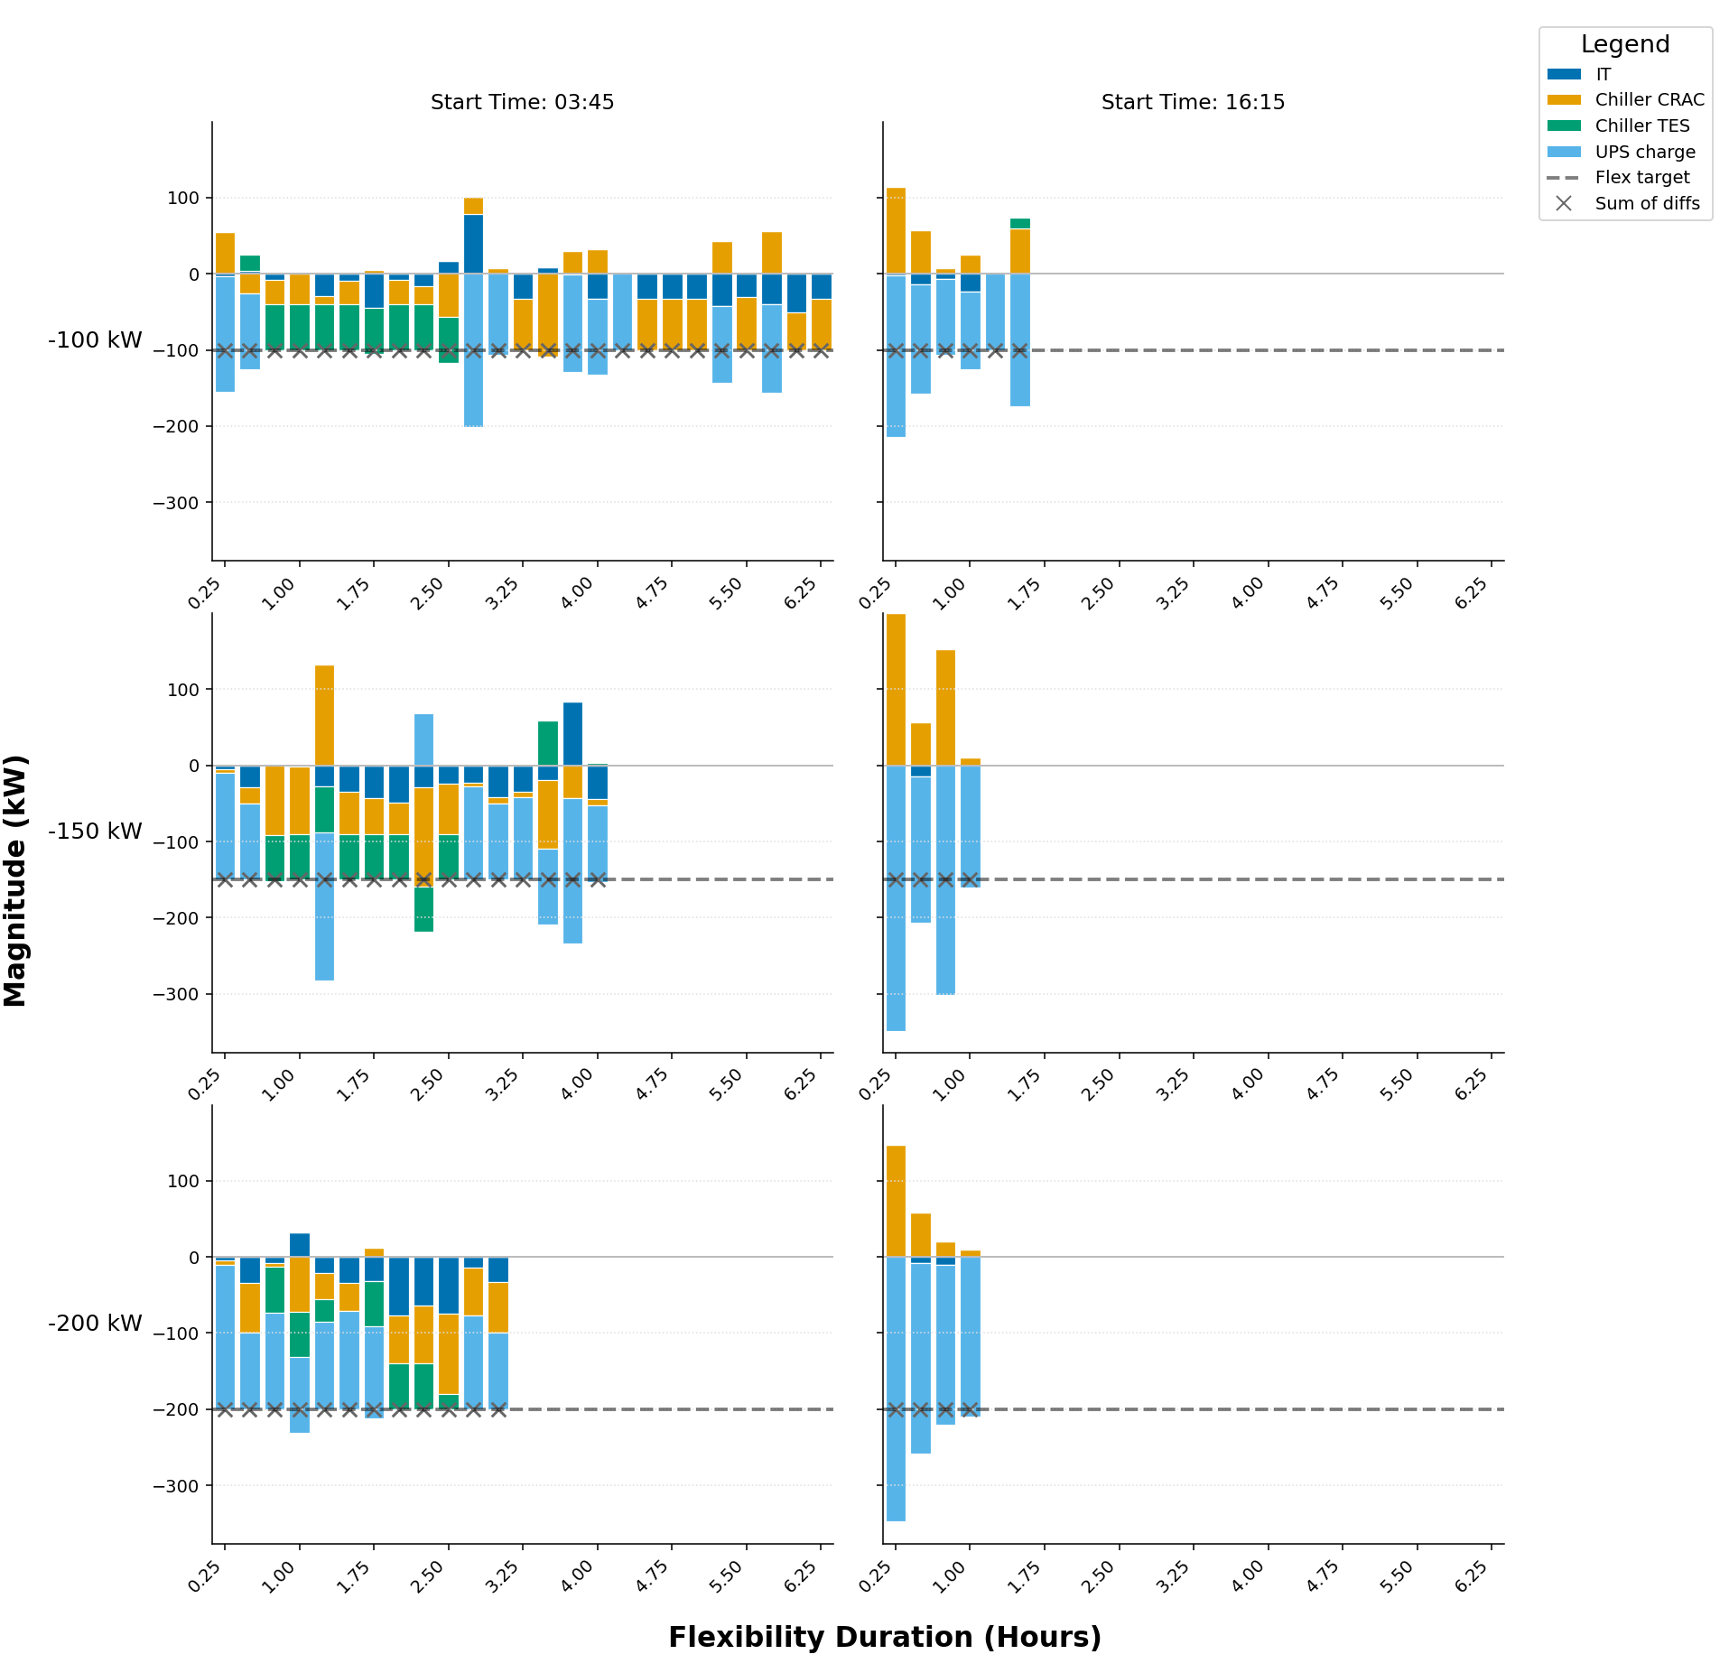
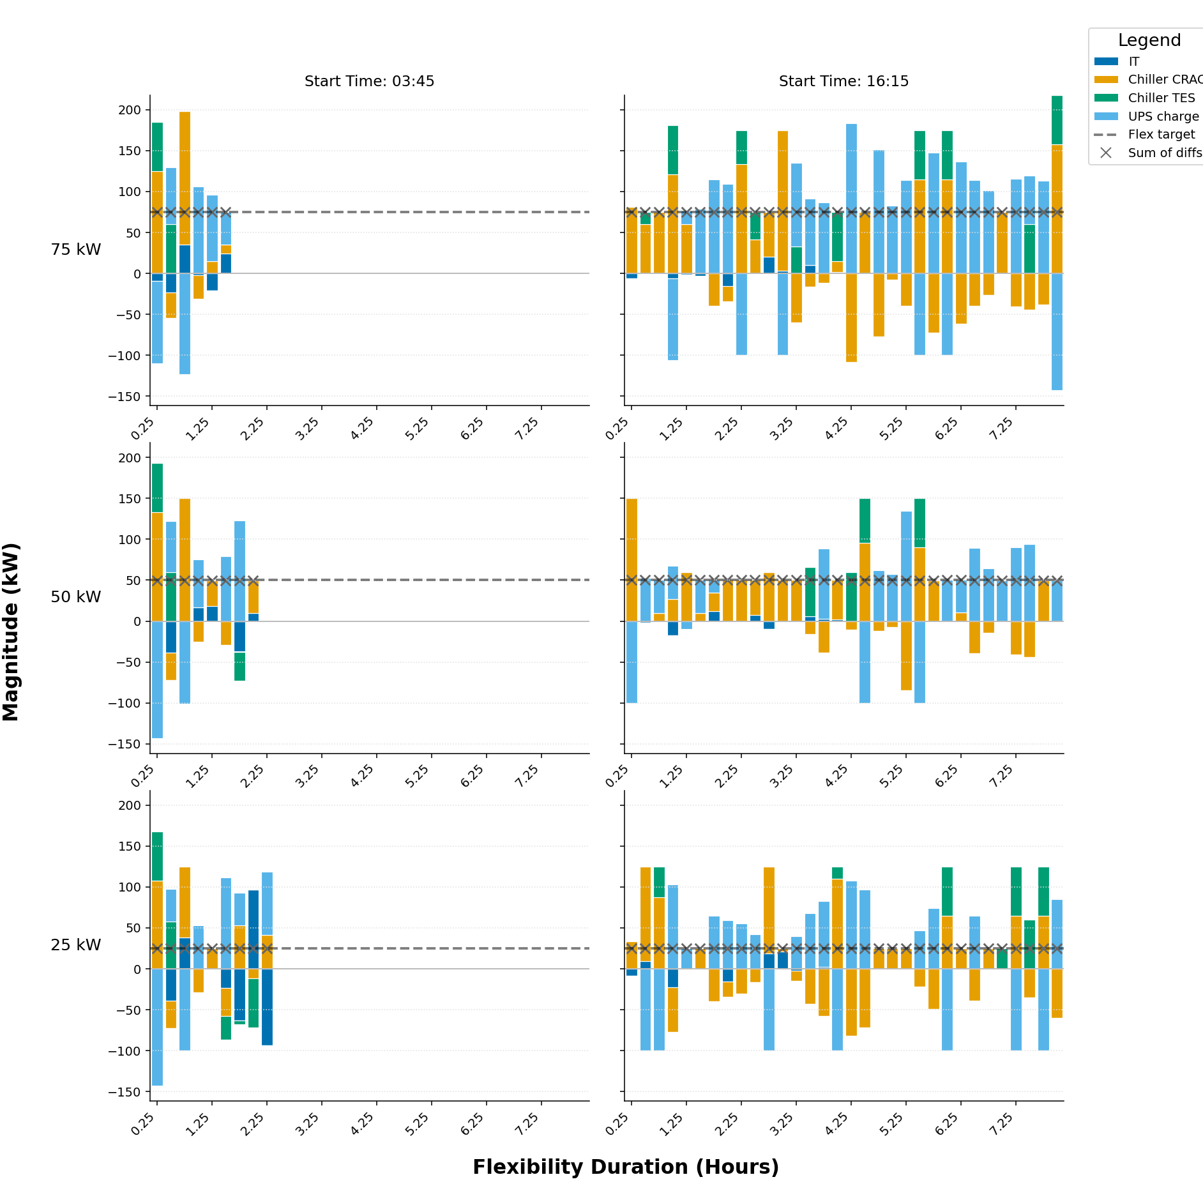
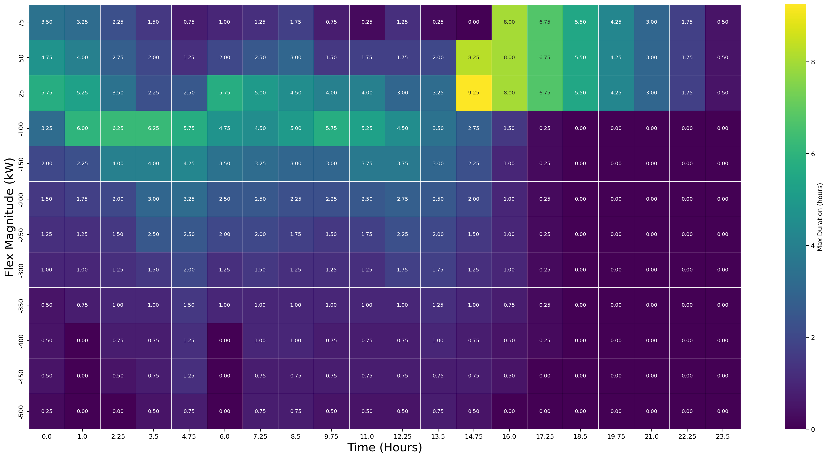
Characterisation and Quantification of Data Centre Flexibility for Power System Support
Mehmet Turker Takci, James Day, Meysam Qadrdan | Cardiff University
Core takeaway: an integrated IT-UPS-cooling strategy can reduce operating cost and provide duration-certified flexibility
to the power system
Problem and Motivation
Global digitalisation and AI are accelerating data centre electricity demand while power systems integrate variable renewable energy sources and new electric loads. This increases peak stress, ramping pressure, and local network congestion. Simultaneously, data centres host controllable assets that can support grid balancing, especially when operated as an integrated system. This positions data centres as both a growing burden on grid stability and a potential solution.
Research Objective
This work develops and tests a whole facility framework with two contributions. First, it computes a least cost day ahead operating baseline by co-optimising IT scheduling, UPS operation, and cooling/TES dispatch. Second, it quantifies the flexibility duration for a range of power deviations. This is done for upward flexibility (reducing power load) and downward flexibility (increasing power load).
Integrated Model
Flexibility is represented through three coupled subsystems. IT flexibility comes from shifting delay-tolerant workload while respecting maximum delay limits and assuming constant computational demand for a given IT job. UPS flexibility comes from varying the state of charge (SOC) and charge / discharge power flow. Cooling flexibility comes from chiller modulation, TES charge/discharge, and temperature dynamics for inlet air, cold aisle, racks, IT components, and hot aisle. The model uses 15-minute time steps over a 24-hour horizon plus a 3-hour extension window. A 1 MW IT facility is analysed with UPS capacity of 600 kWh and TES capacity of 1000 kWh, using day-ahead electricity prices.
F1. Integrated architecture linking the power grid to: IT, UPS, chiller, and TES; flexibility emerges from coordinated electrical and thermal control.
£1,659.54 -> £1,493.19, Savings: £166.34 (10.02%)
F2. Optimised demand tracks price: grid draw increases off-peak and drops during peak-price hours.
F3. Stacked dispatch shows IT, CRAC, UPS, and TES coordination delivering cost-minimising operation.
Scenario Design
Key Results (Cost and Dispatch)
Scenario 1 establishes a no-flexibility base-case cost benchmark. Scenario 2 co-optimises workload, UPS, and cooling/TES to minimise operating cost under physical constraints. Scenario 3 performs a duration-aware flexibility test on top of the Scenario 2 baseline. For each start time t0 and requested deviation ΔP, the model searches for the maximum feasible duration τ, while enforcing thermal and operational constraints and a 12-slot recovery window so post-event operation remains feasible.
Cost optimisation reduces daily operating cost from £1,659.54 to £1,493.19, delivering £166.34 savings (10.02%) without additional hardware investment. During low-price periods, the site increases grid draw to pre-charge TES/UPS and process more IT load; during peak-price periods, it reduces grid draw through deferred IT execution, UPS discharge, and cooling reallocation.
F5. Component-level decomposition highlights asymmetry between upward (left) and downward (right) flexibility provision.
F4. Duration-certified flexibility envelope: maximum feasible duration (tau) varies strongly
with start time and requested +/-DeltaP.
Key Results (Flexibility Asymmetry)
Practical Implications
The flexibility heatmap reveals strong temporal structure and clear asymmetry. Upward flexibility (negative ΔP) is strongest when IT deferral headroom is available and is reinforced by cooling reduction. Downward flexibility (positive ΔP) is concentrated later in the day and relies more on CRAC/TES and UPS charging because advancing IT workloads is constrained. A representative contrast is -100 kW upward flexibility for 6.8 h at 00:15 versus 0.2 h at 17:30. The stacked bar charts above show the flexibility contributions of each asset at each time step. The assets complimentary characteristics result in an integrated system that can provide significant flexibility over the 24 hour time horizon.
The framework turns abstract flexibility potential into market-relevant, duration certified flexibility magnitudes. This flexibility could be utilised in reserve, response or an alternative flexibility service. In doing so, the data centre generates revenue and contributes to grid balancing. Furthermore, system planners gain time and magnitude specific estimates of dependable demand side response from data centres. Because duration is certified rather than assumed, outputs can be mapped directly to products with explicit start-time and magnitude commitments.
Limitations and Next Work
Future work: explicit revenue stacking, pre-conditioning windows for more symmetric downward IT participation, and multi-site portfolio aggregation.
References: IEA (2025) Energy and AI; ASHRAE thermal guidance; Takci et al. (2025).

