Slide 1
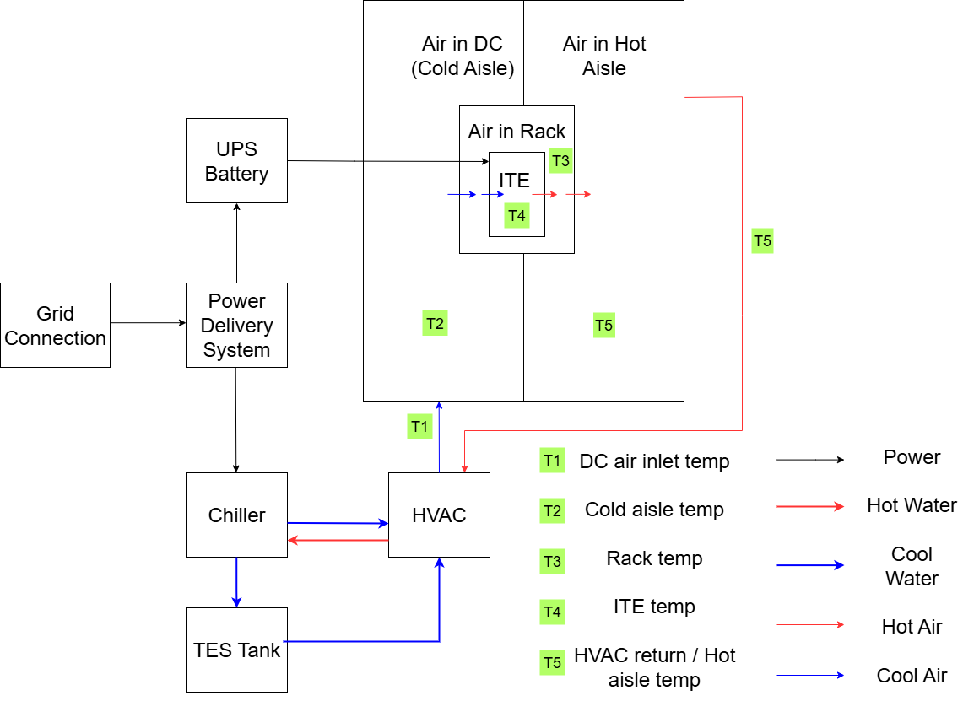
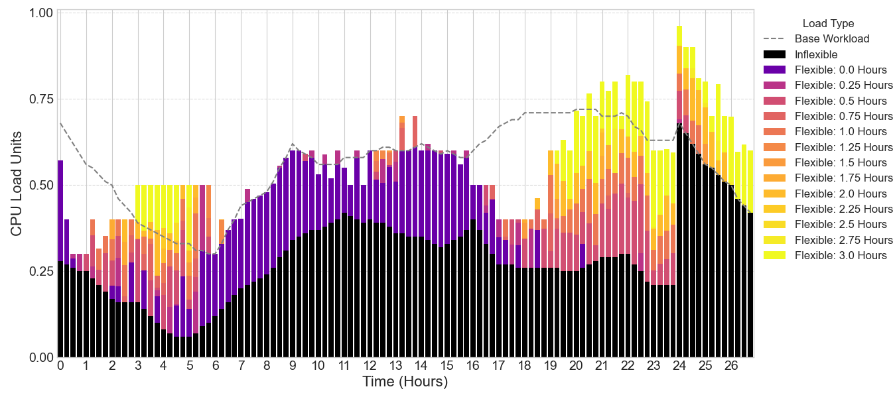
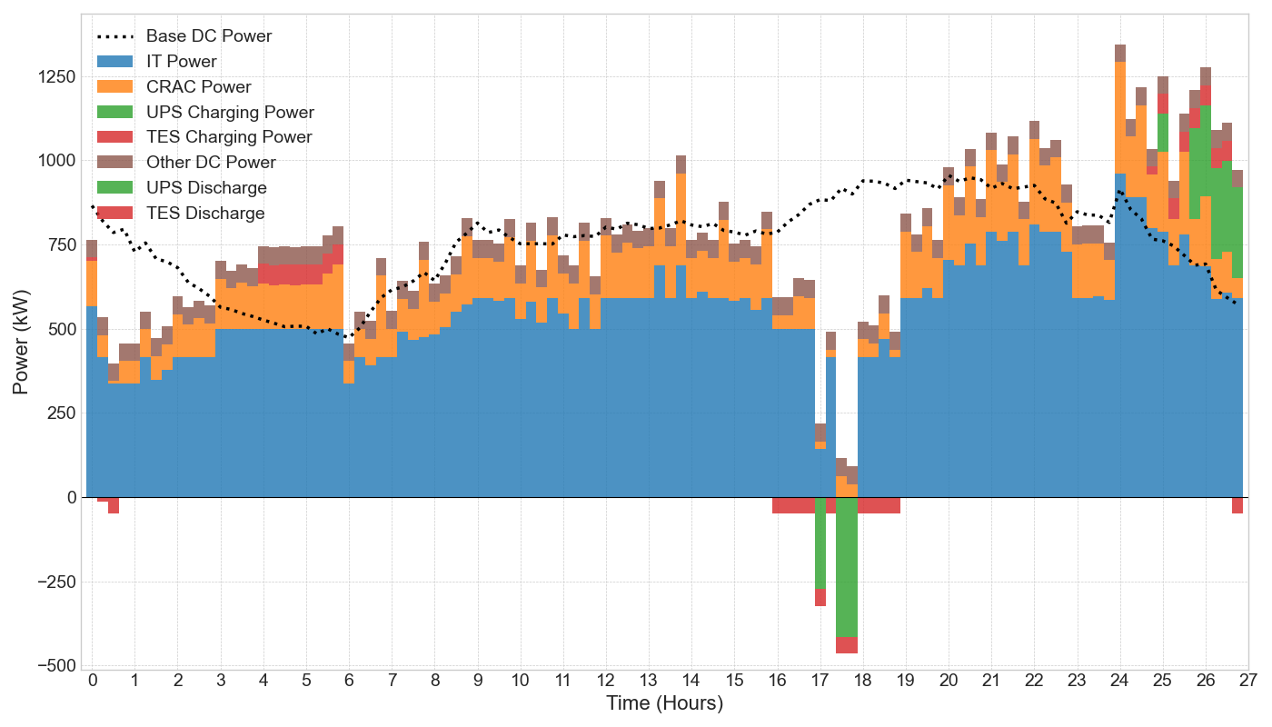
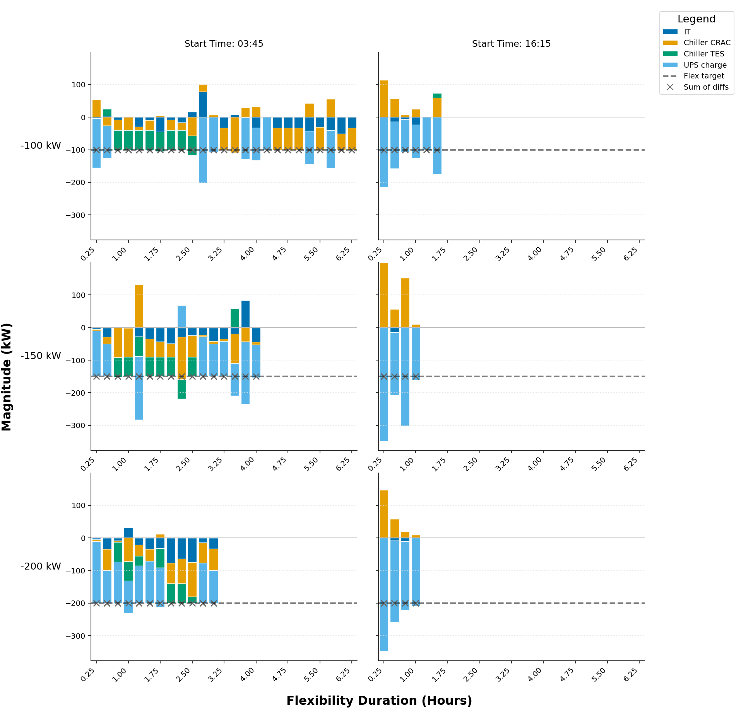
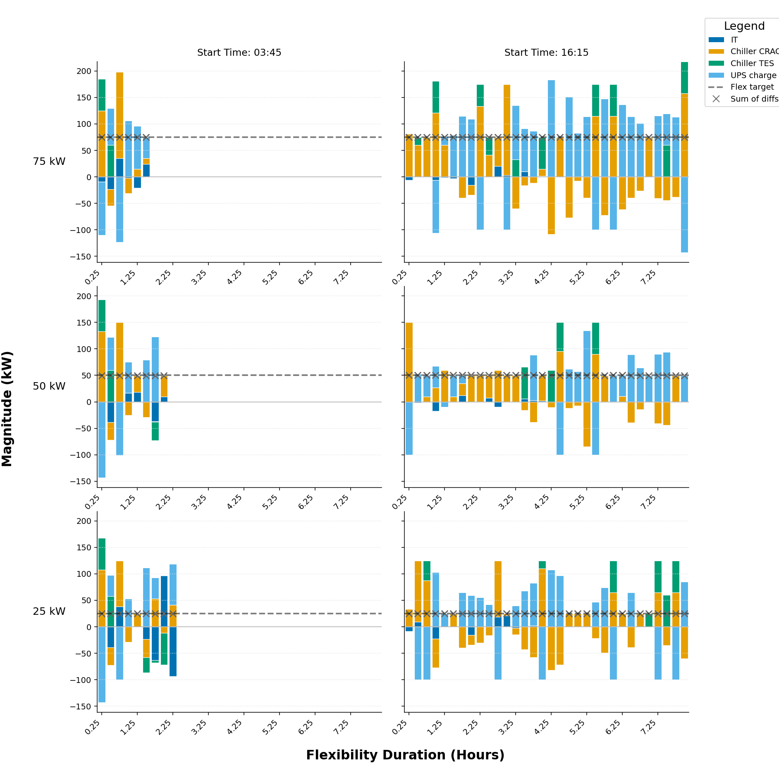
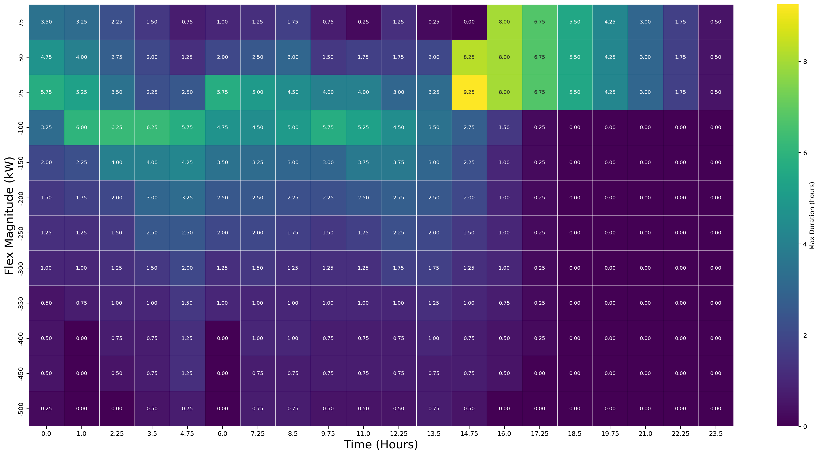

Characterisation and Quantification of Data Centre Flexibility for Power System Support
Mehmet Turker Takci, James Day, Meysam Qadrdan | Cardiff University
Core message: an integrated IT-UPS-cooling strategy can reduce operating cost and provide duration-certified flexibility to the grid.
Problem and Motivation
Global digitalisation and AI are accelerating data-centre electricity demand while power systems integrate variable renewables and new electric loads. This increases peak stress, ramping pressure, and local network congestion. Data centres therefore have a dual role: they are part of the flexibility challenge, but they also host controllable assets that can support balancing when operated as an integrated system.
Research Objective
This work develops and tests a whole-facility framework with two contributions. First, it computes a least-cost day-ahead operating baseline by co-optimising IT scheduling, UPS operation, and cooling/TES dispatch. Second, it quantifies duration-certified flexibility: for any requested power deviation and start time, it computes the maximum feasible provision duration.
Integrated Model
Flexibility is represented through three coupled subsystems. IT flexibility comes from shifting delay-tolerant workload while preserving constant computational demand and respecting tranche delay limits. UPS flexibility comes from bounded charge/discharge power, state-of-charge limits, and non-simultaneous charging/discharging constraints. Cooling flexibility comes from chiller modulation, TES charge/discharge, and thermodynamic temperature dynamics for inlet air, cold aisle, racks, IT components, and hot aisle. The model uses 15-minute time steps over a 24-hour horizon plus a 3-hour extension window. A 1 MW IT facility is analysed with UPS capacity of 600 kWh and TES capacity of 1000 kWh, using day-ahead electricity prices.
F1. Integrated architecture linking grid, UPS, IT, chiller, and TES; flexibility emerges from coordinated electrical and thermal control.
£1,659.54 -> £1,493.19, Savings: £166.34 (10.02%)
F2. Optimised demand tracks price: grid draw increases off-peak and drops during peak-price hours.
F3. Stacked dispatch shows IT, CRAC, UPS, and TES coordination delivering cost-minimising operation.
Scenario Design
Key Results (Cost and Dispatch)
Scenario 1 establishes a no-flexibility base-case cost benchmark. Scenario 2 co-optimises workload, UPS, and cooling/TES to minimise operating cost under physical constraints. Scenario 3 performs a duration-aware flexibility test on top of the Scenario 2 baseline. For each start time t0 and requested deviation DeltaP, the model searches for the maximum feasible duration tau while enforcing thermal and operational constraints and a 12-slot recovery window so post-event operation remains feasible.
Cost optimisation reduces daily operating cost from £1,659.54 to £1,493.19, delivering £166.34 savings (10.02%) without additional hardware investment. During low-price periods, the site increases grid draw to pre-charge TES/UPS and process more IT load; during peak-price periods, it reduces grid draw through deferred IT execution, UPS discharge, and cooling reallocation.
F5. Component-level decomposition highlights asymmetry between upward (left) and downward (right) flexibility provision.
F4. Duration-certified flexibility envelope: maximum feasible duration (tau) varies strongly
with start time and requested +/-DeltaP.
Key Results (Flexibility Asymmetry)
Practical Implications
The flexibility heatmap reveals strong temporal structure and clear asymmetry. Upward flexibility (negative DeltaP) is strongest when IT deferral headroom is available and is reinforced by cooling reduction. Downward flexibility (positive DeltaP) is concentrated later in the day and relies more on CRAC/TES and UPS charging because advancing IT workloads is constrained without pre-conditioning. A representative contrast is -100 kW upward flexibility for 6.8 h at 00:15 versus 0.2 h at 17:30. Asset-level panels show coordinated internal counter-movements that preserve the required net response.
The framework turns abstract flexibility potential into market-relevant, duration-certified products for reserve, balancing, and price-responsive demand. Operators can optimise cost first, then stack flexibility services using residual capability. System planners gain time- and magnitude-specific estimates of dependable demand-side response from data-centre assets. Because duration is certified rather than assumed, outputs can be mapped directly to products with explicit start-time and magnitude commitments.
Limitations and Next Work
Future work: explicit revenue stacking, pre-conditioning windows for more symmetric downward IT participation, and multi-site portfolio aggregation.
QR: full paper PDF
References: IEA (2025) Energy and AI; ASHRAE thermal guidance; Takci et al. (2025).

