Slide 1
E-Commerce Platform Launch
Executive Project Update | Portfolio Case Study
Launch delivered on baseline date with favorable budget variance and zero open launch blockers.
Project Coordinator | Cross-functional delivery | 6-week simulated launch

Slide 2
Executive Health Dashboard
Week 6 - Launch & Hypercare
OVERALL
TASKS
VELOCITY
BUDGET
BLOCKERS
GREEN
100%
48
+1.7%
0
Launch on plan
24 / 24 final week
Up 100% vs Week 1
Favorable variance
At go-live
• Production launch completed August 17 as baselined.
• All critical launch-readiness criteria were satisfied before deployment.
• Hypercare monitoring active with no severity-1 incidents.

Slide 3
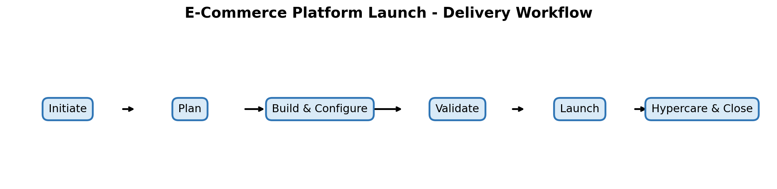
Scope & Delivery Model
• In scope: storefront, catalog, payment integration, UAT, security review, deployment, support readiness, hypercare.
• Out of scope: native mobile app, international expansion, second processor at initial launch, long-term optimization.
• Delivery gates: Initiate -> Plan -> Build & Configure -> Validate -> Launch -> Hypercare & Close.

Slide 4
Milestone Performance
Charter
Build
Payments
UAT
Readiness
Launch
Jul 8
Jul 23
Aug 1
Aug 8
Aug 14
Aug 17
Baseline Jul 8 | 0d
Baseline Jul 24 | -1d
Baseline Jul 31 | +1d
Baseline Aug 7 | +1d
Baseline Aug 14 | 0d
Baseline Aug 17 | 0d
Schedule interpretation
• Two interim milestones moved by one day, but available float protected the August 17 launch baseline.
• No approved change request required a launch-date rebaseline.

Slide 5
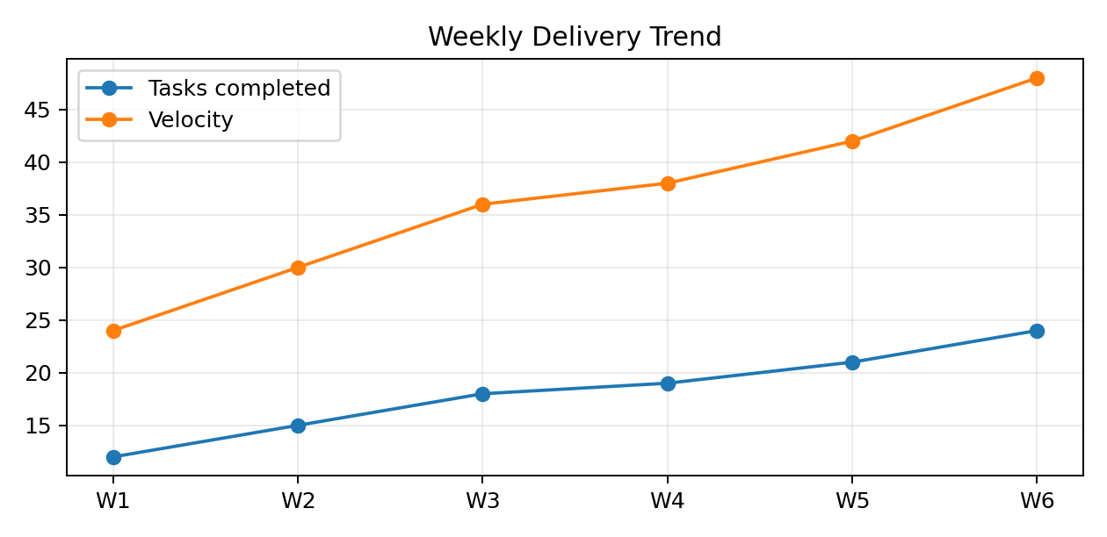
Delivery Performance Trend
• Task throughput doubled from 12 to 24 completed tasks per week.
• Velocity increased from 24 to 48 across the six-week delivery period.
• Final week achieved 100% of planned tasks.

Slide 6
Top Risks, Issues & Dependencies
I-01
Checkout defects during UAT
20
CLOSED
Mitigation tracked to named owner and target date.
Issue score
D-01
Security approval before deployment
20
COMPLETE
Mitigation tracked to named owner and target date.
Dependency score
R-01
Payment certification delay
15
CLOSED
Mitigation tracked to named owner and target date.
Risk score
R-02
Catalog data quality
CLOSED
12
Mitigation tracked to named owner and target date.
Risk score

Slide 7
Budget & Forecast
BASELINE
ACTUAL
VARIANCE
$90,000
$88,450
+$1,550
Excludes $5,000 contingency
Completed below baseline
1.7% favorable
• Payment integration exceeded category baseline by $800 due to certification support.
• Savings in platform development, QA, and hypercare offset the overage.
• Contingency remained available at project close.

Slide 8
Change Control & Decisions
• CR-01 Guest checkout - Approved. Three development days absorbed within schedule float.
• CR-02 Second payment processor - Deferred. Estimated two-week impact conflicted with launch baseline.
• CR-03 Additional 500 SKUs - Approved as phased upload with enhanced validation controls.
• Decision discipline protected the baseline while preserving business value in the post-launch backlog.

Slide 9
Go-Live Readiness
CRITICAL DEFECTS
SECURITY APPROVAL
PAYMENT VALIDATION
0 open
Complete
Passed
Readiness criterion
Readiness criterion
Readiness criterion
SUPPORT RUNBOOK
ROLLBACK PLAN
MONITORING
Accepted
Validated
Active
Readiness criterion
Readiness criterion
Readiness criterion

Slide 10
Outcome & Lessons Learned
• Launch completed on August 17 without rebaselining the target date.
• Final-week delivery reached 24/24 planned tasks; velocity increased 100% from Week 1.
• No launch-blocking issues remained open at go-live; spend finished 1.7% below baseline.
• Early dependency booking, daily UAT triage, and integrated tracking were the strongest execution controls.
• Portfolio note: this is a simulated case study created to demonstrate practical project coordination capability.

