Slide 1
Vergleich von linear mixed models und mixed effects ANOVA zur Analyse des klassischen Therapie-Evaluationsdesigns
Comparison of linear mixed models and mixed effects ANOVA for the analysis of the classical therapy evaluation design
Dr. Jamie Cummins
Teaching Demonstration, University of Luzern

Slide 2
Where We Are
Week | Lecture title
1 | Introduction: reproducibility and simulation
2 | Everything is Regression
3 | Means and Intercepts
4 | Slopes and Change
5 | t-tests and one-way ANOVA
6 | Mixed ANOVA (and multilevel models)
7 | ANCOVA and (good and bad) controls
8 | Linear and logistic regression
9 | Latent variable modelling
10 | Power analysis and the null hypothesis
11 | Measurement error
12 | Missingness
13 | Everything is Still Regression
Notes:
Meta-talk - I envision this as embedded in a broader course

Slide 3

Reading
Chapter 11 (‘Everything is Regression’) of the Monte Carlo Simulation textbook (Hussey & Cummins, 2026)
simulations.tidyver.se

Slide 4
Learning Objectives
Describe the components of the classical therapy evaluation design: AKA a randomized controlled trial
Distinguish between fixed effects and random effects, and between random intercepts and random slopes
Contrast how mixed ANOVA vs. multilevel models handle fixed vs. random effects
Demonstrate how failing to model important random effects can inflate Type I error

Slide 5

Examples Use Simulated Data
Reminder
All code, data, and plots are on the class GitHub page.
English and German slides on GitHub too.
We use simulations and simulated data.
Class GitHub

Slide 6
Statistical Notation
Reminder
dependent variable ~ independent variable(s)

Slide 7
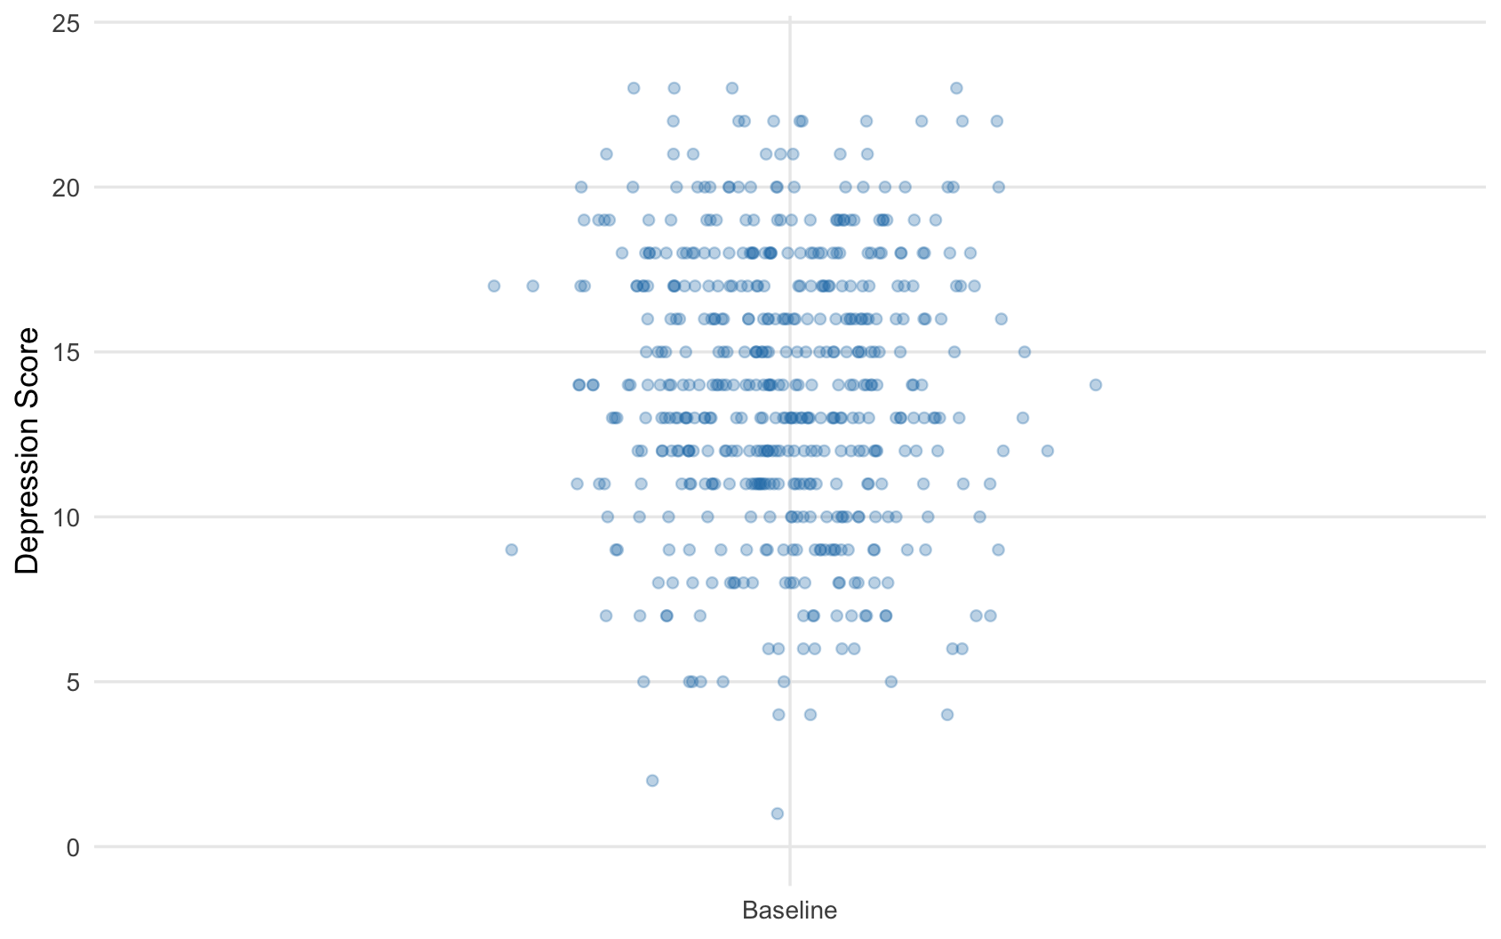
A Mean Is A (Intercept-Only) Model
Reminder
Mean = 13.90

Slide 8
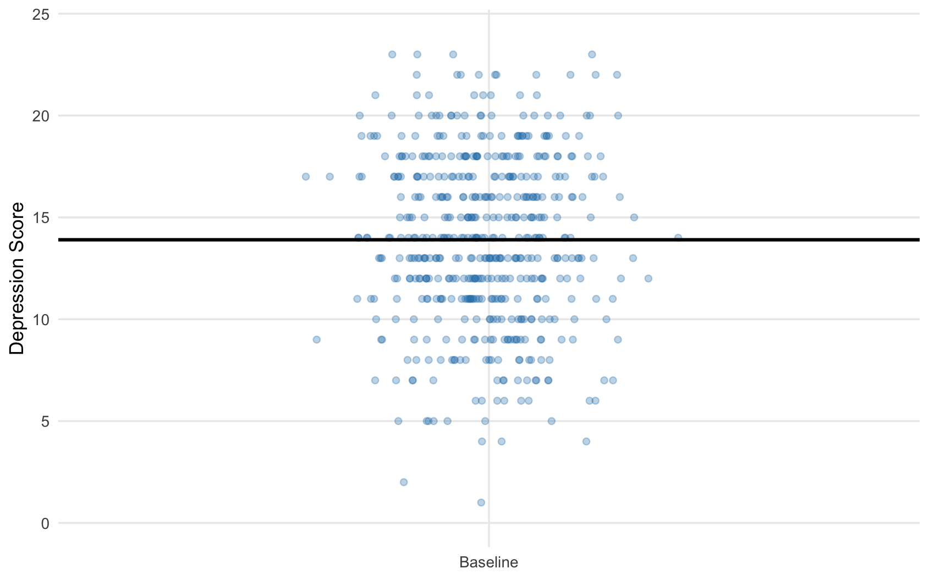
A Mean Is A (Intercept-Only) Model
Reminder
depression ~ 1
Intercept = 13.90

Slide 9
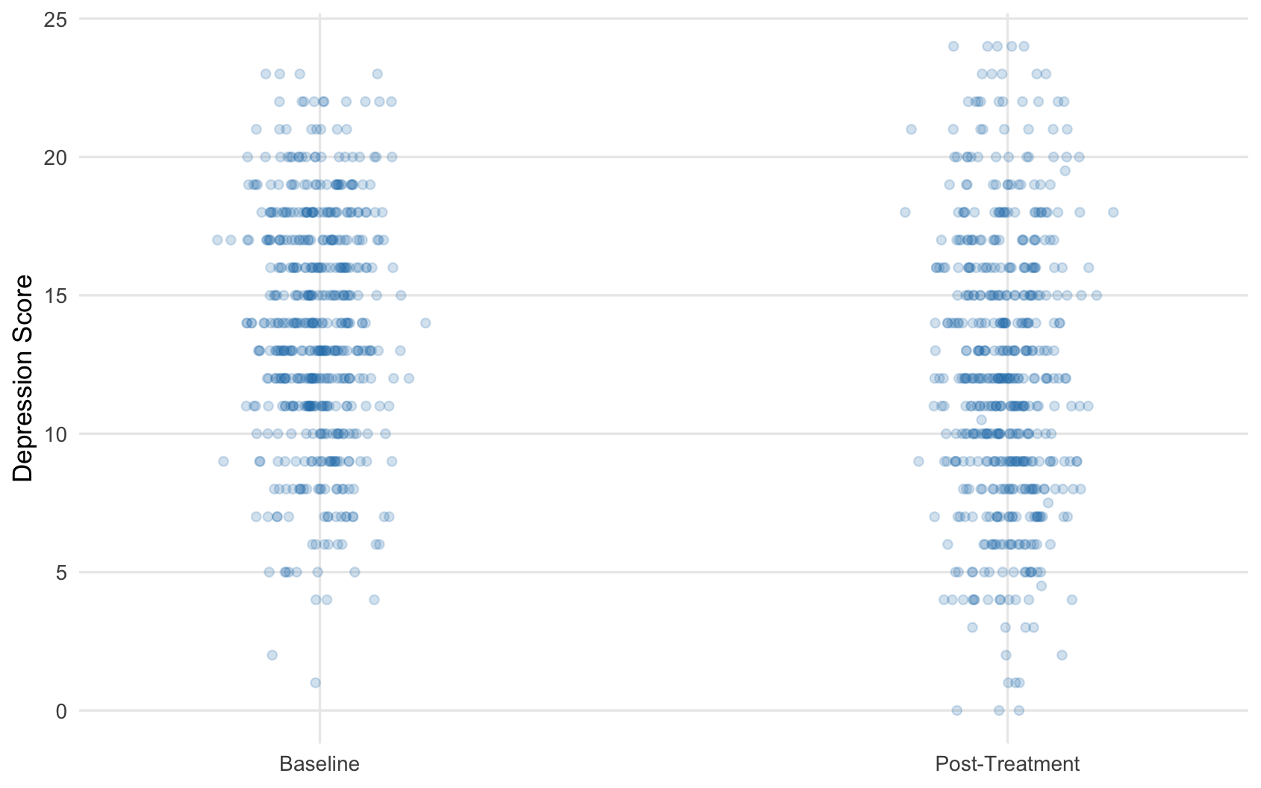
Change Is A Slope
Reminder

Slide 10
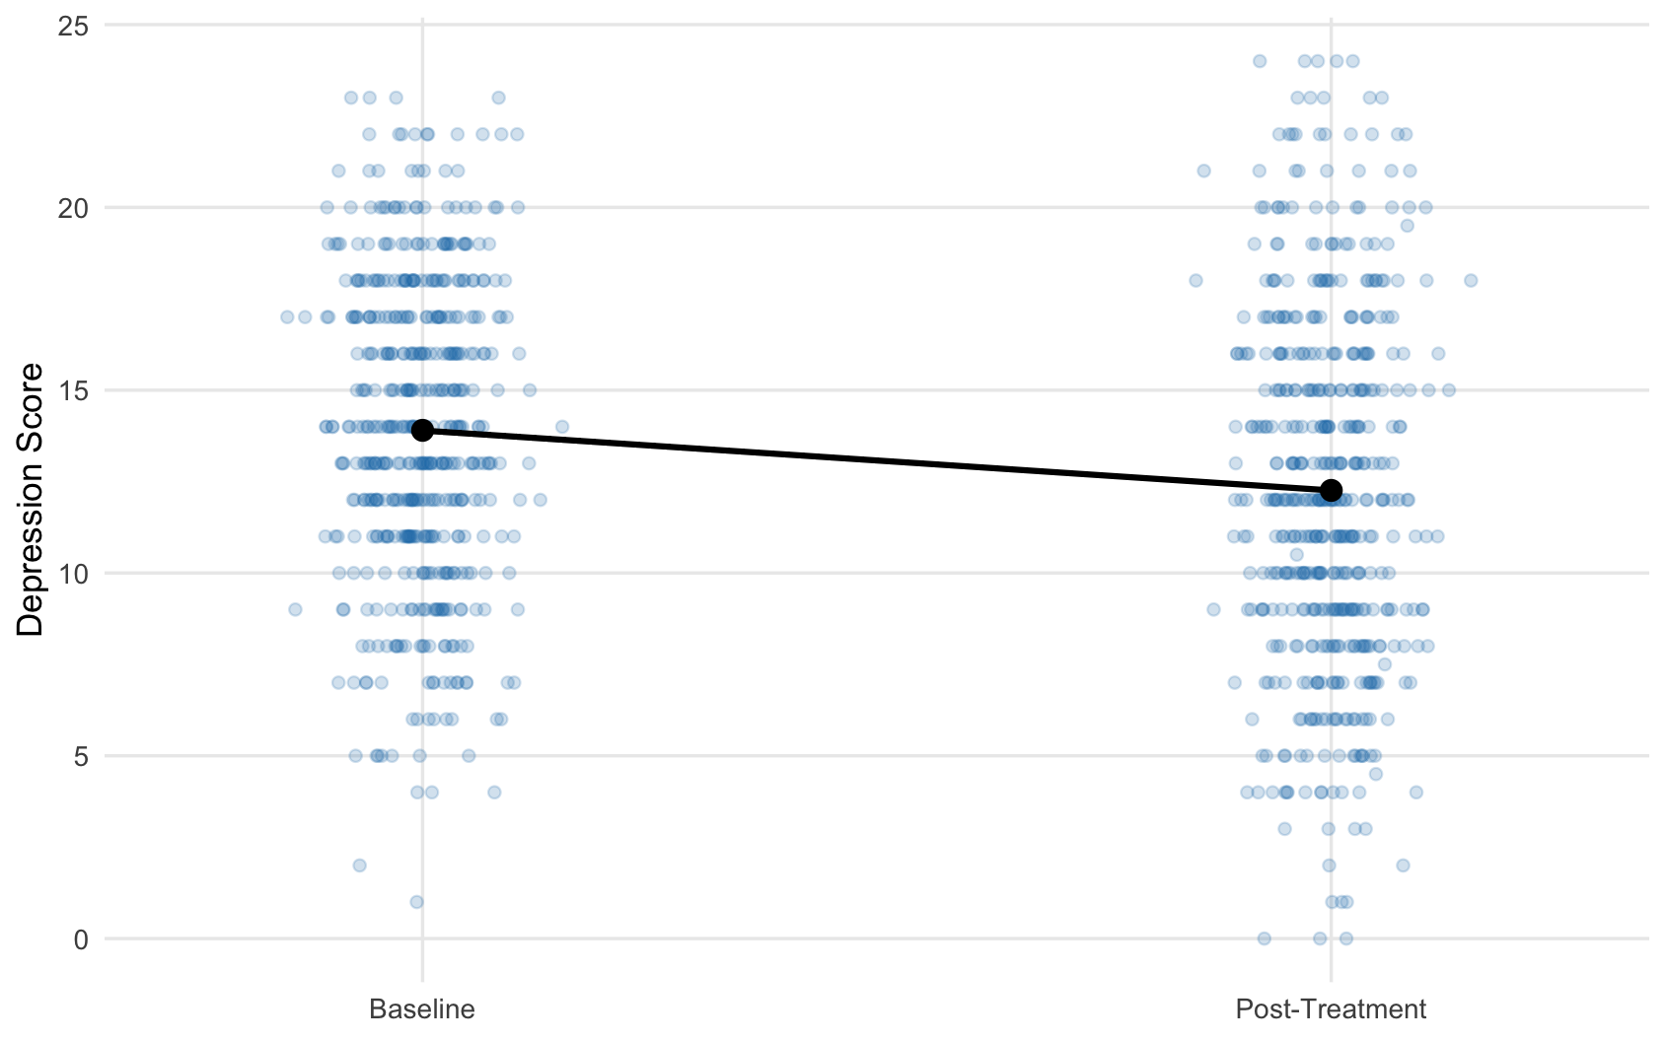
Change Is A Slope
Reminder
depression ~ 1 + timepoint
Mean = 13.90
Mean = 12.26

Slide 11
Change Is A Slope
Reminder
depression ~ 1 + timepoint
Mean = 13.90
slope = -1.64
Mean = 12.26
= difference in means

Slide 12
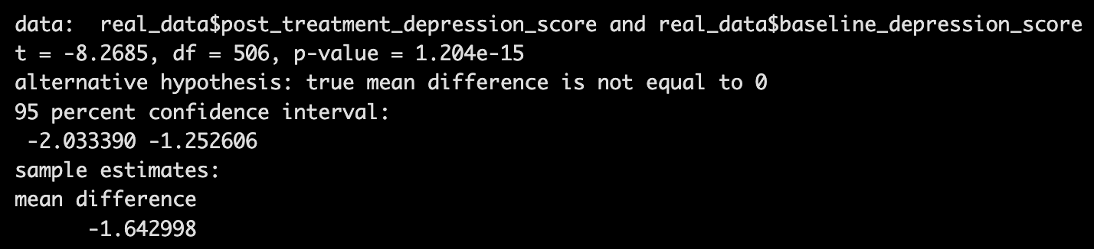
Change Is A Slope
Reminder
depression ~ 1 + timepoint
Mean = 13.90
slope = -1.64
= difference in means
Mean = 12.26

Slide 13
Evaluating Change
Suppose these data are from a new therapy.
Can we conclude, from these data, that our therapy is effective in reducing depression scores?
Why/why not?

Slide 14
Evaluating Change: Counterfactual Thinking
We cannot infer change based on simple pre-post differences.
This is because we do not know the counterfactual: what would have happened without the intervention?

Slide 15
Evaluating Change: Counterfactual Thinking
We cannot infer change based on simple pre-post differences.
This is because we do not know the counterfactual: what would have happened without the intervention?
The data we saw previously are from a real paper where no intervention was administered!
Schleider, J.L., Mullarkey, M.C., Fox, K.R. et al. A randomized trial of online single-session interventions for adolescent depression during COVID-19. Nat Hum Behav 6, 258–268 (2022). https://doi.org/10.1038/s41562-021-01235-0

Slide 16
Evaluating Change: Counterfactual Thinking
To evaluate a therapy we need:
- A counterfactual comparison (AKA a control group)
- Randomization of participants to each treatment
Randomized Controlled Trial
Notes:
Kill some RCT stuff

Slide 17

Randomized Controlled Trial
Control
Baseline (T1)
Post-Treatment (T2)
Intervention
Do scores in our outcome (for example, depression scores), from baseline to post-treatment, change more in the intervention compared to the control?

Slide 18
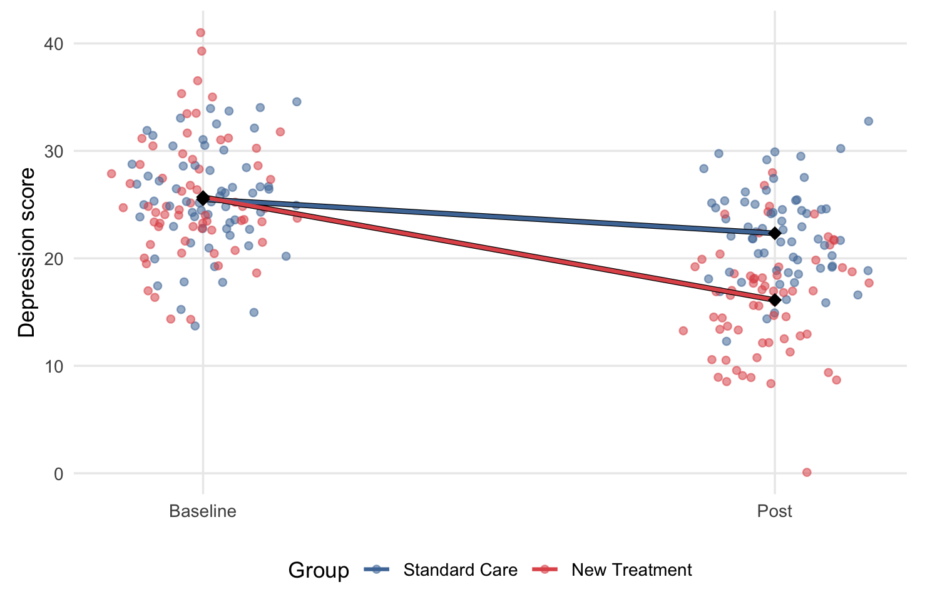
Randomized Controlled Trial
If the slope is the change,
and we want to compare changes,
then: we can compare the slopes to assess change!

Slide 19
Analyzing RCT data: Mixed ANOVA
Most common approach to analysing RCT data: mixed ANOVA

Slide 20
Analyzing RCT data: Mixed ANOVA
Most common approach to analysing RCT data: mixed ANOVA
“Mixed” because there are between and within subject factors:
Between: intervention condition
Within: different timepoints

Slide 21
Analyzing RCT data: Mixed ANOVA
Most common approach to analysing RCT data: mixed ANOVA
Standard mixed ANOVA formula:
depression ~ timepoint * treatment + Error(participant / timepoint)

Slide 22
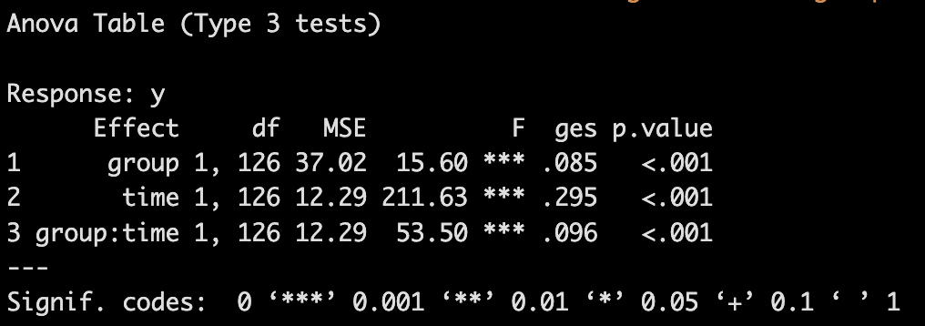
Analyzing RCT data: Mixed ANOVA
Most common approach to analysing RCT data: mixed ANOVA
Standard mixed ANOVA formula:
depression ~ timepoint * treatment + Error(participant / timepoint)

Slide 23


What information might the mixed ANOVA be missing?
Clients might come from clusters of clinics
Clinic 1
Clinic 2
Large clinic in city that deals with a range of different psychological conditions with a large number of clients.
Small clinic in countryside that specializes in serious cases of clinical depression with small number of clients.

Slide 24


What information might the mixed ANOVA be missing?
Clients might come from clusters of clinics
Clients might have different therapists
Therapist 1: Ana
Therapist 2: Mila
Private practitioner with self-referred clients. Has, on average, moderate levels of rapport with clients.
Works in a critical care clinic for severe cases of depression. Has, on average, very high levels of rapport with clients.
Notes:
Is it fair to assume every therapist is exactly as effective as every other one?
Change their names

Slide 25

What information might the mixed ANOVA be missing?
Clients might come from clusters of clinics
Clients might have different therapists
Many other possible types of clustering

Slide 26
What information might the mixed ANOVA be missing?
Clients might come from clusters of clinics
This violates a specific assumption of ANOVA:
Clients might have different therapists
Independence of observations
Many other possible types of clustering
Notes:
Show statistical notation - where is the therapist in the model?
You as second year bachelor students may not be familiar with this notation, but can see therapist is not in the model - question: where is therapist in this model?
Something they already know IRL, show stats do not account for it

Slide 27
Our Worked Example: Different Therapists
Therapist 1: Ana
Therapist 2: Mila
Private practitioner with self-referred clients. Has, on average, moderate levels of rapport with clients.
Works in a critical care clinic for severe cases of depression. Has, on average, very high levels of rapport with clients.

Slide 28
Our Worked Example: Different Therapists
Therapist 1: Ana
Therapist 2: Mila
Private practitioner with self-referred clients. Has, on average, moderate levels of rapport with clients.
Works in a critical care clinic for severe cases of depression. Has, on average, very high levels of rapport with clients.
depression ~ timepoint * treatment + Error(participant / timepoint)

Slide 29
Our Worked Example: Different Therapists
Lower mean baseline depression
Less mean change
Therapist 1: Ana
Different intercepts
Different slopes
Higher mean baseline depression
Greater mean change
Therapist 2: Mila

Slide 30








Handling Sources of Variation
The slopes and intercepts for our therapists are different to our slopes and intercepts for treatment or timepoint
Ana and Mila are just two therapists of a random sample of the population of therapists who might deliver the intervention in the future

Slide 31
Handling Sources of Variation
Our treatment and timepoints are fixed effects
But our therapists are random effects

Slide 32
Handling Sources of Variation
depression ~ 1 + timepoint * treatment + (1 | therapist)
Fixed effects
Random effects
This is called a multilevel model
(or linear mixed model, or mixed-effects model)

Slide 33
Handling Sources of Variation
We have talked about intercepts and slopes for fixed effects. There are also intercepts and slopes for random effects.
Random intercepts mean different levels of a random effect variable may have different means.
Random slopes model not only differences in means, but also differences in how much they change over time.

Slide 34
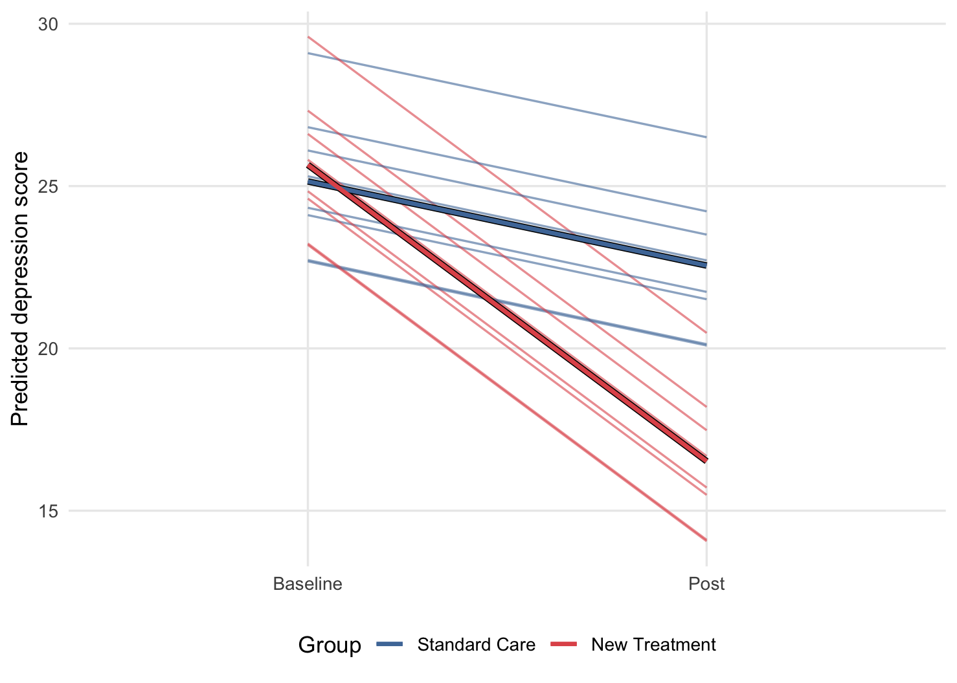
Random Intercepts
depression ~ 1 + timepoint * treatment + (1 | therapist)

Slide 35
Random Intercepts
depression ~ 1 + timepoint * treatment + (1 | therapist)

Slide 36
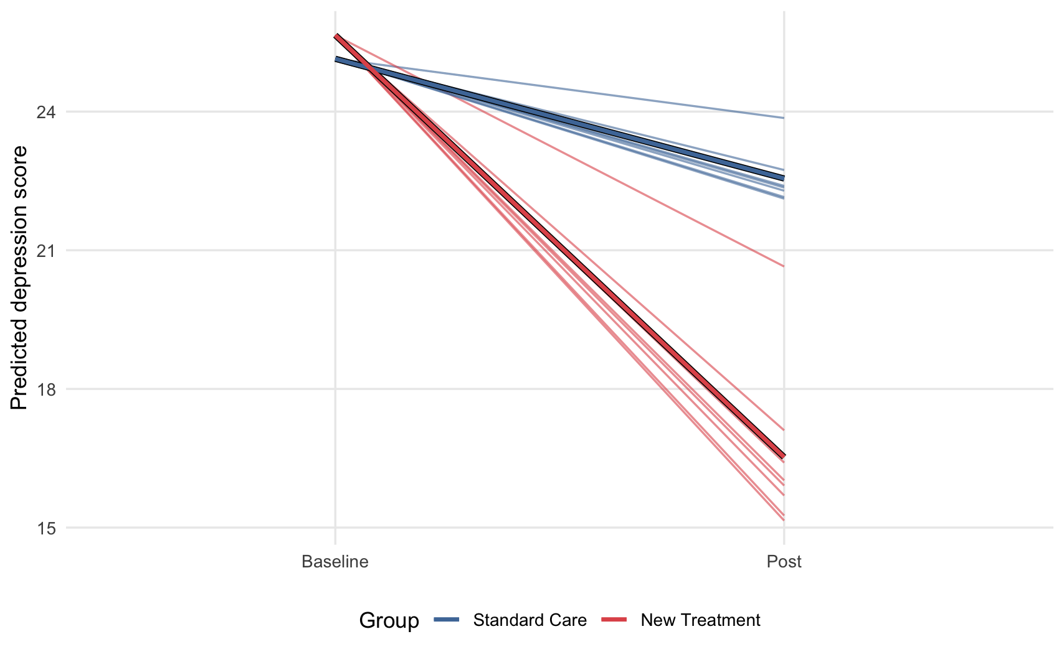
Random Slopes
depression ~ 1 + timepoint * treatment + (0 + timepoint | therapist)

Slide 37
Random Slopes
depression ~ 1 + timepoint * treatment + (0 + timepoint | therapist)

Slide 38
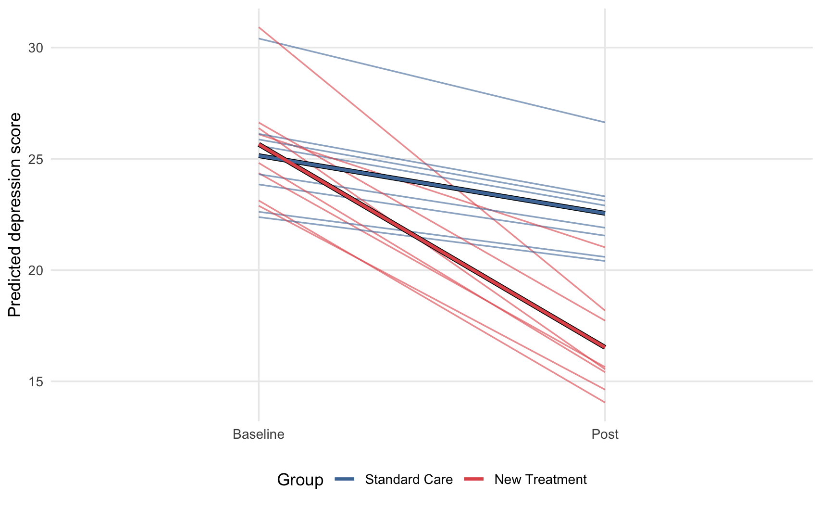
Random Intercepts and Slopes
depression ~ 1 + timepoint * treatment + (1 + timepoint | therapist)

Slide 39
Random Intercepts and Slopes
depression ~ 1 + timepoint * treatment + (1 + timepoint | therapist)

Slide 40
Mixed ANOVA and MLMs
For the two-group, two-timepoint design,
depression ~ timepoint * treatment + Error(participant / timepoint)
is equivalent to
depression ~ 1 + timepoint * treatment + (1 | participant)
when:
There is no missing data
There is no additional source of random variation (e.g., therapist)
Notes:
If these are the same, we might as well do MLM - and chuck in extra bits - latter one gives flexibility

Slide 41
What difference does it make?
Let’s simulate some experiments and find out!

Slide 42
Simulated Study:
Delivered by one of 4 therapists
64 participants
128 participants
Standard care (control)
128 participants
Depression Score (Baseline)
Depression Score (Post-Treatment)
New Therapy (intervention)
64 participants
Delivered by one of 4 therapists
Notes:
Better pivot into simulation
We will understand long run error rate through monte carlo simulation - intro earlier in the course (like everything in the course)
Multiple participants; multiple therapists -> then offer specific values with the simulator

Slide 43
Our Simulation:
In our simulation, we run this study 20’000 times, with the following ground truths:
Notes:
Statistical model on slide + what it means in world - show plots of what these effects look like/common language of what these mean
Why the random slope bigger in treatment vs. standard care - an explanation that could be given to a lay person
Some people respond to therapy more than others, we just model this
Is there a simpler example that could be here?
Plot the REs? - without any focus on downstream results? Cover next week the inferential aspects of this

Slide 44
Our Simulation:
In our simulation, we run this study 20’000 times, with the following ground truths:
Our two interventions (new therapy and standard care) have the same effect on depression (5 point reduction).
There is a true random intercept effect for participants.
There is a true random slope effect for therapist.

Slide 45
Our Simulation:
We know in our simulation that the true interaction effect is zero.
How often should we expect to see p < .05 for the interaction effect?

Slide 46
Our Simulation:
We know in our simulation that the true interaction effect is zero.
How often should we expect to see p < .05 for the interaction effect?
5% of cases (i.e., alpha)

Slide 47
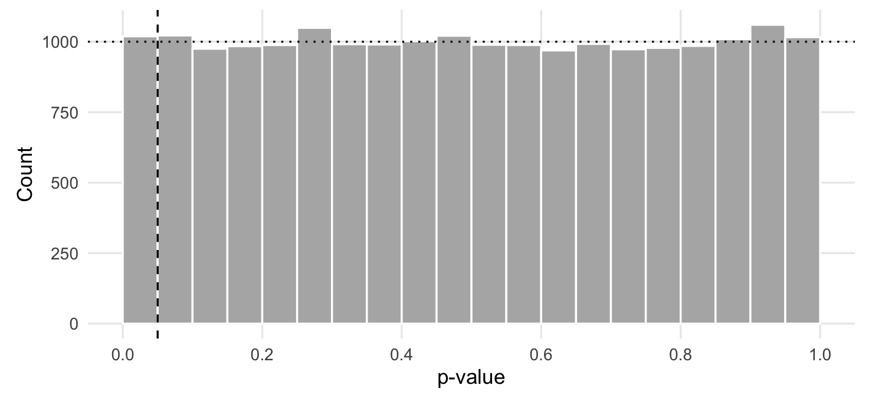
p-value distribution under null
Covered more in Lesson 9
Notes:
Make all distributions waayyyyyy smoother

Slide 48
Our Simulation:
We analyse our 20’000 simulated trials with 3 models:
1. Mixed ANOVA:
depression ~ timepoint * treatment + Error(participant / timepoint)
2. Multilevel model with random therapist intercept:
depression ~ timepoint * treatment + (1 | participant) + (1 | therapist)
3. Multilevel model with random therapist intercept and slope:
depression ~ timepoint * treatment + (1 | participant) + (1 + timepoint | therapist)

Slide 49
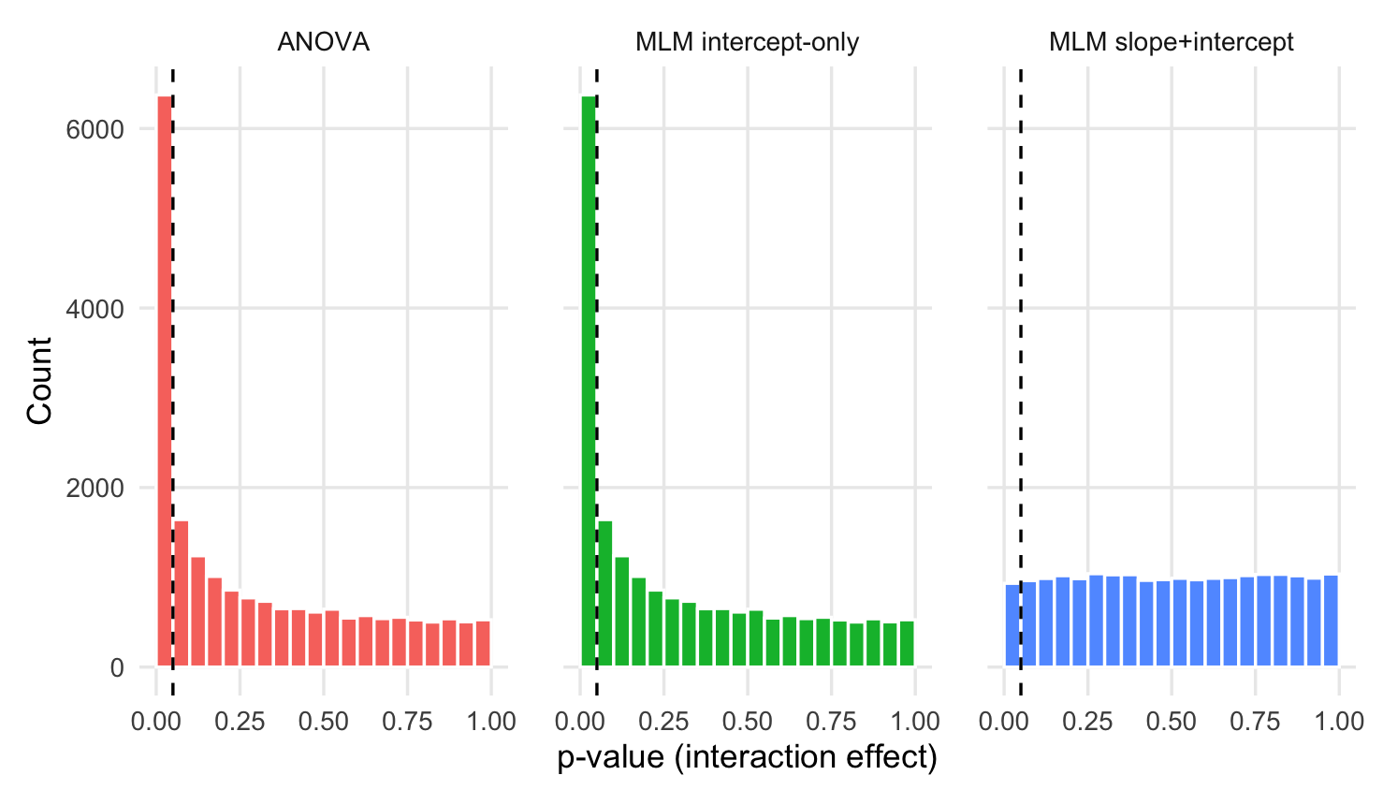
Our Simulation:
Type I error = 31.9%

Slide 50
Our Simulation:
Type I error = 31.9%
Type I error = 31.9%
Notes:
Need to explain why distribution is not flat
Info from RE leaks to fixed - models get confused

Slide 51
Our Simulation:
Type I error = 31.9%
Type I error = 31.9%
Type I error = 4.7%

Slide 52
So when can we use ANOVA?
When the design is balanced and genuinely simple
When our data is too sparse to meaningfully measure random effects
But ANCOVA is better (next week)

Slide 53
Summary
Mixed ANOVA ignores clustering which can frequently occur in RCT data collection
Multilevel models are much more flexible and can therefore much more easily represent a more accurate model of the world
Models that do not account for important clustering, including mixed ANOVA, can lead to increased Type I error rates
Notes:
Multilevel models are more flexible, and can represent a better model of the world
Everything is a linear model

Slide 54


Practice Exam Questions
Notes:
Practice questions, not revision questions
[think about ref]

Slide 55
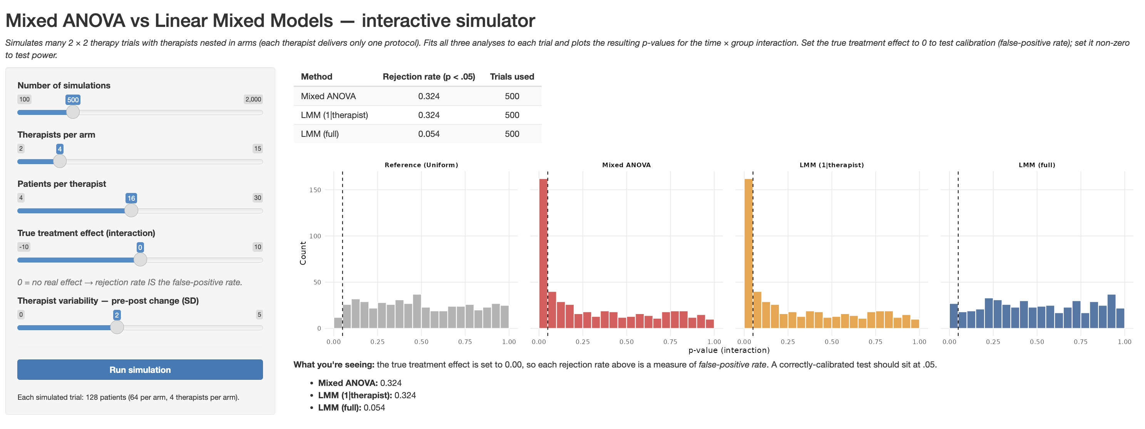

Revision
https://jamiecummins.shinyapps.io/comparing-anova-and-mlms/

Slide 56
Reading
Chapter 12 (‘Estimation’) of the Monte Carlo Simulation textbook (Hussey & Cummins, 2026)
simulations.tidyver.se

Slide 57
Next Week
Examine impact of mixed ANOVA vs. ANCOVA for modeling RCT data
How to know which random effects to include in our models
Introduce the idea of good and bad controls from a causal inference perspective

Slide 58
Thank You!
Examine impact of mixed ANOVA vs. ANCOVA for modeling RCT data
How to know which random effects to include in our models
Introduce the idea of good and bad controls from a causal inference perspective

