Slide 1
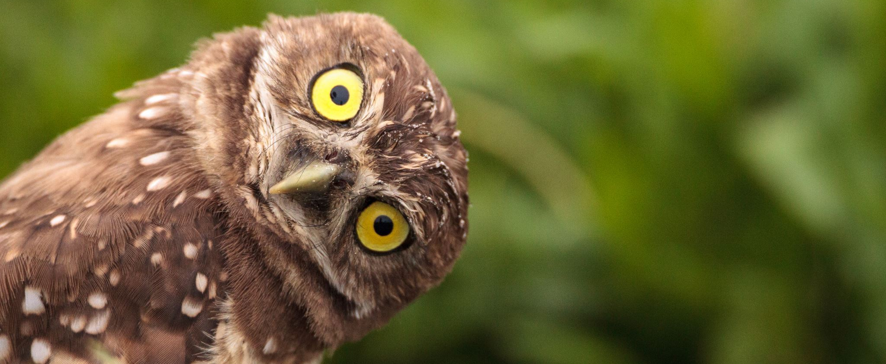
Angry-Owl
Jamie Lee & Jingyi Yu
ECE 4180 – FALL 2019 – Final Project

Slide 2
Project Description
Angry-Owl can scare away pests from your garden!
Rats/mice
Deer
Raccoons
An owl-shaped electronic scarecrow

Slide 3
Parts List
1x MBed
1x Bare-Minimum RedBot Robot Kit
The Bare-Minimum RedBot Robot Kit Contains:
1x 6" 3-Wire Cable
1x Pair of Wheels
1x Pair of 140-RPM Hobby Gearmotors
1x Shadow Chassis
1x Speaker bonnet and Speakers
2x Super Bright White 5mm LED for eyes
3x PIR Motion Sensors
1x HS-422 Servo (Clockwise, Stock Rotation)
1x Pair of 140-RPM Hobby Gearmotors (for wing movement)
1x Dual-H Bridge Module

Slide 4
Software Used

Slide 5
Demo Video/Photo

Slide 6
Summary of Results

