Slide 1
Low cost imaging and image processing with the
Raspberry Pi
Jamie Magee
Supervised by: Dr Alexandre Kabla

Slide 2
Objectives
Provide access to optical flow methods on cheap and readily available hardware
Online and offline processing using the Raspberry Pi
Capture data using the Raspberry Pi Camera
Integrate with existing experiments and other OpenLabTools projects
Provide a clear set of instructions aimed at undergraduate level

Slide 3
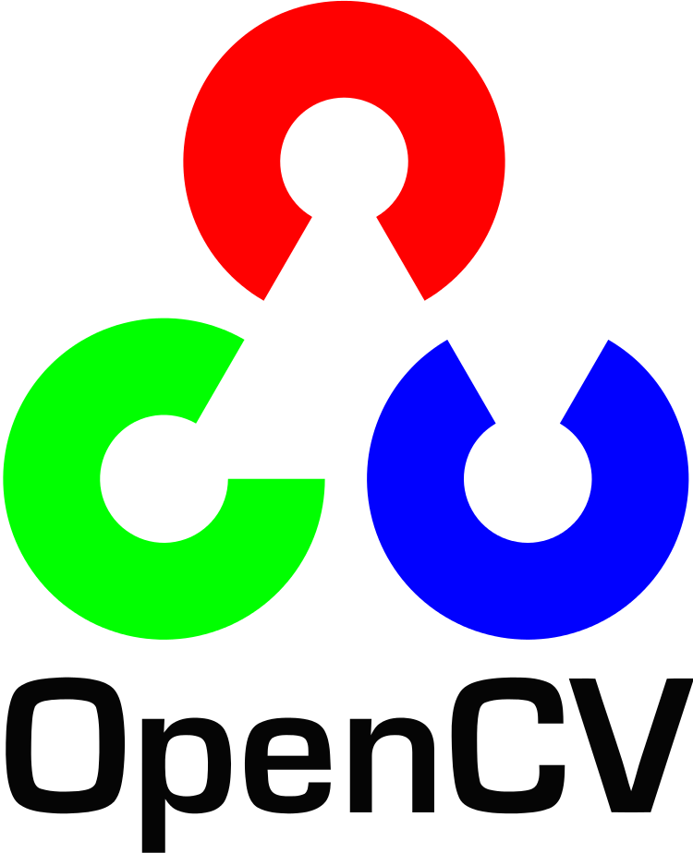
OpenCV & Raspberry Pi Camera
OpenCV is a free and open source library which provides easy access to many image processing and computer vision algorithms, including optical flow algorithms.
A precompiled binary does not exist for the Raspberry Pi, so it was necessary to compile it myself and write instructions on how to do so. The compilation time is around 10-12 hours depending on overclock.
The Raspberry Pi camera by default does not interface with the OS, so an extra driver (UV4l-raspi) was required as well.

Slide 4
Optical Flow
I have considered three different algorithms:
Lucas-Kanade [Lucas, B. and Kanade, T., 1981]
Farnebäck [Farnebäck, G., 2003]
SimpleFlow [Tao, M., Bai, J., Kohli, P. and Paris, S., 2012]
Notes:
L-K is sparse
Fb is dense
SF is semi-dense

Slide 5
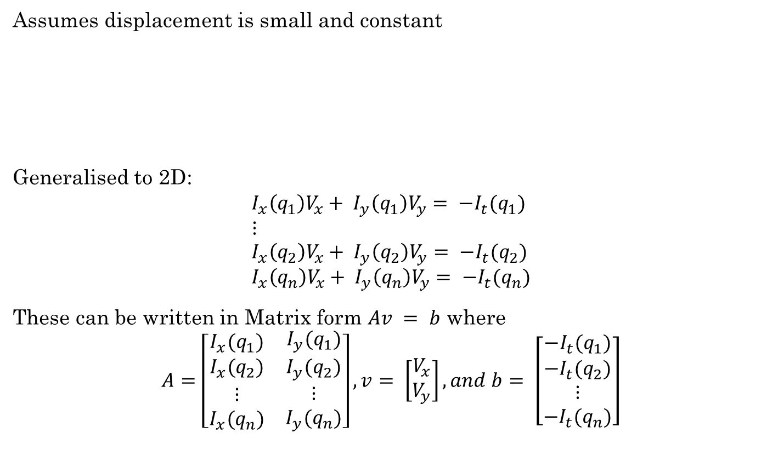
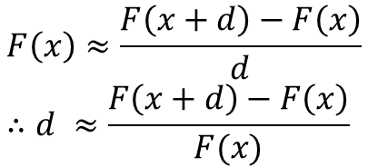


Lucas-Kanade
F(x+d)-F(x)
d
F(x)
F(x+d)

Slide 6
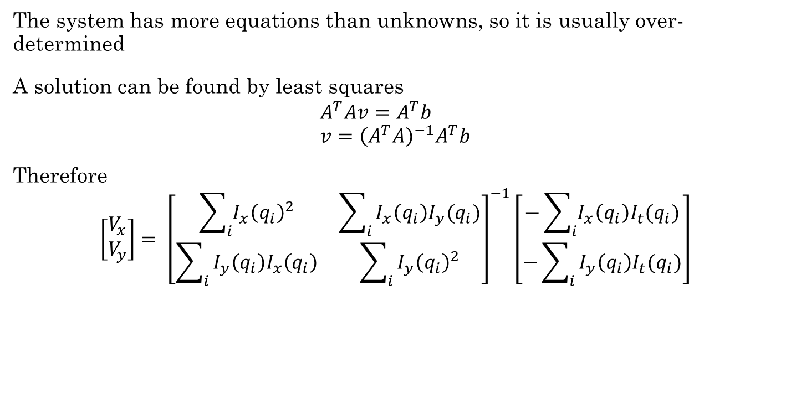
Lucas-Kanade

Slide 7
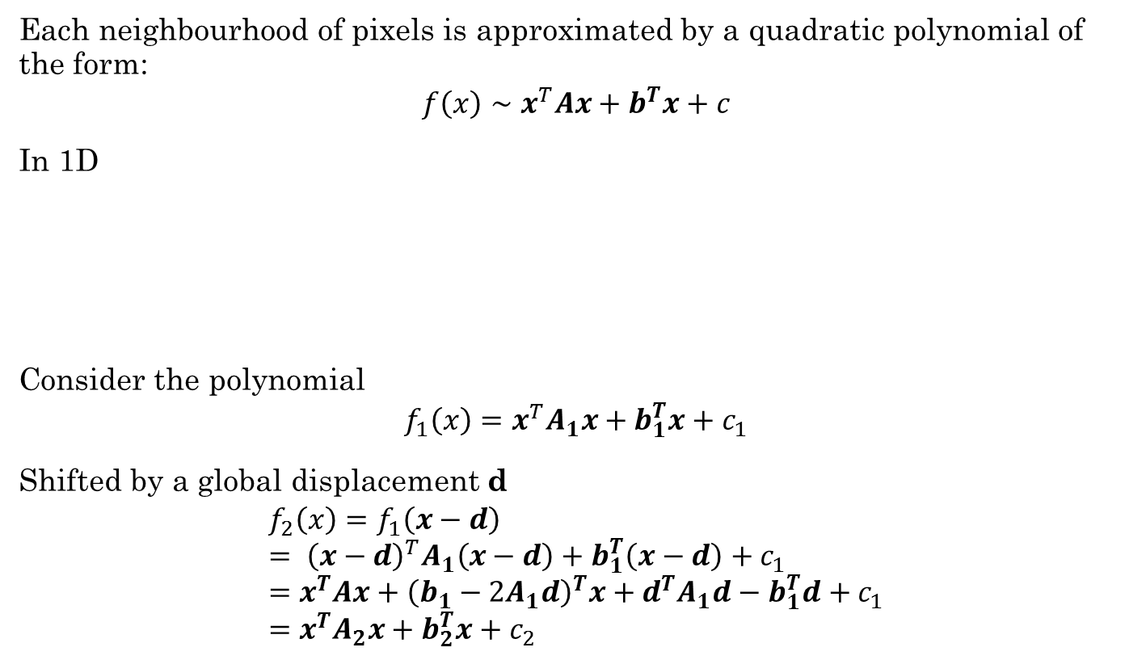
Farnebäck

Slide 8
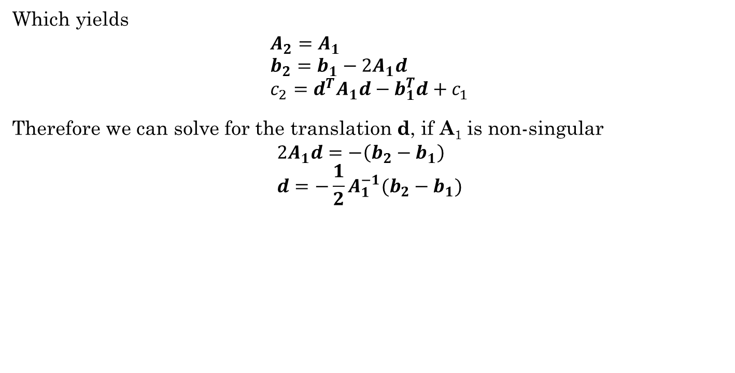
Farnebäck

Slide 9
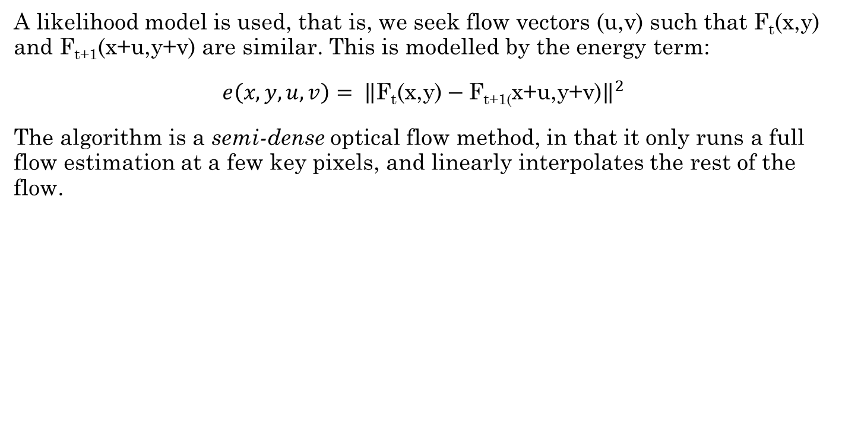
SimpleFlow

Slide 10
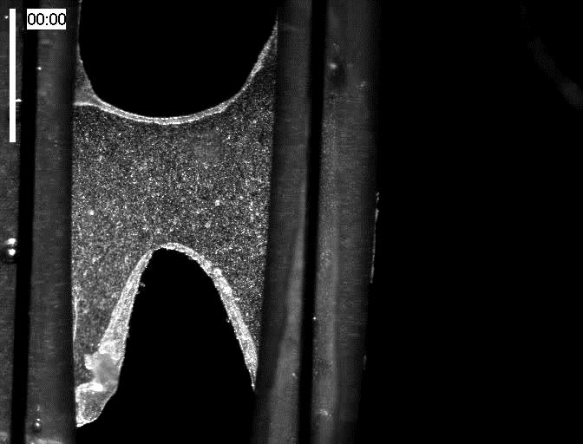
Output

Slide 11
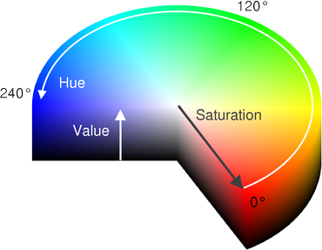
Output
Vectors are converted into polar coordinates and mapped to the HSV colour space as follows:
Hue = Angle
Saturation = 255
Value = Magnitude

Slide 12
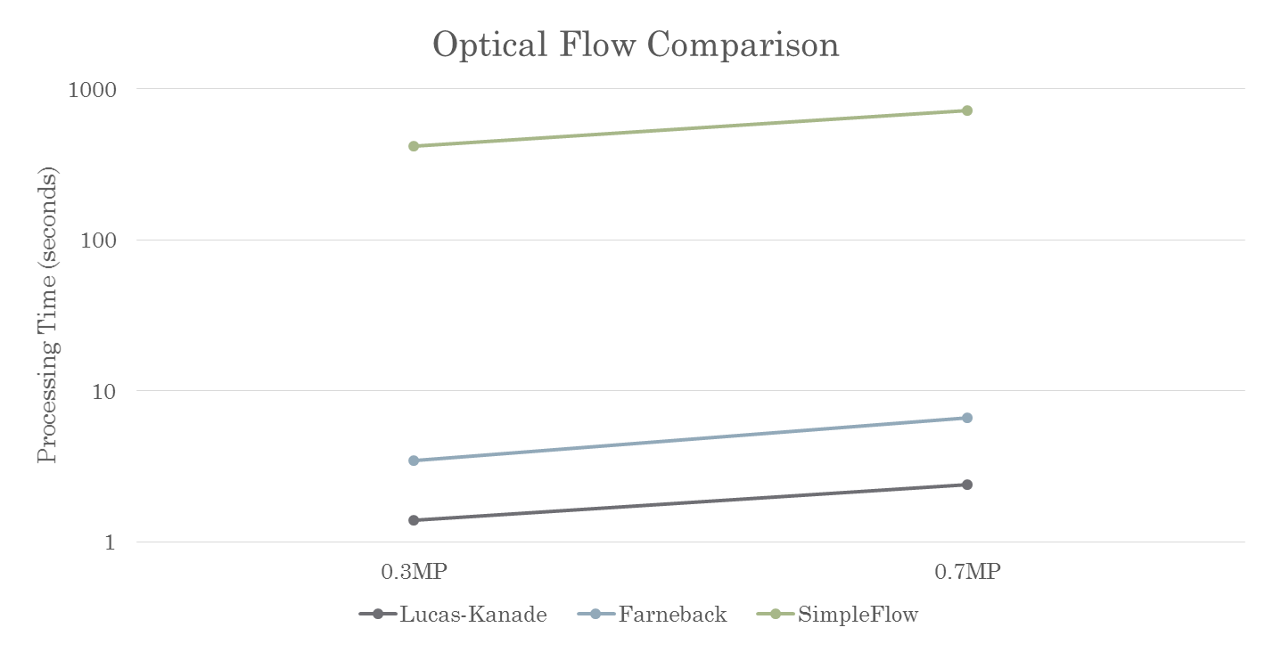
Comparison

Slide 13
Improvements
Find the curl of the vector field
Find the divergence of the vector field
Optimise implementation for online processing with Raspberry Pi camera
Integrate with materials testing (1st year experiment)
Integrate with other OpenLabTools projects (Microscope)
Provide a GUI for immediate user feedback

Slide 14

Questions?

