Slide 1
Ontario Housing Market Analysis
Analyzing Ontario Real Estate data for trends, correlation with inflation, and projected trends

Slide 2


Meet The Team
Jamie Mellway
Josh Esteban
Majeed Raheem
Joey Falvo
Mohammad Zahur

Slide 3
Concept
Collect
Collect and examine data sets pertinent to the Ontario real estate market with the aim of discerning present and prospective patterns
Examine
By conducting this comprehensive analysis, we strive to acquire a deeper understanding of the dynamics within the Ontario property market
Conduct
Analyze

Slide 4
Data Techniques
Data
Real Estate Data was from The Canadian Real Estate Association (CREA)
Interest Rate data was from The Bank of Canada
Geolocation data was from ChatGPT
Reasoning for Data Selection
Collection, Exploration, Cleaning Process
CREA data showed interesting, well formatted, and usuable data
Interest rate data was used as changes to the CREA data appeared to be related
Geolocation data was used to visualize the regional data
The Geolocation data from ChatGPT had Simcoe in the wrong spot
The date format and sorting was different in the different files
Exporting to CSV from Excel introduced a lot of null lines

Slide 5
Approach
Breakdown of tasks and roles:
Housing Trend
Interest Rate Analysis
Monte Carlo
Housing market incites
Challenges
Technologies used:
Finding and converting the longitude and latitude coordinates
Converting data into datetime from different formats
Needed to customize the MCForecastTools library
Python
Pandas
Seaborn
hvplot
MCForecastTools
Successes
Trend Data gave good results.
We found the strong negative correlation we were looking for

Slide 6
DEMO

Slide 7

Next Steps
01
Additional questions that surfaced:
Is the trending spoiled by using data during a global pandemic?
Will trends stabilize when inflation settles down?
02
Additional topics to research
Correlation with inflation
03
Plan for future development
Including predictions of inflation and interest rates to predict trends

Slide 8
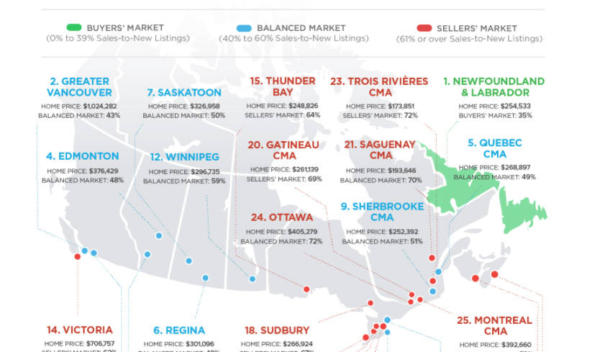
Resources/Links
GitHub repo: https://github.com/JamieMellway/FintechBootcampProject1
CREA
https://creastats.crea.ca/en-CA/
Bank of Canada Interest rates (V122530): https://www.bankofcanada.ca/rates/interest-rates/canadian-interest-rates/

Slide 9

THANK YOU

