Slide 1
Ontario Housing Market Analysis
Part 2
Predicting Ontario real estate data from ETFs,
lumber prices, interest rates, and consumer price index

Slide 2


Meet The Team
Jamie Mellway
Josh Esteban
Majeed Raheem
Joey Falvo
Rafi Nazamodeen

Slide 3
Concept
Collect
Collect and examine data sets pertinent to the Ontario real estate market with the aim of discerning present and prospective patterns
Examine
By conducting this comprehensive analysis, we strive to acquire a deeper understanding of the dynamics within the Ontario property market
Conduct
Analyze

Slide 4
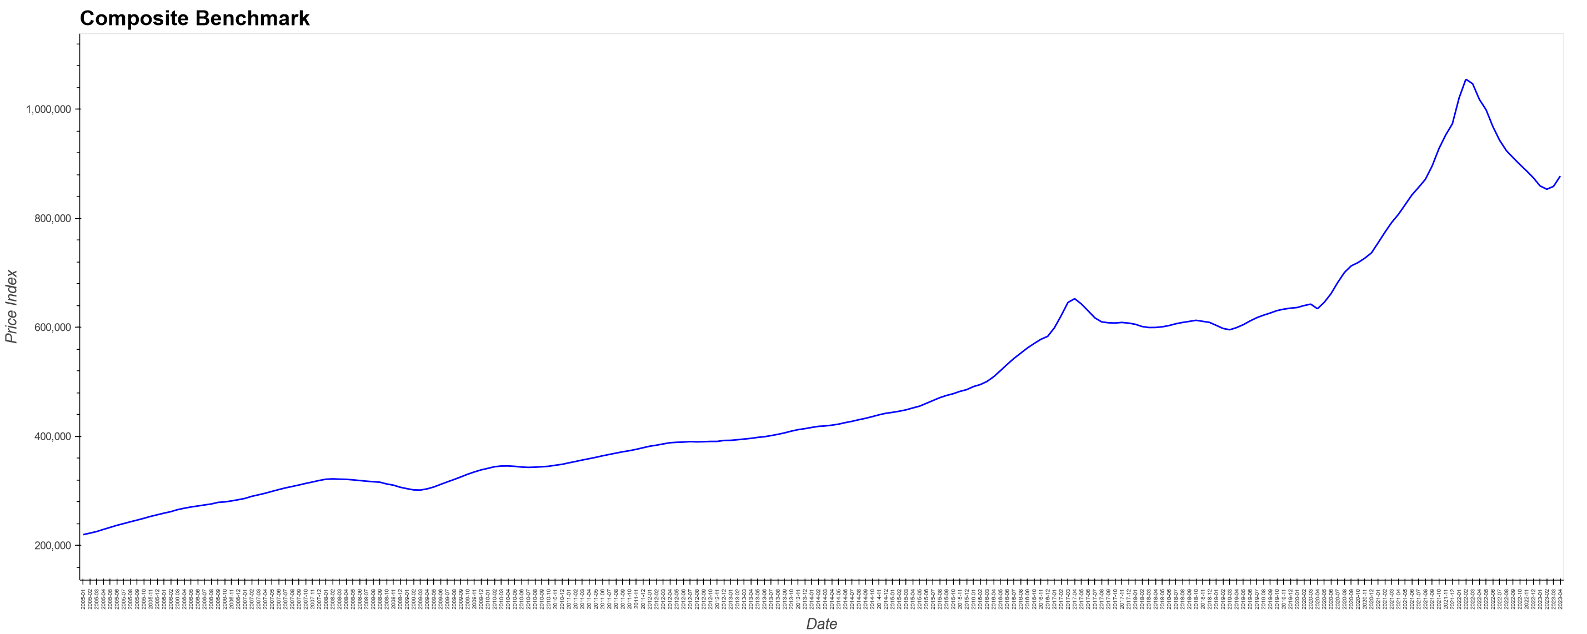
Dependent Variable
CREA – Composite Benchmark for Ontario
https://creastats.crea.ca/en-CA/

Slide 5
Inputs Sources
Macrotrends Lumber Prices - 50 Year Historical Chart
https://www.macrotrends.net/2637/lumber-prices-historical-chart-data
iShares Global Timber & Forestry ETF (WOOD-Q)
https://finance.yahoo.com/quote/WOOD/history?p=WOOD
ta
SPDR S&P Homebuilders ETF (XHB)
https://finance.yahoo.com/quote/XHB/history?p=XHB
iShares U.S. Home Construction ETF (IBT)
https://finance.yahoo.com/quote/ITB/history?p=ITB
Consumer Price Index (CPI)
https://www150.statcan.gc.ca/t1/tbl1/en/tv.action?pid=1810000601&cubeTimeFrame.startMonth=12&cubeTimeFrame.startYear=2005&cubeTimeFrame.endMonth=04&cubeTimeFrame.endYear=2023&referencePeriods=20051201%2C20230401
Interest rates
https://www.bankofcanada.ca/rates/interest-rates/canadian-interest-rates/
ps://finance.yahoo.com/quote/WOOD/history?p=WOOD

Slide 6
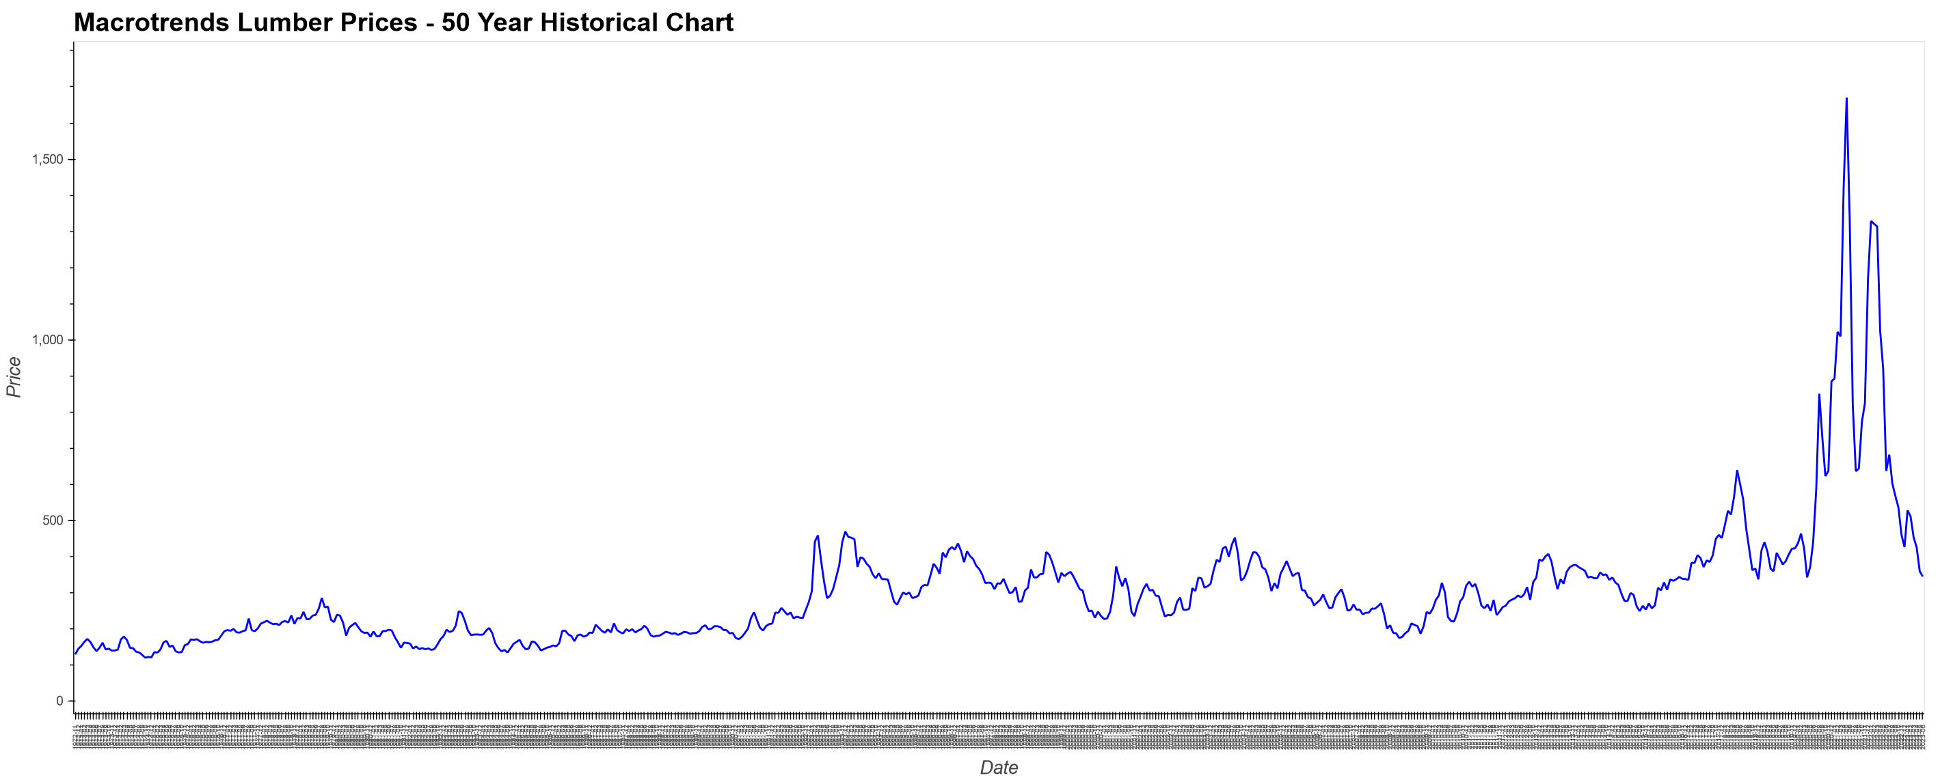
Independent Variables
Macrotrends Lumber Prices - 50 Year Historical Chart
https://www.macrotrends.net/2637/lumber-prices-historical-chart-data

Slide 7
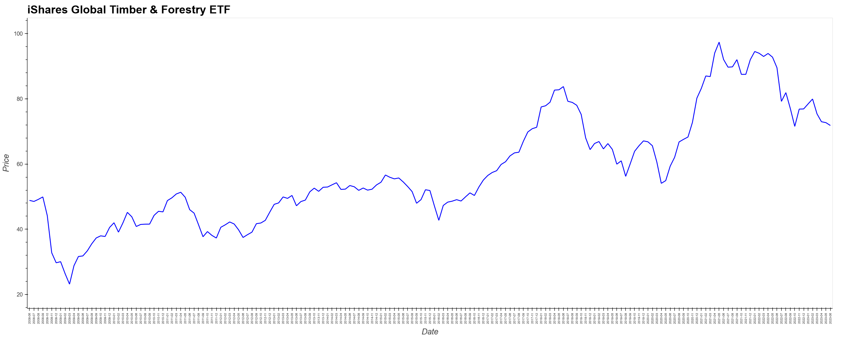
Independent Variables
iShares Global Timber & Forestry ETF (WOOD-Q)
https://finance.yahoo.com/quote/WOOD/history?p=WOOD

Slide 8
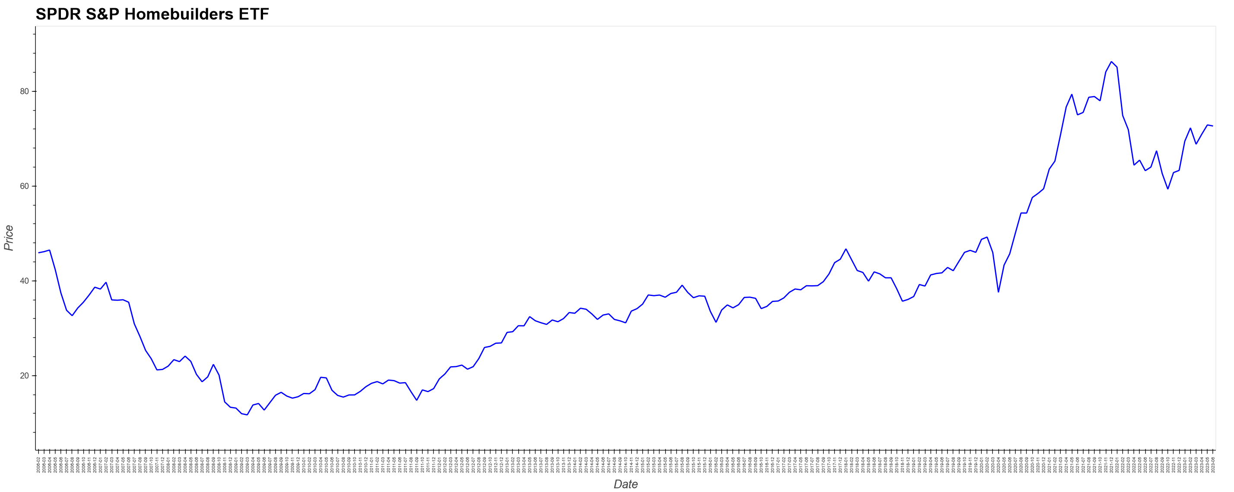
Independent Variables
SPDR S&P Homebuilders ETF (XHB)
https://finance.yahoo.com/quote/XHB/history?p=XHB

Slide 9
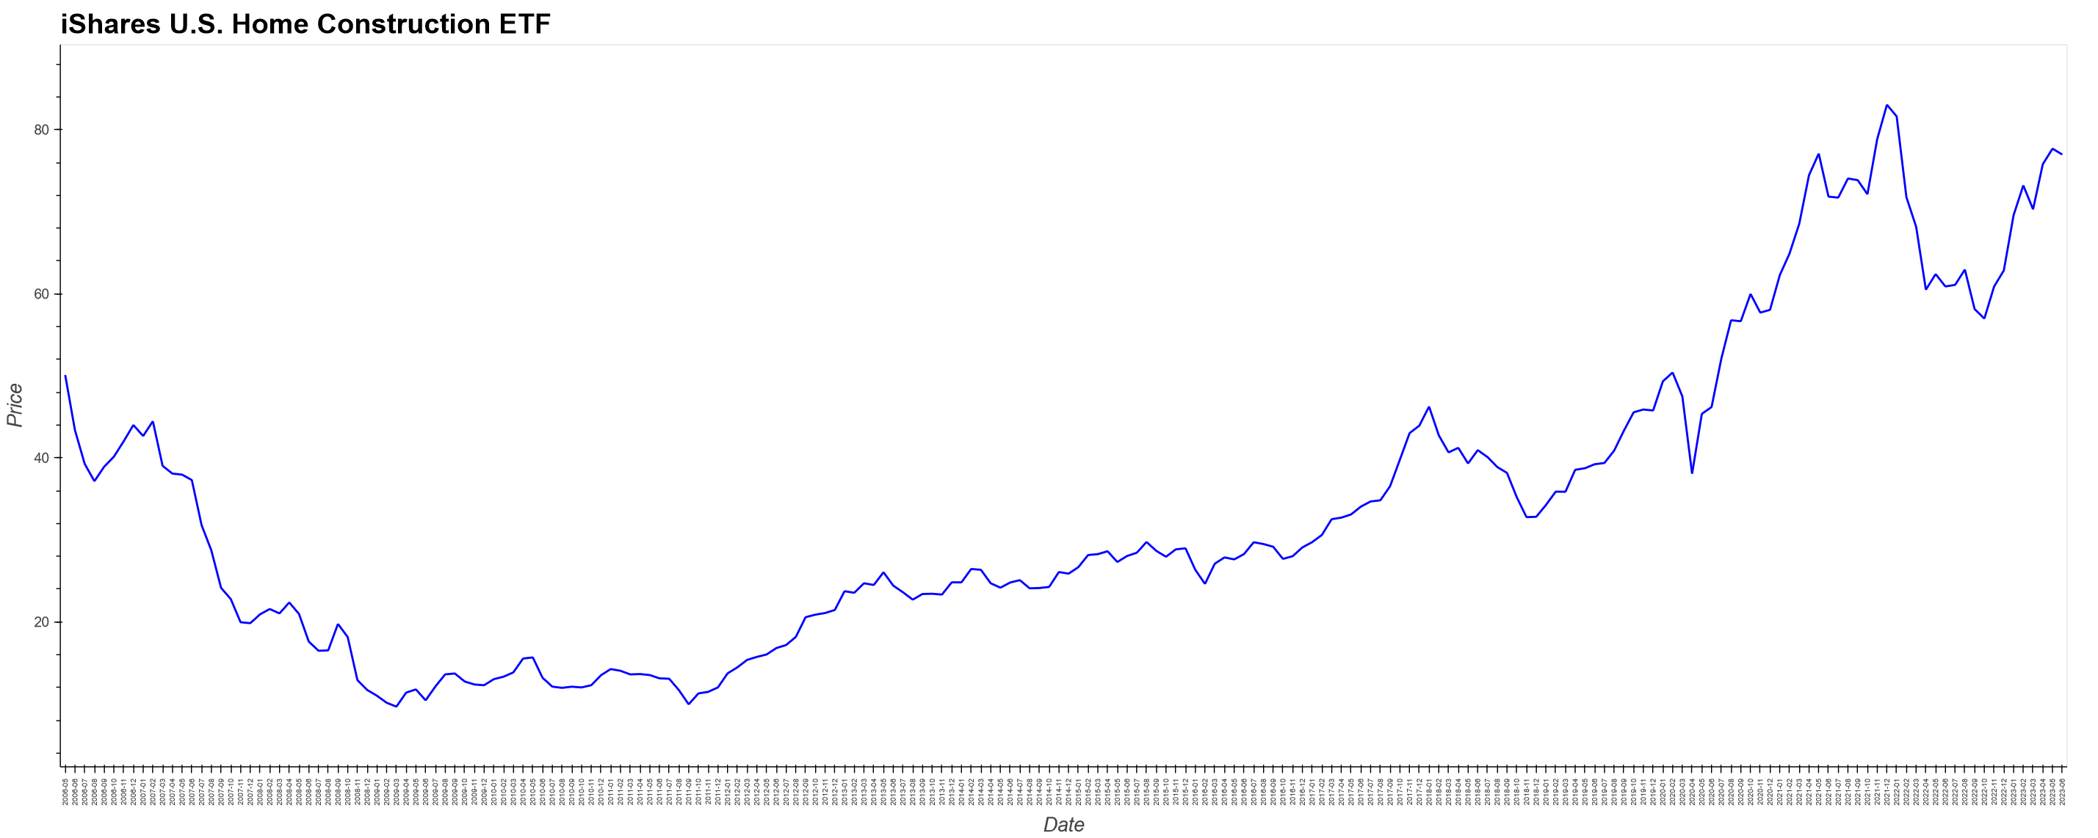
Independent Variables
iShares U.S. Home Construction ETF (IBT)
https://finance.yahoo.com/quote/ITB/history?p=ITB

Slide 10
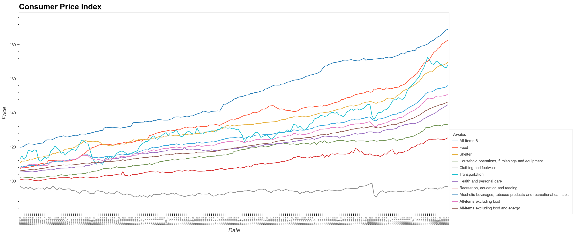
Independent Variables
Consumer Price Index (CPI)
https://www150.statcan.gc.ca/t1/tbl1/en/tv.action?pid=1810000601&cubeTimeFrame.startMonth=12&cubeTimeFrame.startYear=2005&cubeTimeFrame.endMonth=04&cubeTimeFrame.endYear=2023&referencePeriods=20051201%2C20230401

Slide 11
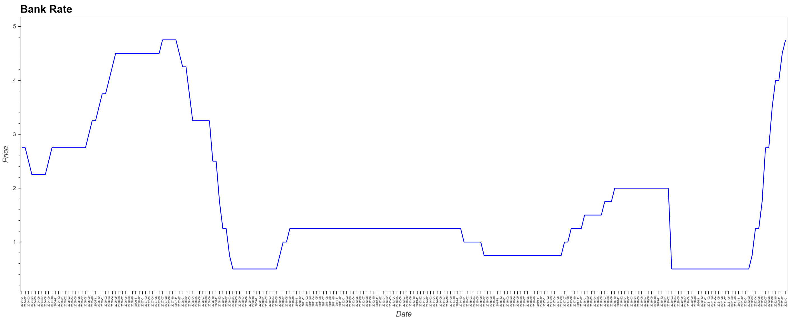
Independent Variables
Interest rates (Bank Rate)
https://www.bankofcanada.ca/rates/interest-rates/canadian-interest-rates/

Slide 12
Data Cleanup
Macrotrends Lumber Prices - 50 Year Historical Chart
iShares Global Timber & Forestry ETF (WOOD-Q)
SPDR S&P Homebuilders ETF (XHB)
iShares U.S. Home Construction ETF (IBT)
Data was business days, so we grouped by month using the maximum value
Consumer Price Index (CPI)
Data was monthly, but need to be transposed
Interest rates
Data was only when the rate changed. There could be multiple changes per month, so we needed to group by month using the last value. There was missing months where the rate hadn’t changed, so we needed to forward fill.

Slide 13
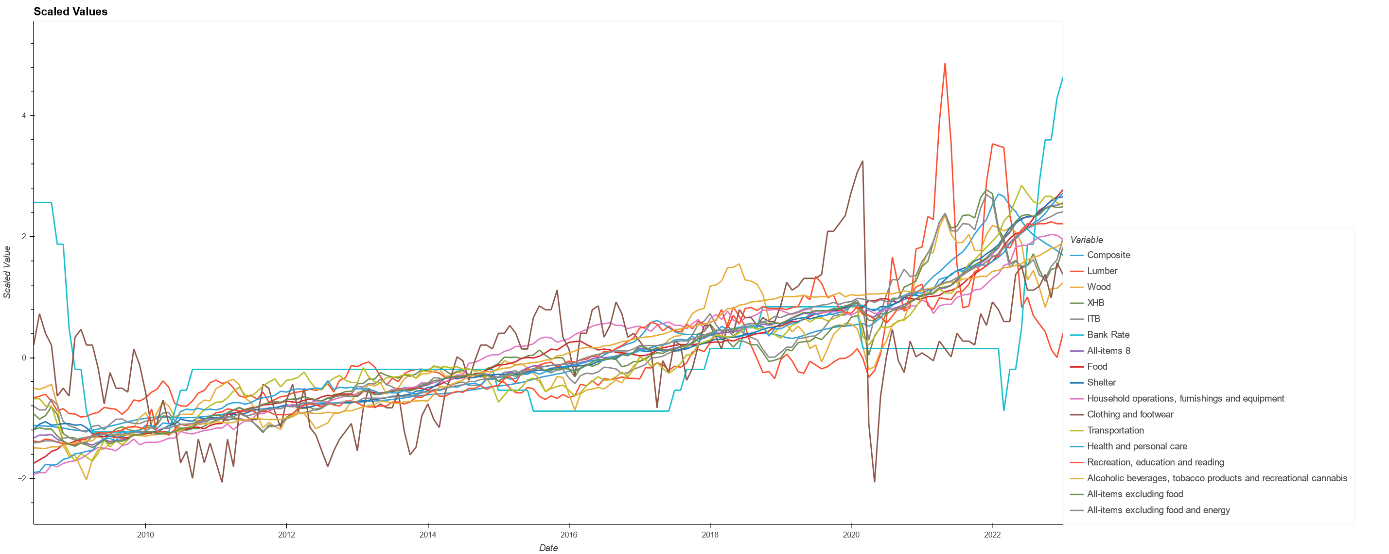
Scaled Values

Slide 14
Model Summary
Model: "sequential" _________________________________________________________________ Layer (type) Output Shape Param # ================================================================= hidden1 (Dense) (None, 128) 2176 hidden2 (Dense) (None, 64) 8256 hidden3 (Dense) (None, 32) 2080 output (Dense) (None, 1) 33 ================================================================= Total params: 12,545 Trainable params: 12,545 Non-trainable params: 0

Slide 15
Model Fit
batch_size=9
validation_split=0.2
epochs=100

Slide 16
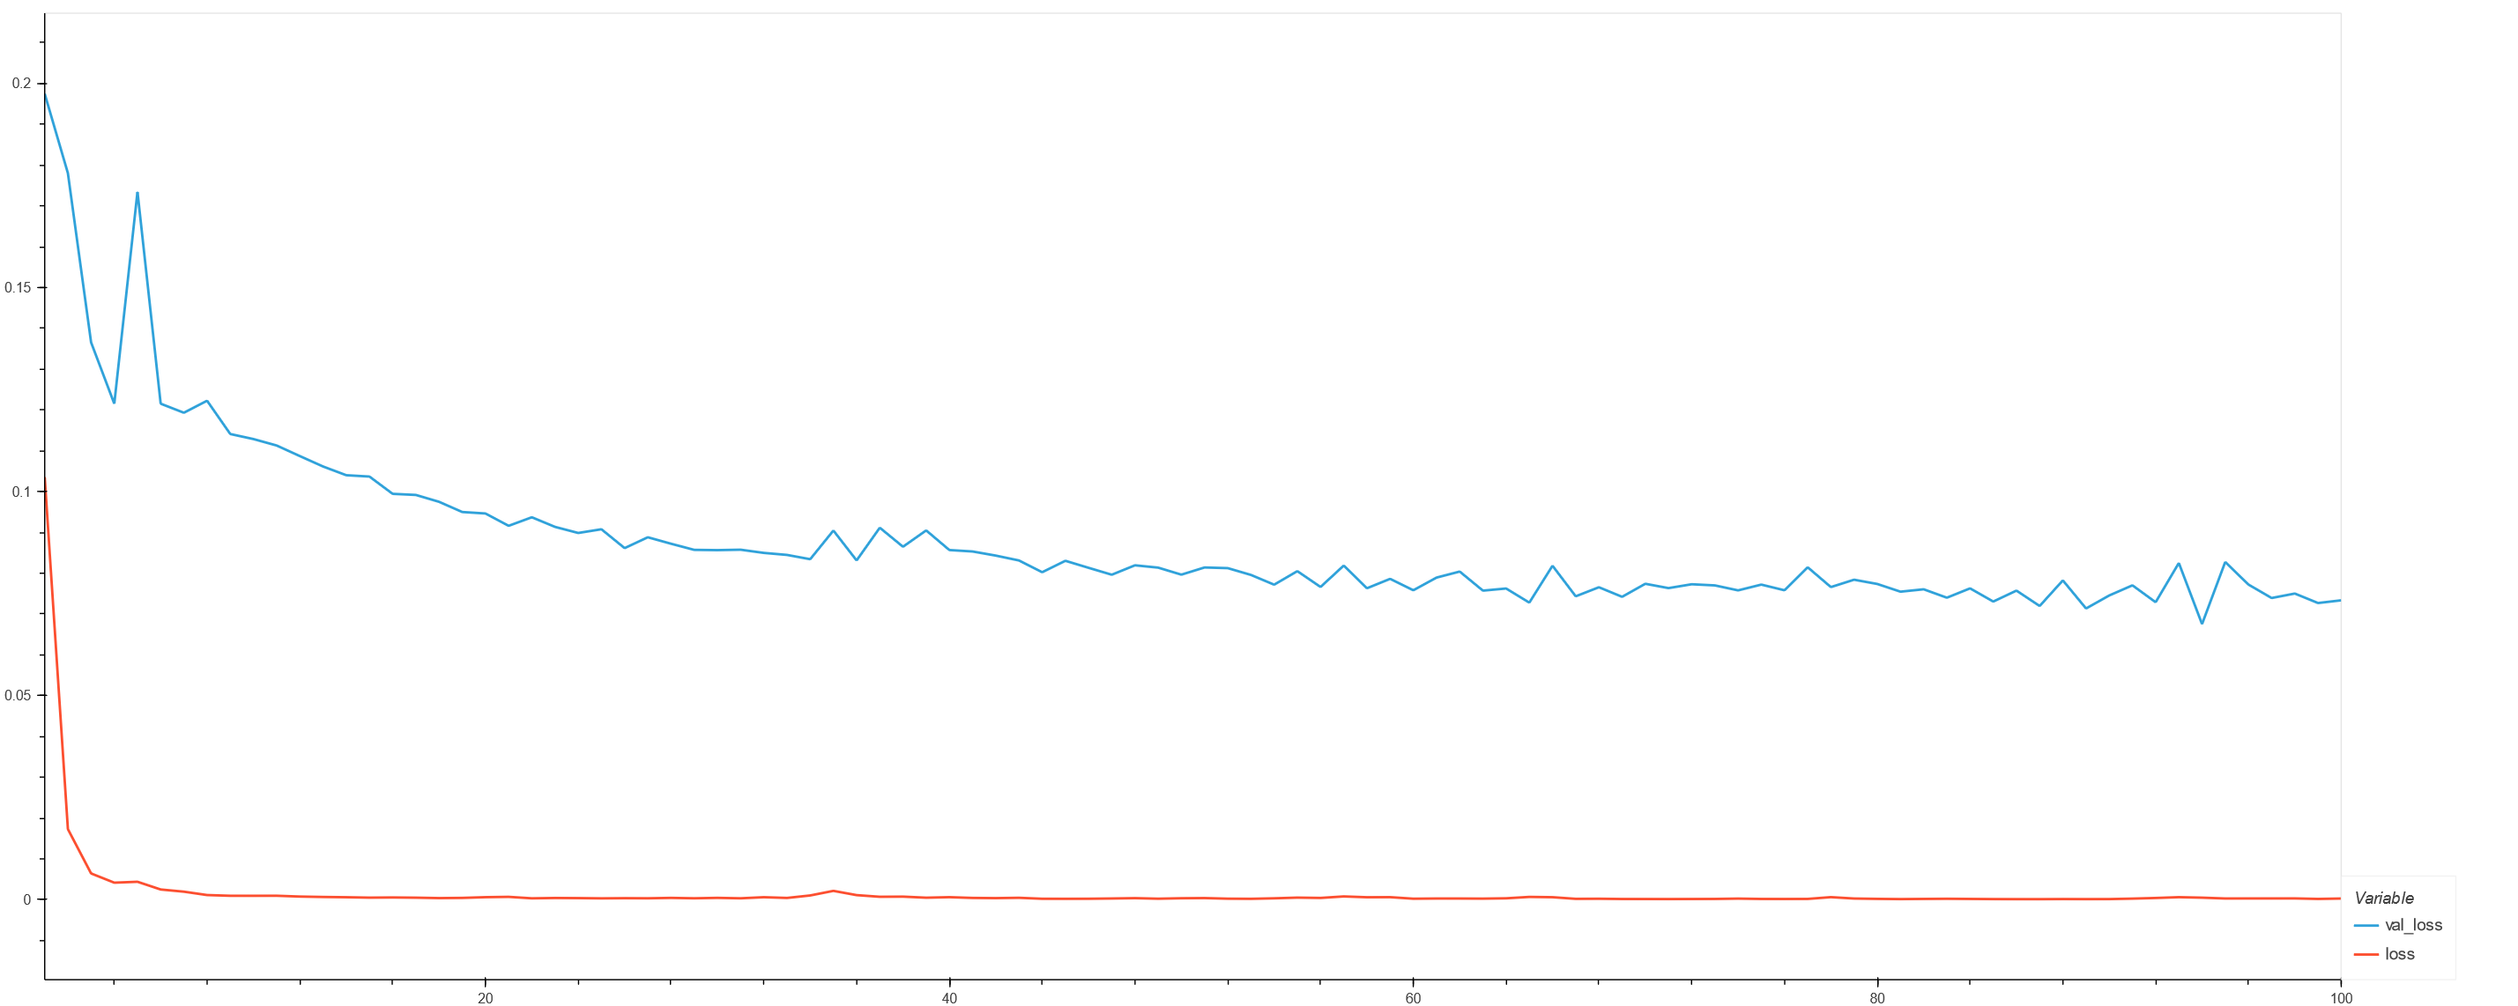
Model Results
R2 = 0.9473472145727345

Slide 17
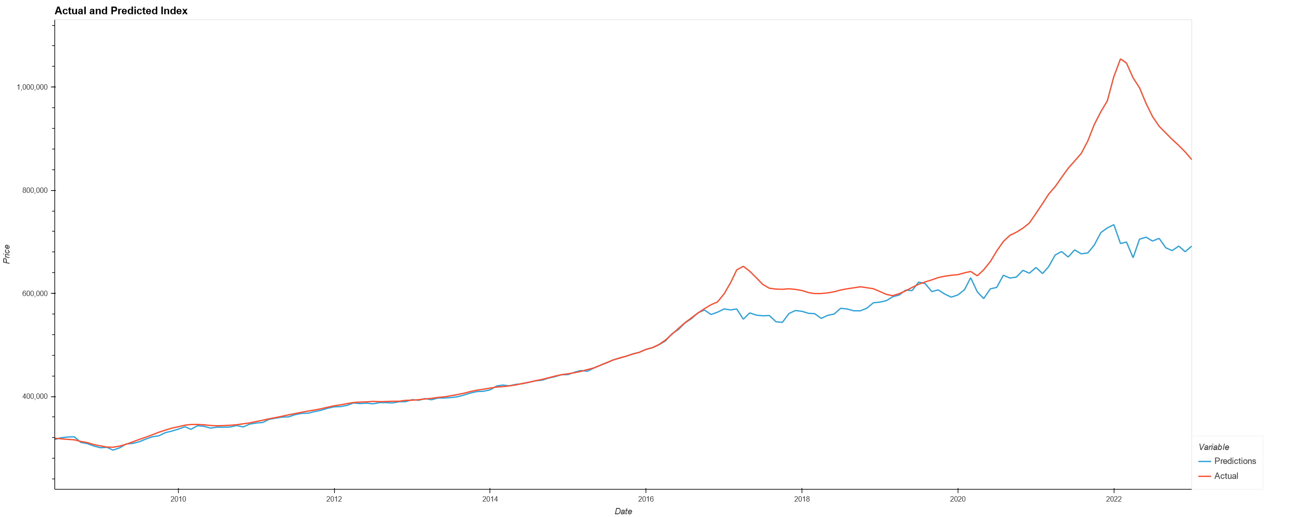
Actual and Predicted Values

Slide 18
DEMO

Slide 19

THANK YOU

