Slide 1
Jamie’s
Very Bad Website

Slide 2
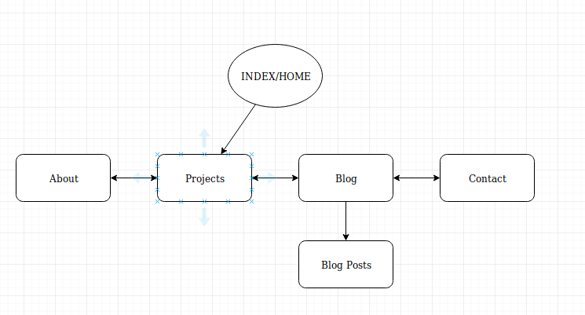
Site map

Slide 3
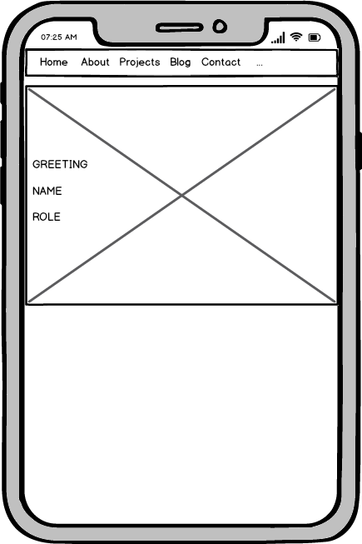
INSPIRATION?
NONE

Slide 4
I’m not a creative person
Simple layouts but let the colour scheme do the job
Don’t flood the screen

Slide 5
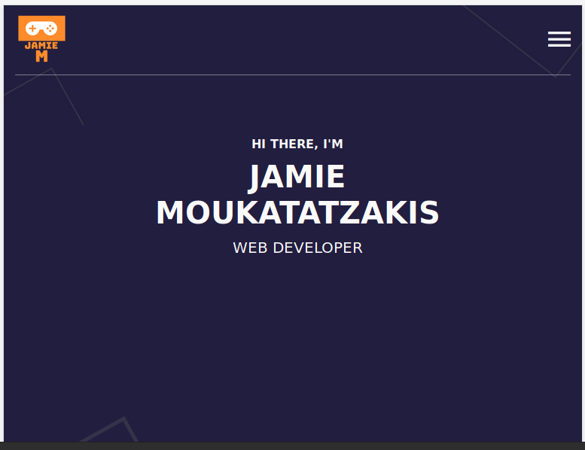
I Think I like Purple now

Slide 6
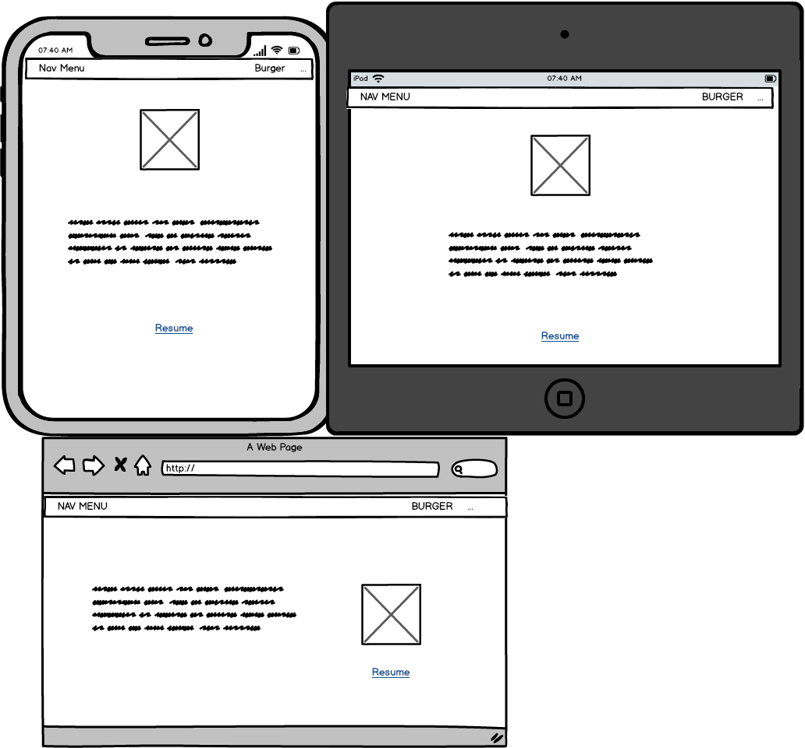
Wireframes - About

Slide 7
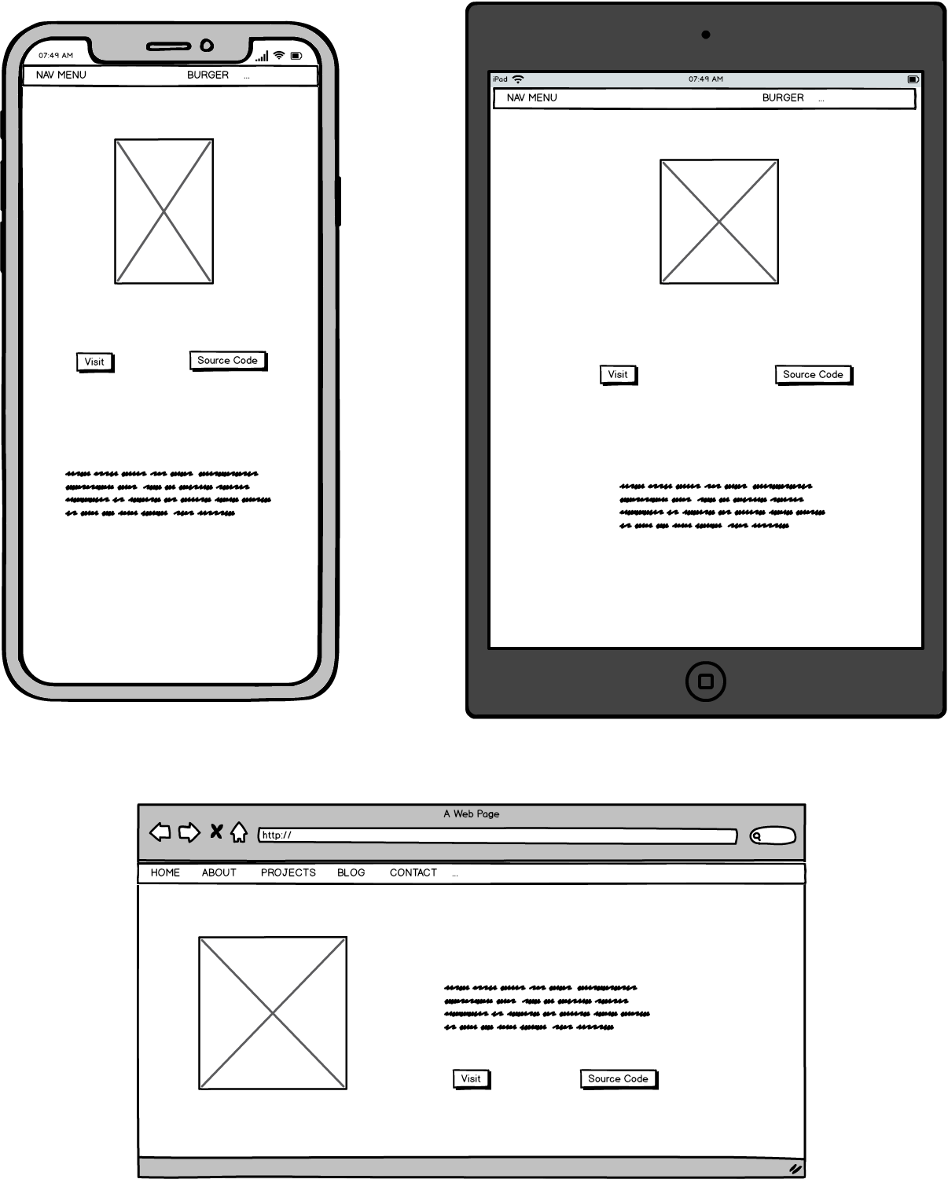
Projects

Slide 8
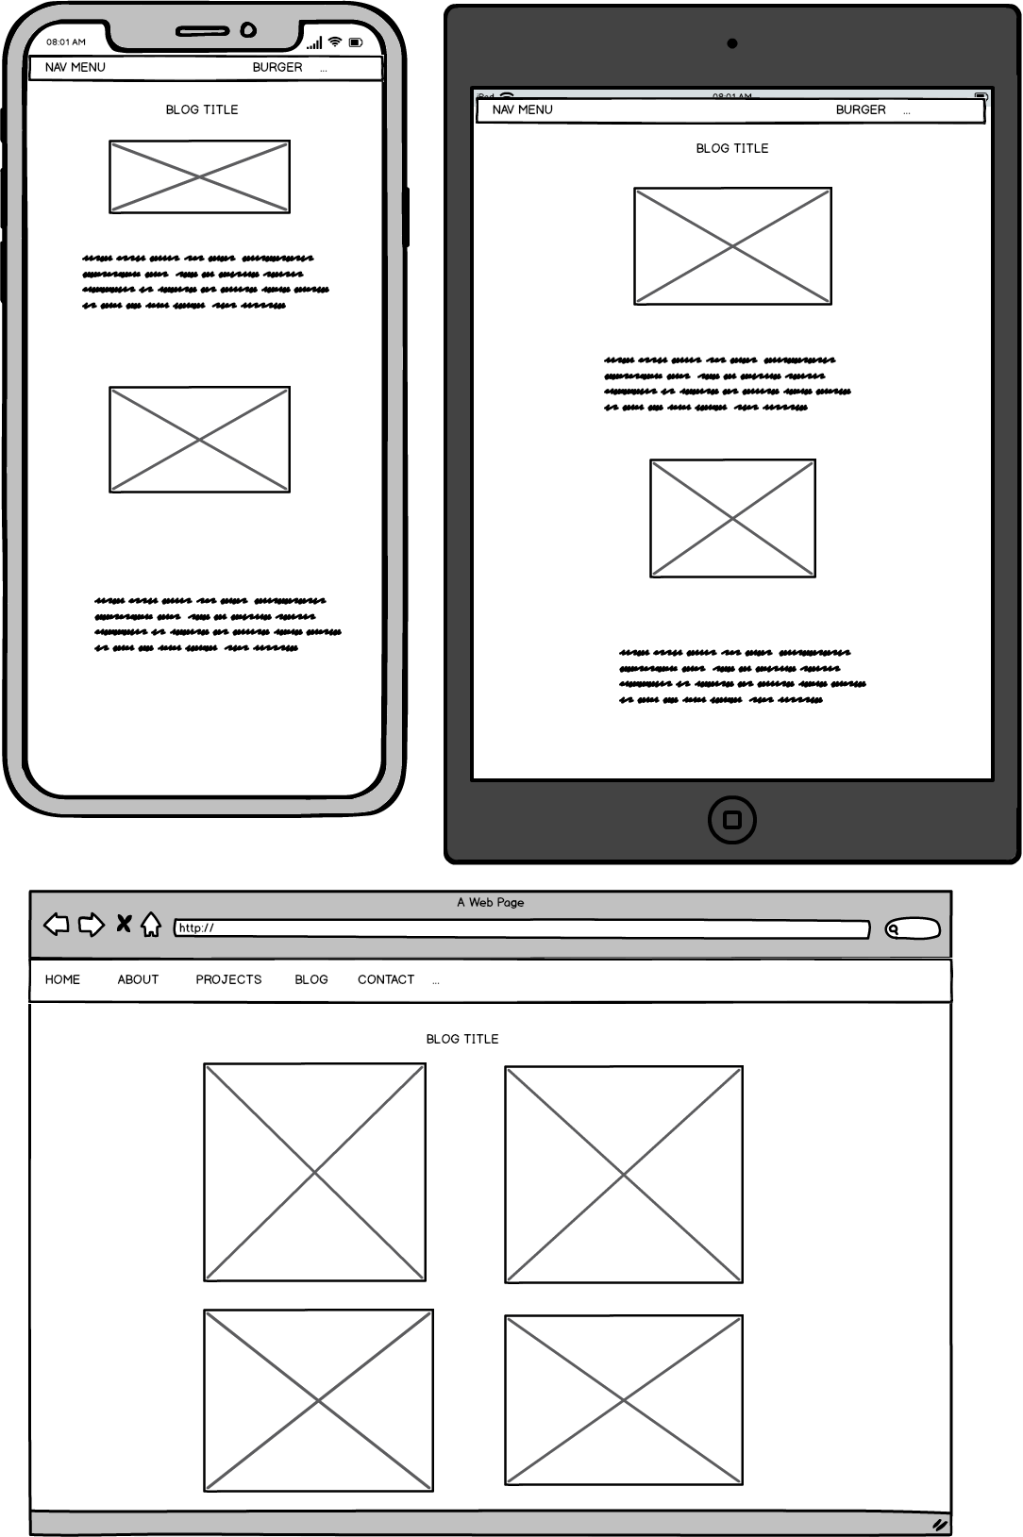
Blog

Slide 9
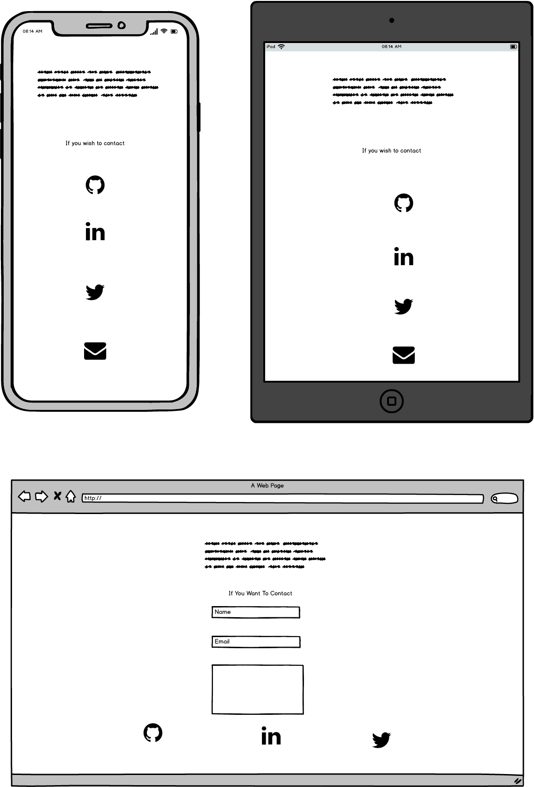
Contact

Slide 10
Features
Used HTML / CSS / A Little Javascript and flexbox
Logo (that counts right =] )
Hover on contact icons
Had hover on nav bar buttons till I broke it >.<
Javascript burger menu
Responsive Design to Iphone6 > X, IPAD and desktop

Slide 11
Where did I go wrong
Gave up on ideas to easily
Used one CSS style sheet
Keeping up with divs and classes
USE THE NORMAL 2.4 RULE AND NOT MY VERSION

Slide 12
What was Challenging
CSS and finally getting the hang of it, using a lot of divs is a blessing and a curse
Start Mobile First

Slide 13
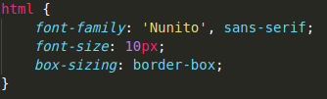
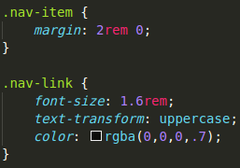
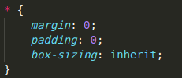
Cool things I tried I probs shouldn’t have done
HTML and rem
Rid of starter margin/pads

Slide 14
I stole a lot but they said it was free
BAD WEBSITE TIME

