Slide 1
Mimp-associated effector identification pipeline
Jamie pike

Slide 2
Fusarium Assemblies
Fusarium species assemblies in FASTA format, as well as a list of assemblies and a mimp profile HMM, are prepared as input.
Final Candidate Effector Set Generated
A FASTA file containing the candidate effectors predicted across the Fusarium assemblies is produced.
Fusarium
pan-effectorome
Sequence identification
Mimp identification
Each Fusarium assembly is searched for mimps using a custom python script (using mimp TIRs) and NHMMER (3.3.1) (using a mimp profile-HMM).
Effector Search
The candidate effector FASTA is queried against the Fusarium assemblies using TBLASTN, with a cut-off 1e-6 and a percentage identity and coverage threshold of 70% and 70%, respectively.
Sequence Expansion
Sequences 2.5kb upstream and downstream of mimps identified are extracted.
Gene Prediction
The extracted 2.5kb mimp-associated sequences are submitted to Augustus (3.3.3) for gene prediction with the “fusarium” species parameter selected.
ORF identification
Getorf from Emboss (6.6.0.0) is used to find open reading frames (ORFs) in the 2.5kb region.
Data Matrix
A data matrix indicating total number of hits within the BLAST threshold is generated for the candidate effectors across the FOSC assemblies.
ORF Parsing
Custom script is used to extract smaller ORFs from within each predicted ORF.
Effector Profile Heatmap
An effector profile heatmap generated in R Studio (version 3.6.3), using the package Pheatmap (version 1.0.12). Data can be converted to binary at this stage to only generate a presence/absence heatmap rather than hit frequency heatmap.
Signal Peptide Filtering
Predicted genes are then searched for the presented of predicted signal peptide using SignalP (4.1).
Effector Profiling
Signal Peptide Filtering
SignalP (4.1) is used search all ORFs for a signal peptide.
Effector Prediction
Fusarium Assembly Effector Profiles
Non-redundant Protein Sets Generated
All predicted genes and ORFs with a signal peptide from each assembly are then clustered using CD-HIT (4.8.1) generating a non-redundant protein set for each Fusarium assembly.
Putative Effectors Combined and Clustered
Non-redundant protein sequences (<300aa) across all assemblies are combined into one FASTA and clustered using CD-HIT (4.8.1) (80% identity).
Fusarium assembly clusters
EffectorP Scan for Likely Effectors
The longest sequence from each cluster is then submitted to EffectorP (2.0.1) for fungal effector prediction.
Candidate effectors clusters

Slide 3
Sequence identification
Fusarium Assemblies
Fusarium species assemblies in FASTA format, as well as a list of assemblies and a mimp profile HMM, are prepared as input.
./Maei.sh AssemblyList.txt
F._oxysporum_f._sp._cubense_160527.fna
F._oxysporum_f._sp._cubense_UK0001.fna
F._oxysporum_f._sp...
Mimp identification
Each Fusarium assembly is searched for mimps using a custom python script (using mimp TIRs) and NHMMER (3.3.1) (using a mimp profile-HMM).
Mimp HMM
The nhmmer tool to searches for mimps each genome using a mimp profile HMM. The mimp profile HMM built using mimp seqs available on Genbank and mimps identified in F. oxysporum genomes using the regex script.
Regex
Custom Python script which searches for mimp TIRs occurring within 400 nucleotides of another.
contig
Mimp
Mimp
Mimp
F. oxysporum f. sp. cubense 160527
Mimp_hits.bed
Sequence Expansion
Sequences 2.5kb upstream and downstream of mimps identified are extracted.
Bedfile for sequence expansion
A bedfile is generated by combining both mimp sets. Bedtools is used to extract 2.5kb either side of the mimps in a fasta file.
contig
Mimp

Slide 4
Effector Prediction
Gene Prediction
The extracted 2.5kb mimp-associated sequences are submitted to Augustus (3.3.3) for gene prediction with the “fusarium” species parameter selected.
ORF identification
Getorf from Emboss (6.6.0.0) is used to find open reading frames (ORFs) in the 2.5kb region.
F. oxysporum f. sp. cubense 160527
F. oxysporum f. sp. cubense 160527
Mimp region
Mimp region
g1.t1
g2.t1
Mimp
g3.t1
g4.t1
ORF_1
ORF_2
Mimp
ORF_3
ORF_4
ORF Parsing
Custom script is used to extract smaller ORFs from within each predicted ORF.
Signal Peptide?
Mimp region
ORF_1
ORF_2
Mimp
ORF_3
ORF_4.1
ORF_4.2
YES
NO
Signal Peptide?
Signal Peptide Filtering
Predicted genes are then searched for the presented of predicted signal peptide using SignalP (4.1).
g4.t1
g1.t1
Signal Peptide Filtering
SignalP (4.1) is used search all ORFs for a signal peptide.
YES
NO
g2.t1
ORF_1
ORF_2
ORF_4
ORF_3
ORF_4.1
ORF_4.2

Slide 5
Effector Prediction
Non-redundant Protein Sets Generated
All predicted genes and ORFs with a signal peptide from each assembly are then clustered using CD-HIT (4.8.1) generating a non-redundant protein set for each Fusarium assembly.
YES
YES
g1.t1
ORF_1
ORF_3
Clustered using Cd-Hit
F. oxysporum f. sp. cubense 160527 Non-redundant set with Signal peptide.
g1.t1
ORF_3
Putative Effectors Combined and Clustered
Non-redundant protein sequences (<300aa) across all assemblies are combined into one FASTA and clustered using CD-HIT (4.8.1) (80% identity).
F. oxysporum f. sp. cubense UK0001
F. oxysporum f. sp. cubense 160527
F. oxysporum f. sp…
+
ORF_9
+
g1.t1
g10.t1
g1.t1
g7.t1
g1.t1
ORF_3
ORF_2
Clustered using Cd-Hit (0.8% identity)
EffectorP Scan for Likely Effectors
The longest sequence from each cluster is then submitted to EffectorP (2.0.1) for fungal effector prediction.
Clustered set used as input for EffectorP
“Pan-effectrome”

Slide 6
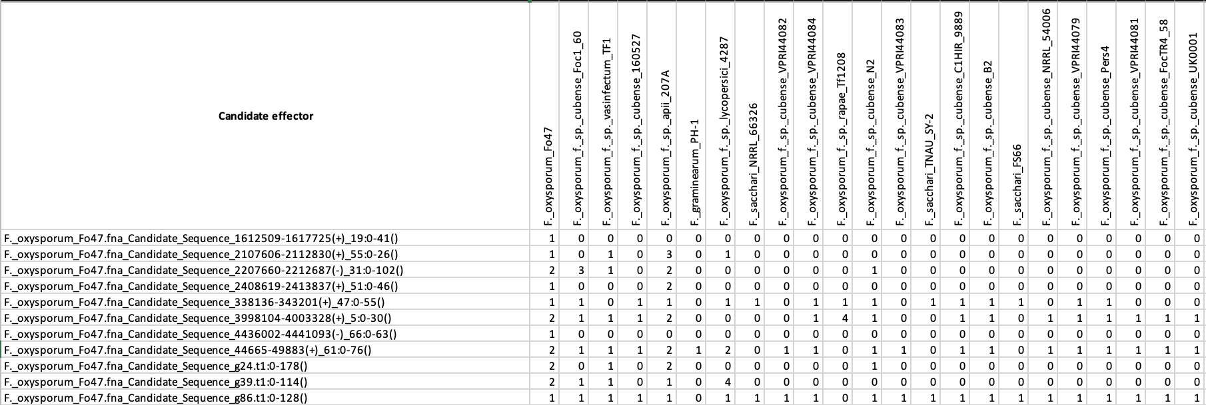
Effector Profiling
Effector Search
The candidate effector FASTA is queried against the Fusarium assemblies using TBLASTN, with a cut-off 1e-6 and a percentage identity and coverage threshold of 65% and 65%, respectively.
“Pan-effectrome”
TBLASTN Search
Data Matrix
A data matrix indicating total number of hits within the BLAST threshold is generated for the candidate effectors across the FOSC assemblies.
F. oxysporum f. sp. cubense 160527 Assembly
F. oxysporum f. sp. cubense UK0001 Assembly
F. oxysporum f. sp. cubense UK0001 Assembly
Locations recorded in .bed file
Locations recorded in .bed file
Locations recorded in .bed file
Effector Profile Heatmap
An effector profile heatmap generated in R Studio (version 3.6.3), using the package Pheatmap (version 1.0.12). Data can be converted to binary at this stage to only generate a presence/absence heatmap rather than hit frequency heatmap.
Number of hits within threshold per sequence
Fusarium Assembly Effector Profiles
Fusarium assembly clusters
Candidate effectors clusters
Heatmap generated using R package, Pheatmap

Slide 7
Fusarium Assemblies
Fusarium species assemblies in FASTA format, as well as a list of assemblies and a mimp profile HMM, are prepared as input.
Final Candidate Effector Set Generated
A FASTA file containing the candidate effectors predicted across the Fusarium assemblies is produced.
Fusarium
pan-effectorome
Sequence identification
Mimp identification
Each Fusarium assembly is searched for mimps using a custom python script (using mimp TIRs) and NHMMER (3.3.1) (using a mimp profile-HMM).
Effector Search
The candidate effector FASTA is queried against the Fusarium assemblies using TBLASTN, with a cut-off 1e-6 and a percentage identity and coverage threshold of 70% and 70%, respectively.
Sequence Expansion
Sequences 2.5kb upstream and downstream of mimps identified are extracted.
Gene Prediction
The extracted 2.5kb mimp-associated sequences are submitted to Augustus (3.3.3) for gene prediction with the “fusarium” species parameter selected.
ORF identification
Getorf from Emboss (6.6.0.0) is used to find open reading frames (ORFs) in the 2.5kb region.
Data Matrix
A data matrix indicating total number of hits within the BLAST threshold is generated for the candidate effectors across the FOSC assemblies.
ORF Parsing
Custom script is used to extract smaller ORFs from within each predicted ORF.
Effector Profile Heatmap
An effector profile heatmap generated in R Studio (version 3.6.3), using the package Pheatmap (version 1.0.12). Data can be converted to binary at this stage to only generate a presence/absence heatmap rather than hit frequency heatmap.
Signal Peptide Filtering
Predicted genes are then searched for the presented of predicted signal peptide using SignalP (4.1).
Effector Profiling
Signal Peptide Filtering
SignalP (4.1) is used search all ORFs for a signal peptide.
Effector Prediction
Fusarium Assembly Effector Profiles
Non-redundant Protein Sets Generated
All predicted genes and ORFs with a signal peptide from each assembly are then clustered using CD-HIT (4.8.1) generating a non-redundant protein set for each Fusarium assembly.
Putative Effectors Combined and Clustered
Non-redundant protein sequences (<300aa) across all assemblies are combined into one FASTA and clustered using CD-HIT (4.8.1) (80% identity).
Fusarium assembly clusters
EffectorP Scan for Likely Effectors
The longest sequence from each cluster is then submitted to EffectorP (2.0.1) for fungal effector prediction.
Candidate effectors clusters

Slide 8
Version 5 Update

Slide 9
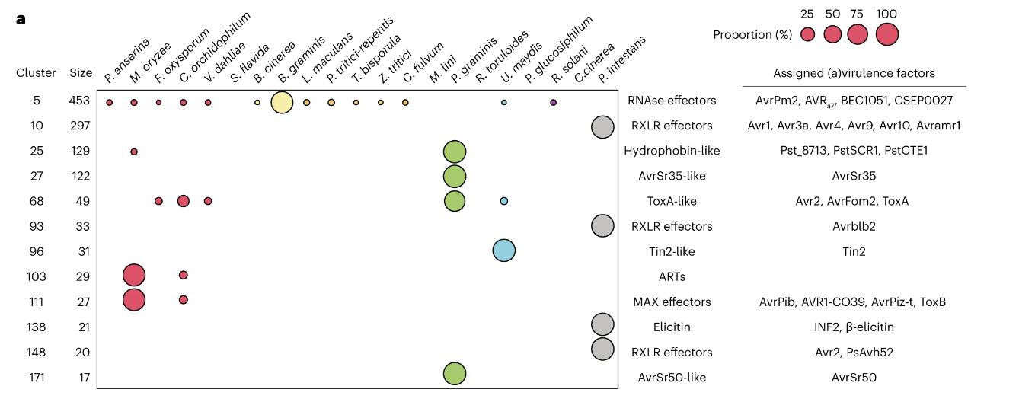
Fusarium Assemblies
Fusarium species assemblies in FASTA format, as well as a list of assemblies and a mimp profile HMM, are prepared as input.
Effector Clustering
Candidate effector sequences are from all assemblies are combined into one FASTA and clustered using CD-HIT (4.8.1) (80% identity (optional using command line input)).
Fusarium
pan-effectorome
Mimp identification
Each Fusarium assembly is searched for mimps using a custom python script (using mimp TIRs) and NHMMER (3.3.1) (using a mimp profile-HMM).
Sequence identification
Cluster Analysis
A custom python script is used to generate a table of effector clusters, containing details on the sequences in each cluster, the assembly from which each sequence originated, and the percentage identity of each sequence within the cluster to the cluster reference.
Mimp region Sequence identification
Identify regions 2.5kb either side of a mimp (mimp region), generating a mimp region gff.
Augustus regions identification
Expand 20kb either side of the mimp regions to identify regions for Augustus annotation. Generate an Augustus region gff, and fastas where all non-Augustus have been hard masked.
Mask non-mimp regions
Using the mimp region gff, create a mimp region fastas, where all non-mimp regions have been hard masked.
Effector Profile Heatmap
An effector profile heatmap generated in R Studio (version 3.6.3), using the package Pheatmap (version 1.0.12). Data can be converted to binary at this stage to only generate a presence/absence heatmap rather than hit frequency heatmap.
Augustus Gene Prediction
The Augustus region fasta is submitted to Augustus (3.3.3) for gene prediction with the “fusarium” species parameter selected.
ORF Prediction
Getorf from Emboss (6.6.0.0) is used to find open reading frames (ORFs) in the 2.5kb region.
Effector Profiling
Fusarium Assembly Effector Profiles
Signal Peptide Filtering
SignalP (4.1) is used search all Augustus gene models and ORFs for a signal peptide.
Effector Prediction
Size Filter.
Protein sequences containing a signal peptide predicted by SignalP are filtered based on size, with sequences <450aa and >30aa kept for effector prediction.
EffectorP Scan for Likely Effectors
Each signal peptide and size filtered sequences is submitted to EffectorP (2.0.1) for fungal effector prediction.
Fusarium assembly clusters
FASTA and GFF generated
For each Fusarium assembly included, a candidate effector fasta and gff file is generated using various custom python scripts..
Candidate effectors clusters

Slide 10
Sequence identification
Fusarium Assemblies
Fusarium species assemblies in FASTA format, as well as a list of assemblies and a mimp profile HMM, are prepared as input.
./Maei.sh AssemblyList.txt 0.8
F._oxysporum_f._sp._cubense_160527.fna
F._oxysporum_f._sp._cubense_UK0001.fna
F._oxysporum_f._sp...
Mimp HMM
The nhmmer tool to searches for mimps each genome using a mimp profile HMM. The mimp profile HMM built using mimp seqs available on Genbank and mimps identified in F. oxysporum genomes using the regex script.
Mimp identification
Each Fusarium assembly is searched for mimps using a custom python script (using mimp TIRs) and NHMMER (3.3.1) (using a mimp profile-HMM).
Regex
Custom Python script which searches for mimp TIRs occurring within 400 nucleotides of another.
Mimp region Sequence identification
Identify regions 2.5kb either side of a mimp (mimp region), generating a mimp region gff.
contig
Mimp
Mimp
Mimp
F. oxysporum f. sp. cubense 160527
Mimp_hits.bed
Augustus regions identification
Expand 20kb either side of the mimp regions to identify regions for Augustus annotation. Generate an Augustus region gff, and fastas where all non-Augustus have been hard masked.
Mask non-mimp regions
Using the mimp region gff, create a mimp region fastas, where all non-mimp regions have been hard masked.
GFF for sequence expansion
A GFF of mimp regions is generated using bedtools. Non-mimp regions are hard masked.
Similarly, an Augustus region GFF is generated (mimp region +20kb) to prevent gene models from being truncated.
contig
NNNNNNN
Mimp
NNNNNNN

Slide 11
Effector Prediction
Augustus Gene Prediction
The Augustus region fasta is submitted to Augustus (3.3.3) for gene prediction with the “fusarium” species parameter selected.
ORF Prediction
Getorf from Emboss (6.6.0.0) is used to find open reading frames (ORFs) in the 2.5kb region.
F. oxysporum f. sp. cubense 160527
Augustus region
g1.t1
g2.t1
Mimp
g3.t1
g4.t1
F. oxysporum f. sp. cubense 160527
Mimp region
Signal Peptide Filtering
SignalP (4.1) is used search all Augustus gene models and ORFs for a signal peptide.
Mimp
ORF_1
ORF_2
ORF_3
ORF_4
Also generate a GFF here!
Size Filter.
Protein sequences containing a signal peptide predicted by SignalP are filtered based on size, with sequences <450aa and >30aa kept for effector prediction.
Gene models and ORFs combined fasta
Signal Peptide?
EffectorP Scan for Likely Effectors
Each signal peptide and size filtered sequences is submitted to EffectorP (2.0.1) for fungal effector prediction.
YES
NO
g1.t1
g4.t1
FASTA and GFF generated
For each Fusarium assembly included, a candidate effector fasta and gff file is generated using various custom python scripts..
Size filter then submitted to EffectorP
Assembly Candidate effector FASTA and GFF.

Slide 12
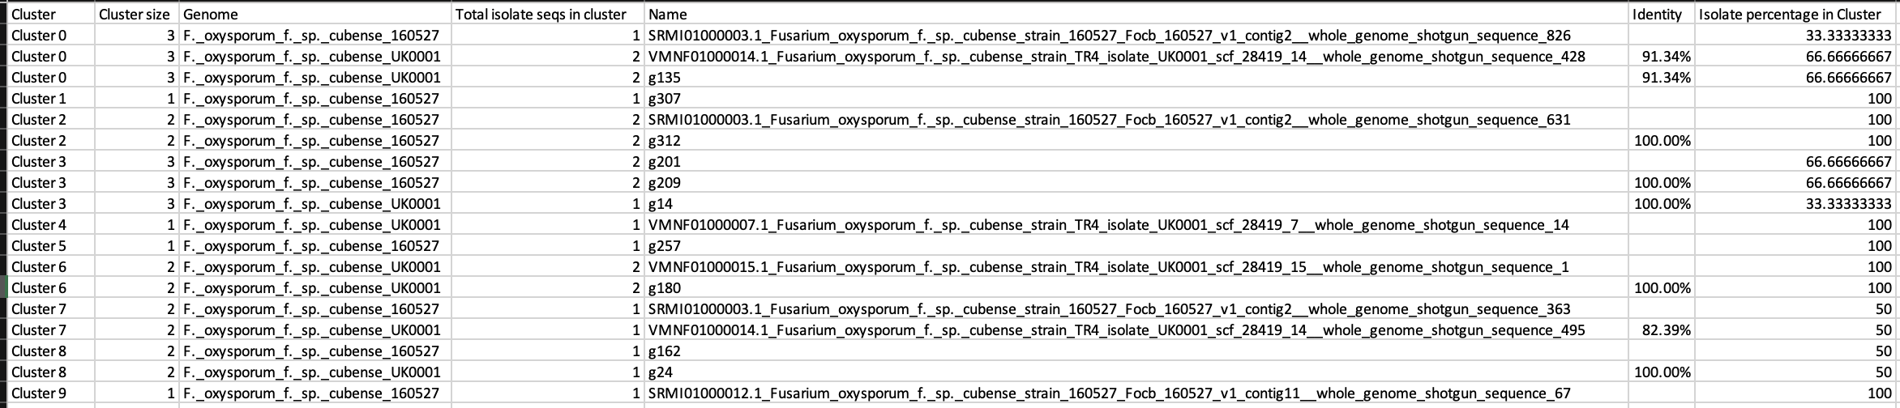
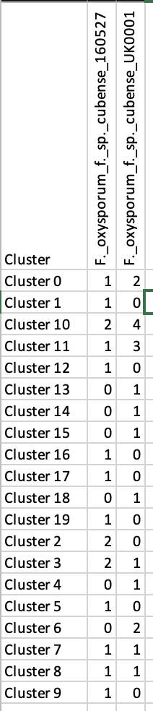
Effector Profiling
Final Candidate Effector Set Generated
A FASTA file containing the candidate effectors predicted across the Fusarium assemblies is produced.
Assembly Candidate effector FASTA
F. oxysporum f. sp…
F. oxysporum f. sp. cubense UK0001
F. oxysporum f. sp. cubense 160527
+
ORF_9
+
Effector Search
The candidate effector FASTA is queried against the Fusarium assemblies using TBLASTN, with a cut-off 1e-6 and a percentage identity and coverage threshold of 70% and 70%, respectively.
g1.t1
g10.t1
g1.t1
g7.t1
g1.t1
ORF_3
ORF_2
Data Matrix
A data matrix indicating total number of hits within the BLAST threshold is generated for the candidate effectors across the FOSC assemblies.
Clustered using Cd-Hit (0.8% identity)
Effector Profile Heatmap
An effector profile heatmap generated in R Studio (version 3.6.3), using the package Pheatmap (version 1.0.12). Data can be converted to binary at this stage to only generate a presence/absence heatmap rather than hit frequency heatmap.
Custom Cd-Hit processing script
The Cd-Hit ouput is used to produce an AllCandidateEffectors_table.tsv and an AllCandidateEffectors_heatmapdata.tsv.
AllCandidateEffectors_
heatmapdata.tsv
Fusarium Assembly Effector Profiles
AllCandidateEffectors_table.tsv
Fusarium assembly clusters
Candidate effectors clusters

Slide 13
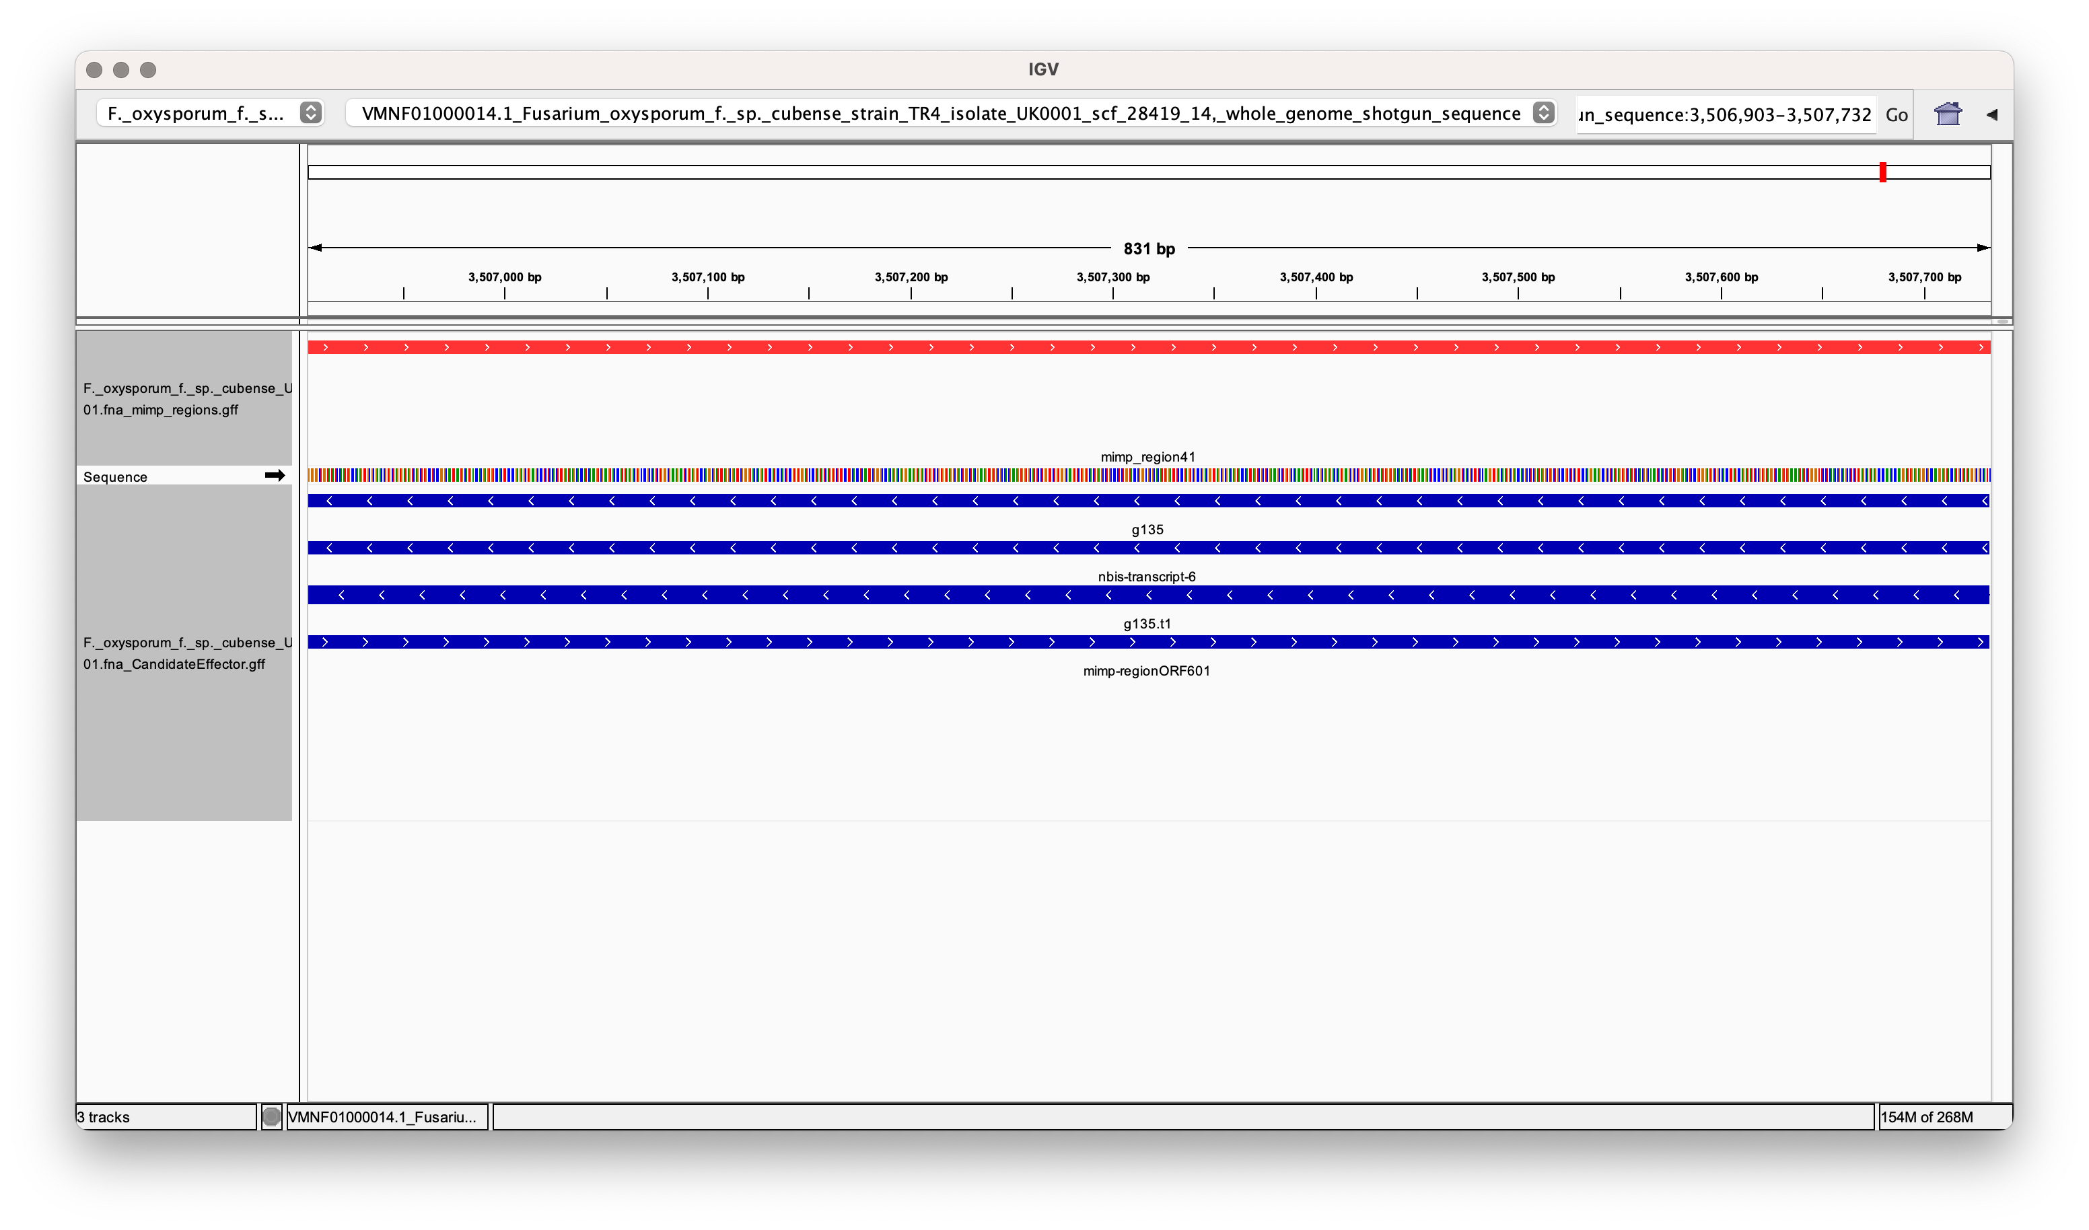

Slide 14
MOCK FIGURE!
Seong, K. and Krasileva, K.V., 2023. Prediction of effector protein structures from fungal phytopathogens enables evolutionary analyses. Nature Microbiology, 8(1), pp.174-187.

