Slide 1
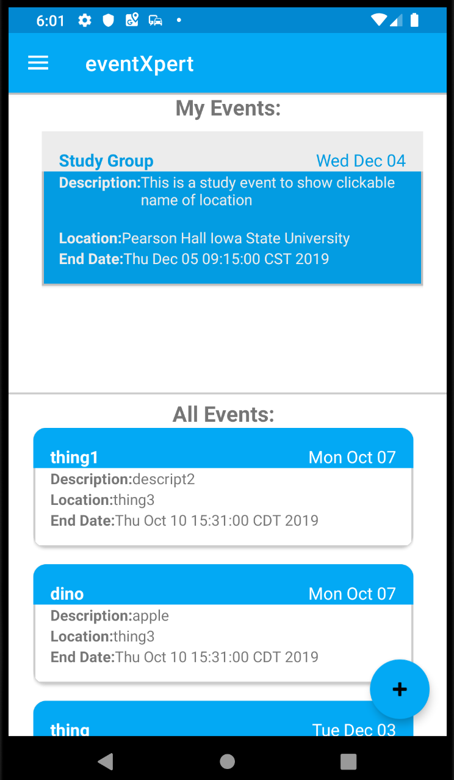
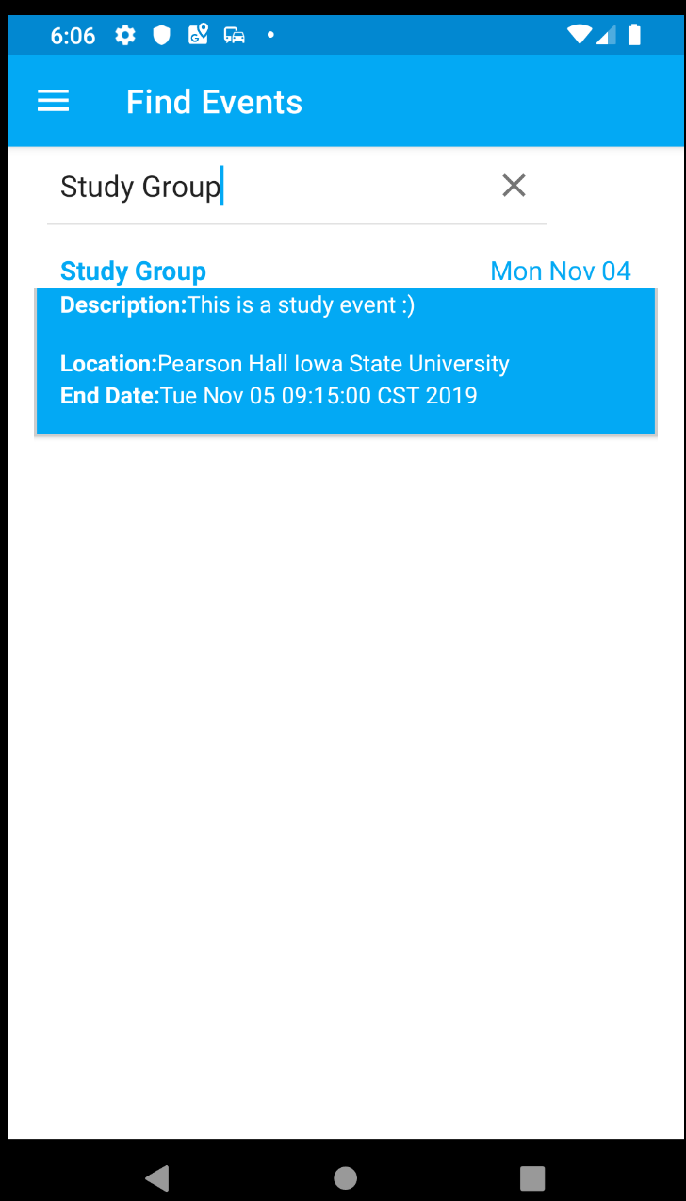
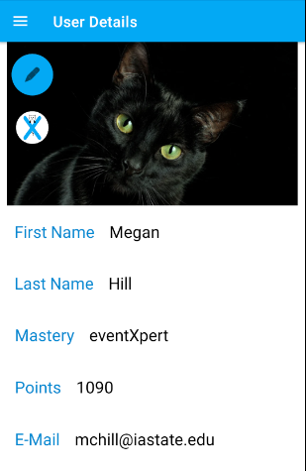
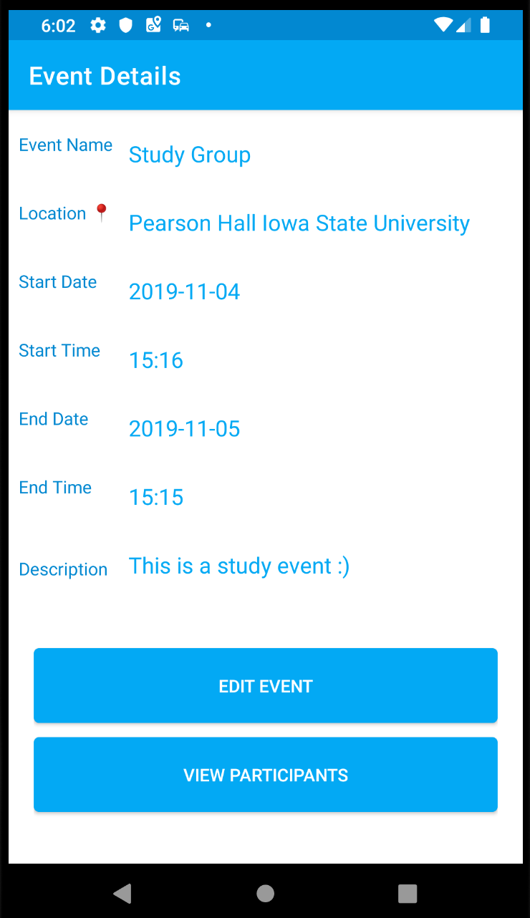
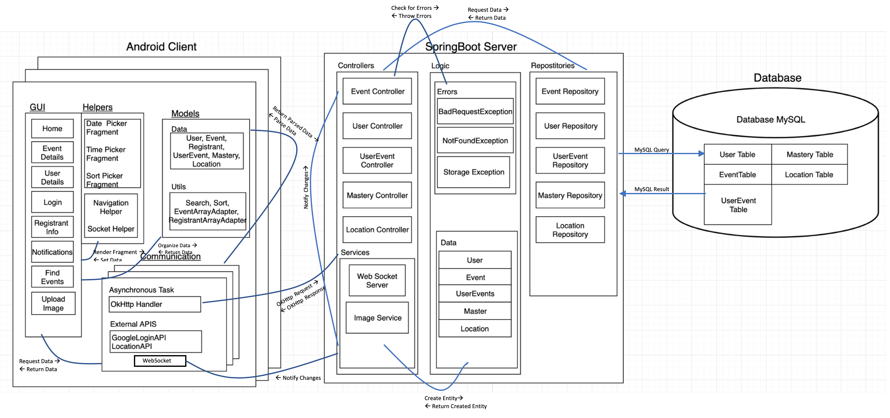
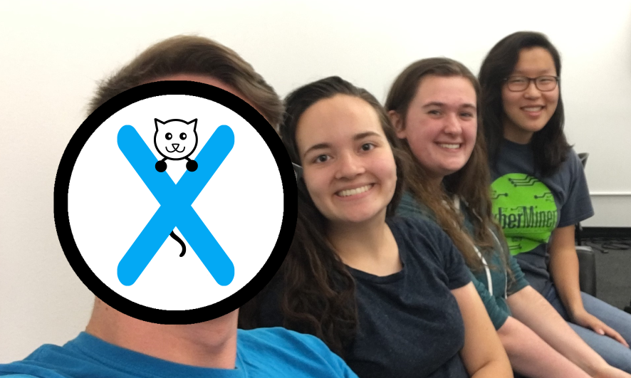
eventXpert
Ellie Bair (CprE Jr) | Jamie Sampson (SE Jr) | Megan Hill (SE Jr)
COM S 309 FALL 2019
Project Description
eventXpert is an Android app which allows users to create, sign up for, and check into events. This allows event creates to keep information about everyone who signed up for their event in one convenient place as well as allowing people to find events that may appeal to them.
Users
Event Creators
Event Attendees
Module Interfaces
Event Controller
getAllEvents(String name, String sort): Returns a list of events in the database with the given name sorted by the passed in sort parameter. If no name is passed in it returns all events.
saveEvent(Event event, String eventId): Finds the event with the given eventId and updates them to have the properties of the passed in event.
getEventById(int eventId): Returns the event in the database with the given id or throws a 404 if there is no event in the database with the given id.
UserEventController
getAllUserEvents(): Returns a list of all user/event relationships
addUserEvent(int userId, int eventId, boolean isAdmin): Adds a userEvent relationship to the database between the given user and event, throwing a 404 if either user or event do not exist.
getUserEvent(int userId, int eventId): Returns the UserEvent relationship between the given user and event if one exists else throws 404.
getEventsByUserId(int userId): Returns any events associated with the given user.
getUsersByEventId(int eventId): Returns any users who have registered for the given event
saveUserEvent(UserEvent userEvent, int userEventId): Finds the given userEvent in the database and updates it to the given userEvent
UserController
getAllUsers(): Gets a list of all users in the database
getUserById(int id): Returns the user in the database with the given id or a 404 if there is not user with that id
addUser(User user): Creates a new user and adds them to the database
deleteUser(int id): Removes the user in the database with the given id or throws a 404 if there is no user in the database with the given id.
saveUser(User user, int userId): Find the user with the given userId and updates them to have the properties of the passed in user.
What went wrong:
Minimal Client Testing
Google Maps SDK
What went right:
Communication
Code Reviews/Git
Lessons Learned
Server & Databases
Andriod & Spring
Design Decisions
UserEvent own entity
Hamburger Menu
OHttp (Request Handler)
ButterKnife (Andriod)

