Slide 1
Gamer Selector / Organizer
Jamie Shamilian
Pratim Patel
Ryan Mccauley
Notes:
CS545

Slide 2
Gamer Selector Description
An application that allows a user to indicate their Video Game preferences
The application limits the huge list of available Games to a smaller list that may interest the user
The application helps the user limit the interest list, by allowing predefined selection query categories.
Notes:
Video games are plentiful. There are thousands to choose from, whether in the iphone app store, android play store, Xbox store, playstation store or the microsoft windows store. The number of available games and platforms are too numerous to count.
The application is meant to help the user limit the list of games to a manageable set, that may interest the user.
Our goal with the Gamer Selector is to create an easy to use and fun method for people to find games that may interest them based on their general interests and preferences. This is accomplished by the user first indicating their Video Game preferences. There are a plethora of different genres and video games available, and our goal is to limit that list and show the user a succinct list of video games that may interest them. By limiting the choices to predefined categories, our application helps the user limit their interest list in an easy and inviting manner. These categories include the date range of how recent games they want to play, a cost range of how much they want to spend, a game platform or what systems they have available to use, and a game type that indicates what genres of games they enjoy.

Slide 3
Targeted E – Easy to learn
The application is focused on ease of user
The application allows for user profiles to be defined
Guest profiles are allowed to encourge first time use
The application limits the choices to predefined selections via combo box widget.
Notes:
Easy to learn was our primary goal. We found that many websites that are available require you to know what you are looking for in advance. So you are guessing as to keywords in order to come up with a query.
The E that we chose was obvious to us. We wanted our application to be as easy to learn for the user as possible. The less friction that exists between the user and our program, the more likely they are to continue to use our program to discover more games. User profiles can be defined so that their preferences can be tracked, but if a user does not want to go through the hassle of creating an account, they have the option of choosing to use a Guest profile so that their first experience is as easy to use as possible. Furthermore, instead of having to search through endless lists of video games mindlessly, our application will limit the user’s choices to certain predefined selections in the combo box widget. By making our application easy to learn, and simple to use, our idea is that they will continue to return to our application.

Slide 4
Measurement of Improvement
Our application is easy to learn, but the limitation on easy to learn is completeness.
We need to provide most of the possible selections that a user may be looking for.
We use industry data on fields and criteria available.
Our survey asks, “Did you find the selection criteria you were looking for ?”
Notes:
While our application is certainly easy to learn, one of the limitations on this is how complete our application can be. We want to ensure that even though we have predefined selection options, we have the ability to expose the user to any possible selections that they are interested in, based on what is being offered in the industry. In order to do this, we constantly update the selections based on industry data, and the different criteria that are being offered. To track improvements, we constantly ask our users if they found the game that they were looking for. As our application improves, and our selection criteria and methodologies get better, we expect the answers to this survey question to lean more and more towards a “Yes” answer. In addition to finding the right game for the user, we want to ensure that our application is constantly as easy to learn and as easy to use as possible. One measurement for this can be through seeing how long a user spends on each page of our application. If we see that users are getting stuck at a certain portion of the application, then we know that there is friction there, and something needs to change. In order to track this, we can use various analytic platforms, such as Google Analytics. If we see a certain part of our application is taking longer for users to get through, we can change that aspect, and measure through the analytics how much less time the users take in the changed version. If there is a decrease in time, then we know that we are improving.

Slide 5
Target Population
Our target populations are in the age group of 18-34 year old. (Millennial Gamers)
The population has a reasonable disposable income.
This population may play on multiple devices
We rely on industry data for selection of targeted population
https://www.theesa.com/esa-research/2019-essential-facts-about-the-computer-and-video-game-industry/
Notes:
https://www.theesa.com/esa-research/2019-essential-facts-about-the-computer-and-video-game-industry/
Millennial Gamers (18-34) – Entertainment Software Association, 2019
Millennial Gamers, those aged between 18 and 34, are our targeted population. According to a pew research study, 67% of respondents between the ages of 18-30 play video games. Furthermore, millennials have a reasonable disposable income, allowing them to spend money on things that they enjoy, including video games. Our hope is to give Millennials the tools to find video games that they enjoy, that they would not have otherwise found, in as easy and efficient a manner as possible.
https://www.nielsen.com/us/en/insights/article/2019/game-on-video-games-are-a-staple-among-millennials-media-diets/
https://www.alistdaily.com/strategy/different-generations-play-video-games-platforms-genres/

Slide 6
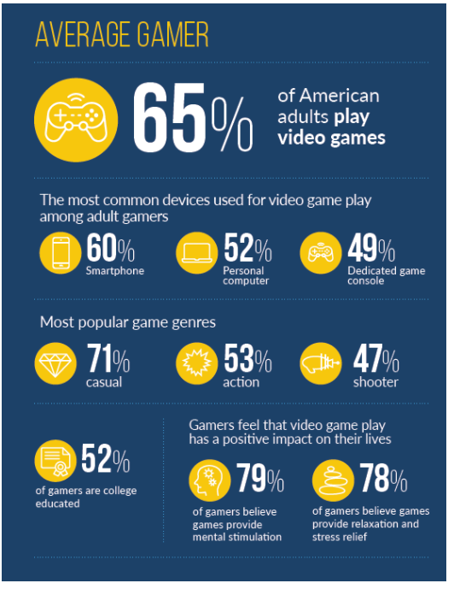
Industry Data
60% of adults play video game
60% on a smartphone
71% casual
52% college education
Notes:
https://www.theesa.com/esa-research/2019-essential-facts-about-the-computer-and-video-game-industry/
Millennial Gamers (18-34) – Entertainment Software Association, 2019
Gen X Gamers (35-54) – Entertainment Software Association, 2019
Baby boomer Gamers (55-64) -Entertainment Software Association, 2019
https://www.gamingscan.com/gaming-statistics/
We put out a survey that attempted to ascertain demographic information, as well as questions about video game playtime, interest, and spending habits. There were a total of 15 responses, 73% were from those between the ages of 18 and 25, 27% were from those between the ages of 26 and 34. Of those between the ages of 18 and 25, 100% said that they played at least 5 hours of video games each week. Furthermore, 81% of those between the ages of 18 and 25 said that they were constantly looking for new video games to play, as well as 66% of those between the ages of 26 and 34. These results were extremely helpful in us finding our target audience. We found that there was a large population of people in this age group that played video games constantly, and wanted to find new video games to play. This meant there was a clear need for something like our Game Selector. This questionnaire was completed using Google Forms

Slide 7

Persona
Name - John Smith
Age - 25
Family – Single
Education – 2 years at Brookdale Community College
Occupation – IT administration
Location – NYC - Brooklyn
Household – lives with 2 room mates
Transportation - Uses Public Transit
John uses most of this time on his phone.
Notes:
John is casual gamer that does not play all the time and needs help to find games he might like. He mainly plays games on his phone. He plays games while on the Bus/Train and waiting for Bus and/or Trains. John also plays on his roommates Xbox system.
John spends most of his commute time on his phone either on a social media site or playing games to pass the time.
John Smith is a 25 year old IT administrator that lives in Brooklyn, New York. He is single, lives with two roommates, and uses public transportation to get to work. John has a stable job, and a relatively large amount of disposable income. Because John uses public transportation to work each day, he often finds himself playing video games on his phone during his commute. John has been playing video games since he was a child, and sees them as a part of his life and daily routine.
John is the perfect example of our target audience for the Game Selector. He has a job, a love of video games, and enough free time to play games. John is constantly looking for new games to play to pass his time on his commute, but doesn't have the time to constantly be looking for new games to play. Game Selector would be perfect for him, as it gives him an easy and quick way of finding new games that he can play during his commute. Because he doesn't want to put in a lot of time in actually finding a game to play, nor does he want to exhaust a lot of effort, Game selector is the ideal choice, because it quickly chooses games for him in a frictionless manner that is not hard to navigate and learn how to use. John fits with our E, easy to learn, perfectly, as it is the quickest and easiest way for him to find new things to play.

Slide 8
Current available ApPs
Most apps are provide by publishers
Apple Store
Google Play store
Xbox/Microsoft Store
Nintendo Store
Alternate Sites
Game Data Library
Video Game Recommendation Engine
Notes:
Game Data Library
https://sites.google.com/site/gamedatalibrary/game-search
https://apps.quanticfoundry.com/recommendations/gamerprofile/videogame/

Slide 9
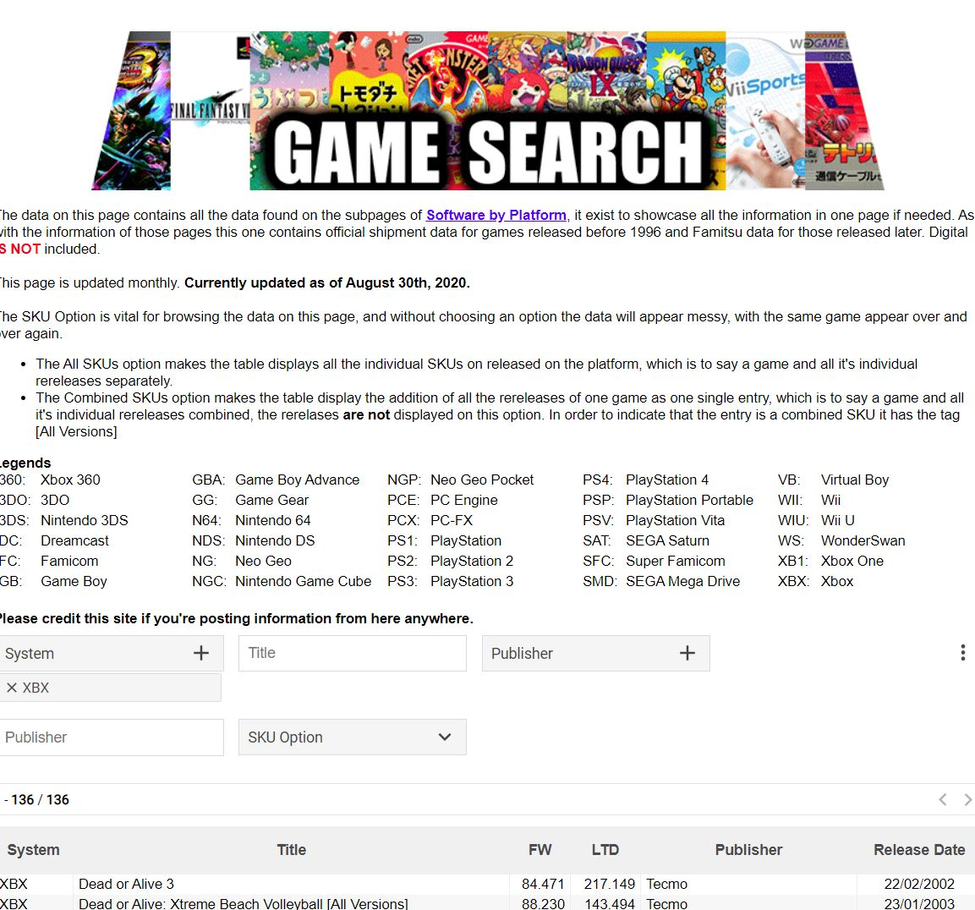
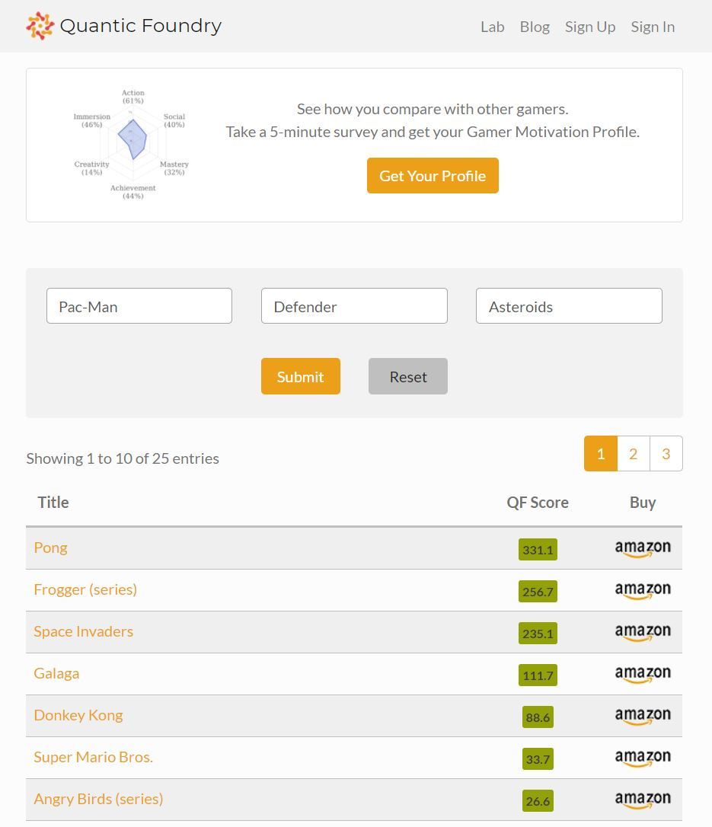
Competition
Notes:
Game Search Library – only has platform games and only by title and publisher
Video Game Recommendation Engine – just asks for names of games you like and gives a list response
Without date of publishing, or cost info, or type of game…..
Currently, there are a few competitors in the market, namely Quantric Foundry, and Game Search. However, we believe that we can easily distinguish ourselves from the competition, based on our E. Our application is designed to be as easy to learn as possible, and facilitate a user experience that is simple and time effective. Compared to our competitors who have multiple hoops to jump through in order to receive a game recommendation, or a profile, which must be then read, understood, and acted upon, our application is much more simple, and after only four decisions by the user, will display to them some possible games that we found may interest them. Our streamlined design, and ease of use truly differentiates us from the rest of the competition.

Slide 10
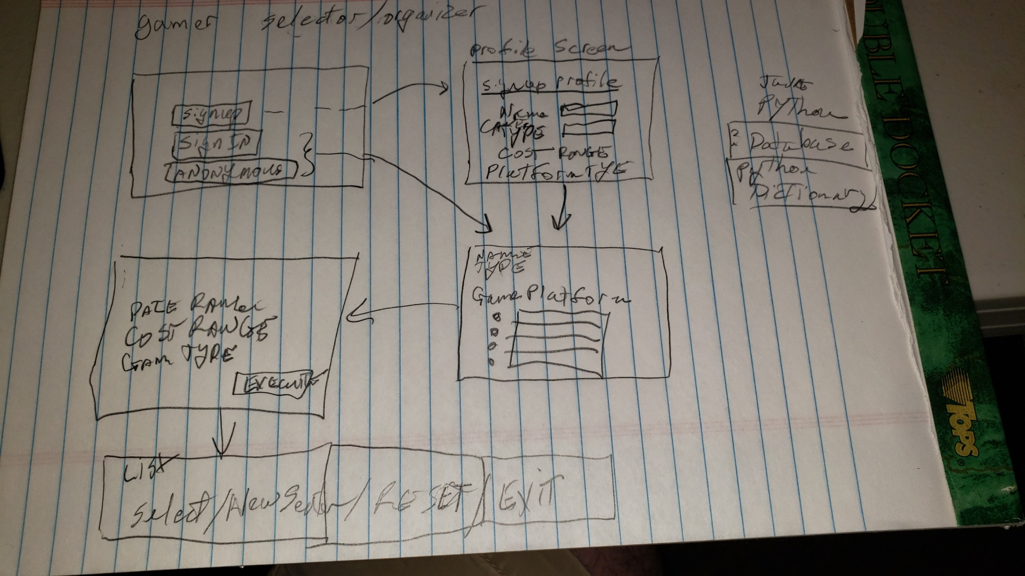
First Design / Paper prototype
Notes:
Hand drawn menu system.
Shows
signup/signin/guest screen
Profile completion screen
Query form
List output screen
In our first design, we wanted to create a rough layout of how the user would maneuver through our application. We wanted to emphasize our E, easy to learn, so we limited the amount of options our user had in signing up or remaining anonymous, kept the sign up profile information requirements simple, and limited the number of questions we would ask about their game preferences to four. By focusing on our E, we also focused on our persona. We knew that our targeted persona did not want to waste a lot of time in getting to the actual game suggestions. The user feedback we received from this first design was very helpful.
User Feedback: After showing our rough sketch prototype to 5 potential users, we realized that they thoroughly enjoyed the idea of only having to answer four questions before being shown games that they would enjoy, as it cut down the time it takes for them to find a new game significantly. This is what truly made us stand out from other competitors online. 80% of those we showed the first sketch to liked only being asked for 4 things when looking for a new game. 20%, however, wanted more specific questions, many of them voicing concerns about our method not being specific enough. We were unclear in exactly how we would ask the users for information in those 4 questions, whether it be a drop down menu, a text input, etc. We found that if we wanted to make our application as easy to learn as possible, a drop down menu would be ideal, and of the 80% that liked the idea of only being asked 4 questions,75% enjoyed the idea of a drop down menu making life simpler for them. Through this survey, we were able to measure whether or not our E was improving. If more people believed that our design was easy to use in successive design implementations, then we knew that our E was improving.

Slide 11
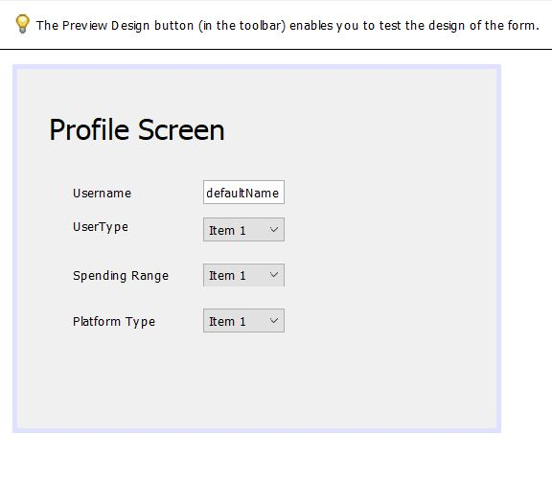
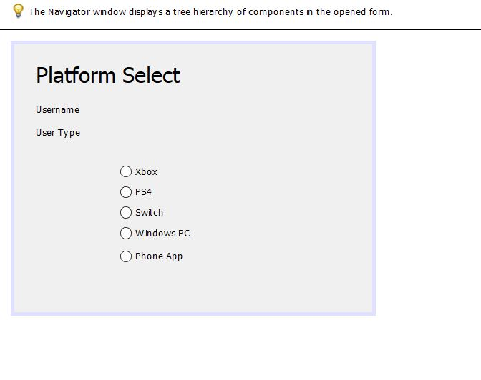
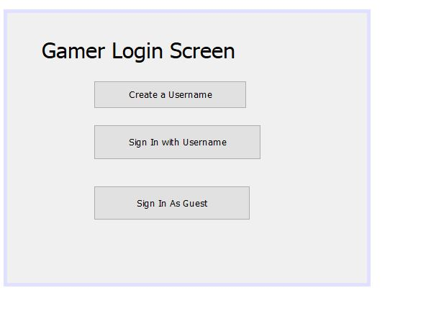
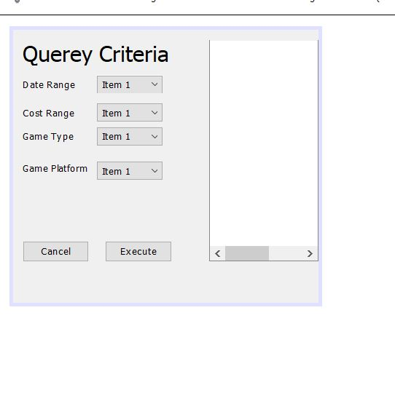
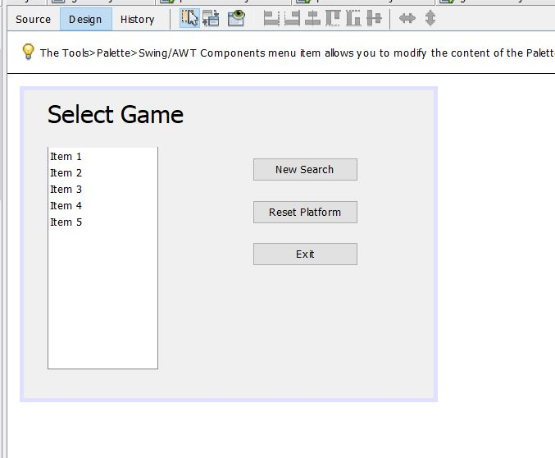
Second Design / GUI builder
Notes:
A second design was implemented with Apache Netbeans GUI builder for java language.
In our second design, we created an actual gui representation of what our application would look like. This medium fidelity prototype made it much easier for us to envision what our final product could look like. Our second design was an improved version of our paper prototype, as it solidified the idea of using drop down menus as methods for our users to select from our 4 criteria. In testing out our second design with potential users, we found that the visual representation made it much easier for them to envision what our application would look like as a final product. We were met with a lot of positive feedback about how easy it is to use our product, and how quickly it would get to the end result of a list of games. There was a lot of constructive criticism about how we would finally display that list of games, however. There was confusion on our end over whether our list of games would be displayed from the query page, or from another page that would pop up. In receiving user feedback, we found that more people wanted the list of games to be displayed on the query page itself, as it would be a much simpler design.

Slide 12
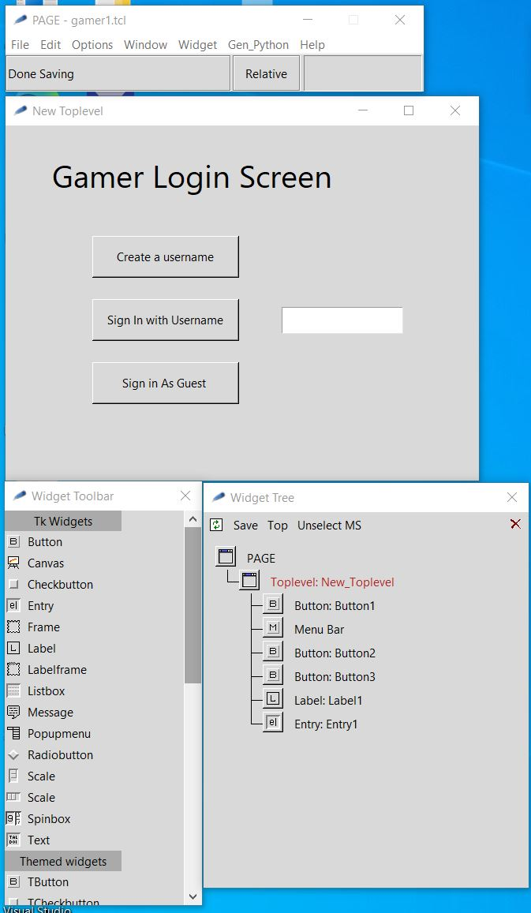
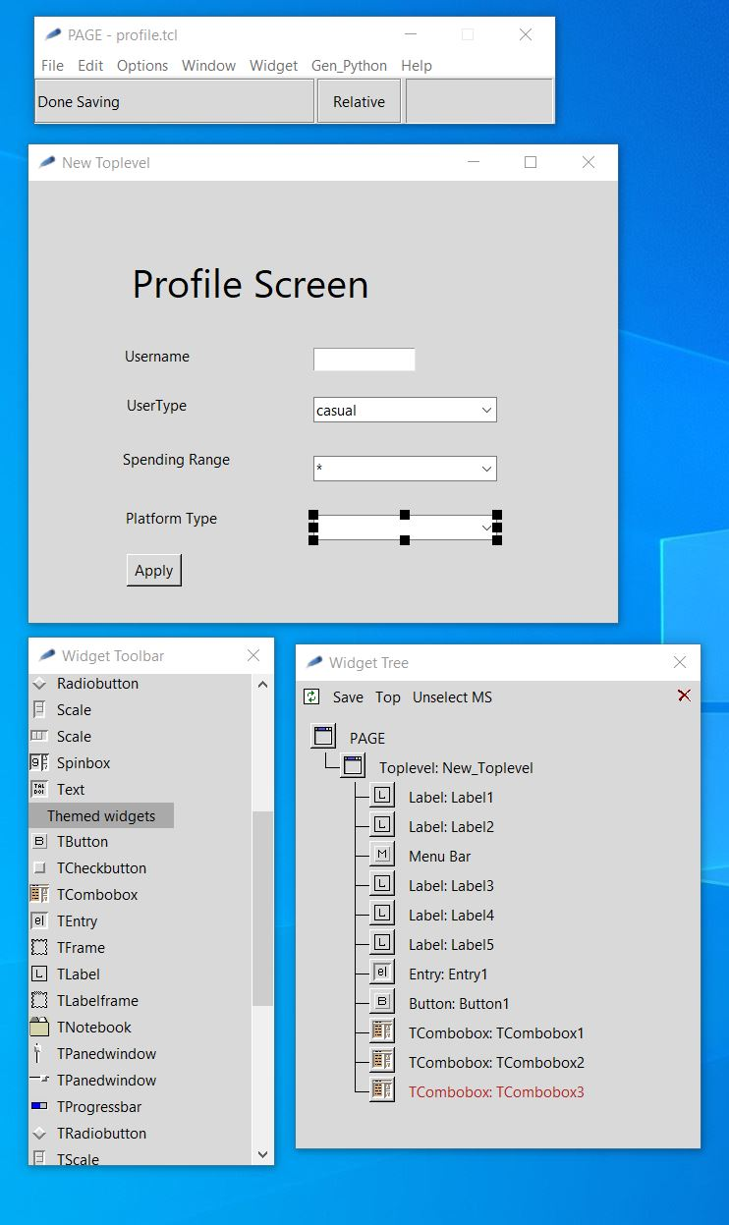
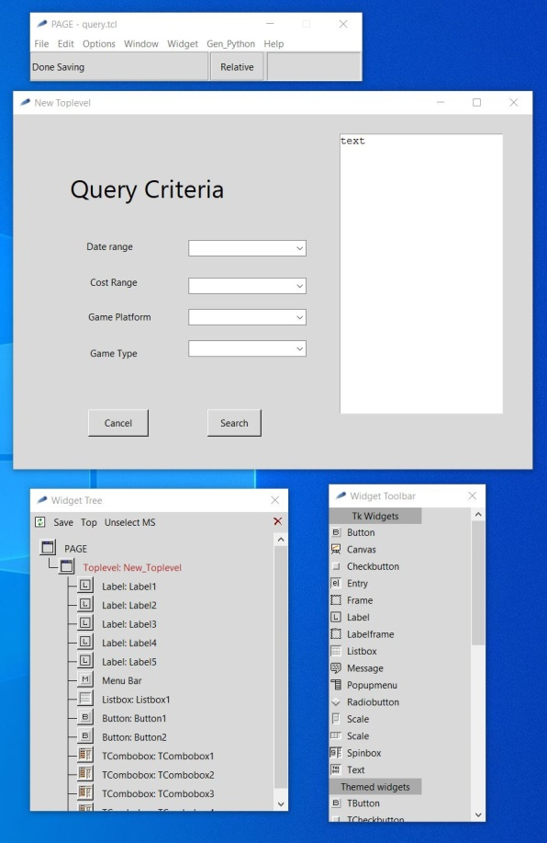
Final Design / GUI builder
Notes:
Our Final design user the “PAGE” GUI builder which is based on Tkinter / Python libraries.
We further simplified the design to only 3 screens.
We removed the radio selection screen of platforms and added it as an extra combo box on the profile screen / query criteria

Slide 13
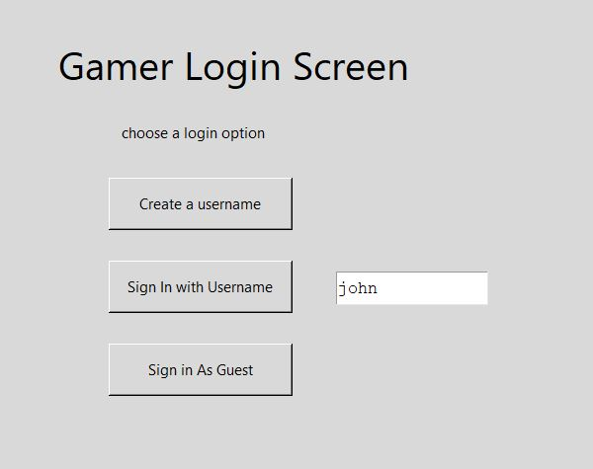
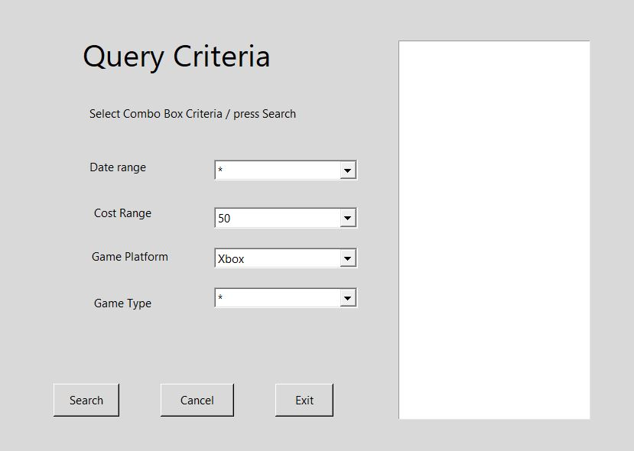
Previous User Flow
Notes:
This shows the simple flow of a previously registed user
Only takes to screens.
The query criteria is pre-populated with profile info.
But can be changed before search.
We add a line to each screen with instructions.
This line is also where an error message would be printed.
Exampe: User john does not exist.

Slide 14
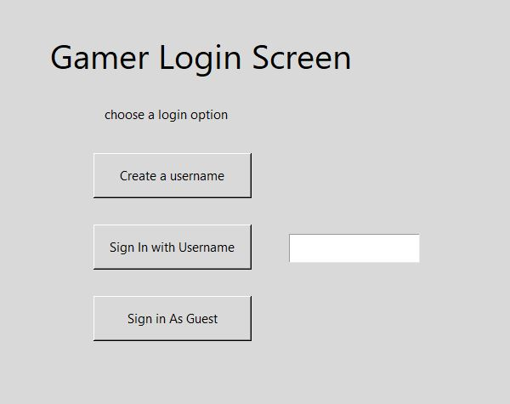
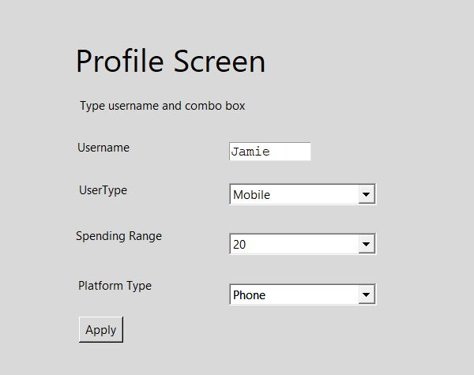
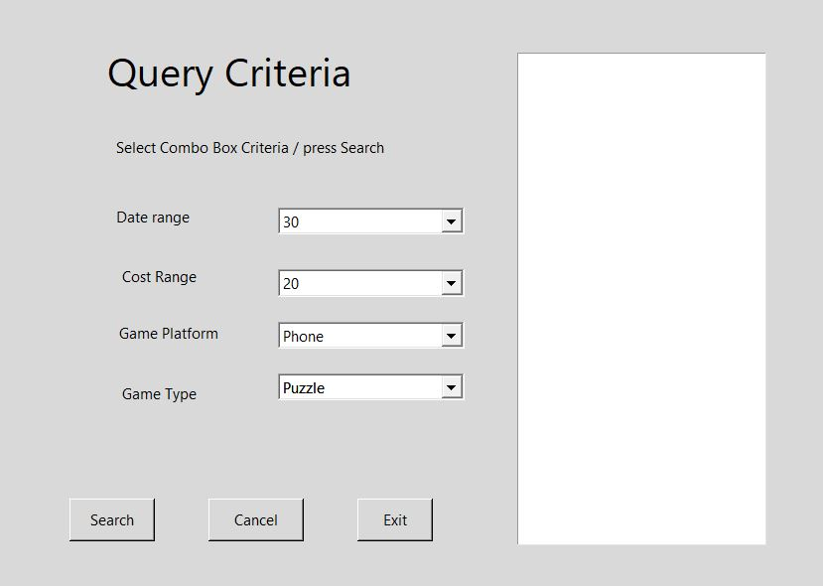
New User Flow
Notes:
In this flow the new user is asked to select a username and user combo box
To select the best description of the user.
The instruction line is updated in case of error:
Username Jamie is not available.

Slide 15
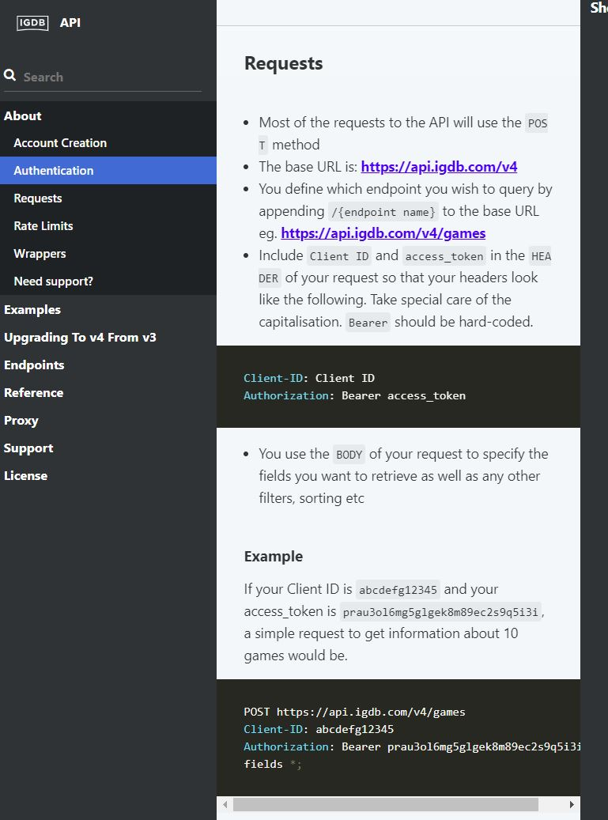
Backend – IGDB / Twitch
Database access
https://api-docs.igdb.com/#about
https://pypi.org/project/igdb-api-v4/
Notes:
Non-commercial db access via twitch developers account
Via igdb.com: https://api.igdb.com/v4
Python library access via igdb-api-v4
Authorization tokens are needed from a valid twitch developer account
For an application/access token.
At run time we provide the clientid and the access token.

Slide 16
PAR
Perception - grouping of class of pulldown selection categories together. Don't mix, genre with publishing dates since they are quite different categories.
Attention - Highlighting the platform (PC/Xbox/Sony/Switch) selection
Retention - use of pull down selection so the user does not have to remember the categories they are allowed to choose from.
Notes:
Our team took PAR into consideration when we designed our application. In taking in the users perception of the application, we wanted to group together the different pulldown categories into section categories. By keeping things like the genres separate from things like publishing dates, we made it easy for users to keep track of exactly what the application is asking for, and allows the user to feel comfortable making choices. In order to keep the user’s attention, we kept the entire application as succinct and quick as possible. There are not a lot of things that can distract the user on our page, and any actions that the user needs to take in the application should take as little time as possible, so that the user’s attention is always held. In addition, we highlight the different categories, such as platform, so that the user is immediately looking at those four categories. In a future version of this application, we could certainly add more color and images in order to engage the user in a certain portion of the application like the categories, as well as keep them engaged, but for the purposes of our demonstration, we chose to keep the application as simple as possible. In terms of retention, we used a very basic pull down menu, so that user’s do not have to remember any information about the categories they can choose from. By using the pull down menu, we are keeping it simple for the users, and putting much less strain on the user than a different method would.

Slide 17
Laws Of Simplicity
Reduce - do not give to user too many choices, use of combo-box
Organize - keep similar items together on a screen
Time - allow guest use app without registering a username / profile
Learn – the combo-box offers limited need to learn outside of the app, familiarity the available choices makes it easier after just a few uses.
Failure – simple instructions and immediate error messages
The one – keep it simple, don’t add extras that are not needed
Notes:
Simplicity was certainly one of the focuses of our application. For this reason, our application touched upon many of the different laws of simplicity. Using Reduce, we kept the choices for the user smaller, which ensured that there was less clutter. This would retain the user’s focus, and make their decision much easier. Using Organize, we grouped together similar items on the screen, and allowed the user to choose four different criteria for their recommendation. This makes it easier for the user to compare the different options, and choose the option most appropriate for them in a smaller amount of time. Time was one of the more important laws that we used. We wanted to ensure that our application was as easy and quick to learn as possible. In order to facilitate an experience that was not cumbersome, we included the option for users to use the application as a guest, skipping the time it takes to create a profile and create an account. This makes the first experience a user has with our application quick, easy, and frictionless. In terms of Learn, we used the combo-box to ensure that user’s did not have to learn anything outside of the app, and were immediately familiar with how to navigate the application. For Failure, we used simple, streamlined instructions, as well as immediate error messages, so that user’s had the easiest experience without encountering roadblocks that could impede them from getting the list of recommended games.

Slide 18
Accessibility
We will produce an alternate version of the app or a mode for ease of reading.
High contrast by removing grey background.
Bold fonts for all words
We have minimal use of typing in the app
Most of the app is point and click via combo-boxes
The user can use Tabs / Arrows and Enter Key instead of a mouse
Notes:
We are working on a version of the app that supports high contrast, bold and large fonts. Unfortunately the tkinter package we used does not have this as a built-in option. We must create another version using these properties.
We built the application with minimal need to type, mostly just point and click of the mouse. If a person can not operate a mouse the tab , arrow keys and the enter key can manipulate the menu items.

Slide 19
Heuristic Evaluation
Using Kessler and Nielson’s Evaluation points
Appropriate feedback
When user presses a button they see an appropriate and immediate response.
Prevent Errors
Use of combo-box to limit response limits errors.
Help
An instruction line tells the user what is expected and when and error has occurred.
Notes:
In terms of a Heuristic Evaluation, we believe that our application stands up well, as it provides users with simple features, and allows the user to safely navigate and interact with our application. We employ appropriate feedback, so that users will immediately see an appropriate response whenever buttons are pressed. We put an emphasis on prevent errors, as our design choices have created a user experience that is simple, easy to use, and limits the amount of places that the user could cause an error. We provide users with sufficient help, giving user’s instructions of how they are expected to use our application, as well as clear directions when an error has occurred. Our design is consistent and minimal. We do not bombard users with information, but provide a natural flow so that they are able to obtain exactly the information that they are looking for.

Slide 20
Demo/Build Repo
https://github.com/JamieShamilian/gamer
For more info Readme.md
Notes:
Required packages to build UI
python 3.7+
https://www.python.org/downloads/windows/
tcl/tk
https://www.magicsplat.com/tcl-installer/index.html#downloads
page
http://page.sourceforge.net/
Also needed common python packages tkinter, request, json, google protobuf…

Slide 21
Targeted E – Revisited
Easy to learn
We have made the app Easy to learn
We have added combo-box choices by selecting fields using industry data and available database fields
We need to add more criteria categories in order to make the app more useful to users

