Slide 1
Gamer Selector / Organizer
Jamie Shamilian
Pratim Patel
Ryan Mccauley
Notes:
CS545

Slide 2
Gamer Selector Description
An application that allows a user to indicate their Video Game preferences
The application limits the huge list of available Games to a smaller list that may interest the user
The application helps the user limit the interest list, by allowing predefined selection query categories.
Notes:
Video games are plentiful. There are thousands to choose from, whether in the iphone app store, android play store, Xbox store, playstation store or the microsoft windows store. The number of available games and platforms are too numerous to count.
The application is meant to help the user limit the list of games to a manageable set, that may interest the user.
Our goal with the Gamer Selector is to create an easy to use and fun method for people to find games that may interest them based on their general interests and preferences. This is accomplished by the user first indicating their Video Game preferences. There are a plethora of different genres and video games available, and our goal is to limit that list and show the user a succinct list of video games that may interest them. By limiting the choices to predefined categories, our application helps the user limit their interest list in an easy and inviting manner. These categories include the date range of how recent games they want to play, a cost range of how much they want to spend, a game platform or what systems they have available to use, and a game type that indicates what genres of games they enjoy.

Slide 3
Targeted E – Easy to learn
The application is focused on ease of user
The application allows for user profiles to be defined
Guest profiles are allowed to encourge first time use
The application limits the choices to predefined selections via combo box widget.
Notes:
Easy to learn was our primary goal. We found that many websites that are available require you to know what you are looking for in advance. So you are guessing as to keywords in order to come up with a query.
The E that we chose was obvious to us. We wanted our application to be as easy to learn for the user as possible. The less friction that exists between the user and our program, the more likely they are to continue to use our program to discover more games. User profiles can be defined so that their preferences can be tracked, but if a user does not want to go through the hassle of creating an account, they have the option of choosing to use a Guest profile so that their first experience is as easy to use as possible. Furthermore, instead of having to search through endless lists of video games mindlessly, our application will limit the user’s choices to certain predefined selections in the combo box widget. By making our application easy to learn, and simple to use, our idea is that they will continue to return to our application.

Slide 4
Measurement of Improvement
Our application is easy to learn, but the limitation on easy to learn is completeness.
We need to provide most of the possible selections that a user may be looking for.
We use industry data on fields and criteria available.
Our survey asks, “Did you find the selection criteria you were looking for ?”
Notes:
While our application is certainly easy to learn, one of the limitations on this is how complete our application can be. We want to ensure that even though we have predefined selection options, we have the ability to expose the user to any possible selections that they are interested in, based on what is being offered in the industry. In order to do this, we constantly update the selections based on industry data, and the different criteria that are being offered. To track improvements, we constantly ask our users if they found the game that they were looking for. As our application improves, and our selection criteria and methodologies get better, we expect the answers to this survey question to lean more and more towards a “Yes” answer. In addition to finding the right game for the user, we want to ensure that our application is constantly as easy to learn and as easy to use as possible. One measurement for this can be through seeing how long a user spends on each page of our application. If we see that users are getting stuck at a certain portion of the application, then we know that there is friction there, and something needs to change. In order to track this, we can use various analytic platforms, such as Google Analytics. If we see a certain part of our application is taking longer for users to get through, we can change that aspect, and measure through the analytics how much less time the users take in the changed version. If there is a decrease in time, then we know that we are improving.

Slide 5
Target Population
Our target populations are in the age group of 18-34 year old. (Millennial Gamers)
The population has a reasonable disposable income.
This population may play on multiple devices
We rely on industry data for selection of targeted population
https://www.theesa.com/esa-research/2019-essential-facts-about-the-computer-and-video-game-industry/
Notes:
https://www.theesa.com/esa-research/2019-essential-facts-about-the-computer-and-video-game-industry/
Millennial Gamers (18-34) – Entertainment Software Association, 2019
Millennial Gamers, those aged between 18 and 34, are our targeted population. According to a pew research study, 67% of respondents between the ages of 18-30 play video games. Furthermore, millennials have a reasonable disposable income, allowing them to spend money on things that they enjoy, including video games. Our hope is to give Millennials the tools to find video games that they enjoy, that they would not have otherwise found, in as easy and efficient a manner as possible.
https://www.nielsen.com/us/en/insights/article/2019/game-on-video-games-are-a-staple-among-millennials-media-diets/
https://www.alistdaily.com/strategy/different-generations-play-video-games-platforms-genres/

Slide 6
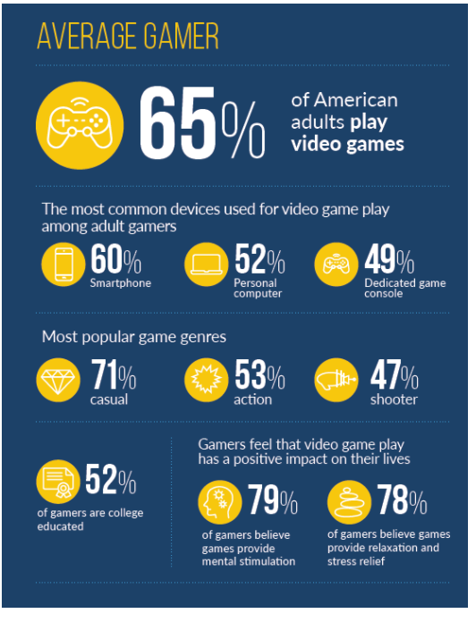
Industry Data
60% of adults play video game
60% on a smartphone
71% casual
52% college education
Notes:
https://www.theesa.com/esa-research/2019-essential-facts-about-the-computer-and-video-game-industry/
Millennial Gamers (18-34) – Entertainment Software Association, 2019
Gen X Gamers (35-54) – Entertainment Software Association, 2019
Baby boomer Gamers (55-64) -Entertainment Software Association, 2019
https://www.gamingscan.com/gaming-statistics/
We put out a survey that attempted to ascertain demographic information, as well as questions about video game playtime, interest, and spending habits. There were a total of 15 responses, 73% were from those between the ages of 18 and 25, 27% were from those between the ages of 26 and 34. Of those between the ages of 18 and 25, 100% said that they played at least 5 hours of video games each week. Furthermore, 81% of those between the ages of 18 and 25 said that they were constantly looking for new video games to play, as well as 66% of those between the ages of 26 and 34. These results were extremely helpful in us finding our target audience. We found that there was a large population of people in this age group that played video games constantly, and wanted to find new video games to play. This meant there was a clear need for something like our Game Selector. This questionnaire was completed using Google Forms

Slide 7

Persona
Name - John Smith
Age - 25
Family – Single
Education – 2 years at Brookdale Community College
Occupation – IT administration
Location – NYC - Brooklyn
Household – lives with 2 room mates
Transportation - Uses Public Transit
John uses most of this time on his phone.
Notes:
John is casual gamer that does not play all the time and needs help to find games he might like. He mainly plays games on his phone. He plays games while on the Bus/Train and waiting for Bus and/or Trains. John also plays on his roommates Xbox system.
John spends most of his commute time on his phone either on a social media site or playing games to pass the time.
John Smith is a 25 year old IT administrator that lives in Brooklyn, New York. He is single, lives with two roommates, and uses public transportation to get to work. John has a stable job, and a relatively large amount of disposable income. Because John uses public transportation to work each day, he often finds himself playing video games on his phone during his commute. John has been playing video games since he was a child, and sees them as a part of his life and daily routine.
John is the perfect example of our target audience for the Game Selector. He has a job, a love of video games, and enough free time to play games. John is constantly looking for new games to play to pass his time on his commute, but doesn't have the time to constantly be looking for new games to play. Game Selector would be perfect for him, as it gives him an easy and quick way of finding new games that he can play during his commute. Because he doesn't want to put in a lot of time in actually finding a game to play, nor does he want to exhaust a lot of effort, Game selector is the ideal choice, because it quickly chooses games for him in a frictionless manner that is not hard to navigate and learn how to use. John fits with our E, easy to learn, perfectly, as it is the quickest and easiest way for him to find new things to play.

Slide 8
Current available ApPs
Most apps are provide by publishers
Apple Store
Google Play store
Xbox/Microsoft Store
Nintendo Store
Alternate Sites
Game Data Library
Video Game Recommendation Engine
Notes:
Game Data Library
https://sites.google.com/site/gamedatalibrary/game-search
https://apps.quanticfoundry.com/recommendations/gamerprofile/videogame/

Slide 9
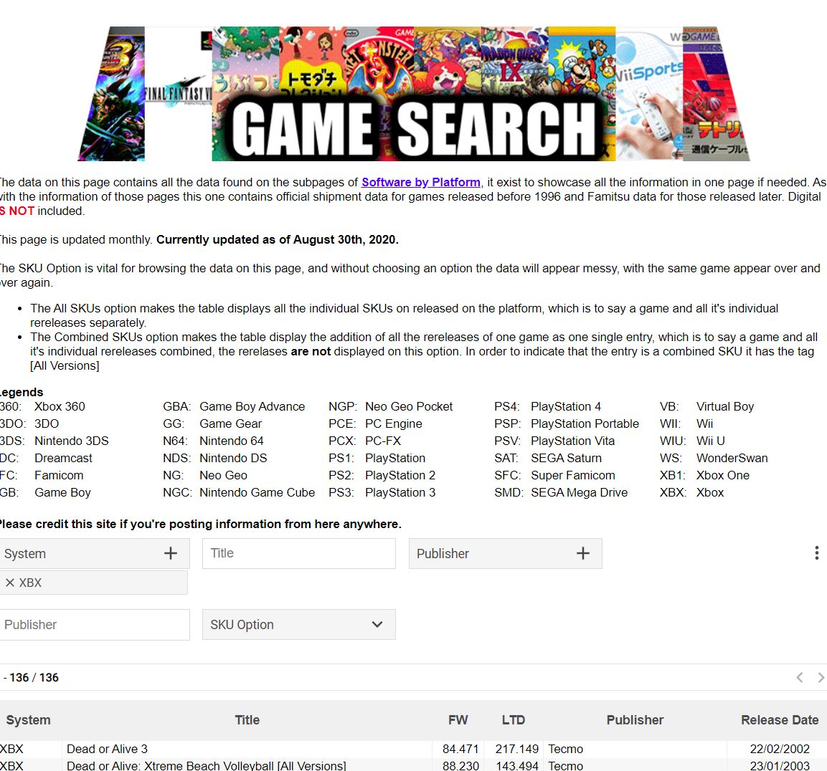
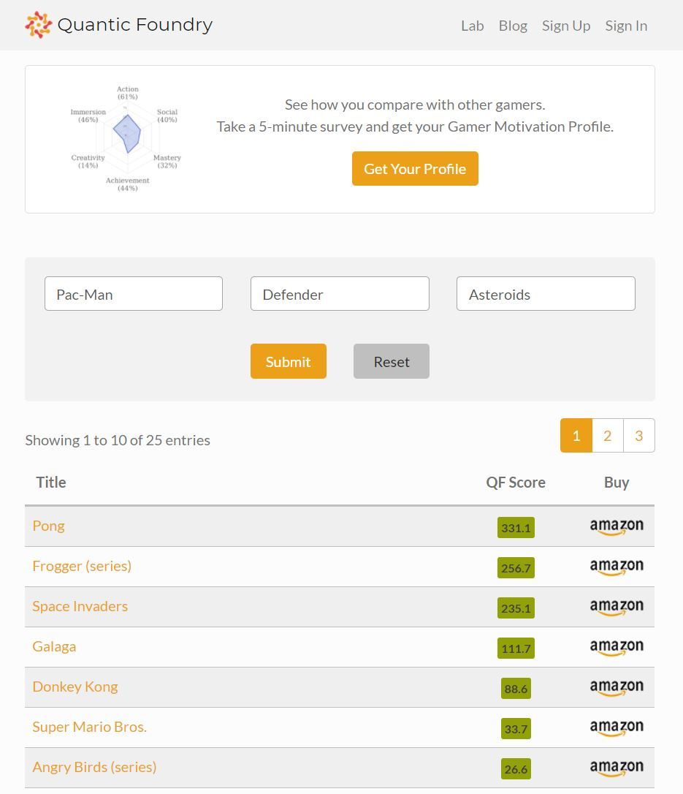
Competition
Notes:
Game Search Library – only has platform games and only by title and publisher
Video Game Recommendation Engine – just asks for names of games you like and gives a list response
Without date of publishing, or cost info, or type of game…..
Currently, there are a few competitors in the market, namely Quantric Foundry, and Game Search. However, we believe that we can easily distinguish ourselves from the competition, based on our E. Our application is designed to be as easy to learn as possible, and facilitate a user experience that is simple and time effective. Compared to our competitors who have multiple hoops to jump through in order to receive a game recommendation, or a profile, which must be then read, understood, and acted upon, our application is much more simple, and after only four decisions by the user, will display to them some possible games that we found may interest them. Our streamlined design, and ease of use truly differentiates us from the rest of the competition.

Slide 10
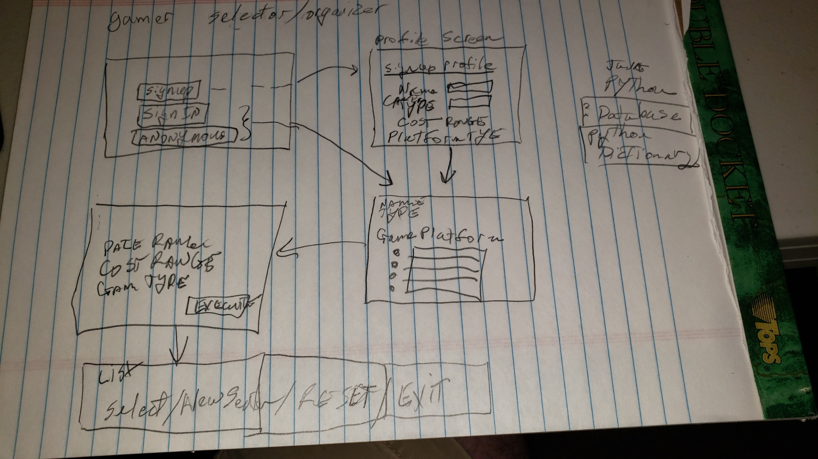
First Design / Paper prototype
Notes:
Hand drawn menu system.
Shows
signup/signin/guest screen
Profile completion screen
Query form
List output screen

Slide 11
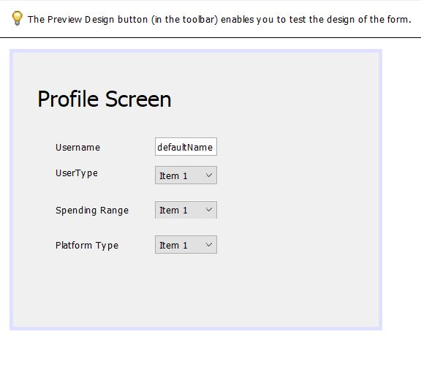
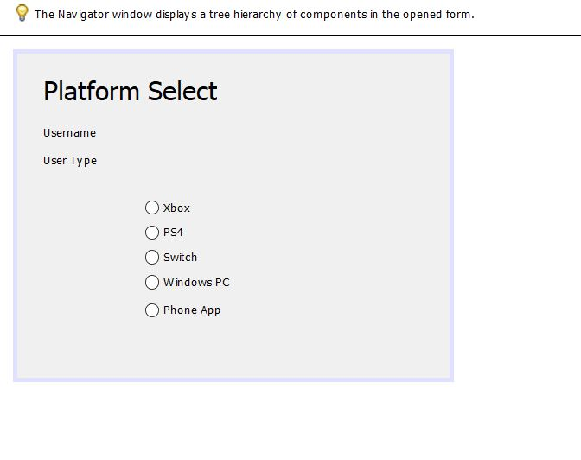
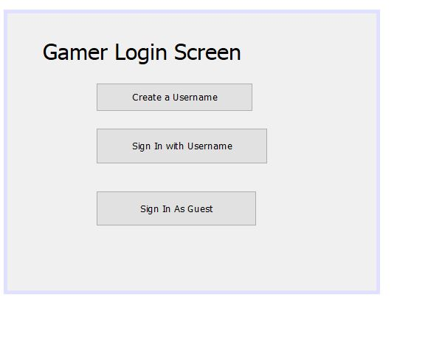
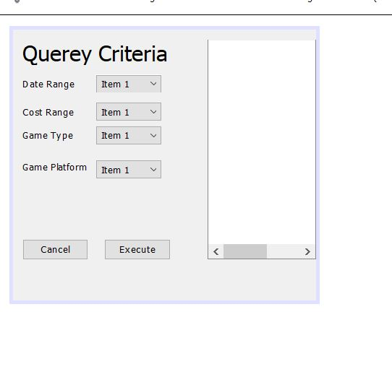
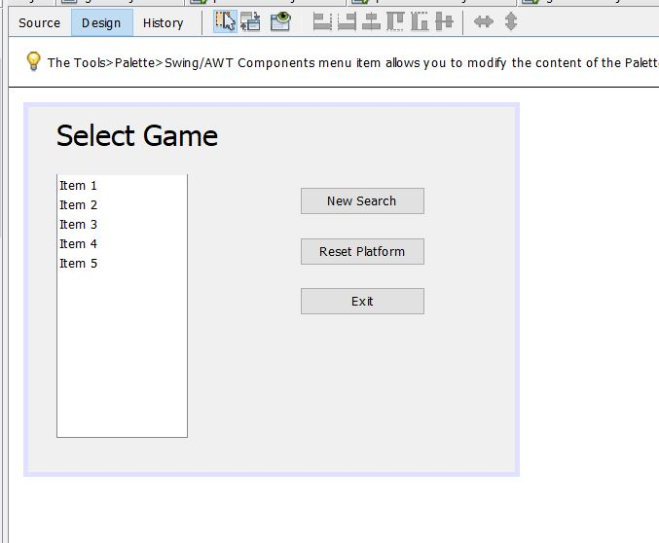
Second Design / GUI builder
Notes:
A second design was implemented with Apache Netbeans GUI builder for java language.
Here we followed most of the first design but we see some questioning about how to execute the query and show the final list.
We were not sure how to show the final, whether to add another screen at the end or just show in the query page.

Slide 12
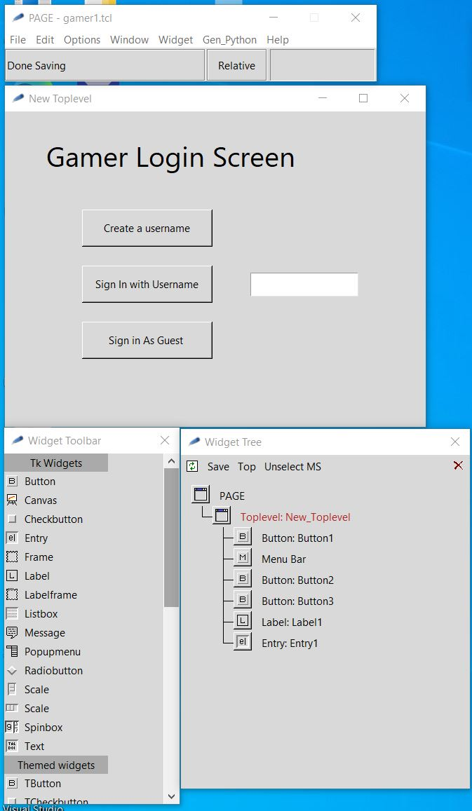
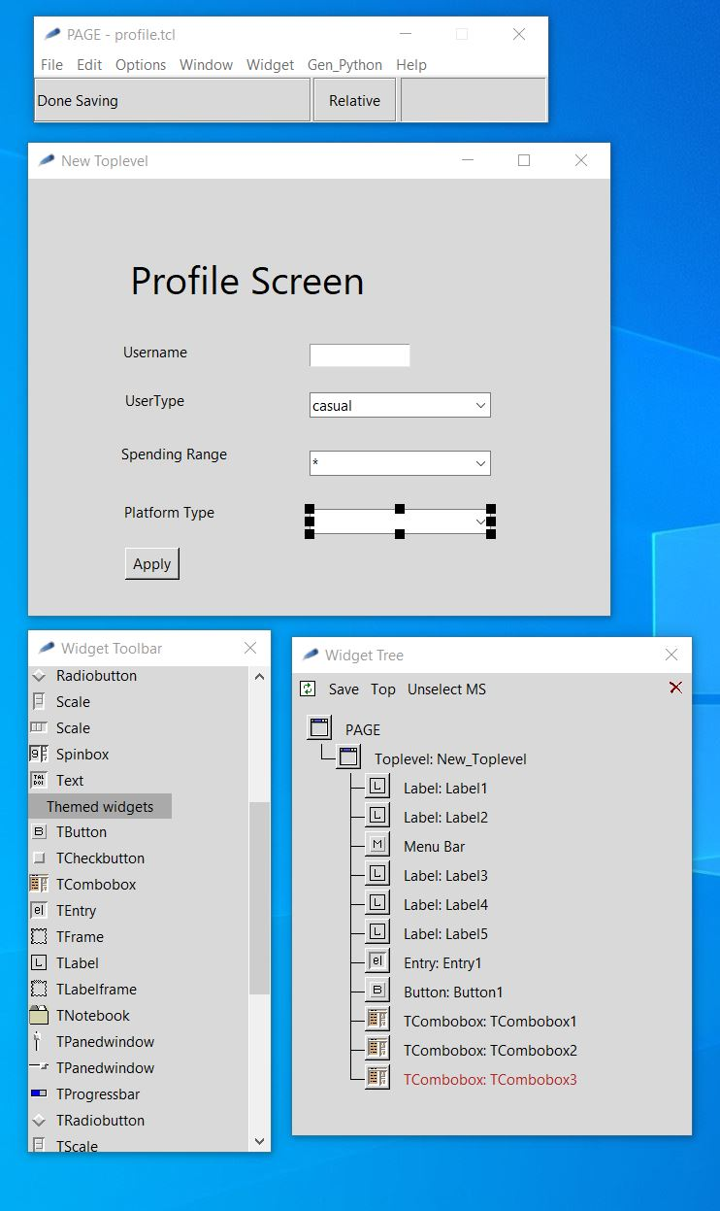
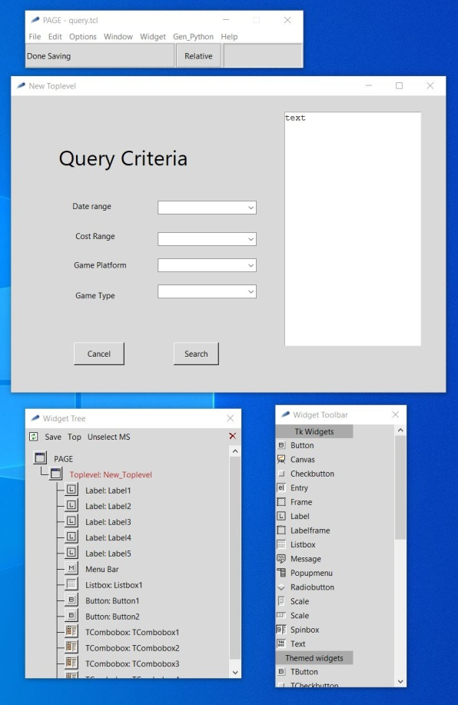
Final Design / GUI builder
Notes:
Our Final design user the “PAGE” GUI builder which is based on Tkinter / Python libraries.
We further simplified the design to only 3 screens.
We removed the radio selection screen of platforms and added it as an extra combo box on the profile screen / query criteria

Slide 13
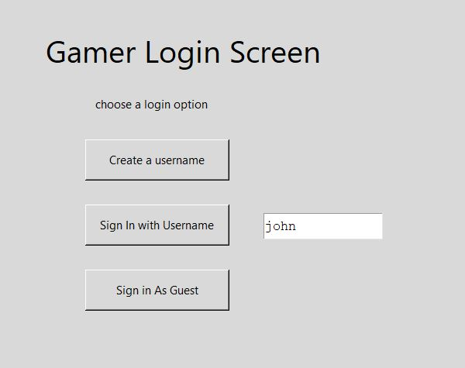
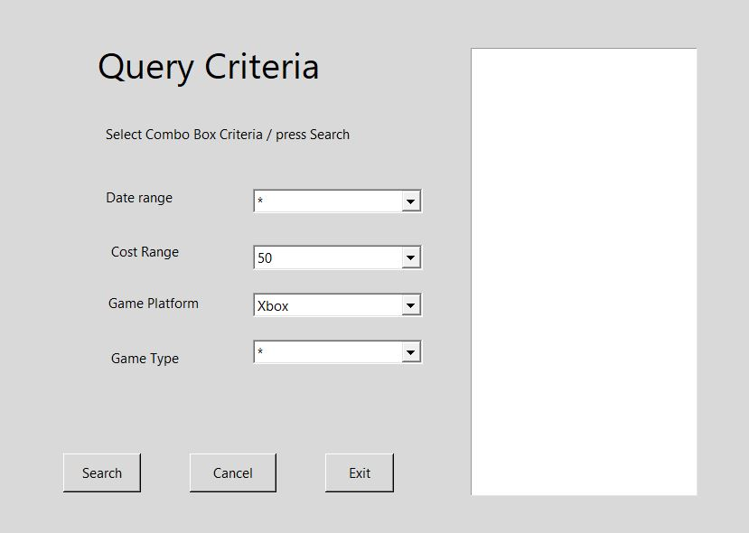
Previous User Flow
Notes:
This shows the simple flow of a previous user
Only takes to screens.
The query criteria is pre-populated with profile info.
But can be changed before search.
We add a line to each screen with instructions.
This line is also where an error message would be printed.
Exampe: User john does not exist.

Slide 14
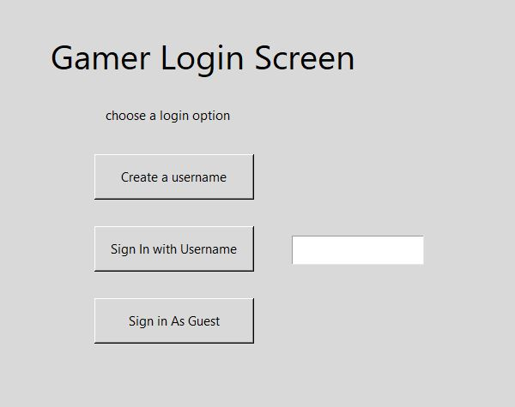
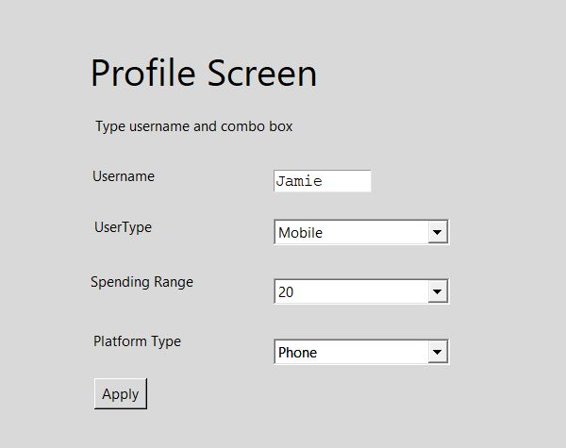
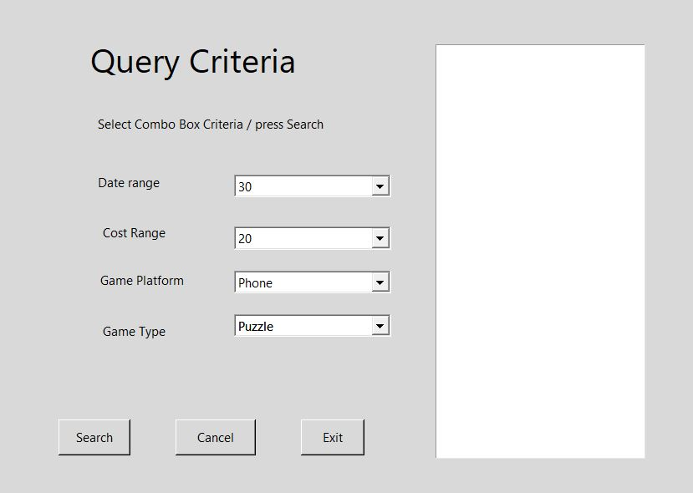
New User Flow
Notes:
In this flow the new user is asked to select a username and user combo box
To select the best description of the user.
The instruction line is updated in case of error:
Username Jamie is not available.

Slide 15
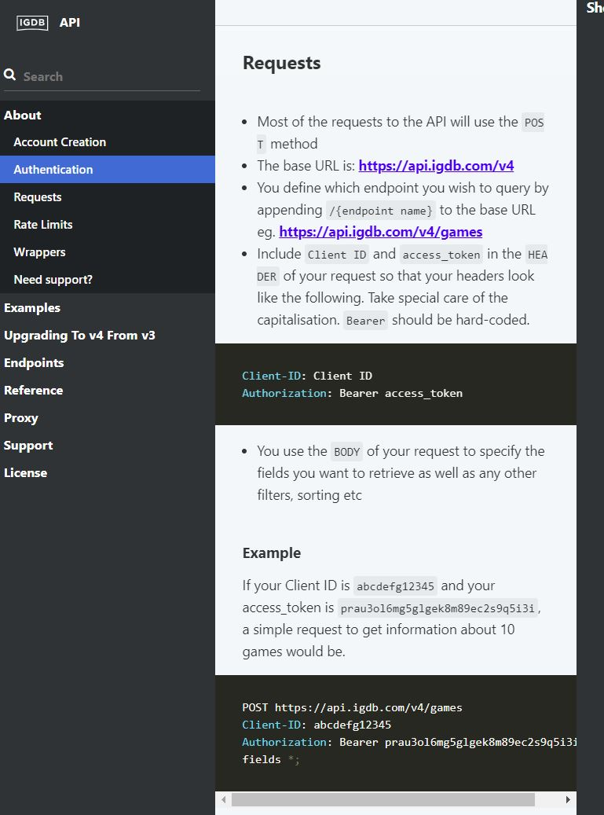
Backend – IGDB / Twitch
Database access
https://api-docs.igdb.com/#about
https://pypi.org/project/igdb-api-v4/
Notes:
Non-commercial db access via twitch developers account
Via igdb.com: https://api.igdb.com/v4
Python library access via igdb-api-v4
Authorization tokens are needed from a valid twitch developer account
For an application/access token.
At run time we provide the clientid and the access token.

Slide 16
PAR
Perception - grouping of class of pulldown selection categories together. Don't mix, genre with publishing dates since they are quite different categories.
Attention - Highlighting the platform (PC/Xbox/Sony/Switch) selection
Retention - use of pull down selection so the user does not have to remember the categories they are allowed to choose from.

Slide 17
Laws Of Simplicity
Reduce - do not give to user too many choices, use of combo-box
Organize - keep similar items together on a screen
Time - allow guest use app without registering a username / profile
Learn – the combo-box offers limited need to learn outside of the app, familiarity the available choices makes it easier after just a few uses.
Failure – simple instructions and immediate error messages
The one – keep it simple, don’t add extras that are not needed

Slide 18
Accessibility
We will produce an alternate version of the app or a mode for ease of reading.
High contrast by removing grey background.
Bold fonts for all words
We have minimal use of typing in the app
Most of the app is point and click via combo-boxes
The user can use Tabs / Arrows and Enter Key instead of a mouse

Slide 19
Heuristic Evaluation
Using Kessler and Nielson’s Evaluation points
Appropriate feedback
When user presses a button they see an appropriate and immediate response.
Prevent Errors
Use of combo-box to limit response limits errors.
Help
An instruction line tells the user what is expected and when and error has occurred.

Slide 20
Demo/Build Repo
https://github.com/JamieShamilian/gamer
For more info Readme.md
Notes:
Required packages to build UI
python 3.7+
https://www.python.org/downloads/windows/
tcl/tk
https://www.magicsplat.com/tcl-installer/index.html#downloads
page
http://page.sourceforge.net/
github

Slide 21
Targeted E – Revisited
Easy to learn
We have made the app Easy to learn
We have added combo-box choices by selecting fields using industry data and available database fields
We need to add more criteria categories in order to make the app more useful to users

