Slide 1
Gamer Selector / Organizer
Jamie Shamilian
Pratim Patel
Ryan Mccauley
Notes:
CS545

Slide 2
Gamer Selector Description
An application that allows a user to indicate their Video Game preferences
The application limits the huge list of available Games to a smaller list that may interest the user
The application helps the user limit the interest list, by allowing predefined selection query categories.
Notes:
Video games are plentiful. There are thousands to choose from, whether in the iphone app store, android play store, Xbox store, playstation store or the microsoft windows store. The number of available games and platforms are too numerous to count.
The application is meant to help the user limit the list of games to a manageable set, that may interest the user.

Slide 3
Targeted E – Easy to learn
The application is focused on ease of user
The application allows for user profiles to be defined
Guest profiles are allowed to encourge first time use
The application limits the choices to predefined selections via combo box widget.
Notes:
Easy to learn was our primary goal. We found that many websites that are available require you to know what you are looking for in advance. So you are guessing as to keywords in order to come up with a query.

Slide 4
Measurement of Improvement
Our application is easy to learn, but the limitation on easy to learn is completeness.
We need to provide most of the possible selections that a user may be looking for.
We use industry data on fields and criteria available.
Our survey asks, “Did you find the selection criteria you were looking for ?”

Slide 5
Target Population
Our target populations are in the age group of 18-34 year old. (Millennial Gamers)
The population has a reasonable disposable income.
This population may play on multiple devices
We rely on industry data for selection of targeted population
https://www.theesa.com/esa-research/2019-essential-facts-about-the-computer-and-video-game-industry/
Notes:
https://www.theesa.com/esa-research/2019-essential-facts-about-the-computer-and-video-game-industry/
Millennial Gamers (18-34) – Entertainment Software Association, 2019

Slide 6
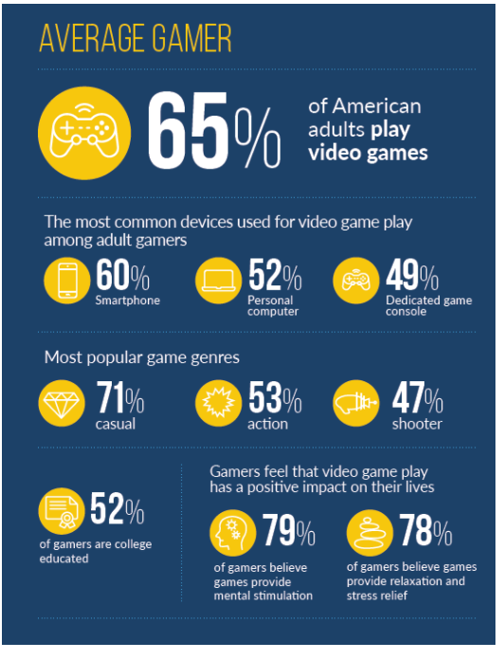
Industry Data
60% of adults play video game
60% on a smartphone
71% casual
52% college education
Notes:
https://www.theesa.com/esa-research/2019-essential-facts-about-the-computer-and-video-game-industry/
Millennial Gamers (18-34) – Entertainment Software Association, 2019
Gen X Gamers (35-54) – Entertainment Software Association, 2019
Baby boomer Gamers (55-64) -Entertainment Software Association, 2019
https://www.gamingscan.com/gaming-statistics/

Slide 7

Persona
Name - John Smith
Age - 25
Family – Single
Education – 2 years at Brookdale Community College
Occupation – IT administration
Location – NYC - Brooklyn
Household – lives with 2 room mates
Transportation - Uses Public Transit
John uses most of this time on his phone.
Notes:
John is casual gamer that does not play all the time and needs help to find games he might like. He mainly plays games on his phone. He plays games while on the Bus/Train and waiting for Bus and/or Trains. John also plays on his roommates Xbox system.
John spends most of his commute time on his phone either on a social media site or playing games to pass the time.

Slide 8
Current avaialble ApPs
Most apps are provide by publishers
Apple Store
Google Play store
Xbox/Microsoft Store
Nintendo Store
Alternate Sites
Game Data Library
Video Game Recommendation Engine
Notes:
Game Data Library
https://sites.google.com/site/gamedatalibrary/game-search
https://apps.quanticfoundry.com/recommendations/gamerprofile/videogame/

Slide 9
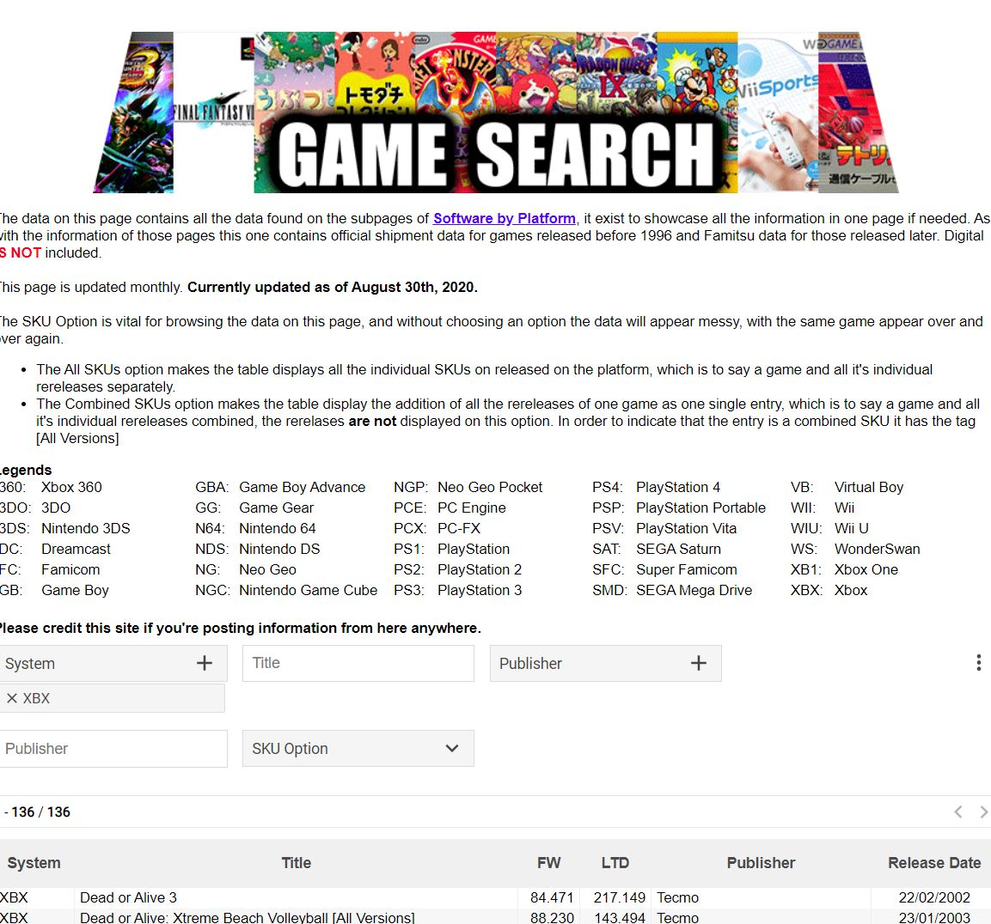
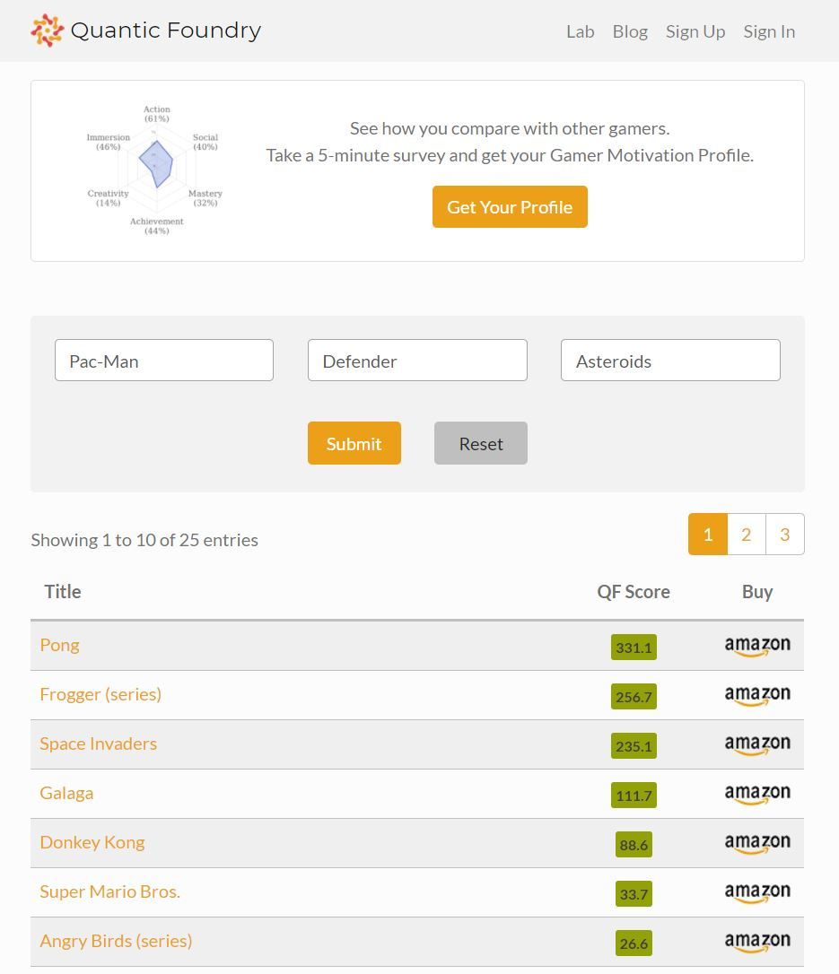
Competition
Notes:
Game Search Library – only has platform games and only by title and publisher
Video Game Recommendation Engine – just asks for names of games you like and gives a list response
Without date of publishing, or cost info, or type of game…..

Slide 10
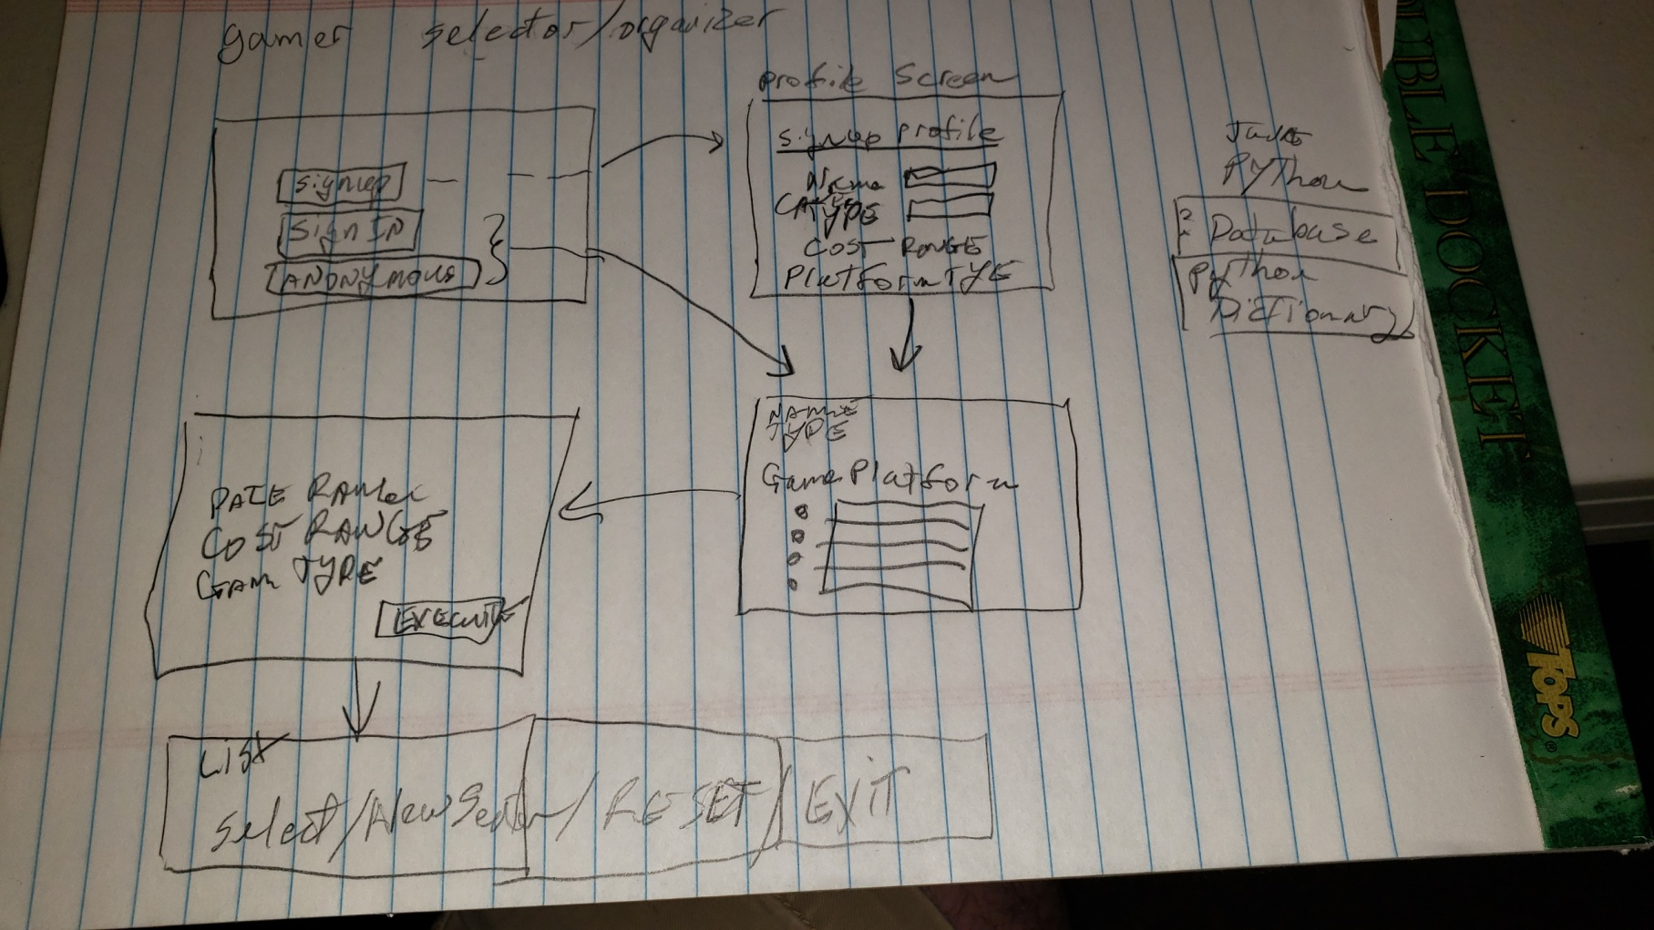
First Design / Paper prototype
Notes:
Hand drawn menu system.
Shows
signup/signin/guest screen
Profile completion screen
Query form
List output screen

Slide 11
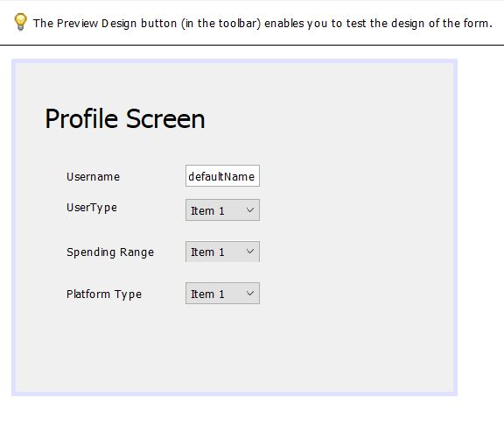
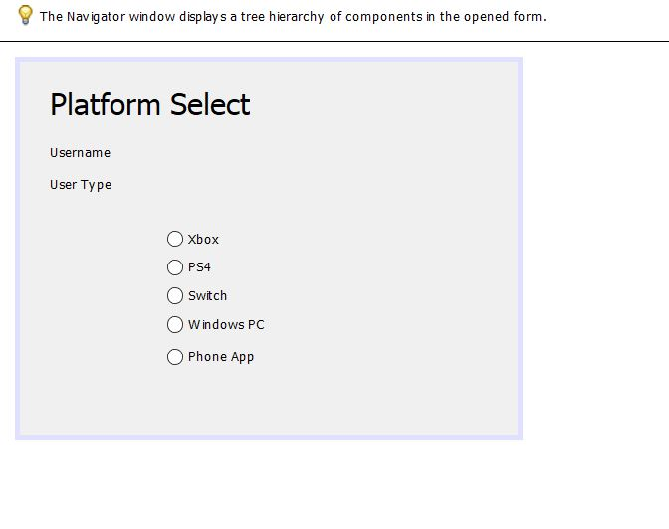
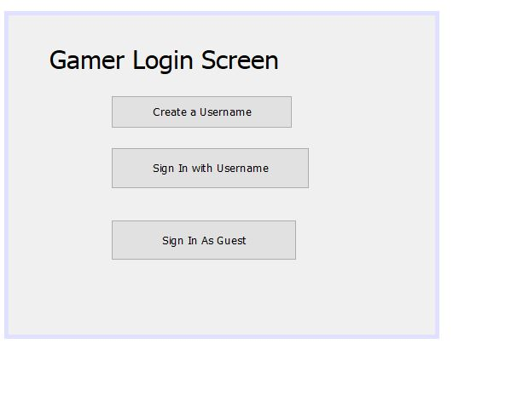
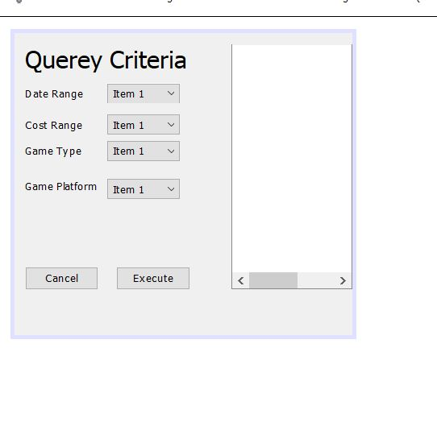
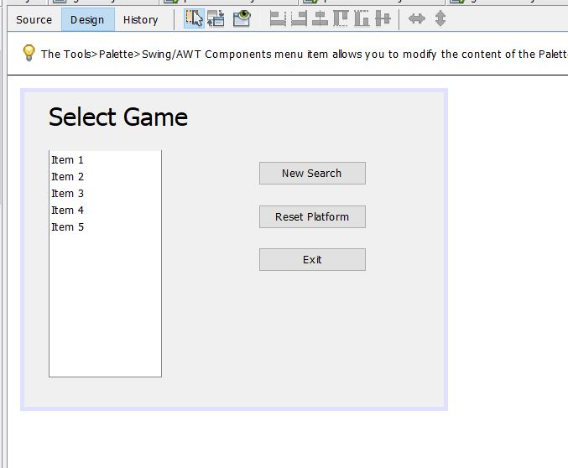
Second Design / GUI builder
Notes:
A second design was implemented with Apache Netbeans GUI builder for java language.
Here was followed most of the first design but we see some questioning about how to execute the query and show the final list.

Slide 12
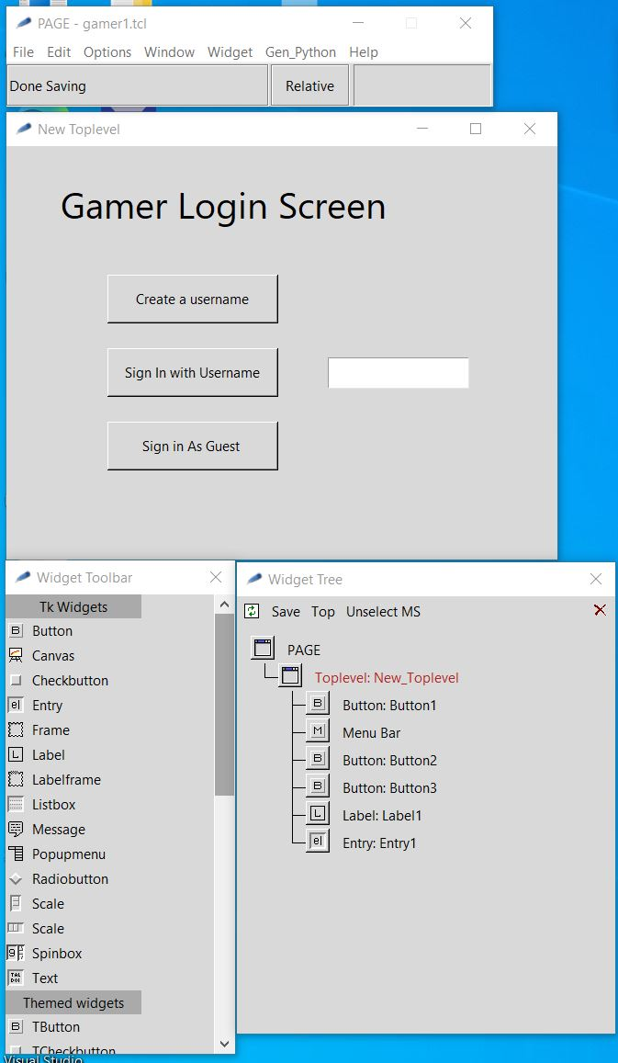
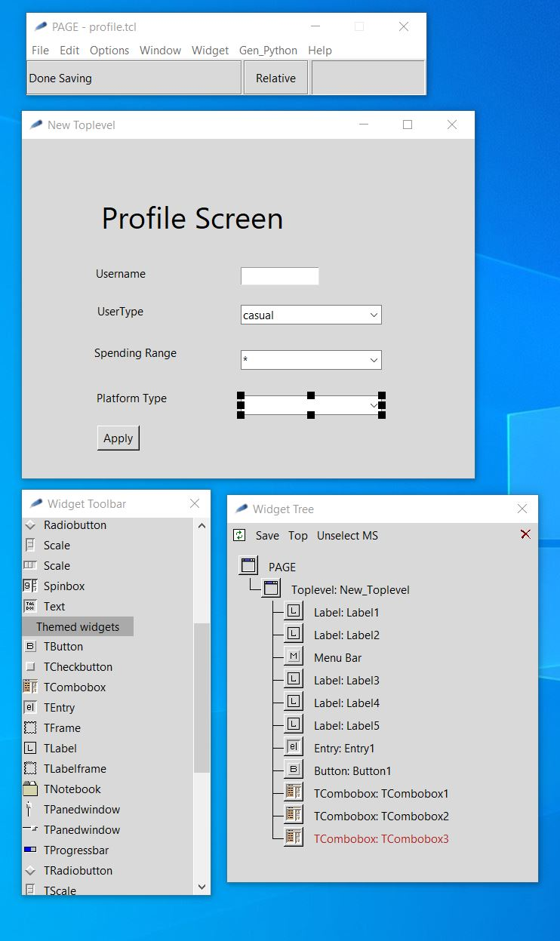
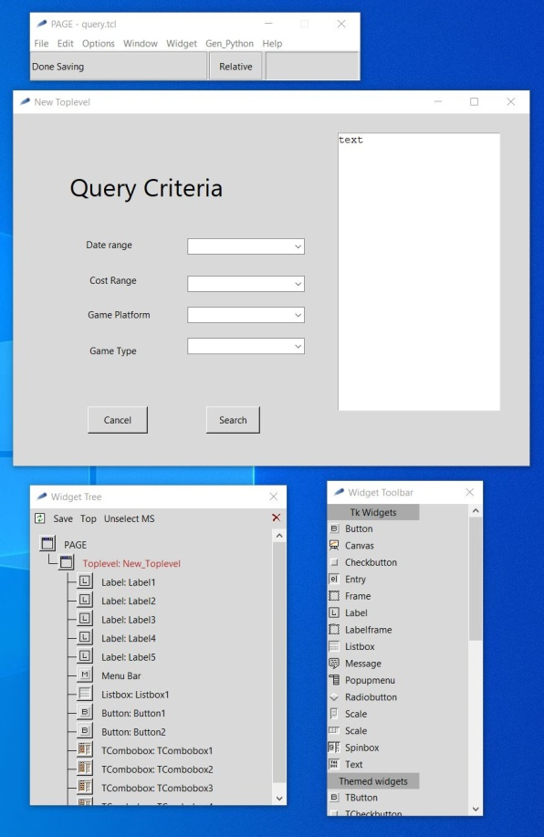
Final Design / GUI builder
Notes:
Our Final design user the “PAGE” GUI builder which is based on Tkinter / Python libraries.
We further simplified the design to only 3 screens.
We removed the radio selection screen of platforms and added it as an extra combo box on the profile screen / query criteria

Slide 13
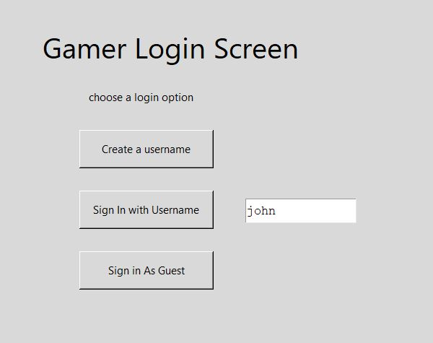
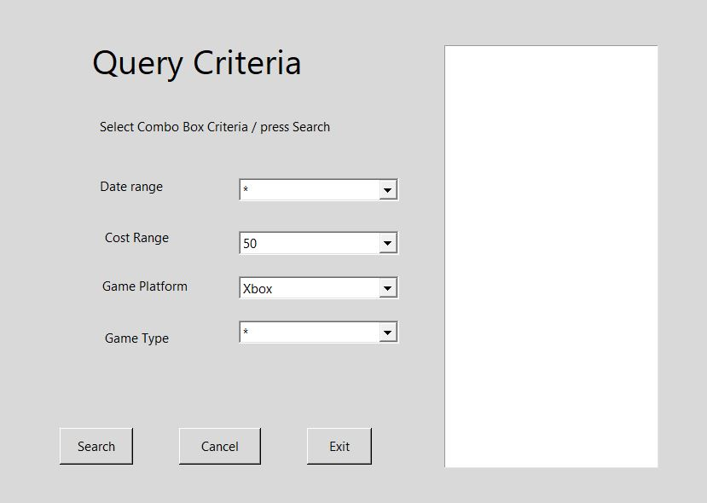
Previous User Flow
Notes:
This shows the simple flow of a previous user
Only takes to screens.
The query criteria is pre-populated with profile info.
But can be changed before search.
We add a line to each screen with instructions.
This line is also where an error message would be printed.
Exampe: User john does not exist.

Slide 14
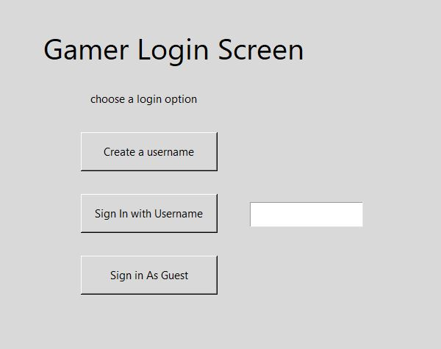
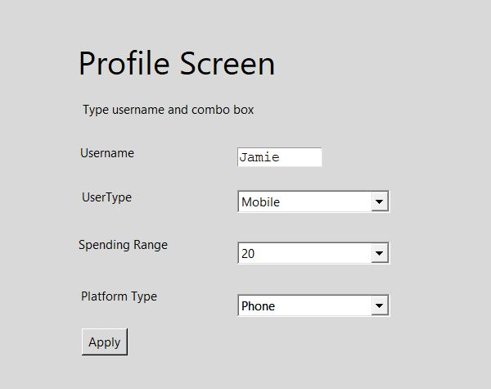
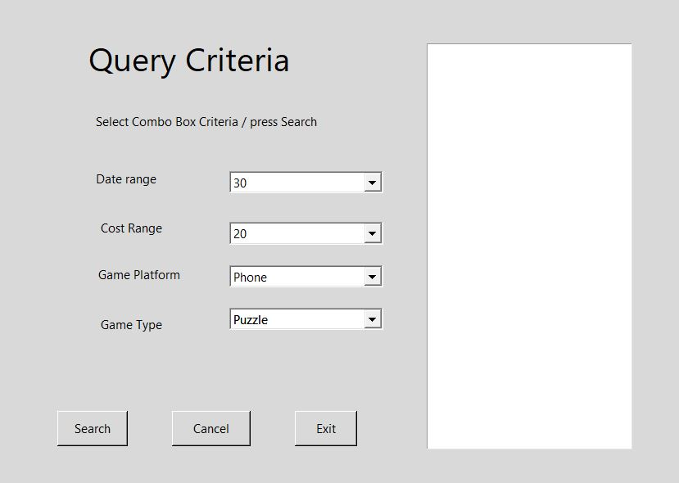
New User Flow
Notes:
In this flow the new user is asked to select a username and user combo box
To select the best description of the user.
The instruction line is updated in case of error:
Username Jamie is not available.

Slide 15
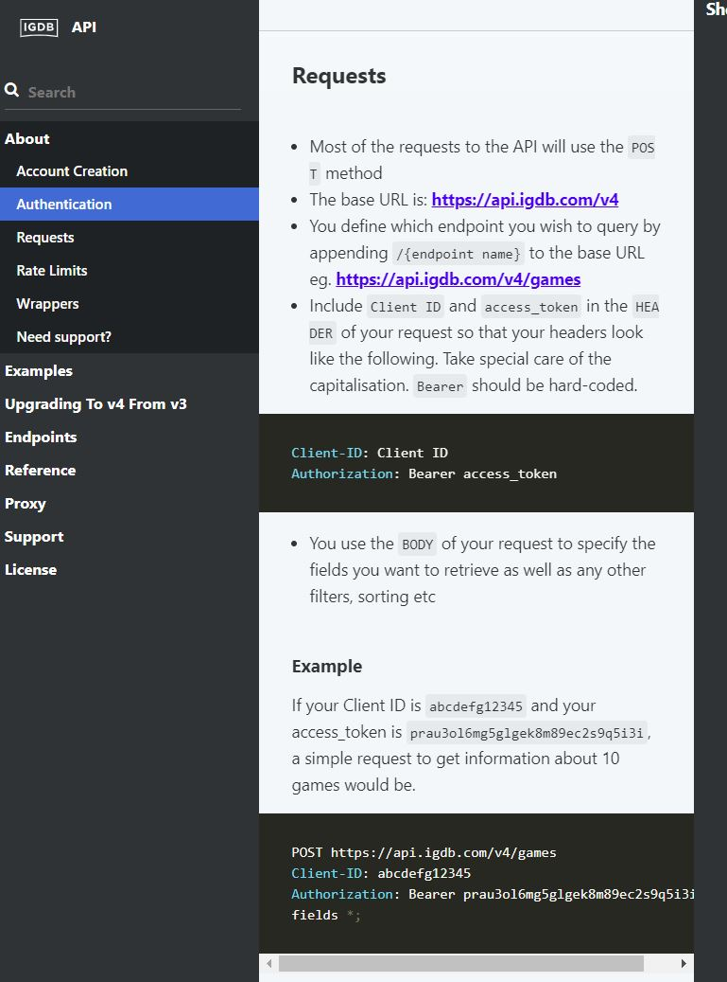
Backend – IGDB / Twitch
Database access
https://api-docs.igdb.com/#about
https://pypi.org/project/igdb-api-v4/
Notes:
Non-commercial db access via twitch developers account
Via igdb.com: https://api.igdb.com/v4
Python library access via igdb-api-v4

Slide 16
PAR
Perception - grouping of class of pulldown selection categories together. Don't mix, genre with publishing dates since they are quite different categories.
Attention - Highlighting the platform (PC/Xbox/Sony/Switch) selection
Retention - use of pull down selection so the user does not have to remember the categories they are allowed to choose from.

Slide 17
Laws Of Simplicity
Reduce - do not give to user too many choices, use of combo-box
Organize - keep similar items together on a screen
Time - allow guest use app without registering a username / profile
Learn – the combo-box offers limited need to learn outside of the app, familiarity the available choices makes it easier after just a few uses.
Failure – simple instructions and immediate error messages
The one – keep it simple, don’t add extras that are not needed

Slide 18
Accessibility
We will produce an alternate version of the app or a mode for ease of reading.
High contrast by removing grey background.
Bold fonts for all words
We have minimal use of typing in the app
Most of the app is point and click via combo-boxes
The user can use Tabs / Arrows and Enter Key instead of a mouse

Slide 19
Heuristic Evaluation
Using Kessler and Nielson’s Evaluation points
Appropriate feedback
When user presses a button they see an appropriate and immediate response.
Prevent Errors
Use of combo-box to limit response limits errors.
Help
An instruction line tells the user what is expected and when and error has occurred.

Slide 20
Demo/Build Repo
https://github.com/JamieShamilian/gamer
For more info Readme.md
Notes:
Required packages to build UI
python 3.7+
https://www.python.org/downloads/windows/
tcl/tk
https://www.magicsplat.com/tcl-installer/index.html#downloads
page
http://page.sourceforge.net/
github

Slide 21
Targeted E – Revisited
Easy to learn
We have made the app Easy to learn
We have added combo-box choices by selecting fields using industry data and available database fields
We need to add more criteria categories in order to make the app more useful to users

