Slide 1
Kuramoto-Model Reservoir Computing for Mackey-Glass Time-Series Prediction
Jamie Graham

Slide 2
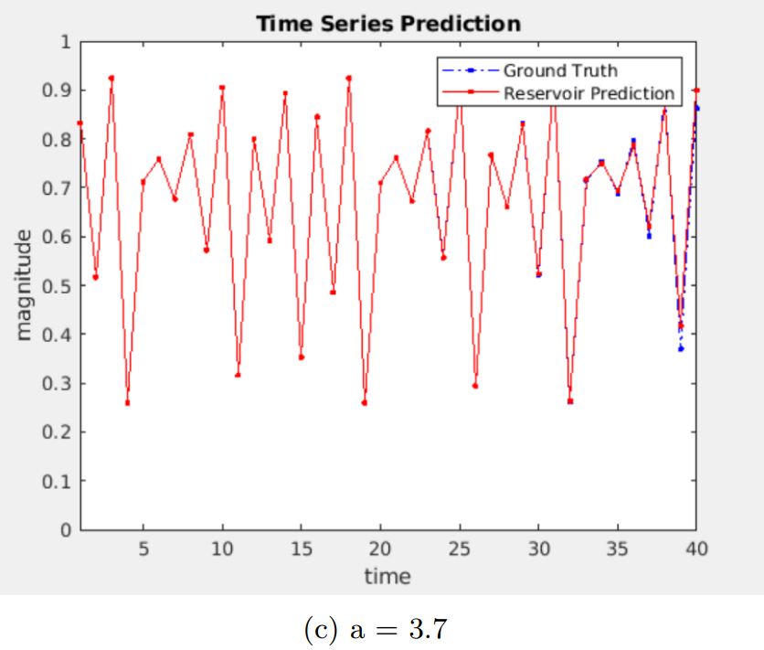
A Kuramoto Model Approach to Predicting Chaotic Systems with Echo State Networks
Paper to Replicate:
Sophie Wu, Jackson Howe, Lyle Muller
Logistic Map
Can we use this computational approach to predict the Mackey-Glass system? Analytical Insights on mechanism of algorithm

Slide 3
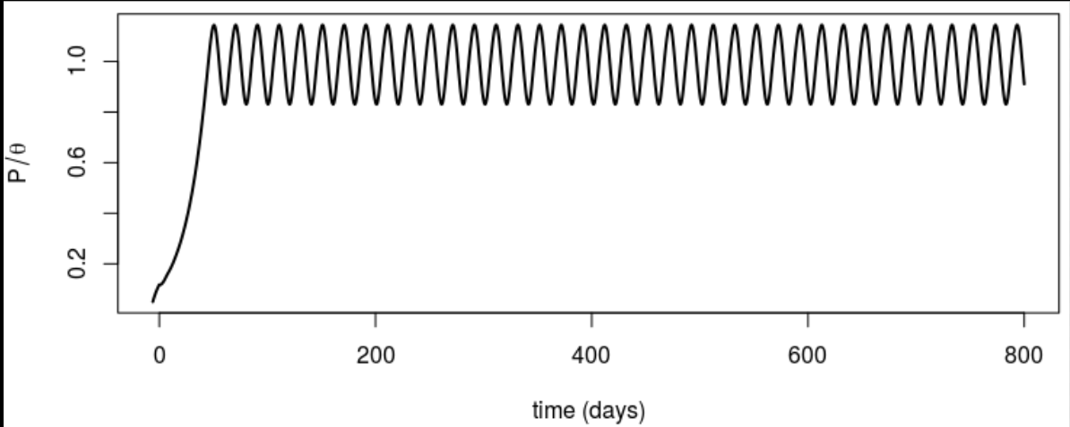
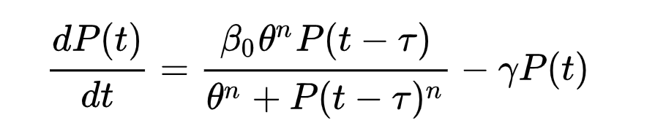
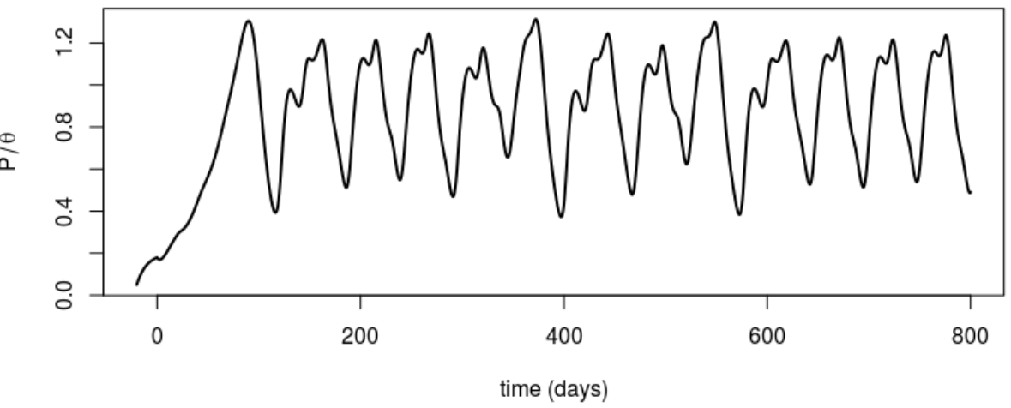

Mackey-Glass Equation
Tau = 6
a canonical nonlinear dynamical system
that exhibits chaotic behavior
Tau = 20
are parameters of the system, tau controls ‘chaotic-ness’
Models both healthy and pathological behaviour in certain biological contexts, models blood cell dynamics
Time series prediction of the Mackey Glass system is a difficult problem due to the chaotic dynamics

Slide 4
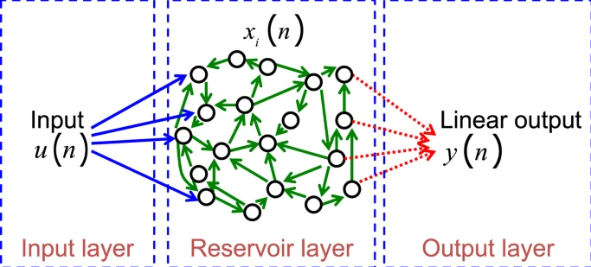
Reservoir Computing (Echo-State-Networks)
Popular ML algorithm combining ideas from RNN, FFN, non-linear dynamics
Used in speech recognition, nonlinear channel equalization, detection of epileptic seizures, robot control, time series prediction, financial forecasting, handwriting recognition, etc

Slide 5
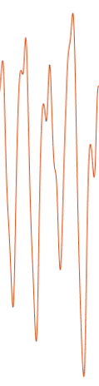
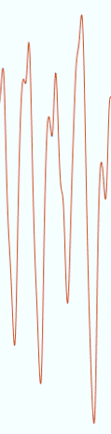
The Idea of a Reservoir Computer (ESN)
3 layers, randomly initialized fixed-size reservoir of nonlinear nodes
transform the input time series into a high-dimensional feature space, internal representation, nodes output ‘basis functions’
Train a linear readout layer to predict future values based on the reservoir state
predictions

Slide 6
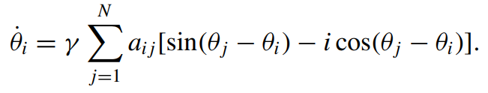
Can We Predict Mackey-Glass Using Reservoir Computer With A Kuramoto-Activation Function?
Complex generalization of Kuramoto Model (CKM)
Has been used previously in RC work, may yield analytical insights into how the signal is being internally represented by the reservoir because the eigenbasis of the CKM is defined by the discrete fourier transform matrix.

Slide 7



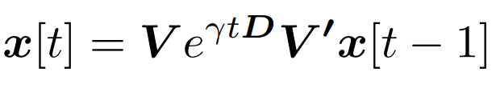
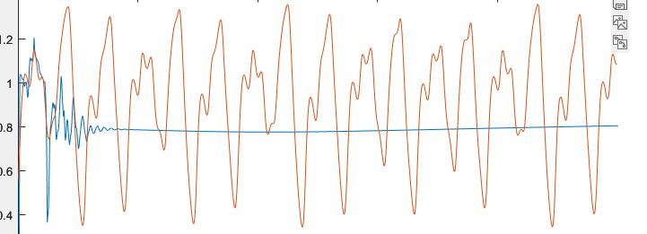
Kuramoto-Inspired Activation Function
Reservoir State Equation
Complex Kuramoto Model
q
Tanh is most commonly used for the activation function f for the reservoir dynamics ^^

Slide 8
Next-Step Forecasting
Training
Testing
W_out
Run reservoir computer for 1000 time points, let reservoir state evolve.
Input raw Mackey-Glass data at time t, get prediction at time t+1. Iterate for all t
Ridge Regression to train W_out matrix

Slide 9
Closed-Loop Forecasting
Training
Testing
W_out
Run reservoir computer for 1000 time points, let reservoir state evolve.
Ridge Regression to train W_out matrix
Use the output as input, self-generating signal prediction

Slide 10
Process
Implemented Reservoir Computer in Matlab
Implemented function that solves Mackey Glass System numerically (euler method) to generate training data
Initialized with 1000 training time steps, 1000 testing time steps
Trained W_out using ridge regression analytical equation
Implemented time-series forecasting with tanh activation, next-step forecasting vs closed-loop forecasting for Mackey-Glass system
Currently: Kuramoto inspired activation function

Slide 11
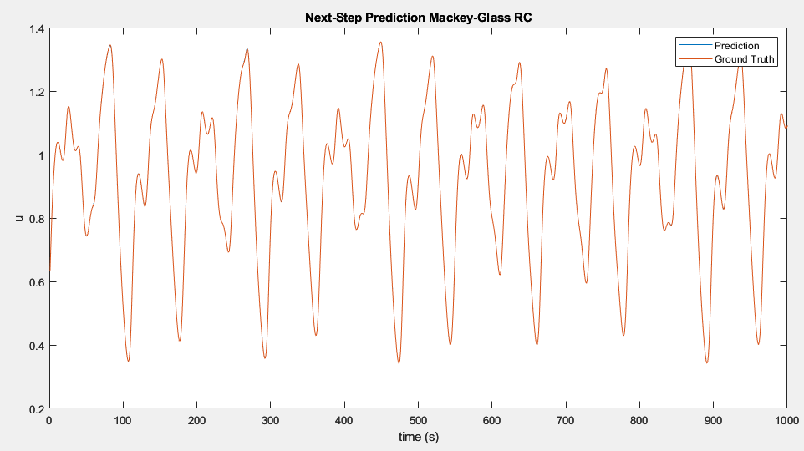
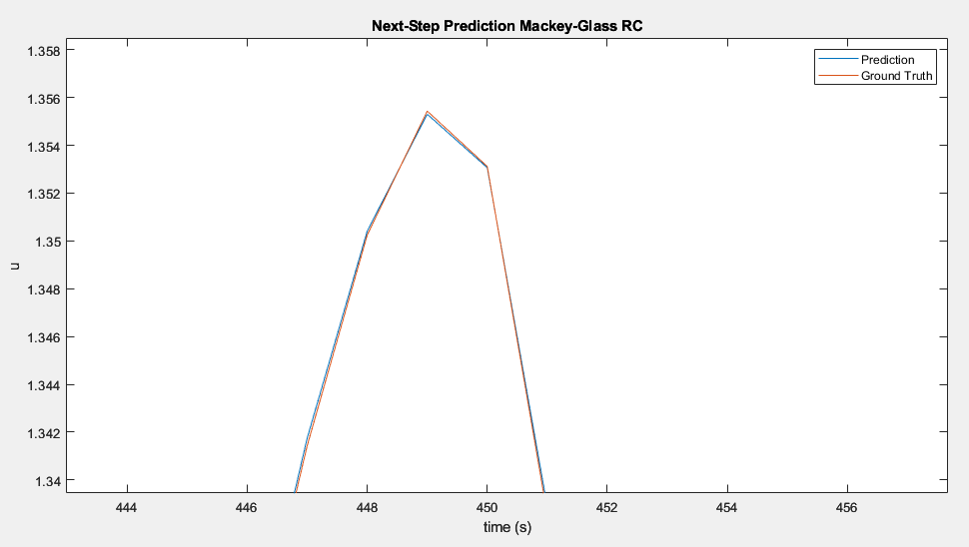
Next-Step Prediction

Slide 12
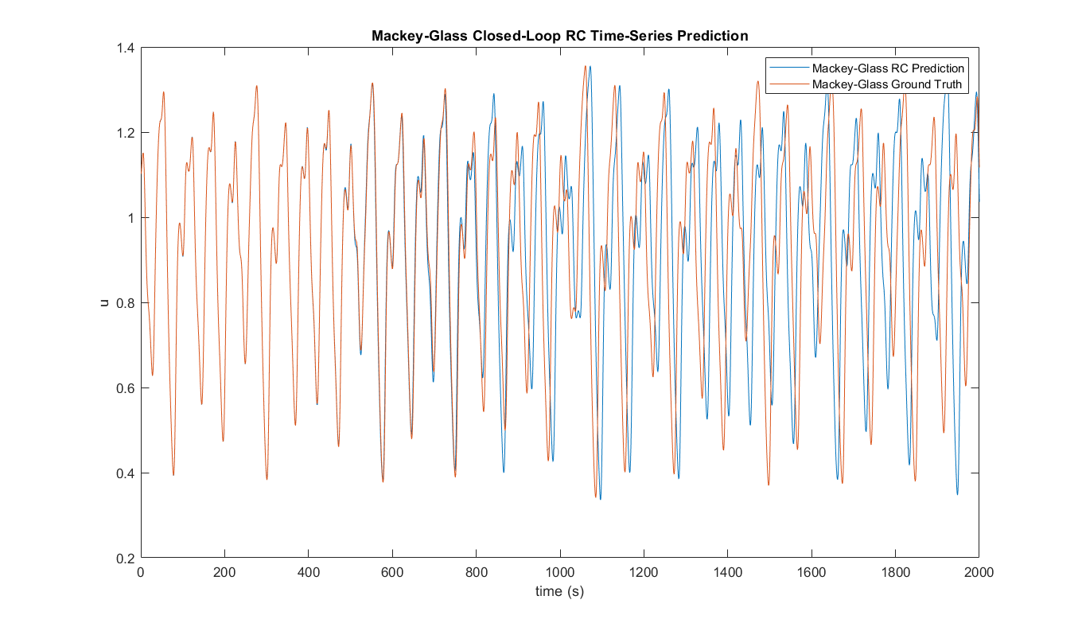

Slide 13
Wrapping Up
Able to predict Mackey-Glass using tanh activation function with ESN paradigm
Able to do Next-Step and Closed Loop Forecasting (up to 600 time points)
Still Working on Hyperparameter tuning for ESN Kuramoto
Learned that performing a hyperparameter grid search early on may help
Learned about the predictive and computational power of ESN’s, benchmark system, validates that RC works well for time-series prediction.

Slide 14
Thank you for listening!

Slide 15
Some RC Hyperparameters
Reservoir size (number of internal units): The number of neurons in the reservoir, which influences the network's capacity to capture complex dynamics. A larger reservoir may provide better short-term memory but may also increase the computational cost and risk of overfitting.
Input scaling: A factor that adjusts the amplitude of the input signals. Proper scaling can help balance the input's influence on the reservoir dynamics, which can lead to better performance.
Spectral radius: The largest absolute eigenvalue of the reservoir's weight matrix. It influences the reservoir's dynamic behavior, such as the fading memory property. Values smaller than one can promote stability and preserve short-term memory, while larger values may increase the risk of instability or long-lasting activations.
Connectivity (sparsity): The proportion of non-zero connections in the reservoir weight matrix. A sparser connectivity may lead to faster computation and lower risk of overfitting, while denser connectivity can increase the reservoir's capacity for complex dynamics.
Regularization parameter (ridge regression, Tikhonov regularization): A factor that controls the trade-off between fitting the training data and minimizing the model complexity. A higher value can reduce overfitting but may also result in underfitting.
Feedback scaling: A factor that adjusts the strength of the feedback connections from the output to the reservoir.

